Slide 1
PHYTOCHEMICAL EVALUATION OF QUERCUS INFECTORIA
Mrs. Madhusmita Sahu ,
Research scholar,
Department of Pharmacy,
SRM Institute of Science and Technology (Delhi-NCR Campus),
Ghaziabad, Uttar Pradesh, India
ms3541@srmist.edu.in

Slide 2
BACKGROUND
Important advantage for therapeutic uses of the plants includes their safety, effectiveness, economic feasibility, and ease of availability. Plants have been utilised as remedies for thousands of years and all across the world.
In recent years, scientific interest in the investigation of these plants' chemical make-up and biological processes has increased. Among a number of medicinal plants, species belonging to the genus Quercus are widely used in traditional medicine. 'is genus belongs to the family Fagaceae.
Species of the Quercus genus are mainly distributed in the basin Mediterranean (Portugal, Spain, Algeria France, Italy, Tunisia, and Morocco), Asia, and North Americas' extraordinary species diversity reported in America and Asia together is with the highest diversity at 15–30°Nin Mexico and East Asia.
Europe exhibits lower species richness (up to 30 species), but the genus is nearly as widespread there as it is in North America and East Asia, as a limited number of European species have expanded across the continent.
The galls of Q. infectoria have also been pharmacologically documented to possess astringent, antidiabetic, antitremorine, local anesthetic antiviral antibacterial antifungal larvicidal and anti-inflammatory activities.

Slide 3
MATERIALS AND METHODS
Collection material from plant - Quercus Infectoria galls were taken in December 2022 from Hasanpur, Amroha, Uttar Pradesh.
Identification of Plant material –Identification of the plant material and its authentication were done at the Botany Department, Chaudhary Charan Singh University, by Prof. Vijai Malik. (Authentication reference no.Bot/PB/151)
Preparation of Plant Material-To get rid of dirt and other foreign objects, the nutgalls were washed under running water from the faucet and rinsed with distilled water. The plant's nutgalls were dried in the shade. The plant material was blended and weighed after being ground.
Extract preparation -The nutgalls were washed with distilled water and made it completely dry at room temperature. After drying cut the nutgalls into small pieces and crushed in a mechanical mortar or through hand mill (making sure heat is not provided). The plant powder was extracted with 100gm powder drug macerated with 500 ml 95% ethanol (1:5) at room temperature for 7 days. After 7 days filtration was done with muslin cloth and the excess water was evaporated by rotary evaporator at 60 ºC until the mixture was completely dried. The percentage of yield was found to be 53 %.

Slide 4
Qualitative Phytochemical Screening
The presence or absence of phenols (ferric chloride test), flavonoids (sodium hydroxide test), alkaloids (Dragendroff's test, Wagner's test), cardiac glycosides (Killer-Killani test), carbohydrate (Molish Test, Fehling Test), saponin (Foam Test), and steroids (Salkowski test) were qualitatively screened for in the phytochemical constituents of Quercus Infectoria.
Flavonoids Test–
  Reaction with NaOH - To identify flavonoids in the ethanolic extract of Quercus Infectoria, initially dispersed in H₂O. Then NaOH was used to treat the filtrate after filtering. Flavonoids are present when a colour is yellow.
  Shinoda test- A small quantity of extract was taken in a test tube and dissolved in methanol (1 ml). A pinch of magnesium powder was added followed by conc. HCl. Appearance of pink color indicates the presence of flavonoids.
Test for Phenol – Test using Ferric Chloride: Phenols are typically precipitated using a 90% alcohol with 5% ferric chloride w/v solution. Phenols are then identified.
Alkaloid Test –Dragendroff’s test- The reagent produces an orange-brown tinted precipitate when used with alkaloid. In 50 ml of glacial acetic acid, 5.2 grammes of bismuth carbonate and 14 grammes of sodium iodide were heated for a short period of time to create this reagent.

Slide 5
Wegner’s Test- A reddish-brown precipitate is produced by alkaloid. To create a final volume of 200 milliliters, In 5 milliliters of water, 1.27 grammes of iodine and 2 grammes of potassium iodide was dissolved.
Test for cardiac glycosides- Killer-Killiani Test- The extract in glacial acetic acid was combined with concentrated sulphuric acid and a few drops of ferric chloride. The intersection of the two layers develops a reddish brown colour and the top layer becomes bluish green.
Tests For Tannins
  Test with Lead Acetate- Tannins get precipitate with lead acetate.
  Test with Gelatine Solution- To a solution of tannins (0.5 - 1%) aqueous solution of gelatine (1%) and sodium chloride (10%) were added. A white buff precipitate confirms the compounds
Carbohydrate Test-
Fehling’s Test- If there is a yellow or brick-red precipitation forms at the base of the test tube, that indicates that there is some of the monosaccharide and thus the presence of reducing sugar.
Molisch’s Test- The presence of carbohydrates is shown by a violet ring at the intersection of the two liquids in the Molisch's Test, involves shaking a 10% alcohol solution of alpha-napthol in an aqueous or alcoholic solution of the extract.

Slide 6
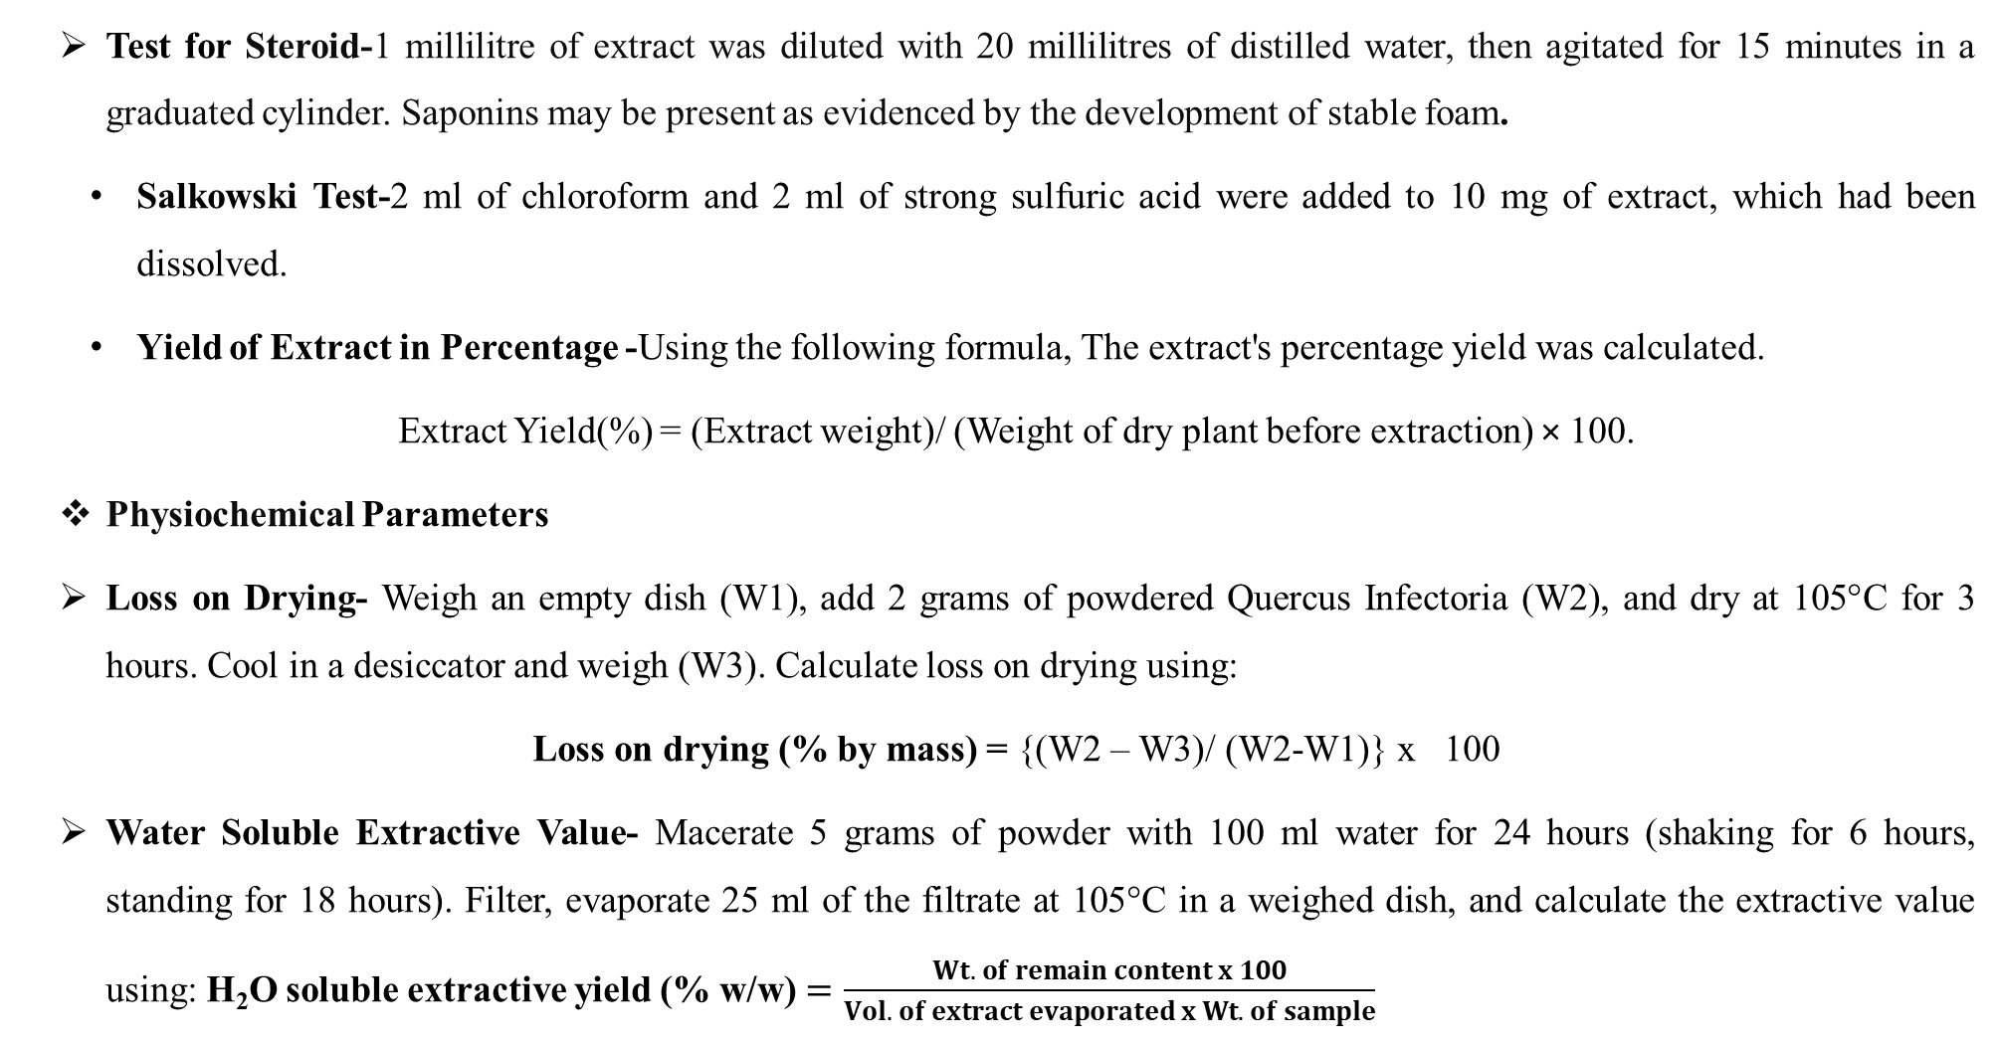
Test for Steroid-1 millilitre of extract was diluted with 20 millilitres of distilled water, then agitated for 15 minutes in a graduated cylinder. Saponins may be present as evidenced by the development of stable foam.
  Salkowski Test-2 ml of chloroform and 2 ml of strong sulfuric acid were added to 10 mg of extract, which had been dissolved.
  Yield of Extract in Percentage -Using the following formula, The extract's percentage yield was calculated.
Extract Yield(%) = (Extract weight)/ (Weight of dry plant before extraction) × 100.
Physiochemical Parameters
Loss on Drying- Weigh an empty dish (W1), add 2 grams of powdered Quercus Infectoria (W2), and dry at 105°C for 3 hours. Cool in a desiccator and weigh (W3). Calculate loss on drying using:
Loss on drying (% by mass) = {(W2 – W3)/ (W2-W1)} x 100
Water Soluble Extractive Value- Macerate 5 grams of powder with 100 ml water for 24 hours (shaking for 6 hours, standing for 18 hours). Filter, evaporate 25 ml of the filtrate at 105°C in a weighed dish, and calculate the extractive value using: H₂O soluble extractive yield (% w/w) $=\frac{Wt. of remain content x 100}{Vol. of extract evaporated x Wt. of sample}$

Slide 7
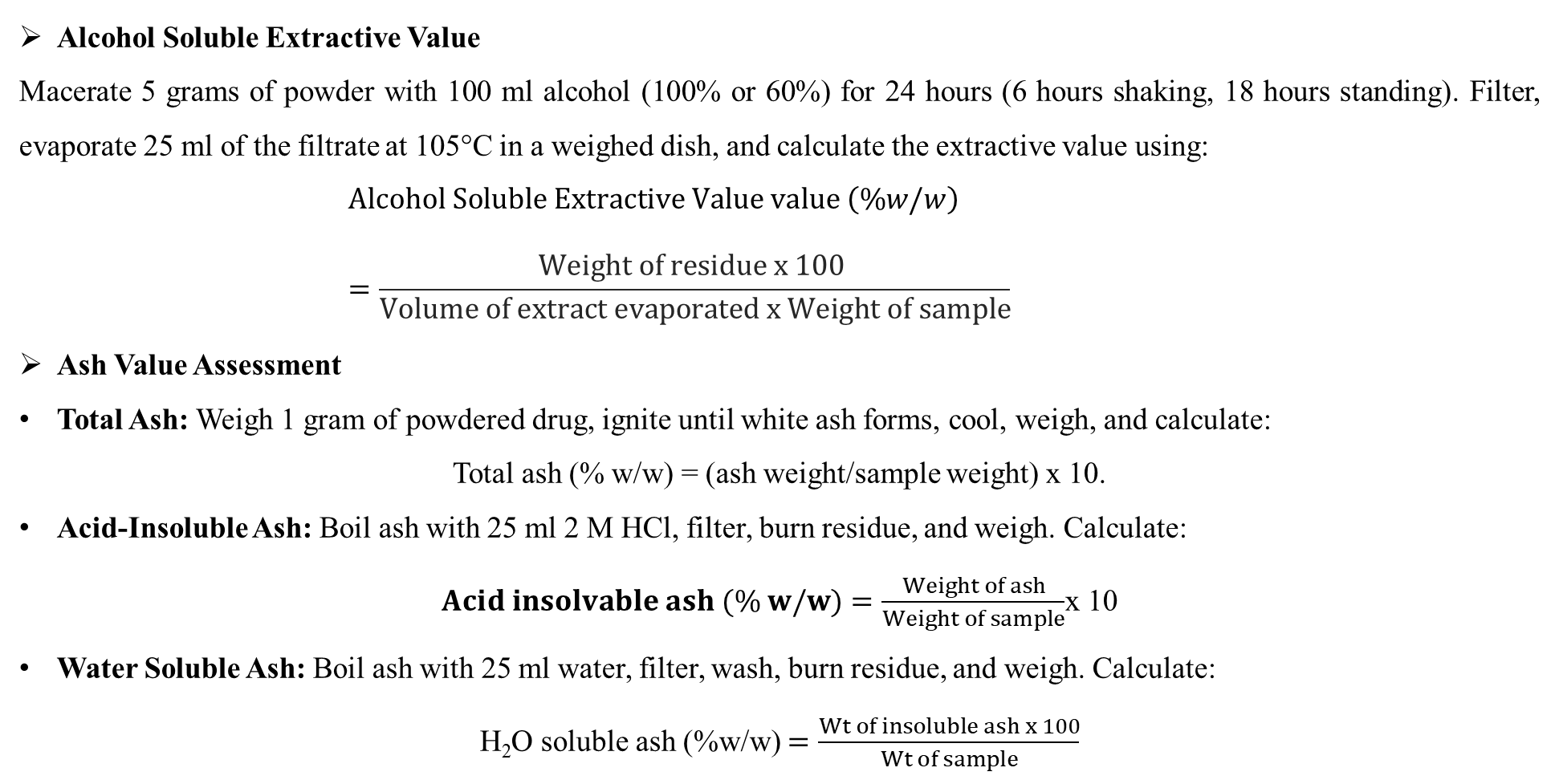
Alcohol Soluble Extractive Value
Macerate 5 grams of powder with 100 ml alcohol (100% or 60%) for 24 hours (6 hours shaking, 18 hours standing). Filter, evaporate 25 ml of the filtrate at 105°C in a weighed dish, and calculate the extractive value using:
$$Alcohol Soluble Extractive Value value \left(\%w/w\right) =\frac{Weight of residue x 100 }{Volume of extract evaporated x Weight of sample}$$
Ash Value Assessment
Total Ash: Weigh 1 gram of powdered drug, ignite until white ash forms, cool, weigh, and calculate:
Total ash (% w/w) = (ash weight/sample weight) x 10.
Acid-Insoluble Ash: Boil ash with 25 ml 2 M HCl, filter, burn residue, and weigh. Calculate:
$Acid insolvable ash (\% w/w)=\frac{Weight of ash}{Weight of sample}$x 10
Water Soluble Ash: Boil ash with 25 ml water, filter, wash, burn residue, and weigh. Calculate:
H₂O soluble ash (%w/w) $=\frac{Wt of insoluble ash x 100}{Wt of sample}$

Slide 8
Quantitative Phytochemical Screening of Quercus Infectoria Extract
Total Phenolic Content- Measure total phenolics using the Folin-Ciocalteu method. Prepare Gallic acid standards at 6.25, 12.5, 25, and 50 µg/ml. Add 1 ml of each standard to 10 ml water, mix with 1.5 ml Folin-Ciocalteu reagent, then 4 ml of 20% Na2CO3, and adjust to 25 ml. For the extract, dissolve 1 g in 15 ml 50% methanol, filter, and process similarly. Measure absorbance at 765 nm and express results as mg gallic acid equivalents (GAE) per gram of extract.
Total Flavonoid Content- Mix 0.3 ml extract with 3.4 ml 30% methanol, 0.15 ml NaNO2, and 0.15 ml AlCl3.6H2O. After 5 minutes, add 1 ml NaOH and measure absorbance at 506 nm. Use a rutin standard curve to report flavonoid content as mg rutin equivalents per gram of extract.
Antioxidant Assay (DPPH)- Mix 200 µl extract with 2 ml 0.1 mM DPPH solution and incubate for 15 minutes. Measure absorbance at 517 nm. Calculate scavenging activity with:
Effect of Scavenging for DPPH (%) =[(A0 -A1/A0) 100]
where A1 denoted the absorbance in the presence of the extract and A0 the absorbance of the controlled reaction. The graph of DPPH scavenging action vs extract concentration allowed for the identification of the extract concentration that produced 50% inhibition (IC50).

Slide 9
RESULTS AND DISCUSSIONS
The phytochemical constituent of the Quercus Infetoria extract is shown in Table 1. Results of Physicochemical parameters are shown in Table 2.
Table 1: Phytochemical compounds of the extract of Quercus Infetoria
Table.2: Results of Physicochemical parameter
Physicochemical parameter | Observations for extract of Quercus Infetoria
LOD | 4.5
Ash value-Total ash | 14.5
Acid insoluble ash | 5.04
Water soluble ash | 4.32
Water soluble extractive value | 9.3
Alcohol soluble extractive value | 4.7
S No. | Constituent | Qualitative Analysis
1 | Flavonoid | +
2 | Alkaloid | -
3 | Carbohydrate | +
4 | Cardiac Glycosides | -
5 | Phenols | +
6 | Steroid | +
7 | Saponin | +
8. | Tannins | +

Slide 10
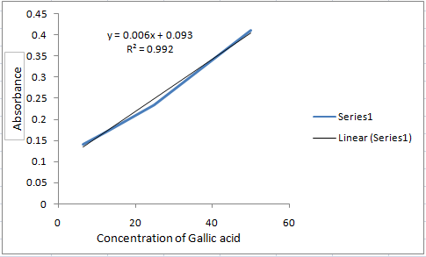
Total Phenolic content –Gallic acid's standard curve served as the foundation for the quantification. Figure 1 represents for Standard curve for extinction vs concentration of gallic acid. The outcomes calculated using the following procedure and expressed as percentages w/w. The results are shown in Table 3.
Total phenolic content (% w/w) = GAE×V×D×10⁻⁶×100/W
Table 3: Standard curve results for Total Phenolic content
S.no. | concentration | Absorbance | % phenolic content GAE
1 | 6.5 | 0.144
2 | 12.5 | 0.163 | 5.23
3 | 25 | 0.182
4 | 50 | 0.236
Fig.1: Standard curve for Absorbance vs concentration of gallic acid: y = 0.006x + 0.093; R² = 0.992

Slide 11
CONCLUSION
The results of this study provide information on the antioxidant capacity of the analysed fractions as well as any potential compounds that may have been present.
The fraction's high antioxidant activity must have been due in part to the presence of poly-hydroxyl compounds and other components, which were established in this study.
As a result, the fraction can now be used as a phytopharmacological agent to study other biological conditions like diabetes, wound healing, and other.

Slide 12
REFERENCE
[1] V. K. Bharti, J. K. Malik, and R. C. Gupta, “Ashwagandha:multiple health benefits,” in Nutraceuticals, pp. 717–733, Academic Press, Cambridge, MA, USA, 2016.
[2] Djeridane A, Yousfi M, Nadjemi B, Boutassouna D, Stocker P, Vidal N: Antioxidant activity of some Algerian medicinal plants extracts containing phenolic compounds. Food Chem. 2006; 97: 654-660.
[3] A. F. Ismail, J. C. M. Barreira, A. S. G. Costa, and M. B. P. P. Oliveira, “A new age for Quercus spp. fruits: review on nutritional and phytochemical composition and related biological activities of acorns,” Comprehensive Reviewsin Food Science and Food Safety, vol. 15, no. 6, pp. 947–981, 2016.
[4] S. Valencia, “Diversidad del g´enero Quercus (Fagaceae) enM´exico,” Botanical Sciences, vol. 75, pp. 33–53, 2004.
[5] K. C. Nixon, “Global and geotropically distribution and diversity of oak (quercus) and oak forests,” Ecology andConservation of Montane Oak Forests, vol. 3, pp. 13–21, 2010.
[6] A. Kremer and A. L. Hipp, “Oaks: an evolutionary success story,” New Phytologist, vol. 31, pp. 630–400, 2019.
[7] Dar MS, Ikram M, Fakouhi T. Pharmacology of Quercus infectoria. J Pharm Sci 1976; 65:1791-4.

Slide 13
Thank You

