Slide 1
UNDERSTAND THE STRUCTURE OF ALOE VERA AND ITS MEDICINAL BENEFITS
RITU
Subject: BOTANY

Slide 2
ABSTRACT
Aloe vera incorporates nutrients, minerals, proteins, amino acids, normal sugars, and mitigating and hostile to microbial mixtures.
The Aloe is emollient, laxative, and defenseless. Its antimicrobial, sedative, and germicide qualities make it valuable for tissue reclamation.
Eyewash with Aloe may block sun UV radiation. As a purgative. Aloe is a strong laxative and should not be taken internally.
It rejuvenates, reduces wrinkles, cures acne, and gives skin a young sheen.

Slide 3
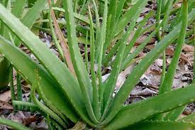
INTRODUCTION
The enduring green spice known as aloe vera (Aloe barbadensis Mill operator, family Xanthorrhoeaceae) is broadly tracked down in hot, dry locales of North Africa, the Center East, Asia, the Southern Mediterranean, and the Canary Islands.
Aloe vera has furthermore exhibited antihyperlipidemic, antidiabetic, cancer prevention agent, and anticancer impacts.

Slide 4
Literature Review
Kurian et al. (2018) subgingivally-conveyed 1% metformin and Aloe vera gel for intrabony abandons in persistent periodontitis patients were looked at. Both therapies showed promising results in stimulating periodontal tissue regeneration and lowering clinical markers of inflammation. These findings emphasize the need of trying new periodontal treatments like Aloe vera gel.
Kumar et al. (2014) A randomised control trial examined Aloe vera mouthwash's preliminary antiplaque efficacy. The study found that Aloe vera mouthwash may prevent plaque regrowth and enhance dental hygiene. Aloe vera may be a natural alternative to standard oral hygiene products for periodontal health.
Lin et al. (2017) Aloe vera has been studied for its potential in periodontal therapy and inflammatory disorders. They tested how exopolysaccharide, a component, protects against ulcerative colitis. Their findings explain Aloe vera polysaccharides' anti-inflammatory processes, suggesting their use in treating inflammatory bowel illnesses.

Slide 5
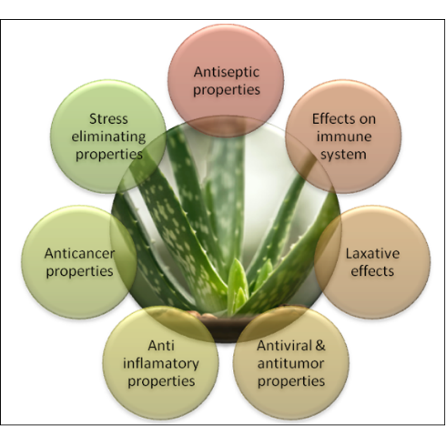
PROPERTIES OF ALOE VERA
It is a stemless or extremely short-stemmed plant developing to 80-100 cm tall, spreading by balances and root sprouts.
The leaves are lanceolate, thick and meaty, green to dim green, with a serrated edge.

Slide 6
Medicinal Benefits of Aloe Vera
For ages, the medicinal benefits of aloe vera, a succulent plant species with thick, meaty leaves, have been known. Here are some of the medicinal benefits of Aloe vera supported by scientific research:
It contains intensifies like polysaccharides, glycoproteins, and nutrients that add to its capacity to mitigate and mend harmed skin.
Aloe vera gel is a characteristic lotion that can hydrate and relax the skin.
Aloe vera contains compounds with calming properties, for example, salicylic corrosive, bradykinase, and acemannan.
Aloe vera has been customarily used to help stomach related wellbeing and deal with gastrointestinal issues like stoppage, indigestion, and irritable bowel syndrome (IBS).

Slide 7
Conclusion
Aloe vera, an individual from the Asphodelaceae family, is known for its restorative applications and advantages.
The plant has been utilized for quite a long time and has become well known in different items, including skin creams, beauty care products, shampoos, lip ointments, cleansers, and sunscreens.
The main demonstrated benefit in interior use is the alleviation of blockage.
Be that as it may, inward utilization of Aloe makes side impacts, can cause queasiness, and ought not be taken by pregnant ladies.

Slide 8
References
Lin, H., Honglang, L., Weifeng, L., Junmin, C., Jiantao, Y., & Junjing, G. (2017). The mechanism of alopolysaccharide protecting ulceralive colitis. Biomedicine & Pharmacotherapy, 88, 145–150. doi: 10.1016/j.biopha.2016.11.138.
Maan, A. A., Nazir, A., Khan, M. K. I., Ahmad, T., Zia, R., Murid, M., & Abrar, M. (2018). The therapeutic properties and applications of Aloe vera: A review. Journal of Herbal Medicine, 12, 1–10. doi: 10.1016/j.hermed.2018.01.002.
Malik, I., & Zarnigar, H. N. (2003). Aloe vera - A review of its clinical effectiveness. International Research Journal of Pharmacy, 4, 75–79. doi: 10.7897/2230-8407.04812.
Moghaddam, A. A., Radafshar, G., Jahandideh, Y., & Kakaei, N. (2017). Clinical evaluation of effects of local application of Aloe vera gel as an adjunct to scaling and root planning in patients with chronic periodontitis. Journal of Dentistry, 18, 165–172.
Nejaim, Y., Silva, A. I., Vasconcelos, T. V., Silva, E. J., & de Almeida, S. M. (2014). Evaluation of radioprotective effect of Aloe vera and zinc/copper compounds against salivary dysfunction in irradiated rats. Journal of Oral Science, 56, 191–194. doi: 10.2334/josnusd.56.191.

Slide 9
Thank you

