Slide 1
ORGANIC COMPOUND THEORY AND ITS DRUG BENEFITS
Debopriya Darker
Subject: Chemistry

Slide 2
INTRODUCTION
Most clever substance elements (NCEs) around the world are little atom drugs and helpful possibilities.
A portion of these synthetics are accessible thanks to therapeutic and cycle physicists' skill and genius. Drugs like atorvastatin (1), ledipasvir (2), imantinib (3), AZT (4), and linezolid (5) have saved and drawn out endless lives, helping society, families, and companions.
Subsequent to combining every atom in the lab (presumably milligrams), protected, effective, and versatile techniques were created to deliver kilograms of dynamic drug fixing (Programming interface) that was integrated into measurement structures for patients.
The Significance of Organic Substances
Although the building blocks of life, carbohydrates, proteins, and lipids, are organic substances
They are the fundamental elements of several cycles that propel the planet. As an illustration, consider the carbon cycle, which involves the exchange of carbon between plants and animals during photosynthesis and cellular respiration.

Slide 3
DRUG DISCOVERY, MEDICINAL AND ORGANIC CHEMISTRY
Drug advancement and improvement envelop therapeutic and substance science notwithstanding drug disclosure. This covers the formation of conveyance strategies and details notwithstanding pharmacokinetic and pharmacodynamic property improvement.
Drug Benefits in Organic Compound
Biological Activity: Many chemical compounds display particular biological activities that can be utilised for therapeutic purposes, such as antibacterial, antiviral, anticancer, or anti-inflammatory properties. These activities can be harnessed for therapeutic applications.
Specificity: Organic compounds can frequently be tailor-made to interact with certain biological targets, thereby reducing the likelihood of off-target effects and increasing the effectiveness of therapeutic interventions.
Bioavailability: It is possible to construct organic compounds in such a way as to improve their absorption, distribution, metabolism, and excretion inside the body. This would result in an increase in the bioavailability of the compounds and an increase in their therapeutic effectiveness.

Slide 4
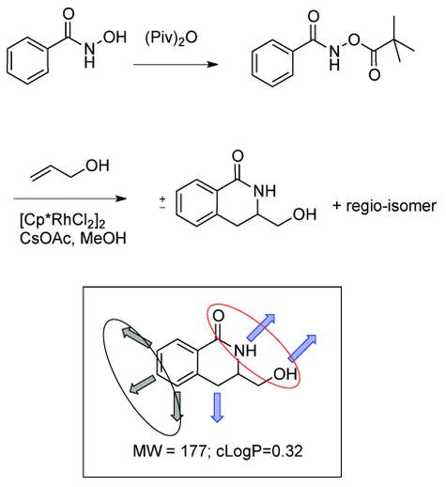
CHEMISTRY CHALLENGES FOR FBDD
The "rule-of-three," which was first proposed 12 years ago, was one of the earliest methods to characterise a fragment's chemical properties. Other significant studies on fragment library design are also available. characteristics that are helpful to us.
Figure 1: The bottom structure has fragmented MW and cLogP. Polar protein binding functionality: red circle; synthetically precedented fragment optimisation vectors without affecting the predicted binding pharmacophore: grey circle; implicit growth vectors: blue arrows.

Slide 5
ORGANIC CHEMISTRY FOR DRUG WORLD
Since organic compounds make up the majority of biological molecules in living systems, organic chemistry is extremely important. As a result, organic chemistry plays a critical role in the search for novel medication candidates that can be used to treat a wide range of illnesses.
The goal of the organic chemistry course at the Faculty of Pharmacy was to prepare students for the medicinal aspects of diseases on a molecular level based on chemical structures by introducing them to the basics of "Drug World."
As we already know, organic chemistry is the study of how things, particularly atomic and molecular systems, are arranged, structured, behave, and react. Chemistry permeates every aspect of our existence, and life itself is the contemplation of an unbroken chain of biochemical reactions.
Organic chemistry is widely present in everything from cell structure to complete organisms, and most materials used in human anatomy and physiology are organic.
Pharmaceuticals, which can be either organic or inorganic chemical molecules, are used to treat a variety of ailments. However, the majority of medications are derived from organic structural characteristics.

Slide 6
CONCLUSION
In conclusion, organic chemistry continues to be an essential component in the process of drug discovery and development.
It has made a substantial contribution to the general advancement of medical research as well as the improvement of healthcare all over the world.
Through its development, Fragment-Based Drug Discovery (FBDD) has brought to light the significance of having a comprehensive grasp of the chemical properties of compounds as well as the synthesis techniques that are necessary to manufacture them.
Organic chemistry will surely continue to be a driving force behind innovation and serve as a facilitator for the production of novel pharmaceuticals that can address a wide variety of medical requirements as we continue to unlock new technologies and approaches.

Slide 7
REFERENCES
Abraham, M. H., Ibrahim, A., & Acree Jr, W. E. (2007). Air to liver partition coefficients for volatile organic compounds and blood to liver partition coefficients for volatile organic compounds and drugs. European journal of medicinal chemistry, 42(6), 743-751.
Baxendale, I. R. (2013). The integration of flow reactors into synthetic organic chemistry. Journal of Chemical Technology & Biotechnology, 88(4), 519-552.
Chuprina, A., Lukin, O., Demoiseaux, R., Buzko, A., & Shivanyuk, A. (2010). Drug-and lead-likeness, target class, and molecular diversity analysis of 7.9 million commercially available organic compounds provided by 29 suppliers. Journal of chemical information and modeling, 50(4), 470-479.
Ghasemi, J., & Saaidpour, S. (2007). QSPR prediction of aqueous solubility of drug-like organic compounds. Chemical and pharmaceutical bulletin, 55(4), 669-674.
Prakash, G., Paul, N., Oliver, G. A., Werz, D. B., & Maiti, D. (2022). C–H deuteration of organic compounds and potential drug candidates. Chemical Society Reviews, 51(8), 3123-3163.

Slide 8
THANK YOU

