Slide 1
ENHANCING SUPPLY CHAIN MANAGEMENT IN FOOD MANUFACTURING: INTEGRATING PRODUCTION, PLANNING, AND QUALITY CONTROL
GIRISH M LOKHANDE
Subject: MANAGEMENT

Slide 2
INTRODUCTION
The ongoing advancements in technology and industry rivalry, businesses that want to differentiate themselves from the competition via superior goods and services and a focus on customer demands must work to include critical business processes and management principles.
Ahumada and Villalobosa contend that the conventional approach to food supply chain management has to be improved with new the acceptance of this theory offers a foundation for the fusion of contemporary quality management ideas with logistics.
In actuality, these ideas prioritize the demands of the consumer and enhance organizational internal procedures.

Slide 3
LITERATURE REVIEW
Zhao, X., Wang, P., & Pal, R. (2021) That's what the outcomes show, with regards to the agro-food store network, provider and interior mix are urgent for further developing item quality. Besides, the connection between provider incorporation and monetary accomplishment as well as the connection between inside combination and monetary execution are both completely interceded by the nature of the item.
Ben-Daya, M., Hassini, E., Bahroun, Z., & Banimfreg, B. H. (2020) To get a superior comprehension of the potential, snags, and job of IoT and other empowering innovations, such blockchain, on FSC quality administration, we will focus on the FSC, inspect the writing, and do a bibliometric examination.

Slide 4
RESEARCH METHODOLOGY
This publication's primary goal was to investigate how the operation of food supply chains is affected when standardized quality management system criteria are implemented.
The following factors are responsible for the work's selection:
There are currently insufficient studies in the literature on how quality management systems affect food supply chains' ability to function.
The idea of the food chain supply is crucial to modern business operations, both practically and scientifically.
In the context of customer happiness in the European Union, food product quality is very crucial.
Through careful integration of logistics and quality management, businesses may create a synergistic effect that greatly streamlines their operations.

Slide 5
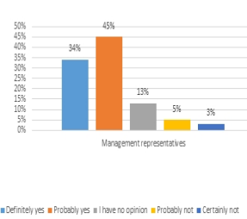
RESEARCH RESULTS
The survey's findings will be shown in the section that follows. Finding out how introducing quality management systems improved food supply chains was the aim of the first inquiry (Fig. 1.).

Slide 6
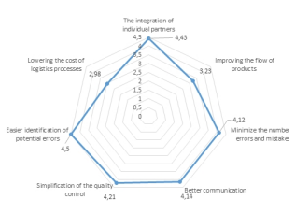
Quality management improves supply chain aspects
Figure shows the distribution of responses

Slide 7
CONCLUSION
The food supply chain's quality problem is a complicated one. Every logistic subsystem has a specific objective and influences the food product's quality in a unique way.
Based on research and analysis, it is possible to conclude that: quality management systems improve food supply chains, particularly in areas like enhancing supplier collaboration, streamlining quality control, and improving customer service logistics; the implementation of quality management systems should be predicated on a carefully chosen strategy that enables an increase in their effectiveness and efficiency; and quality management systems have the least impact on processes that are directly related to the physical flow of products.

Slide 8
REFERENCES
Zhao, X., Wang, P., & Pal, R. (2021). The effects of agro-food supply chain integration on product quality and financial performance: Evidence from Chinese agro-food processing business. International Journal of Production Economics, 231, 107832.
Ben-Daya, M., Hassini, E., Bahroun, Z., & Banimfreg, B. H. (2020). The role of internet of things in food supply chain quality management: A review. Quality management journal, 28(1), 17-40.
Reyes, J., Mula, J., & Díaz-Madroñero, M. (2023). Development of a conceptual model for lean supply chain planning in industry 4.0: multidimensional analysis for operations management. Production Planning & Control, 34(12), 1209-1224.
Lu, H., Zhao, G., & Liu, S. (2024). Integrating circular economy and Industry 4.0 for sustainable supply chain management: a dynamic capability view. Production Planning & Control, 35(2), 170-186.
Kayikci, Y., Subramanian, N., Dora, M., & Bhatia, M. S. (2022). Food supply chain in the era of Industry 4.0: Blockchain technology implementation opportunities and impediments from the perspective of people, process, performance, and technology. Production planning & control, 33(2-3), 301-321.

Slide 9
THANK YOU

