Slide 1
ASSESSMENT OF THE ECO- DISTRIBUTION AND STATUS OF FERNS OF DARJEELING, WEST BENGAL
Amitabala Patra
Subject: Commerce & Management

Slide 2
INTRODUCTION
Cycles of species extravagance and distribution have been analyzed in ecology. To all the more likely comprehend elevational inclinations and species wealth and think up systems for biodiversity security that are viable with environmental change, ongoing exploration has investigated these points.
Variety designs incorporate a level at low heights, a top in the mid-rise district that is tolerably rich, and a steady decrease in animal varieties extravagance with rise.
Various factors impact the species wealth of rise inclinations. Most ecologists accept that slope species distribution is affected by environmental change.
Taking into account altitudinal slopes and climatic factors, local area ecologists have set up various speculations to look at species lavishness and its controllers
The distribution of mountain plants can be impacted by climatic circumstances like temperature, dampness, evapotranspiration, length of developing season, and sun radiation.

Slide 3
ECO- DISTRIBUTION AND STATUS OF FERNS OF DARJEELING, WEST BENGAL
Darjeeling, West Bengal, has a wealth of ferns and other greenery. Vascular plants that recreate through spores are called ferns.
Under soggy, concealed conditions, they cycle nitrogen, give home to creatures, and maintain the dirt.
Darjeeling's geology, environment, and soil all influence the distribution of ferns. Ferns flourish at 100 and more meters above ocean level.
Darjeeling ferns are hurt by overexploitation, deforestation, environmental change, and living space misfortune.
The woods are under strain from framework, the travel industry, and farming.
Environmental change is making certain plant species move uphill looking for sufficient natural surroundings.
Darjeeling ferns should be preserved. Protection of territory, sustainable land use, and indictment of unlawful collecting are a couple of models. The assurance of ferns can be aided by open mindfulness and instruction.

Slide 4
RESEARCH METHODOLOGY
Rhizomes, rachis, and fronds are accumulated in various areas in Darjeeling, West Bengal.
From that point onward, the examples are dried for three to five days utilizing a hot air stove set at 400°C. Particles are delivered by dried examples.
To make rhizome, rachis, and frond separates, powdered examples are absorbed ethanol, a natural dissolvable.
Five grams of powder are utilized for every example and extraction, and twenty milliliters of dissolvable are utilized in three 100 millilitres tapered flagons.
To stop vanishing, cup lips are loaded down with cotton that is impervious to fluid and lubed. It requires about a day to shake the carafes at room temperature (370 degrees Celsius).
The circle dissemination method is utilized to evaluate sifted concentrates' antibacterial properties against both gram-positive and gram-negative microorganisms on a supplement agar plate.
This work includes making another bacterial culture medium with 106 cells for every millilitre and making 6-millimeter circles on supplement agar for a dispersion examine.

Slide 5
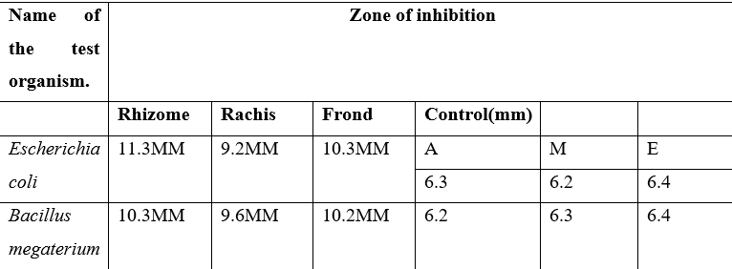
Antibacterial activity of Dicranopteris linearis
RESULTS
The antibacterial action of three explicit ferns Athhyrium filix-femina, Dicranopteris linearis, and Pleopeltis macromarpa is displayed in this Table. The outcomes show that the antibacterial action of Gramme (+) and Gram(-) microorganisms is great. Rhizome and frond separate from these three plants have antibacterial properties. Rhizome and frond have adequate measures of antimicrobial synthetics. The most antibacterial concentrates come from the rhizome and fronds of these plants.

Slide 6
CONCLUSION
The antibacterial properties of three fern species—Athyrium filix-femina, Dicranopteris linearis, and Pleopeltis macromarpa from the West Bengali Darjeeling region were investigated.
The results demonstrated the potent antibacterial activity of all three ferns, with the rhizome and frond extracts exhibiting the highest activity.
While Athyrium filix-femina rhizome extract was more effective against gram-negative bacteria, Dicranopteris linearis rhizome extract showed the highest effectiveness against both gram-positive and gram-negative bacteria.
The most efficient frond extract against both types of bacteria was found in Pleopeltis macromarpa, out of the three ferns that were the subject of the investigation.
These findings, which suggest that these ferns may be used as natural antibacterial agents, highlight the importance of these plants in pharmaceutical and ethnobotanical research.

Slide 7
REFERENCES
Liang, J., Liu, S., Sun, Y., & Liu, X. (2020). Climate change explains more than other ecological characteristics in shaping species richness pattern along the Tibetan Plateau elevation gradient. Ecological Indicators, 115, 106321.
Pandey, S., Negi, M., & Sharma, A. (2020). Patterns of plant species richness along the altitudinal gradient in the Western Himalaya, India. Journal of Mountain Science, 17(8), 1934-1946.
Dhar, M. L., Dhar, M. M., Dhawan, B. N., Mehrotra, B. N., & Roy, C. (2006). Screening of Indian plants for biological activity, Part I. Indian Journal of Experimental Biology, 6, 232-247.
Dhawan, B. N., Patnaik, G. K., Rastogi, R. P., Singh, K. K., & Tandon, J. S. (2017). Screening of Indian plants for biological activity, Part VI. Indian Journal of Experimental Biology, 15, 208-219.
Lai, H. Y., Lim, Y. Y., & Tan, S. P. (2009). Antioxidative, tyrosinase inhibiting and antibacterial activities of leaf extracts from medicinal ferns. Bioscience, Biotechnology, and Biochemistry, 73, 1362-1366.

Slide 8
Thank you

