Slide 1
MODERN INNOVATIVE STRATEGIES IN RESEARCH
Tamal Taru Roy
Subject: Education

Slide 2
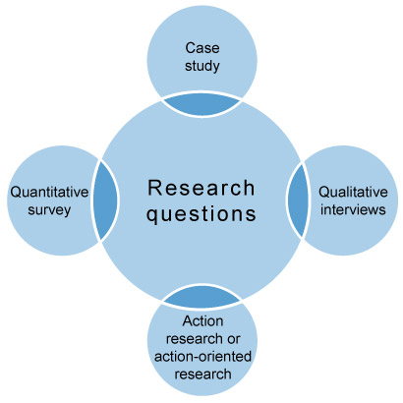
INTRODUCTION
Modern inventive tactics are driving a revolutionary shift in the pursuit of knowledge within the continually changing terrain of contemporary research. This introduction lays the groundwork for an in-depth investigation of innovative techniques that transform conventional research methods. The rapid growth of technology necessitates interdisciplinary collaboration more than ever before, as adaptable frameworks that defy the status quo arise. This paper explores the dynamic junction of these factors and looks at how contemporary approaches are changing the field of research. We want to understand how these cutting-edge approaches have transformed a variety of fields by looking into case studies and actual data. This investigation highlights the necessity of adopting cutting-edge strategies to tackle difficult problems, ultimately directing the course of research activities into unexplored and exciting domains. The four primary categories of research strategies are depicted in Figure 1 action-oriented research, qualitative interviews, case studies, and quantitative surveys. You are more likely to employ one of the first three strategies than action-oriented research.
Figure 1: Main research strategies

Slide 3
LITERATURE REVIEW
Bryman's (2015) is a seminal work in the subject that provides an extensive analysis of both qualitative and quantitative research methods. Bryman is a priceless tool for researchers in a variety of fields since it skillfully handles the challenges of research design, data gathering, and analysis.
The seminal study Corbin and Strauss (2014) stands out. With a grounded theory emphasis, the book offers a thorough manual for the methodical creation of theory from empirical data, giving qualitative research an organised approach. A strong framework developed by Corbin and Strauss is now essential for researchers who want to work closely with qualitative research methodologies.
A crucial work that helps scholars navigate the terrain of qualitative research is Creswell (2013). The book outlines five different strategies, offering a thorough framework for selecting and putting into practice qualitative research designs. As he deftly handles the subtleties of each strategy, Creswell's proficiency with qualitative methodologies is clear, enabling researchers to make decisions that are in line with their goals.

Slide 4
MODERN RESEARCH LANDSCAPE
The contemporary research landscape is characterised by a dynamic and ever-evolving environment. This environment is defined by developments in technology, changes in societal needs, and an increased emphasis on multidisciplinary collaboration. Because of the constantly shifting landscape, it is essential to have a solid understanding of the most up-to-date research approaches in order to effectively address difficult problems. To put it another way, innovation is at the vanguard of this environment, acting as a catalyst for pushing the boundaries of established research methodologies. Researchers are required to adapt and incorporate creative tactics in order to improve the efficiency, precision, and relevance of their work in light of the continually evolving capabilities of technology. For researchers, it is of the utmost importance to remain current with these contemporary techniques. Not only does this ensure that their methodologies are in line with the current state of the art, but it also puts them in a position to take advantage of new opportunities as they manifest themselves. Keeping up with the latest developments in the area is not only important for individual research endeavours, but it also makes a contribution to the overall advancement of knowledge and helps to cultivate a research community that is capable of addressing the complex problems that we confront in this era. Maintaining an awareness of and involvement with modern techniques becomes a vital component of the researcher's toolkit as the research landscape continues to advance. This makes it possible for researchers to make contributions that are more powerful and transformational to the academic and scientific domains.

Slide 5
TECHNOLOGICAL INTEGRATION IN RESEARCH
Traditional research techniques have been greatly impacted and transformed by the revolutionary shift that is the integration of sophisticated technologies in research. Investigating these state-of-the-art technologies is crucial to comprehending their significant influence on the field of study. Particularly, big data analytics, machine learning, and artificial intelligence (AI) have become extremely potent instruments that are transforming the methods by which scientists gather, process, and evaluate data. For example, AI and ML algorithms allow massive datasets to be processed at previously unheard-of speeds and precision, exposing patterns and insights that would otherwise go unnoticed when utilising traditional techniques. This is further enhanced by big data analytics, which offers the framework for managing and deriving valuable information from enormous databases.
These technologies have an impact on a wide range of academic fields, including social sciences, environmental studies, healthcare, and finance. For example, AI is used in healthcare to diagnose illnesses and optimise treatments, and machine learning algorithms are used in finance to estimate market trends and assess risk. Large dataset analysis is useful in the social sciences to better understand human behaviour, and environmental studies use technology to monitor and address ecological issues. In order to open up new avenues for investigation and discovery, researchers must not only be knowledgeable about modern technologies but also skilled at integrating them into their methods.

Slide 6
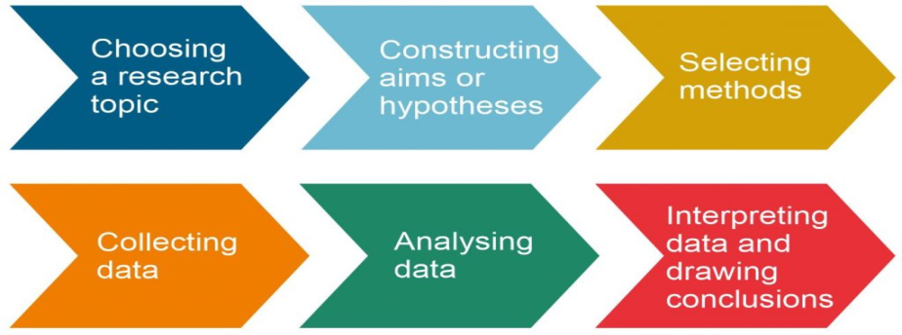
APPROACHES TO RESEARCH
For the majority of researchers, if not all of them, selecting a strategy is simple. While qualitative research is more appropriate in the field of social work that focuses on persons and families, quantitative research will be used to study the mechanics of an organic chemical reaction. While some study gains more insight from a combination of the two methodologies, other research benefits more from just one of them.
There are, in reality, some significant similarities between qualitative and quantitative research methodologies. Every kind of research typically adheres to the phases of the scientific process, in particular:
Every strategy usually starts with a hypothesis based on a value judgement or qualitative reasoning. It is possible to apply or translate these conclusions into quantitative terms using both deductive and inductive reasoning skills. Both can be extremely extensive, but qualitative research can be more flexible in how much detail it contains.
Figure 1: A Step-by-Step Illustration of the Scientific Method Process

Slide 7
CONCLUSION
This study explores cutting-edge, contemporary research methodologies, emphasising the revolutionary power of cutting-edge technologies, multidisciplinary cooperation, and adaptable frameworks. The results emphasise how important it is to adopt new strategies for improved knowledge creation and problem-solving in a variety of fields. The survey of the literature highlights the important contributions made by Bryman, Corbin and Strauss, Creswell, and Field, providing information on qualitative and quantitative approaches. Researchers must stay up to date with the ever-changing world of research, particularly with the integration of technologies such as AI and ML, which are proving to be revolutionary in the fields of environmental studies, healthcare, finance, and social sciences. The demand for proactive engagement with these contemporary tactics in the paper's conclusion ensures that researchers make a significant contribution to the rapidly changing academic and scientific arenas.

Slide 8
REFERENCES
Bryman, A. (2015). Social research methods. Oxford University Press.
Corbin, J., & Strauss, A. (2014). Basics of qualitative research: Techniques and procedures for developing grounded theory. Sage publications.
Creswell, J. W. (2013). Qualitative inquiry and research design: Choosing among five approaches. Sage publications.
Daft, R. L. (2018). Management. Cengage Learning.
Field, A. (2013). Discovering statistics using IBM SPSS statistics. Sage publications.
Google. (2021). Google Workspace. Retrieved from https://workspace.google.com/
QSR International. (2021). NVivo 12. Retrieved from https://www.qsrinternational.com/nvivo-qualitativedata-analysis-software/home

Slide 9
THANK YOU

