Slide 1
CHARACTERIZING SCATTERING IONIZATION PATHWAYS IN CHEMICAL MOLECULES THROUGH ELECTRON INTERACTION STUDIES
Riya Sharma
Subject:Physics

Slide 2
ABSTRACT
Using a new semiclassical method described in recent literature, this work explores the complex dynamics of scattering ionization routes in Ne*(3P2,0)-Ng (Ng = Ar, Kr, Xe) systems. With the primary goal of clarifying the function of electron-molecule interactions, the study offers a thorough examination of experimental data, such as ionization cross sections and Penning ionization electron spectra (PIES), in order to identify underlying processes.
The work provides insights into the development of reaction transition states by highlighting the crucial effects of collision energy, separation distance, and relative alignment of valence orbitals on reaction kinetics. Interestingly, ionization cross section energy dependency in Ne*-molecule systems displays a variety of tendencies that are indicative of the distinct electronic structures of the molecules involved.
With implications for atmospheric chemistry, materials science, and basic chemical kinetics, the discoveries advance our knowledge of chemical processes that are sparked by electron interactions. This work provides a framework for further investigation into scattering ionization routes and theoretical model improvement in the clarification of intricate chemical processes.

Slide 3
INTRODUCTION
Deciphering the underlying principles of ionization routes in chemical molecules is crucial to the advancement of several scientific areas as well as basic chemical processes. Important applications of ionization processes brought about by electron interactions may be found in atmospheric chemistry, materials science, and chemical kinetics.
Studies of electron interactions provide a potent way to look at the complex interactions that occur between electrons and molecules during collisions. These investigations combine experimental methods with theoretical models to provide contrasting views of the underlying chemistry and physics.
Because of their use in a variety of scientific situations, certain chemical systems, such Ne*(3P2,0)-Ng (Ng = Ar, Kr, Xe), are often the subject of research into scattering ionization routes. Researchers may learn essential things about electron-molecule interactions and how they play a part in starting chemical reactions by examining these systems.
To make reagent particles in the CI cycle, electrons should initially attack the reagent gas. The reagent particles then ionize the example atoms by means of particle and sub-atomic response pathways. Throughout the entire existence of CI, the 1970s were viewed as a defining moment.

Slide 4
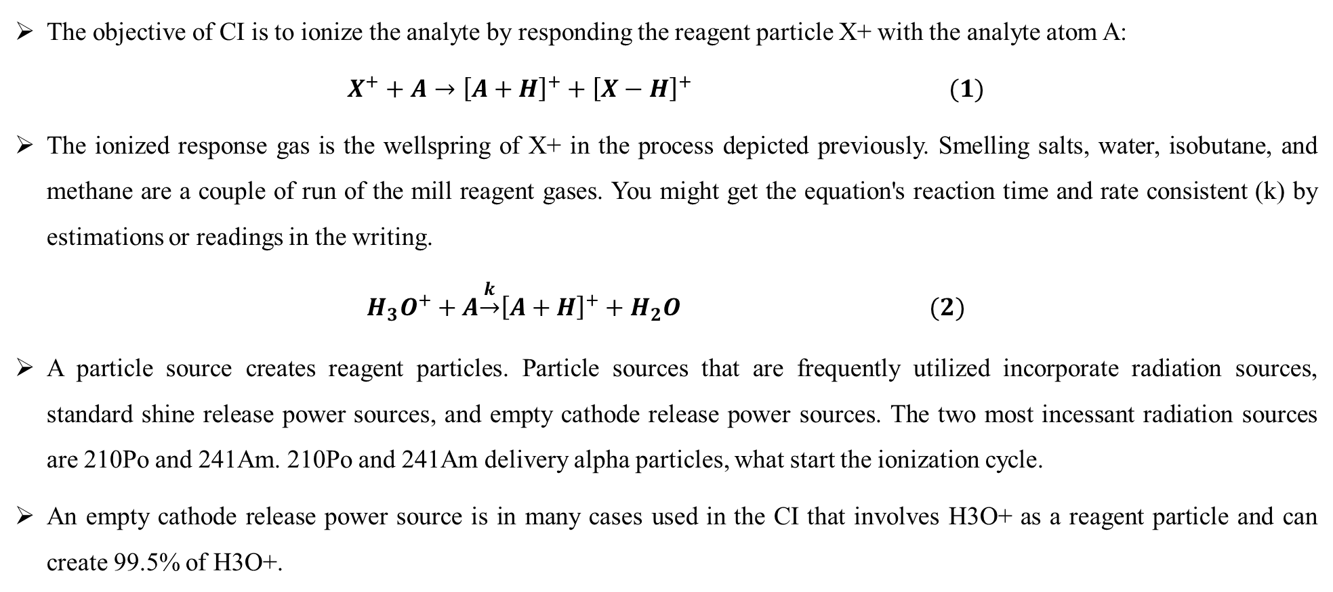
THE PRINCIPLE OF CHEMICAL IONIZATION
The objective of CI is to ionize the analyte by responding the reagent particle X+ with the analyte atom A:
$$X^{+}+A→{\left[A+H\right]}^{+}+{\left[X−H\right]}^{+ }(1)$$
The ionized response gas is the wellspring of X+ in the process depicted previously. Smelling salts, water, isobutane, and methane are a couple of run of the mill reagent gases. You might get the equation's reaction time and rate consistent (k) by estimations or readings in the writing.
$$H_{3}O^{+}+A\underset{→}{k}{\left[A+H\right]}^{+}+H_{2}O (2)$$
A particle source creates reagent particles. Particle sources that are frequently utilized incorporate radiation sources, standard shine release power sources, and empty cathode release power sources. The two most incessant radiation sources are 210Po and 241Am. 210Po and 241Am delivery alpha particles, what start the ionization cycle.
An empty cathode release power source is in many cases used in the CI that involves H3O+ as a reagent particle and can create 99.5% of H3O+.

Slide 5
RESEARCH METHODOLOGY
We explored Ne*(3P2,0)- Ng (Ng = Ar, Kr, Xe) frameworks utilizing a new semiclassical treatment that has been completely portrayed in late papers. The examination offered an inside steady legitimization of accessible exploratory outcomes, including Writing ionization electron spectra (PIES), aggregate and halfway ionization cross areas, and their stretching proportions (BRs).
The optical potential model is described as a mix of a real and an imaginary portion. It was initially presented to explain the dynamics of nuclear processes and is also used to CHEMI. We have shown that, as they originate from the same interaction components, the two components—which regulate, respectively, the collision dynamics and the "opacity" or likelihood of CHEMI—must be interdependent.
The relative alignment of valence orbitals, separation distance R, and collision energy (Ecoll) are crucial variables that impact the stability and structure of the adducts created when reagents collide, which in turn affects the reaction TS.
Twelve reaction channels have been identified, each of which is impacted by a distinct relative role played by the two fundamental processes previously discussed. These channels are thought to represent certain transitions from a quantum state of reagents to that of products.

Slide 6
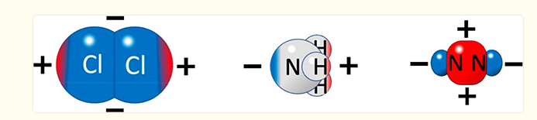
RESULTS AND DISCUSSION
The notable examination of Beijerinck and partners demonstrates that the sub-atomic frameworks that produce CHEMI, which were all completely concentrated on tentatively in the gas stage under single crash conditions utilizing the sub-atomic shaft method, can be partitioned into two gatherings: those that show an unmistakable pattern toward a decline in cross segments and those that display an undeniable expansion in the all out ionization cross area as Ecoll increments.
Total ionization cross sections in relation to collision energy for some Ne*-molecule complexes. Third-degree polynomials of experimental data are interpolated by the curves in the following cases: (a) some inorganic compounds. (b) Saturated and unsaturated hydrocarbons in their most basic form.
The distinct behaviours shown by the different partners of the Ne* reagent is contingent upon their basic chemical and physical characteristics, as seen in Figure 2 for three instances of inorganic molecules. In the case of Ne*-Cl2, when an effective ion pair is formed by harpooning, it is guessed that the limiting energy in the crash complex would ascend by something like two significant degrees contrasted with Ne*-N2, leaning toward a nearer approach of reagents.

Slide 7
COLLISION ENERGY (meV)
 | NH₃ | O₂ | Cl₂ | Co | N₂ | CH₄ | C₂H₂ | C₂H₄ | C₂H₆
10 | 70 | 40 | 70 | 12 | 5 | 12 | 25 | 25 | 15
100 | 50 | 45 | 28 | 15 | 10 | 16 | 15 | 15 | 20
1000 | 45 | 20 | 18 | 20 | 20 | 19 | 16 | 15 | 25

Slide 8
A schematic outline of the Ne*-Cl2 CHEMI response's minuscule elements. Redox 1 in the top board The Rydberg electron of Ne* might fill the σ-opening of Cl2 a good way off of around 6 Å when collinear Cl2 is available, prompting the making of Ne+-Cl2-particle matches. The antibonding 3σu* orbital contains the additional electron in Cl2-. Redox 2 on the centre panel Two electrons from the 3σ molecular orbitals may be involved in the ionization process at shorter distances.
Stronger attraction due to ion pair formation and Cl2– instability causes the highly excited NeCl* adduct to form, which then autoionizes to produce Ne + Cl+ + e– products. At a short R, the overlap between the populated 3σ molecular orbitals of Cl2 and the half-filled orbital of Ne+ initiates a further electronic rearrangement process, as seen in the center panel.
). Besides, the Coulomb fascination supports the catching of the Ne+-Cl2-particle pair at nearer goes, where an organized CT including both inward 3σg and outside 3σu* populated sub-atomic orbitals of Cl2- (where the external electron fills the p-orbital of the Ne and the other deepest electron is launched out) decides the oxidation to the last territory of Cl+.
In these conditions, the worldwide reactivity drops and impacts become genuinely doable for all overall directions of the two accomplices, including the Cl2 particle's opposite way to deal with the Ne* molecule. Here, both backhanded (counting expected radiative impacts) and direct (chemical or trade) systems become cutthroat in the opposite arrangement of the shaped adduct, which is fairly shaky because of the absence of solid alluring parts.

Slide 9
THE DEPENDENCE OF LMAX, DEFINING THE ABSOLUTE MAXIMUM OF THE CENTRIFUGAL BARRIER, FOR THE TWO SELECTED GEOMETRIES FOR EACH COLLISION ENERGY
The acquired cross-segment values and their proportions show that just when Ecoll is more noteworthy than the pivotal worth does the commitment from the most elevated b or values become recognizable. Subsequently, the outward hindrance's specific capability begins to decrease, and a particular scope of b or values empowers the response, making those values greater than bmax or lmax successful too since defining moments are distinguished at moderate and genuinely huge R.
θ = 90°; ϕ = 220° |  | θ = 15°; ϕ = 270°
E_{coll} (meV) | l_{max} | l_{max}
0.1 | 10 | 10
0.3 | 15 | 15
1 | 23 | 23
3 | 34 | 34
10 | 52 | 37
30 | 78 | 44
100 | 114 | 55
300 | 140 | 110
1000 | 190 | 115

Slide 10
CONCLUSION
The study on scattering ionization pathways in Ne*(3P2,0)-Ng systems provide insights into chemical reactions initiated by electron-molecule interactions. The review uncovers the relationship of genuine and non-existent pieces of the optical likely model, which control crash elements and the likelihood of chemical ionization.
Two cutthroat minute response instruments are recognized: an immediate system driven by compelling charge move and a roundabout component beginning from noncovalent powers. The reactivity of the frameworks relies upon impact energy, detachment distance, and valence orbital arrangement.
Twelve response channels have been distinguished, each addressing explicit sections from the quantum condition of reagents to items. The findings have implications for atmospheric chemistry, materials science, and fundamental chemical kinetics.

Slide 11
REFERENCES
Aguilar A.; Brunetti B.; González M.; Vecchiocattivi F. A crossed beam study of the ionization of molecules by metastable neon atoms. Chem. Phys. 1990, 145, 211–218. 10.1016/0301-0104(90)89116-8.
Alagia M.; Balucani N.; Candori P.; Falcinelli S.; Pirani F.; Richter R.; Rosi M.; Stranges S.; Vecchiocattivi F. Production of ions at high energy and its role in extraterrestrial environments. Rend. Lincei Sci. Fis. Nat. 2013, 24 (1), 53–65. 10.1007/s12210-012-0215-z.
Brunetti B.; Falcinelli S.; Paul S.; Vecchiocattivi F.; Volpi G. G. Collisional Autoionization Dynamics of Ne*-Cl₂. J. Chem. Soc., Faraday Trans. 1993, 89, 1505–1509. 10.1039/FT9938901505.
Brunetti B.; Falcinelli S.; Sassara A.; de Andres J.; Vecchiocattivi F. Auto-Ionization of the Collisional Complexes of Metastable Neon and H₂, D₂, or HD. Chem. Phys. 1996, 209 (2–3), 205–216. 10.1016/0301-0104(96)00096-1.
Conrad H.; Ertl G.; Küppers J.; Sesselman W.; Haberland H. Deexcitation mechanisms in metastable He*-surface collisions. Surf. Sci. 1980, 100, L461–L466. 10.1016/0039-6028(80)90372-6.

Slide 12
Thank you

