Slide 1
AN ANALYSIS ON THE PARADIGM SHIFT IN CROP PRODUCTION MANAGEMENT FOR MODERN SUSTAINABILITY
Renshu¹, Poonam Juneja², Meenakshi³
^{[1,3]} Baba Mastnath University, Rohtak,
^{[2]} Maitreyi College, University of Delhi, New Delhi
renshudeshwal17@gmail.com¹,
Corresponding Author - pjuneja@maitreyi.du.ac.in²

Slide 2
ABSTRACT
Developing management structures that guarantee that the essential activities and plans are done to get an attractive result from the movement of the undertaking's functioning system is the fundamental errand of production management in cultivating tries.
These issues are connected to the absence of modern hardware and specific materials, the unstable monetary circumstances looked by most farmsteads, and the deficiency of regulatory work in the field of crop production. Huge mechanical headways in cultivating production have been made conceivable by modern varieties, transgenic crops, and the green revolution (GR) (GM crops).
Albeit the reception of GR expanded the area's general adequacy internationally, it is additionally remembered to be adding to resource debasement in nations like India, for the most part because of the development pack itself and somewhat to the impossible execution of its partner.
Nonetheless, plants with hereditarily changed groupings are helpless against long haul medical problems and ecological results. Understanding the parts of imaginative shifts toward sustainability that are reasonable for agricultural production accordingly requires cautious idea.

Slide 3
INTRODUCTION
One of the essential parts of agriculture is crop production. The explanation the populace has food and the creature's business feed is a direct result of crop yield. Besides, crop items are utilized in many undertakings as unrefined substances got from plants, like food, fuel, materials, and medications.
This is principally made sense of by the way that homegrown makers make items that are ok for the climate, in any event, when the most common way of creating them includes the utilization of fundamental added substances. The interest in cultivating items is fuelled by these conditions. Besides, the market for farm style agricultural items — that is, those made under average circumstances — is as of now developing.
Systems for crop production that produce more food with more healthy benefit are essential, however they likewise need to an affect the climate. The 20th century saw an enormous development in country regions because of the broad utilization of pesticides, manure, and water systems, all at a critical biological expense.
Bleeding edge cropping structures that join natural advancements (plant-helpful microorganisms, cover crops) with precision agriculture (Father) and precision conservation (PC) ought to be created as a feature of practical agriculture to lessen how much compost, pesticide, and water inputs while expanding the feasibility of conservation to keep up with supportable agriculture at the field level and all through a watershed.

Slide 4
LITERATURE REVIEW
Bhalla and Singh's (2010) The report, requested by the Indian Orchestrating Commission, centers around the areas of agriculture advancement in India at the neighborhood level. This exhaustive research gives a reasonable examination of elements impacting cultivation efficiency, sustainability, and monetary profit in various pieces of the country.
Choudhary and Gaur's (2010) The ISAAA Series of Biotech Crop Profiles remembers a national profile for Bt cotton in India that gives an itemized outline of the improvement of hereditarily changed (GM) cotton in the country and its effect. This dissemination no doubt gives goodies of information about the agronomic show, monetary advantages, ecological worries, and managerial cycles related with the reception of Bt cotton in India.
Evenson and Gollin (2003) give an intensive examination of the effect of the Green Revolution more than a forty-year time span. The presentation of high-yielding crop assortments, water system systems, and pesticide inputs, once in a while alluded to as the "Green Revolution," essentially expanded cultivation efficiency and created unmistakable outcomes in different regions of the planet.
Gómez-Limón and Sanchez-Fernandez (2010) add to the discussion on manageable cultivating rehearses by putting out a system for observational assessment that utilizes composite pointers.

Slide 5
TECHNOLOGY PARADIGMS AND TECHNOLOGY TRANSITIONS - TOWARDS AN ANALYTICAL FRAMEWORK
Ordinary models make sense of the construction and wellsprings of agricultural improvement in a straight style. As per the immediate model, developments stream from worldwide research offices to national research workplaces prior to growing to arrive at farmers.
Technology paradigms and the global technological landscape: It is essential to initially comprehend what a development paradigm and is a paradigm shift prior to diving into the conversation of the rise of development paradigms. "An illustration of common decisive reasoning activity on the grounds of such an imaginative paradigm," is the manner by which he portrays mechanical course.
With these center components of a development paradigm as a main priority, we are right now attempting to work on this whole documentation. In the first place, the issue set is where we start. Consider a few mechanical difficulties that might emerge during production.
Allow Lp to address the development scene 7 for a specific issue set p, and allow p to be a plane of all mechanical designs that are possible and sensible, as well as the essential consistent fields that contrast with the issue set p.

Slide 6
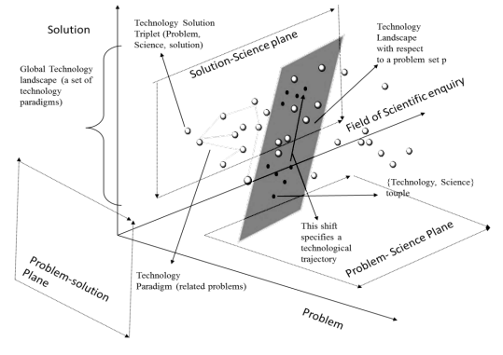
GLOBAL TECHNOLOGICAL LANDSCAPE
There might be an answer accessible on 𝐿𝑝 for a particular issue at a particular second for an issue pi. Be that as it may, an issue pi requires an answer; in this way, a logical examination concerning an overarching development scene Tp (expecting to be the as of late existing) for a connected issue set starts. That is, researchers and engineers apply methods appropriate to the prevailing plan models of the scene while the pursuit happens inside the scene's locales of consistent request. In the far-fetched occasion that an answer can't be recognized inside the current scene, the pursuit extends to incorporate consistently related areas outside the scene's limits while remaining inside the boundaries of the paradigm

Slide 7
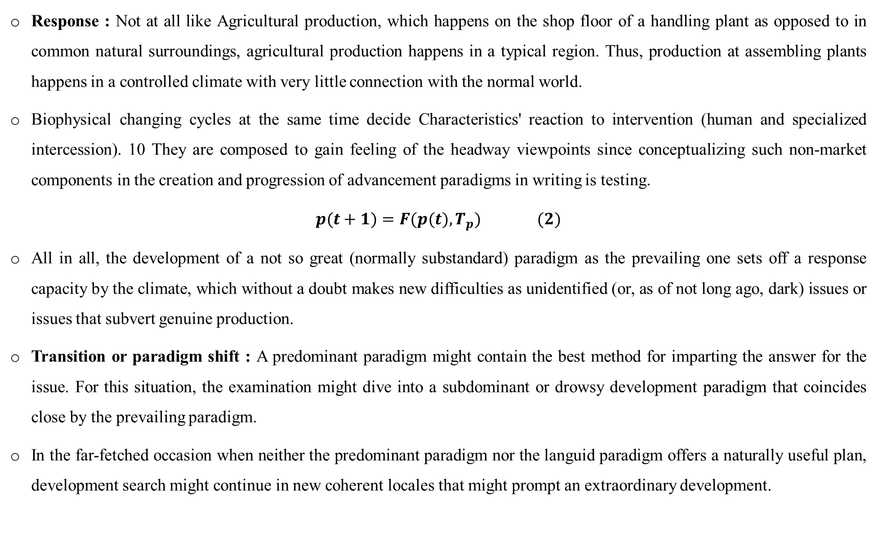
Response : Not at all like Agricultural production, which happens on the shop floor of a handling plant as opposed to in common natural surroundings, agricultural production happens in a typical region. Thus, production at assembling plants happens in a controlled climate with very little connection with the normal world.
Biophysical changing cycles at the same time decide Characteristics' reaction to intervention (human and specialized intercession). 10 They are composed to gain feeling of the headway viewpoints since conceptualizing such non-market components in the creation and progression of advancement paradigms in writing is testing.
$$p(t+1)=F(p(t),T_{p}) (2)$$
All in all, the development of a not so great (normally substandard) paradigm as the prevailing one sets off a response capacity by the climate, which without a doubt makes new difficulties as unidentified (or, as of not long ago, dark) issues or issues that subvert genuine production.
Transition or paradigm shift : A predominant paradigm might contain the best method for imparting the answer for the issue. For this situation, the examination might dive into a subdominant or drowsy development paradigm that coincides close by the prevailing paradigm.
In the far-fetched occasion when neither the predominant paradigm nor the languid paradigm offers a naturally useful plan, development search might continue in new coherent locales that might prompt an extraordinary development.

Slide 8
APPLICATION OF THE CONCEPTUAL FRAMEWORK TO AGRICULTURAL PRODUCTION
Being developed focuses, paradigmatic portrayal of contemporary advancements is ordinary; in agriculture, it is less considered normal. This could be ascribed to the multiplication of both non-modern (regular) and modern (compound and mechanical) mechanical systems in agricultural result.
As indicated by our own portrayal, biotechnologies (GM crops and biotech-upheld raising techniques), agro-organic methods (customary, uninformed, normal developing practices), early and late green revolution progresses (MVs), and biotechnologies (Half and Parts) describe agricultural production.
Fundamental plant sciences like inherent science, plant science, plant physiology (shape and size), plant pathology (vulnerability to diseases), and entomology (to break down bug populaces and their approach to acting towards a host plant creature gatherings) stayed the area of focal point of sensible enquiry during the start of decisive reasoning for additional created yields.
The solution design: From the beginning in the green revolution, new plant assortments were fostered that could answer the utilization of fertilizers without lodging, empowering the plant to deliver more grains per tail. Thus, the plants' morphological and physiological qualities were adjusted to all the more likely suit agroecology.

Slide 9
CONCLUSION
The examination causes to notice the significant paradigm shift toward contemporary sustainability rehearses that is happening in agricultural production management. The research discoveries approve the gather pattern up from customary methodologies and toward widely inclusive methodologies that focus on resource efficiency, monetary reasonability, and ecological stewardship.
Besides, this change stretches out past direct cultivating works on, enveloping more significant essential changes in system structures, market parts, and customer conduct.
As we research the intricacies of really focusing on a developing worldwide populace while safeguarding the planet's limited assets, this shift recommends a crucial point in time in shifting agriculture's future course toward an extra feasible and hearty paradigm.
. It will be fundamental for embrace progress, joint effort, and knowledge partaking to prepare these arising paradigms to the furthest reaches conceivable to handle the difficulties representing things to come.

Slide 10
REFERENCES
A.M. Petrov, M.A. Kanaev, Yu.A. Savelev, S.A. Vasilev, E.S. Kanaeva, Research J. of Pharmaceutical, Biological and Chemical Sciences 5, 925-934 (2018)
Bhalla, G. S., & Gurmail, Singh. (2010). Final Report on Planning Commission Project Growth of Indian Agriculture: A District Level Study. Planning Commission of India Project Report.
Choudhary, Bhagirath, & Gaur, Kadambini. (2010). Bt cotton in India: A country profile. ISAAA Series of Biotech Crop Profiles. ISAAA: Ithaca, NY.
Dhiman, S., Yadav, A., Debnath, N., & Das, S. (2021). Application of core/shell nanoparticles in smart farming: A paradigm shift for making the agriculture sector more sustainable. Journal of Agricultural and Food Chemistry, 69(11), 3267-3283.
Edwards, A. R. (2005). The sustainability revolution: Portrait of a paradigm shift. New Society Publishers.

Slide 11
Thank you

