Slide 1
INVESTIGATING THE INFLUENCE OF DRAWBEAD GEOMETRIES ON SPRINGBACK IN MILD STEEL SHEET METAL FORMING USING ABAQUS SOFTWARE
TARUN NHARWAL
Mechanical Engineering
MU
Jan -21
20200944

Slide 2
ABSTRACT
This research study aims to investigate the influence of drawbeads on minimizing springback in the forming of mild steel sheet metal using the Abaqus software. Springback, which refers to the elastic recovery and inaccurate geometry of deformed parts after the forming process, can be reduced by introducing drawbeads. Four different drawbead geometries, namely without drawbeads, circular drawbeads, rectangular drawbeads, and triangular drawbeads, are examined through computational analysis using the finite element method. The results indicate that the triangular drawbeads are the most effective in reducing springback compared to the other geometries..
Keywords: springback, drawbead, metal forming, Abaqus software.

Slide 3
INTRODUCTION
Springback, an elastic deformation occurring in sheet metal forming, presents challenges in subsequent assembly due to geometric distortions (Neto et al., 2017).
Drawbeads are employed to control material flow during forming processes and improve product quality by applying restraining forces.
The influence of drawbead geometries on minimizing springback behavior is a significant area of research within sheet metal forming.

Slide 4
INTRODUCTION
Numerical simulations, particularly Finite Element (FE) analysis, play a crucial role in understanding and predicting springback behavior. However, achieving accurate and reliable results poses challenges Maia,et al (2017).
Advanced techniques such as through-thickness integration schemes for shell elements and equivalent drawbead models help improve the accuracy and efficiency of FE simulations, contributing to better product design and manufacturing processes.
This research study aims to investigate the influence of drawbeads on minimizing springback in the forming of mild steel sheet metal using the Abaqus software

Slide 5
PROBLEM STATEMENT
Springback in sheet metal forming causes inaccuracies in part geometry and complicates assembly processes. While drawbeads are employed to mitigate springback effects, there's a lack of understanding regarding the mechanism and impact of drawbead geometries. Further exploration is needed to elucidate how drawbead configurations influence springback behavior, facilitating more effective strategies for minimizing springback and improving manufacturing outcomes

Slide 6
OBJECTIVES OF THE STUDY
Study the influence of various drawbead geometries on springback.
Determine the most effective drawbead geometry for reducing springback.
Gain insights into the springback mechanism through visual simulation using Abaqus software

Slide 7
SCOPE OF STUDY
This project focuses on simulating springback under different drawbead geometries for 1mm mild steel sheet metal. The simulation results will provide a benchmark for two-dimensional analysis and help select the most effective drawbead geometry for reducing springback.

Slide 8
METHODOLOGY
The methodology follows three phase
Preprocessing with MSC.Patran involves constructing the die set model and defining boundary conditions.
Forming Simulation using Abaqus/Explicit entails conducting a two-step analysis to apply symmetry conditions, increase blank holder force, and drive the punch downward to simulate forming. This process obtains deformed geometry and residual stress.
Springback Simulation and Measurement are carried out using Abaqus/Explicit to analyze springback by measuring angle changes in the blank before and after forming. This step assesses elastic deformation and geometric distortions to guide design modifications..

Slide 9
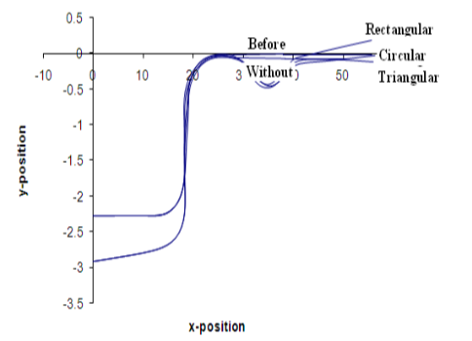
RESULTS
The simulation results for mild steel show that the triangular drawbead geometry provides the closest approximation to the blank sheet before springback. It produces a more sufficient restraining force, resulting in effective springback reduction compared to other drawbead geometries shown in figure
The sharp shape of the triangular drawbead restricts material flow, leading to reduced springback. This shape effectively holds the blank sheet in the die cavity, allowing the restraining force to act predominantly in one direction in smaller areas. Conversely, drawbeads with circular and rectangular shapes allow for freer material flow due to their larger areas, resulting in more uniform force distribution around the area
Figure: Four different drawbead configurations were evaluated to assess their impact on springback in mild steel

Slide 10
KEY FINDINGS OF THE STUDY
The sharp shape of the triangular drawbead geometry is more effective in reducing springback compared to other geometries.
The material properties of the blank sheet, particularly its softness, influence the occurrence of springback. Material selection is a significant concern for forming simulations.
Thicker blank thickness can contribute to more effective springback reduction compared to thinner blanks.
The simulation results show a relatively small percentage error compared to experimental data, validating the use of simulations for springback prediction

Slide 11
CONCLUSION
The study underscores drawbeads as effective solutions for mitigating springback in sheet metal forming, with triangular geometries showcasing superior performance due to enhanced material flow control and restraining force application.
Future research avenues include conducting three-dimensional simulations to mirror real-world industry scenarios accurately and broadening the exploration of drawbead geometries to identify more optimal configurations for minimizing springback.

Slide 12
REFERENCES
Maia, A., Ferreira, E., Oliveira, M.C., Menezes, L.F. and Andrade-Campos, A., 2017. Numerical optimization strategies for springback compensation in sheet metal forming. In Computational methods and production engineering (pp. 51-82). Woodhead Publishing.
Neto, D.M., Oliveira, M.C., Santos, A.D., Alves, J.L. and Menezes, L.F., 2017. Influence of boundary conditions on the prediction of springback and wrinkling in sheet metal forming. International Journal of Mechanical Sciences, 122, pp.244-254.

