Slide 1



Optimization of Surface Integrity During Dry Turning of AISI 4130r Steel
Subhash Chandra Manufacturing Engineering, Faculty of Mechanical Technology, Federal TVTI, lambert, Addis Ababa, Ethiopia. suchandra404@gmail.com,
Gezae Mebrahtu Manufacturing Engineering, Faculty of Mechanical Technology, Federal TVTI, lambert, Addis Ababa, Ethiopia. gezaemebrahtu@gmail.com
Kishan Pal Singh Mechanical Engineering Department, FET, Mangalayatan University, India
Shiferaw Semu Dutebo Student MSc Program Manufacturing Engineering, TVTI, Addis Ababa, Ethiopia

Slide 2
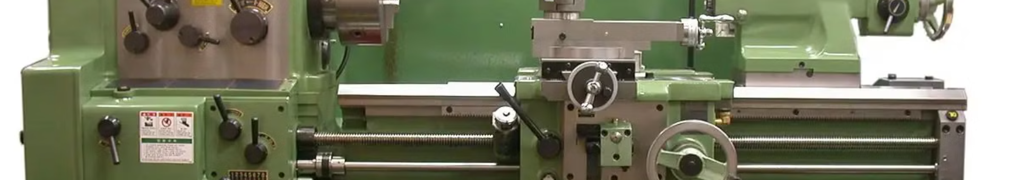
Introduction to Turning Process
Common Method
Optimization Techniques
Optimization Model
The turning process is the most common method for metal cutting and finishing circular machined parts in the manufacturing industries.
This paper presents a method to develop an optimization model and ranks input parameters for their effects on surface roughness.
Application of optimization techniques in turning process is essential for increasing product quality and minimizing manufacturing time.

Slide 3
Literature Review on Machining Processes
Effect of Cutting Speed
Taguchi Method
Optimizing Machining Parameters
Researchers have used Taguchi design and ANOVA to determine the contribution of cutting speed, feed, and depth of cut to surface roughness.
Cutting speed has a dominant effect on surface finish, followed by nose radius, feed rate, and depth of cut.
Researchers have reviewed the literature on optimizing machining parameters in turning processes using the Taguchi method.

Slide 4
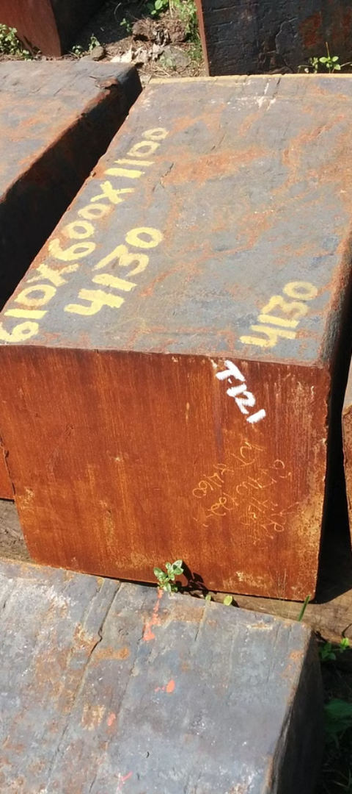
Material and Methods
1
Sample Material
2
Software and Analysis
The research used round bars of AISI 4130r steel, known for its strong strength and good machinability, as the sample material.
Minitab 21 software was used for fraction factorial Taguchi’s L9 Orthogonal array to perform S/N analysis and ANOVA.

Slide 5
Data Analysis Using Taguchi Method
1
2
S/N Ratio
Quadratic Quality Loss Function

Slide 6
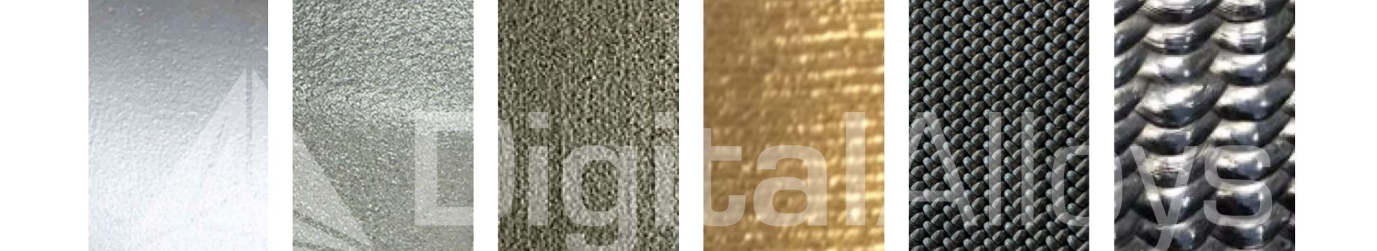
Results and Discussions
1
Impact on Surface Roughness
The order of high impact to low impact on surface roughness by process parameters is cutting velocity, nose radius, feed rate, and depth of cut.
2
Linear Regression Model
The linear regression model developed is applicable to the given work material and tool material.

Slide 7

Conclusion: Development of Roughness Model
Material Removal Rate
Experimental Design
The same model can be developed for material removal rate, which can save cutting time and increase productivity.
The paper has considered fraction factorial Taguchi design, reducing experimental time and cost while providing the same results.

Slide 8
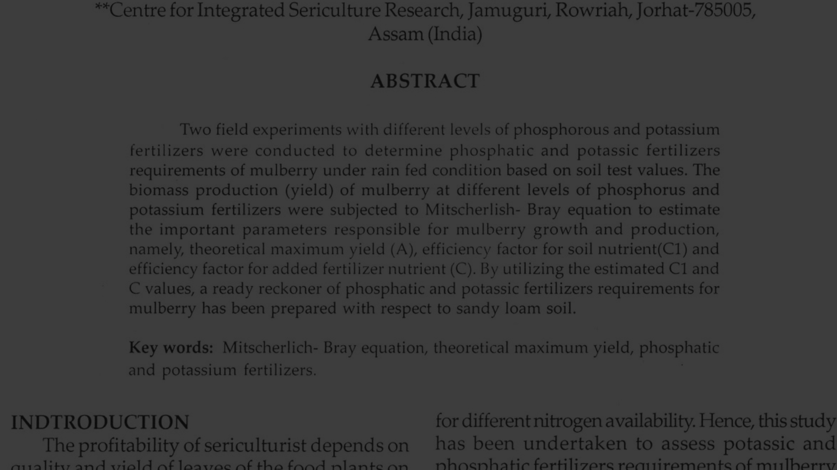
References
1
Deepak, S. S. K. (2012), A Geometric Programming Model for Production Rate Optimization of Turning Process with Experimental Validation.
2
Deepak Pal et. al. (2013), Optimization of Turning Process Parameters for Their Effect on En 8 steel Material Work piece Hardness by Using Taguchi Parametric Optimization Method.
3
M. N. Islam (2011), An investigation of surface finish in dry turning, Proceedings of the World Congress on Engineering, Vol I, WCE, July 6 - 8, London, U.K.
4
Cus F and Balic J (2000), Selection of Cutting Conditions and Tool Flow in Flexible Manufacturing System, the International Journal for Manufacturing Science and Technology, Vol. 2, pp. 101-106.
5
S. Xie, Y. Guo , et. al.(2011), Intelligent Selection of Machining Parameters in Multi-pass Turnings Using a GA-based Approach, journal of computational information system, vol. 7:5, pp. 1714-1721.

