Slide 1
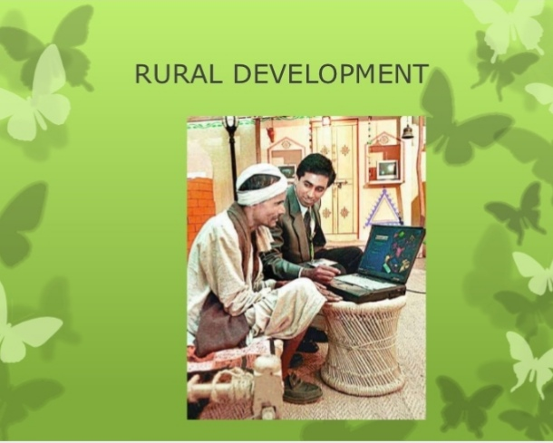
PRESENTED BY VEENA N
RESEARCH SCHOLAR IN ECONOMICS
SUNRISE UNIVERSITY,RAJASTHAN

Slide 2


Slide 3
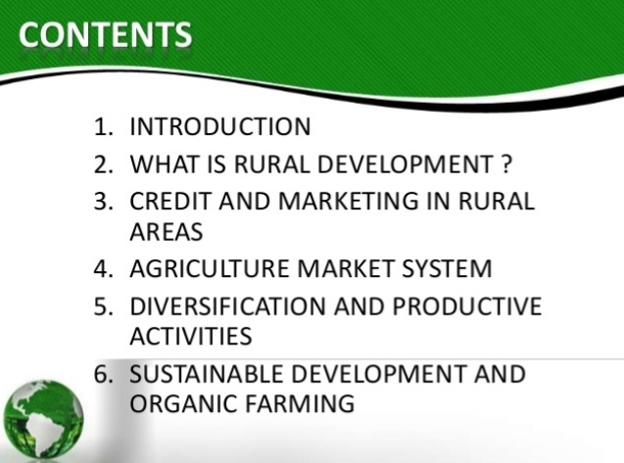

Slide 4
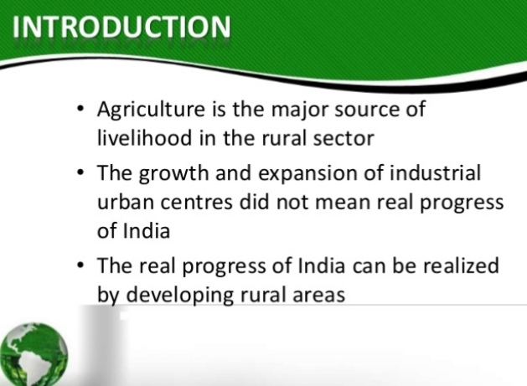

Slide 5
RURAL DEVELOPMENT
Refers to the overall development of the village economy.
It is the process of improving the quality of life and economic well-being of people living in rural areas.
This requires concerted efforts from the authorities at all levels
Central
State
Local

Slide 6
COMMUNITY DEVELOPMENT PROGRAMME
Rural Development focus on programmes of people/s participation in development efforts.
COMMUNITY DEVELOPMENT PROGRAMME
1952
DEPARTMENT OF RURAL DEVELOPMENT
OCTOBER 1974
As part of Ministry of Food and Agriculture later upgraded to Ministry of Rural Development-1991

Slide 7
CHALLENGES OF RURAL
DEVELOPMENT
Land reforms
Pucca school buildings
Health facilities
Road networks
Electricity
Sanitation facility
Irrigation facility
Institutional credit
Local productive resources

Slide 8
CHALLENGES
Agricultural research ,Extension , Information Dissemination
Employment opportunity
Food safety

Slide 9
CHALLENGES OF RURAL DEVELOPMENT
Land reforms to ensure land is taken from absentee landlords and handed over to actual tillers of the soil and landless labour households.
Providing a network of pucca school buildings complete with all infrastructure at elementary ,primary and secondary levels with special focus on education of girls and underprivileged sections of the society.

Slide 10
CHALLENGES
3 . Providing a network of health facilities to
address the issues of public health.
4. Improving road network in all villages
and providing feeder roads to nearby
highways.
5. Providing electricity to all rural household
across all villages

Slide 11
CHALLENGES
6. Improving sanitation facilities.
7. Expanding irrigational facilities to bring
more land under cultivation.
8. Providing more institutional credit –
small, marginal farmers and weaker
sections.
9.Development of the local productive
resources of rural communities.

Slide 12
CHALLENGES
10.Agricultural research and extension and
information dissemination.
11.Providing more employment
opportunities in rural areas.
12.Ensuring food safety –proper food
distribution network which can ensure
adequate and timely supply of food grains
at cheaper prices.

Slide 13
RURAL CREDIT
ON THE BASIS OF TIME
ON THE BASIS OF PURPOSE

Slide 14
ON THE BASIS OF TIME
SHORT TERM
MEDIUM TERM
LONG TERM

Slide 15
SHORT TERM LOANS
Purchase of seeds,fertilisers,pesticides
Feeds & fodder of livestock
Marketing of agri produce
Payment of wages
Litigation
Consumption purpose
Un productive purpose.
Period-15 months

Slide 16
SHORT TERM LOANS
SOURCES
MONEY LENDERS
COOPERATIVE SOCIETIES

Slide 17
MEDIUM TERM LOANS
PURCHASE OF CATTLE
SMALL AGRICULTURAL IMPLEMENTS
REPAIR AND CONSTRUCTION OF WELL

Slide 18
MEDIUM TERM LOANS
PERIOD
15 MONTHS TO 5 YEARS
MONEY LENDERS
RELATIVES
COOPERATIVE SOCIETIES
COMMERCILAL BANKS

Slide 19
LONG TERM LOANS
PERMANENT IMPROVEMENTS ON LAND
DIGGING TUBEWELLS
PURCHASE OF LARGER IMPLEMENTS AND MACHINERY

Slide 20
LONG TERM LOANS
PERIOD-BEYOND 5 YEARS
  SOURCE
PCARDBs
  PRIMARY COOPERATIVE AGRICULTURAL AND RURAL DEVELOPMENT BANKS.

Slide 21
ON THE BASIS OF
PURPOSE
PRODUCTIVE NEED
UNPRODUCTIVE NEED
CONSUMPTION NEED

Slide 22
PRODUCTIVE NEED
Purchase of seeds,fertilisers,manures
Agriculture
Implements
,livestockk,
Digging of wells
Payment of wages
Permanent improvement on land
Marketing

Slide 23
SOURCES OF RURAL CREDIT
NON-INSTITUTIONAL
INSTITUTIONAL
MONEY LENDERS
RELATIVES
TRADERS
COMMISSION AGENTS
LANDLORDS
COOPERATIVE CREDIT SOCIETIES
SCHEDULED COMMERCIAL BANKS
REGIONAL RURAL BANKS
NABARD

Slide 24
NON INSTITUTIONAL SOURCES
EXPLOITATION
Exorbitant rate of interest charged by the moneylenders.
Manipulation of accounts
Forcing to sell the agricultural produce to them at low prices
Seizure of land

Slide 25
INSTITUTIONAL SOURCES
Ist institution established and promoted-COOPERATIVE CREDIT SOCIETIES
1904
Even in 1951,it provided only 3.1 %
1969-Nationalisation of 14 banks
1980-Nationalisation of 6 banks---reduced the grip of money lenders

Slide 26
INSTITUTIONAL SOURCES
1975
RRB
1976
MULTI AGENCY APPROACH
1982
NABARD

Slide 27
COOPERATIVE CREDIT SOCIETIES
SHORT TERM
93,770
LONG TERM
614
PRIMARY AGRICULTURAL CREDIT SOCIETIES
(93,367)
STATE COOPERATIVE BANKS
(33)
SCARBs(13)
DISTRICT CENTRAL COOPERATIVE BANKS(370)
PCARDs(601)

Slide 28
CRITICAL REVIEW
PACSs have failed on large scale mobilisation of resources locally.
High level of NPAs
High loss
Most of them are too small in size to be economical and viable.
Large landowners have concerned greater benefits from cooperatives while the demands of small farmers and rural landless have been largely ignored.
Too little participation of members but excessive government control.

Slide 29
COMMERCIAL BANKS
CAUSES FOR LIMITED PARTICIPATION
The subsistence nature of agriculture and its unorganised ,individualistic functioning.
The heavy dependence of agriculture on monsoons which made it a risky venture.
The more organised nature of industry.

Slide 30
AFTER NATIONALISATION OF BANKS- 1969
Participation of commercial banks in rural credit increased.
Enabled the farmers to
Purchase agricultural inputs
Adopt new agricultural technology
Expand activities in the non –farm areas
Accelerate the pace of private agricultural investment.
Banks share in total agricultural credit is 75%,ieas high as Rs.877200 crore out of Rs.11,68,500

Slide 31
CRITICAL REVIEW
Quality of scheme preparation and lending has deteriorated due to rapid expansion and diversification of credit.
Increased the cost of operations of banking.
Lack of adequate staff in rural banking
The profitability has been affected adversely .
The recovery position of the banks is very poor.

Slide 32
REGIONAL RURAL BANKS
Set up in 1975
To meet the credit needs –weaker sections-small and marginalised farmers, landless labourers,artisans and other rural residents of small means.
MULTI-AGENCY CONTROL OF RRBs
Each RRB is sponsored by a commercial bank.
The Central and State Government –contribute to its capital.
RRBs accounted 12.1% of institutional credit.

Slide 33
LOSSES SUFFERED BY RRBs
Interest earned on loans is the lowest in the banking system.
Low margins along with high cost of servicing a large number of small accounts.
RRBs not in a position to compensate losses on low-interest loans.
Opening of branches year after year added to the overhead costs.
Non-availability of competent and trained staff posed serious problems.

Slide 34
NABARD
July 1982
Took over from the RBI all the functions in the field of rural credit.
Apex institution in the field of rural credit.

Slide 35
MICROCREDIT AND SHGs
MFIs provide loans of up to Rs.25,000
To the poor people
Without collateral
For self-employment projects.
It can be traced to SHGs-Bank linkage programme.
Started the pilot project in 1992 by NABARD.
Covered 10 crore families-at end-March 2017 through 86 lakh SHGs with saving deposits of Rs.16,114 crore
85% SHGs run by women.

Slide 36
AGRICULTURAL MARKETING
covers the various services involved in
moving an agricultural products from the
farm to the consumer.

Slide 37
AGRICULTURAL MARKETING
1.Gathering the produce after harvesting
2.Processing
3.Grading
4.Packaging &Storing
5.Transporting
6.Selling

Slide 38
DEFECTS
A considerate part sold to village traders and moneylenders at vey low prices.
Lack of proper warehousing facilities.
No provision for proper grading of agricultural produce.
Inadequate transportation facilities.
No knowledge regarding the prices prevailing in Mandis

Slide 39
DEFECTS
Arhatiyas and Brokers took advantage of the ignorance and illiteracy of the farmers,used unfair measures to cheat them.The farmers were required to pay
Arhat—Arhatiyas
Tulaii---- weighing
Palleri---- unload
Garda---- impurities
Wrong weigh and measures used in mandis to cheat farmers.

Slide 40
GOVERNMENT STEPS TO IMPROVE AGRICULTURAL MARKETING SYSTEM
ORGANISATION OF REGULATED MARKETS. Managed by Market Committees ----nominees from the State government, local bodies,Arhatiyas,Brokers and Farmers
Functions
Fixation of charges for weighing, brokerage etc
Prevention of unauthorised deductions, underhand dealing and wrong practices by Arhatiyas

Slide 41
REGULATED MARKETS
3.Enforcing the use of standardised weights.
4.Providing up to date and reliable market information to the farmers.
5.Settling of disputes among the parties arising out of market operations.

Slide 42
GOVERNMENT STEPS TO IMPROVE AGRICULTURAL MARKETING SYSTEM
GRADING AND STANDARDISATION
Central Quality Control Laboratory at Nagpur
Regional subsidiary quality control laboratories
On the basis of the analysis of the physical and chemical properties of the samples, grades are drawn up and authorised packers are issued AGMARK seals.

Slide 43
GOVERNMENT STEPS
GODOWN AND STORAGE FACILITIES
1. Central Warehousing Corporation
– 1957
2.State warehousing corporations
3.Food Corporation of India – 1965
4.Scheme of rural godowns –6th Plan—to provide storage facility at village level.

Slide 44
GOVERNMENT STEPS
PROVIDING MARKET INFORMATION
Daly broadcasts of agricultural prices in national media.
Agricultural prices published by newspapers

Slide 45
GOVERNMENT STEPS
DIRECTORATE OF MARKETING AND
INFORMATION
To coordinate the agricultural marketing activities.
Advise the Central and State governments on the problem of agricultural marketing
Notifies grade standards for agricultural commodities

Slide 46
DIRECTORATE OF MARKETING AND INSPECTION
Enforces compulsory quality control before export.
Extends financial help to regulated market
Helps in development of infrastructural facilities.

Slide 47
GOVERNMENT STEPS
GOVERNMENT PURCHASE AND FIXATION OF SUPPORT PRICES
Minimum Support Price ----- recommendation of Commission of Agricultural Costs and Prices
FCI buys the commodities
FCI builds buffer stocks
Sold through PDS

Slide 48
GOVERNMENT STEPS
NATIONAL AGRICULTURAL MARKET AND GRAMIN AGRICULTURAL MARKETS
Launched National Agricultural Market (e-NAM)-April 14,2016
Brought 585 Mandis under e-NAM>
Upgraded 22,000 rural haats into Gramin Agricultural Markets (Grams)

Slide 49
GOVERNMENT STEPS TO IMPROVE AGRICULTURAL MARKETING
Organisation of regulated markets
Grading and Standardisation.
Godown and Storage facilities.
Providing market information.
Government purchases and fixation of support price
(e-NAM) and (GrAMs)

Slide 50
COOPERATING MARKETING
Small and marginal farmers forming cooperating society and sell the produce through the society.
ADVANTAGES
1.Increases bargaining power of farmers .Expect more prices.
2.Deal directly with final buyers.
3.Provide credit to farmers to save them from the need of selling their produce immediately---ensures better returns

Slide 51
COOPERATIVE MARKETING
4 Bulk transport—easier and cheaper.
5.Provide storage facility
6.Arrange to obtain data on prices, demand and supply position---plan their activities

Slide 52
COOPERATING MARKETING IN INDIA
Initiated –2nd Five Year Plan
Extended-3rd Five Year Plan
Cooperating Making Structure built at various levels

Slide 53
COOPERATING MARKETING -INDIA
GENERAL PURPOSE PRIMARY COOPERATIVE MARKETING SOCIETIES
SPECIALISED PRIMARY MARKETING SOCIETIES
DISTRICT/CENTRAL FEDERATIONS
NATIONAL AGRICUTURAL COOPERATIVE MARKETING FEDERATION OF INDIA
NAFED

Slide 54
ALTERNATE MARKETING CHANNELS
APNI MANDI(Punjab ,Rajasthan & Haryana)
HADASPUR MANDI (Pune)
RYTHU BAZAR( Andhra Pradesh, Telegana)
UZHAVAR SANDIES(Tamil Nadu)

Slide 55


Slide 56
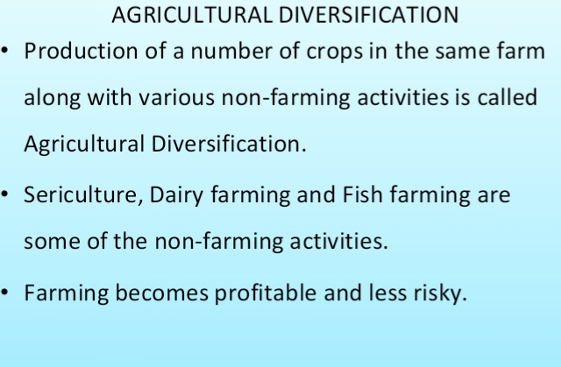

Slide 57
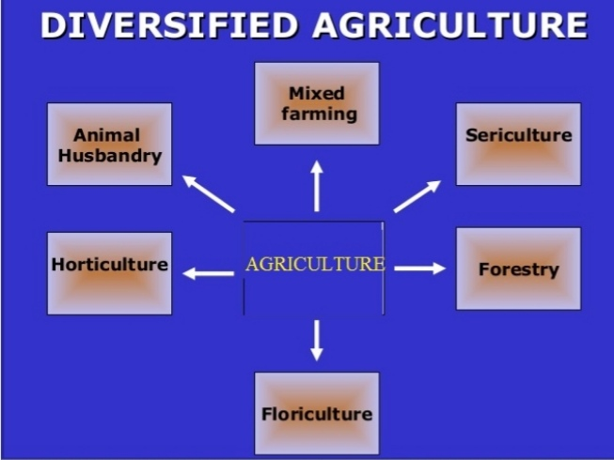

Slide 58
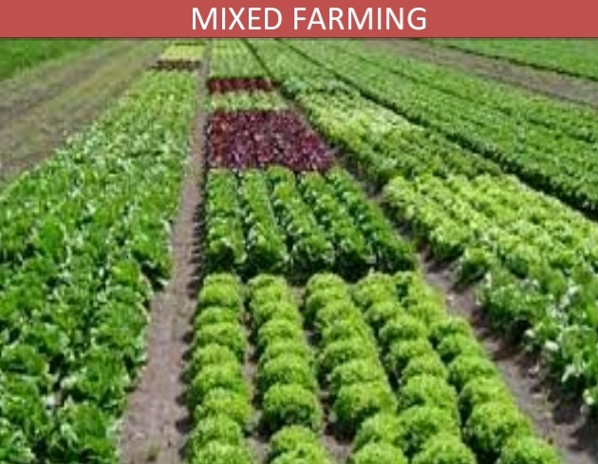

Slide 59
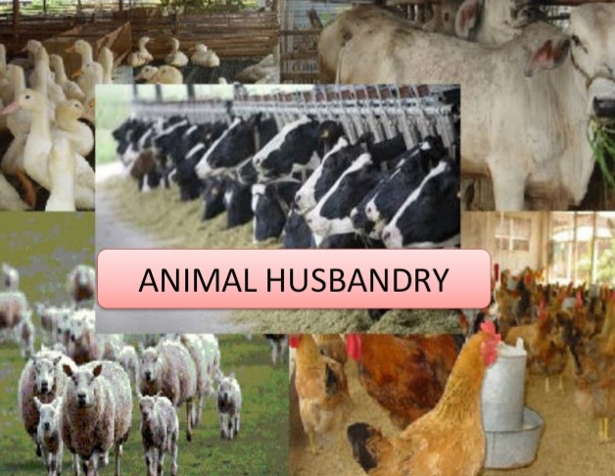

Slide 60
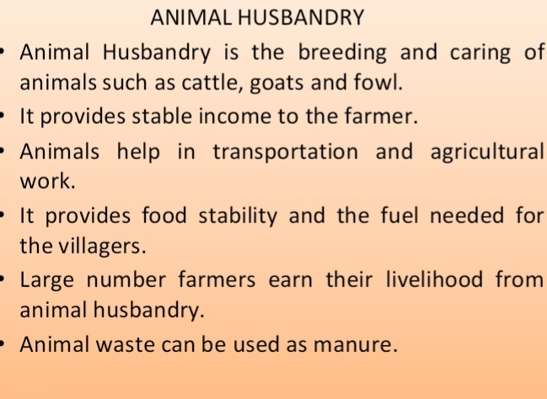

Slide 61


Slide 62


Slide 63
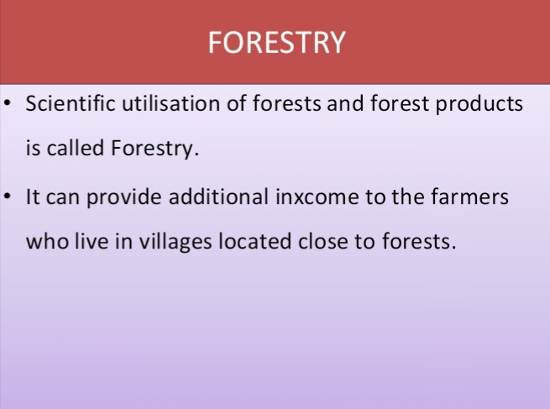

Slide 64


Slide 65
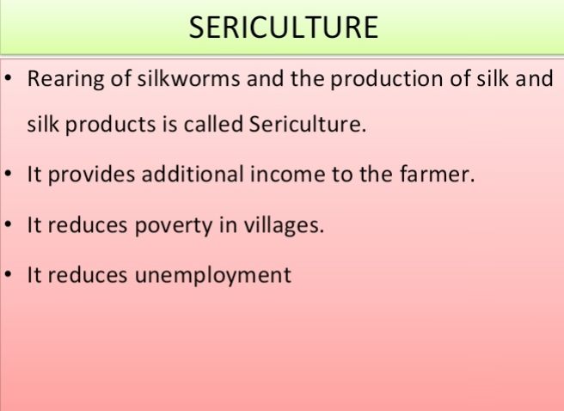

Slide 66


Slide 67
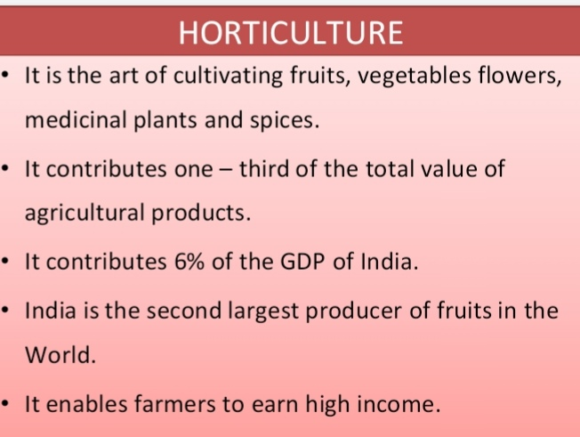

Slide 68


Slide 69


Slide 70


Slide 71
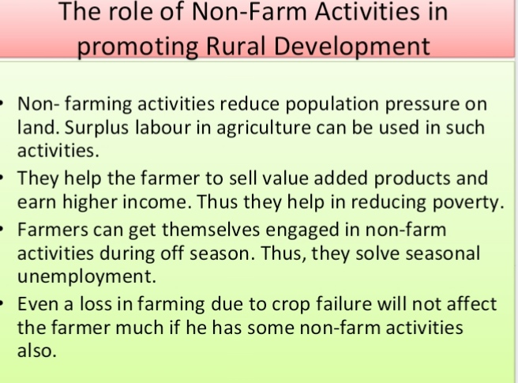

Slide 72
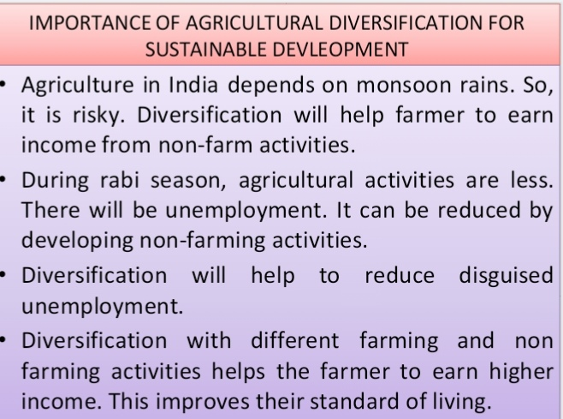

Slide 73
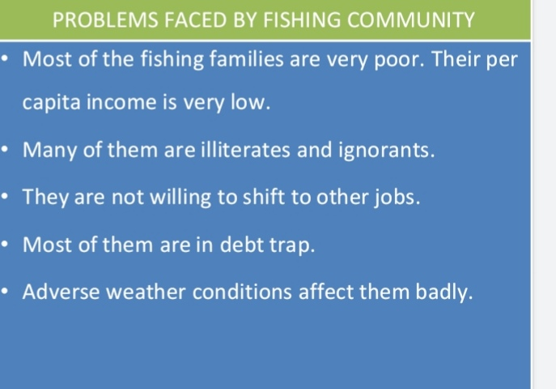

Slide 74


Slide 75


Slide 76


