Slide 1

Credit card fraud detection using ml with analysis of algorithms
Presented By
Shiv Kumar, Payal Kumari, Mamta
RTCIT, Ranchi

Slide 2
Introduction
Credit card usage has increased a lot with recent development in digital technology.
Increase in credit card fraud is also happening at fast pace.
Skimming, Hacking and Phishing are common types of threats in credit card field.
There are few common machine learning algorithms employed for detection of fraudulent transaction by Banks and organizations.

Slide 3
Literature Review
In [1], researchers did an empirical evaluation on a number of standard models which include NB, SVM, and DL.
In [2], researchers evaluated algorithms such as decision tree, Random forest, logistic regression and naive bayes classification.
In [3], researchers implemented a web based application using machine learning algorithms such as Logistic Regression, Random Forest, and AdaBoost.
In [4], researchers proposed a model where two algorithms are used viz Fraud Detection in credit card using Decision Tree and Fraud Detection using Random Forest.
In [5], Donglin Li proposed combination of XGBoost model and Lasso-Logistic model. With this calculation, speed become faster and important variables can also be selected.
In [6], researchers used random forest, support vector machine, & decision tree algorithms in the proposed method to identify the credit card frauds.

Slide 4
Literature Review
In [7], researches used an imbalanced dataset and evaluated different supervised machine learning models to find fraudulent transaction.
In [8], researchers proposed a system based on whale algorithm optimized BP neural Network. The aim is to solve the problems of slow convergence rate, easy to fall into local optimum, network defects and poor system.
In [9], researchers analysis three machine learning algorithm, viz. Navie Bayes, SVM and DNN to find fraudulent credit card transactions.
In [10], researchers proposed an algorithm named as BLAH for credit card fraud detection.
In [11], researchers combined the Lasso-Logistic model and the XGBoost model. By this calculation speed is increased.

Slide 5
PROBLEM STATEMENT
With increase use of credit card, we need a secured system which can prevent fraudulent transactions.
There are few Machine learning algorithms available which are useful in finding fraudulent txns.
It is important to find out accuracy of algorithms based on different factors and attributes.
OBJECTIVE
Evaluating following algorithms with large dataset. Algorithm names - Decision Tree (DT), Logistic Regression (LR) and Random Forest(RF).
Study and use parameters such as Accuracy, Precision, MCC and Recall score for evaluation.

Slide 6
PROPOSED SYSTEM
We are using data set received from European cardholder[12],from Kaggle website.
Data set is divided in 2 set, viz. Data for validation and Data for training
Training data (80% of total data) is fed to the application for training purpose.
Any one ML algorithm is enabled at one time.
Testing data is passed to application, application will verify and conclude if any transaction is in fraudulent category or in normal category.

Slide 7
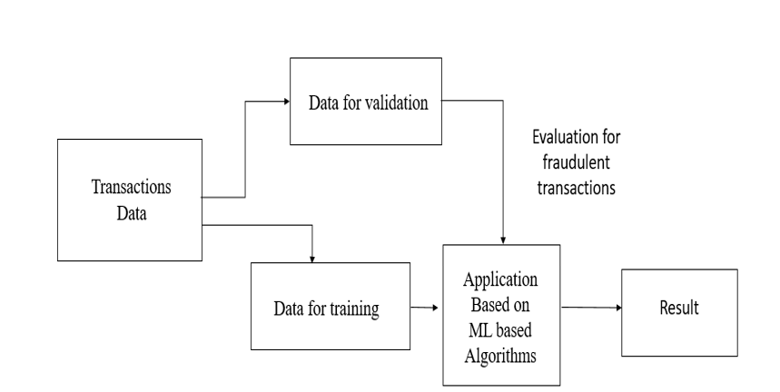
PROPOSED SYSTEM
Fig 1 Workflow of Credit Card Fraud Detection System

Slide 8
LOGISTIC REGRESSION
Logistic Regression is a supervised learning technique.
In this result will be either ‘fraud’ or ‘non-fraud’ if a transaction occurs.
There will be given set of parameters, on the basis of those probability of fraud and non-fraud transaction is calculated.

Slide 9
Identity
Amount
Input Data
0.9
Location
Output
Frequency

Slide 10
DECISION TREE
Decision Tree is a supervised learning technique. it is preferred for solving Classification problems.
It is a tree-structured classifier.
Internal nodes represent the features of a dataset.
Branches represent the decision rules and each leaf node represents the outcome.

Slide 11
Amount > Rs.100000
Yes
No
Location = IP address of customer
No. of locations at the same time > 1
Yes
No
Yes
No
25%
25%
75%
75%

Slide 12
RANDOM FOREST
Random Forest uses a combination of decision trees to improve the results.
Each decision tree checks for different conditions.
Decision trees are trained on random datasets.
All the sub-trees will give the probabilities for a transaction to be ‘fraud’ and ‘non-fraud.’ Based on the combined result, the model will mark the transaction as ‘fraud’ or ‘genuine.’

Slide 13
All Data
Credit/Debit Number
Location
Date and Time
IP Address
Amount

Slide 14
IMPLEMENTATION
Our application is based on Python.
System configuration
Table 1 Prerequisites tools and software
Sr.No. | Tool/Software | Version
1 | Python | 3.x
2 | Matplotlib | 3.3.4
3 | Jupiter | 4.4.0

Slide 15
Table 5.2 H/W Requirement
Sr. No. | Tool/Software
1 | RAM - 16GB
2 | Processor - Intel(R) Core(TM) i7-8550U CPU @ 1.80GHz 1.99 GHz
3 | Windows 11 Pro

Slide 16
MODELS USED
Numpy is a python library. It is used while working with arrays. It is useful for quick array based operations.
Pandas is used for working with relational data. It provide support in analyzing and manipulating data.[16]
Matplotlib is a plotting library. its numerical mathematics extension Numpy. It provides an object-oriented API for embedding plots into applications.[17]

Slide 17
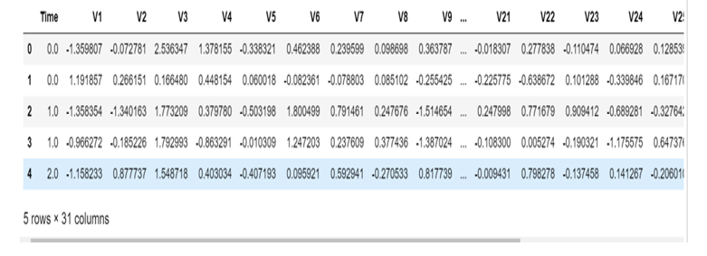
Fig. 2. Fraud transaction data

Slide 18
In the figure 2, few transactions are shown.
We have 28 properties, which are V1, V2…V28. Here, “Time”, “Amount” and “Class” are 3 extra properties.
We have total 31 properties.
All properties are having some value for every transaction.
Once application is trained, then we can verify system correctness and performance by passing test dataset to application.
We will get either 0 or 1 for column “Class”. Here 0 is for valid transaction and 1 is for fraudulent transaction.

Slide 19
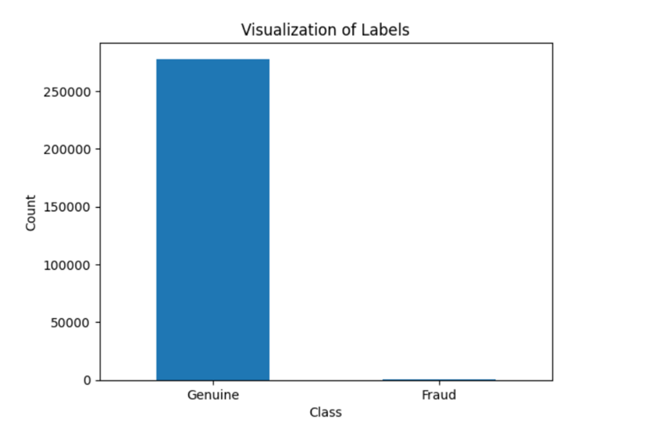
RESULT AND DISCUSSION
As shown in Fig.3, we have total 2,84807 transaction. In that, 492 are fraudulent transaction.
Fig.3. Fraud and Genuine Transactions

Slide 20
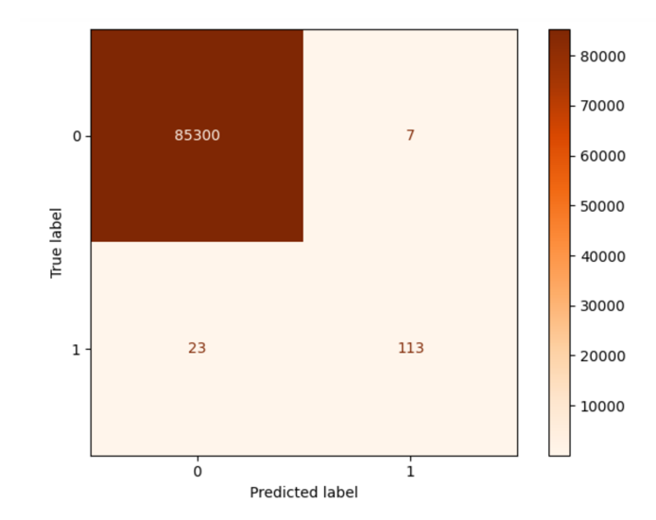
With application deployed with Random forest algorithm, we found Precision Score of 0.94167, F1 Score of 0.88281, Accuracy Score of 0.99965 and Recall Score of 0.83088.
Fig. 3 shows matrix plot of Random forest algorithm.
Fig.3. Random Forest algorithm Matrix

Slide 21
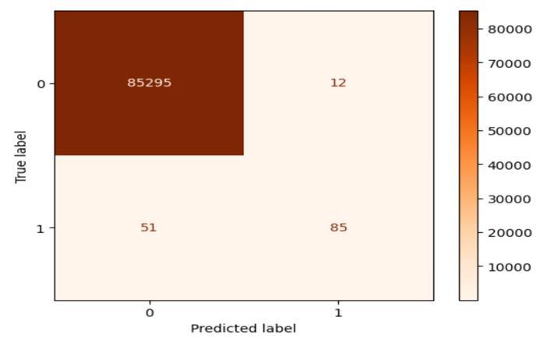
With application deployed with Logistic Regression (LR) algorithm, we found Precision Score of 0.87629, F1 Score of 0.72961, Accuracy Score of 0.99926 and Recall Score of 0.62500.
Fig. 4 shows matrix plot of Logistic Regression (LR) algorithm.
Fig. 4 Logistic Regression (LR) algorithm Matrix

Slide 22
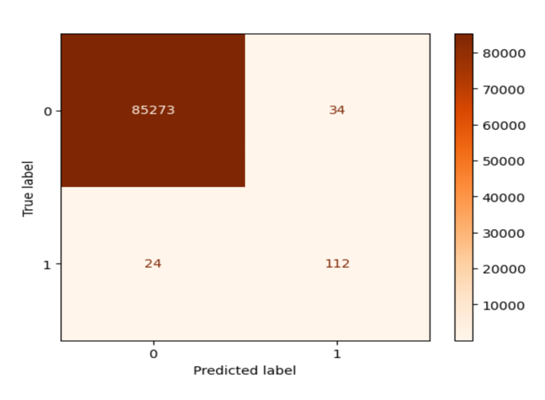
With application deployed with Decision Tree algorithm, we found Precision Score of 0.76712, F1 Score of 0.79433, Accuracy Score of 0.99932 and Recall Score of 0.82353.
Fig. 5 shows matrix plot of Decision Tree algorithm.
Fig. 5 Decision Tree algorithm algorithm Matrix

Slide 23
Below Table 2 shows the comparison of algorithms based on different parameters.
Table 2 Algorithm comparison on basis of four scores,
viz. Precision, MCC,Accuracy and Recall
 |  | Algorithms used
 |  | Random Forest | Logistic Regression (LR) | Decision Tree
Score | Precision Score | 0.94167 | 0.87629 | 0.76712
 | MCC Score | 0.88281 | 0.72961 | 0.79433
 | Accuracy Score | 0.99965 | 0.99926 | 0.99932
 | Recall Score | 0.83088 | 0.62500 | 0.82353

Slide 24
CONCLUSION AND FUTURE SCOPE
We found that Random Forest algorithm is best amongst all algorithms used.
It has better Accuracy, Precision, MCC and Recall score.
We can work towards creating more interactive web application.

Slide 25
References
[1] K. Randhawa, C. K. Loo, M. Seera, C. P. Lim and A. K. Nandi, "Credit Card Fraud Detection Using AdaBoost and Majority Voting," in IEEE Access, vol. 6, pp. 14277-14284, 2018, doi: 10.1109/ACCESS.2018.2806420.
[2] D. Tanouz, R. R. Subramanian, D. Eswar, G. V. P. Reddy, A. R. Kumar and C. V. N. M. Praneeth, "Credit Card Fraud Detection Using Machine Learning," 2021 5th International Conference on Intelligent Computing and Control Systems (ICICCS), 2021, pp. 967-972, doi: 10.1109/ICICCS51141.2021.9432308.
[3] V. Jain, H. Kavitha and S. Mohana Kumar, "Credit Card Fraud Detection Web Application using Streamlit and Machine Learning," 2022 IEEE International Conference on Data Science and Information System (ICDSIS), 2022, pp. 1-5, doi: 10.1109/ICDSIS55133.2022.9915901.
[4] M. R. Dileep, A. V. Navaneeth and M. Abhishek, "A Novel Approach for Credit Card Fraud Detection using Decision Tree and Random Forest Algorithms," 2021 Third International Conference on Intelligent Communication Technologies and Virtual Mobile Networks (ICICV), 2021, pp. 1025-1028, doi: 10.1109/ICICV50876.2021.9388431.
[5] D. Li, "Credit card fraud identification based on unbalanced data set based on fusion model," 2019 IEEE 1st International Conference on Civil Aviation Safety and Information Technology (ICCASIT), 2019, pp. 235-239, doi: 10.1109/ICCASIT48058.2019.8973167.
[6] S. K. Saddam Hussain, E. Sai Charan Reddy, K. G. Akshay and T. Akanksha, "Fraud Detection in Credit Card Transactions Using SVM and Random Forest Algorithms," 2021 Fifth International Conference on I-SMAC (IoT in Social, Mobile, Analytics and Cloud) (I-SMAC), 2021, pp. 1013-1017, doi: 10.1109/I-SMAC52330.2021.9640631.

Slide 26
[7] S. Khatri, A. Arora and A. P. Agrawal, "Supervised Machine Learning Algorithms for Credit Card Fraud Detection: A Comparison," 2020 10th International Conference on Cloud Computing, Data Science & Engineering (Confluence), 2020, pp. 680-683, doi: 10.1109/Confluence47617.2020.9057851.
[8] C. Wang, Y. Wang, Z. Ye, L. Yan, W. Cai and S. Pan, "Credit Card Fraud Detection Based on Whale Algorithm Optimized BP Neural Network," 2018 13th International Conference on Computer Science & Education (ICCSE), 2018, pp. 1-4, doi: 10.1109/ICCSE.2018.8468855.
[9] C. H. Sumanth, P. P. Kalyan, B. Ravi and S. Balasubramani., "Analysis of Credit Card Fraud Detection using Machine Learning Techniques," 2022 7th International Conference on Communication and Electronics Systems (ICCES), 2022, pp. 1140-1144, doi: 10.1109/ICCES54183.2022.9835751.
[10] A. Kundu, S. Panigrahi, S. Sural and A. K. Majumdar, "BLAST-SSAHA Hybridization for Credit Card Fraud Detection," in IEEE Transactions on Dependable and Secure Computing, vol. 6, no. 4, pp. 309-315, Oct.-Dec. 2009, doi: 10.1109/TDSC.2009.11.
[11] D. Li, "Credit card fraud identification based on unbalanced data set based on fusion model," 2019 IEEE 1st International Conference on Civil Aviation Safety and Information Technology (ICCASIT), 2019, pp. 235-239, doi: 10.1109/ICCASIT48058.2019.8973167.

Slide 27
[12]What is a credit card? (2003, November 19). Investopedia. https://www.investopedia.com/terms/c/creditcard.asp
[13]Credit card fraud. (2022, September 22). Wikipedia, the free encyclopedia. Retrieved May 11, 2023, from https://en.wikipedia.org/wiki/Credit_card_fraud
[14] Fraud detection algorithms | Fraud detection using machine learning. (2023, March 2). Intellipaat Blog. https://intellipaat.com/blog/fraud-detection-machine-learning-algorithms/
[15] Credit Card Fraud Detection Accessed: Jan. 20, 2022.
[Online].Available:https://www.kaggle.com/mlgulb/creditcardfrad.
[16] Wikipedia. (n.d.). pandas (software). https://en.wikipedia.org/wiki/Main_Page. Retrieved February 28, 2023, from https://en.wikipedia.org/wiki/Pandas_(software)
[17]Wikipedia.(n.d.). Matplotlib. https://en.wikipedia.org/wiki/Main_Page. Retrieved February 28, 2023, from https://en.wikipedia.org/wiki/Matplotlib

Slide 28
LIST OF PUBLICATION
Paper | Title | Author List | Conference/Journal
Paper1 | A relative analysis of Machine Learning algorithms in Credit card fraud detection | Mamta Mantri Mr. B.L.Pal, Mr. Shiv Kumar | National Conference on “EMERGING TRENDS IN SCIENCE, TECHNOLOGY & MANAGEMENT''(NCETSTM – 2K23)"

Slide 29
Thankyou
Q&A.

