Slide 1

MACHINE LEARNING TECHNIQUE FOR SOCIAL MEDIA FAKE PROFILE DETECTION
Abhimanyu Nayak (abhin.rs.cse19@bitsindri.ac.in)
PhD Scholar B.I.T Sindri Dhanbad-828123
GUIDE-Prof.(Dr) D.K.Singh(dksingh.bits@gmail.com)

Slide 2
INTRODUCTION
Social media has revolutionized global communication, enabling unparalleled connectivity and information exchange. Facebook, Twitter, and Instagram influence public conversation and social dynamics in personal, professional, and political domains. Despite these benefits, social media has also brought new issues, particularly false profiles. Misinformation, fraud, public opinion manipulation, and cyber harassment are common uses of these fake accounts.
Fake profiles damage social media trust, making their discovery and eradication essential. Manual verification and heuristic-based approaches to detecting false profiles cannot keep up with the expanding scope and sophistication of these fraudulent operations.
Machine learning, a branch of AI, can find complicated patterns and anomalies in vast datasets. This permits programmed discovery of small signs that recognize counterfeit profiles from genuine ones. Choice trees, support vector machines, and brain organizations can be prepared on named datasets with phony and genuine profiles.
Fake profiles include irregular posting patterns, unusual user interactions, and suspect network connections, which these models learn to identify. However, unsupervised learning can reveal hidden patterns in unlabeled data, revealing phone pay accounts' structural and behavioral irregularities.

Slide 3
This research investigates machine learning methods for social media false profile detection. Using supervised and unsupervised learning models, we test various techniques for detecting bogus accounts. This approach relies on feature extraction to identify crucial traits that indicate fraudulent profiles.
These variables may include post frequency and timeliness, user-generated content sentiment analysis, network structure, and user interactions. The suggested system seeks to detect and respond in real time and be robust and scalable.

Slide 4
REVIEW OF LITERATURE
Ahmad et al. (2020) investigated machine learning ensemble approaches for fake news identification. Their research emphasizes the need of integrating algorithms to increase detection system accuracy and robustness. Ensemble learning uses decision trees, support vector machines, and neural networks to combine their strengths and mitigate their faults. This thorough strategy improves the system's ability to recognize bogus news, improving precision and recall.
Aslam et al. (2021) introduced "Fake Detect," a deep learning ensemble model for fake news identification. Their model uses CNNs and RNNs to capture news content's geographical and temporal properties. The ensemble model uses CNNs' hierarchical structure to extract high-level textual features and RNNs' sequential nature to grasp context and flow. This dual strategy helps the model recognize bogus news better than typical machine learning.
Balaji et al. (2021) reviewed social media analysis machine learning algorithms, covering their methods and uses. They explore supervised, unsupervised, and reinforcement learning techniques for sentiment analysis, trend prediction, and anomaly detection. Machine learning can analyze social media data and address issues like phoney profiles and fake news, according to the report.

Slide 5
OBJECTIVES
To Develop a machine learning model using LSTM, XG Lift, Random Backwoods, and Neural Organizations to recognize false Twitter accounts through devotee/companion numbers and status updates.
To Identify key elements of authentic social media profiles, including interaction patterns and follower metrics.
To Optimize machine learning algorithm architecture and hyperparameters for enhanced detection accuracy.
To Train the model on actual and false profiles, evaluate its performance, and find XG Boost the most effective strategy for detecting phone pay profiles.

Slide 6
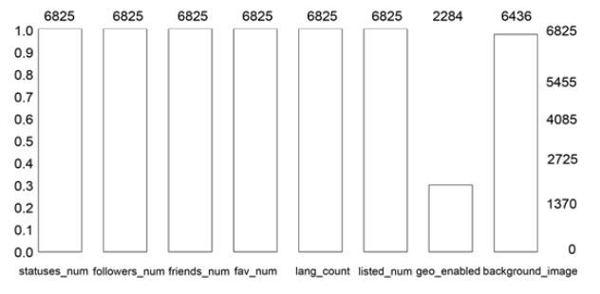
METHEDOLOGY
In this model, XG Boost, a random forest and profile-focused multi-layered neural network features were applied. CSV files with extracted characteristics are simply read by the model.
Model training, testing, and analysis conclude whether a profile is real. Because Google Colab offers free GPU access, researchers picked it to develop models. The 12-GB Google Colab NVIDIA Tesla K80 GPU runs for 12 hours.
Dataset Collection
Author utilized MIB dataset. The data collection had 3474 real and 3351 fake profiles. For legitimate accounts, the dataset utilised E13 and TFP, while for fraudulent ones, it utilised TWT, INT, and FSF. For machine extraction, CSV files are utilised. Figure 2's indicator x-axis for false profile recognition qualities.
Figure 1: Dataset

Slide 7
Model Development
The adjacency matrix of the social network graph was first computed. Next, depending on their network friends, nodes (members of social networks) were compared to see how similar they were. Then, for every metric—common friends, Jaccard, cosine, and any other pertinent measurements—similarity matrices were made. The similarity of the nodes was displayed by several matrices.
Proposed Methodology
Each model may detect a bogus profile using visible features. Each supervised model's accuracy and loss graphs use the same data. Several model accuracy comparison graphs are also shown.

Slide 8
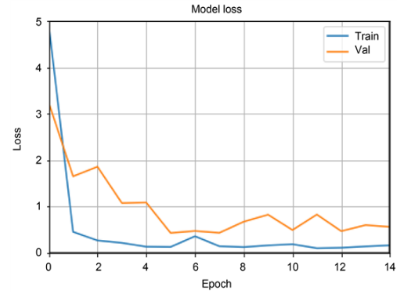
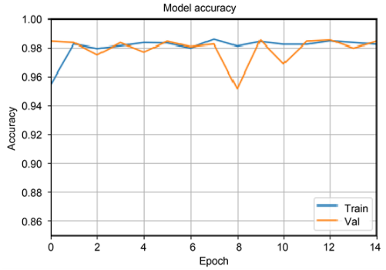
EXPERIMENTAL RESULTS AND DISCUSSION
We present model accuracy comparisons, misfortune against eras graphs, stochastic woodland, XG help, and other ROC bends, as well as model comparisons for the LSTM neural organization.
Neural Network
The trained neural network's accuracy and loss graphs are shown in both Figures 2 and 3
Figure 2: Model precision.
Figure 3: Model loss.

Slide 9
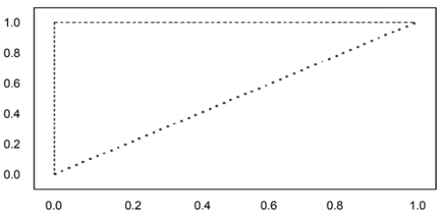
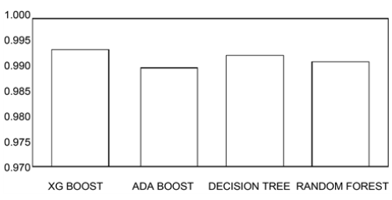
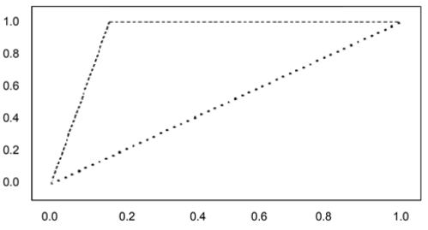
Random Forest and Other Approaches
The accuracy of decision trees, boost, random forests, and ada boosts are contrasted in Figure 4. The highest precision is produced with XG boost (0.996). Random forests and decision trees both have 0.99 accuracy. At last, the writer secures assistance from the ADA. Figure 4 shows the accuracy comparison, while Figures 5 and 6 provide the ROC curve graphics.
Figure 5: XG boost ROC curve.
Figure 4: Accuracy of different models.
Figure 6: ROC curve for a random forest.

Slide 10
CONCLUSION
Using techniques including LSTM, XG Boost, Random Forest, and Neural Networks, this study created a strong machine learning model to identify phoney Twitter profiles, tackling the serious problem of phoney profiles that disseminate false information and influence public opinion.
Finding essential components of genuine profiles, enhancing algorithm performance, and testing the models on a sizable dataset of real and fictitious profiles were among the main goals.
The approach comprised profile-specific features and supervised learning techniques. SMOTE was used to preprocess and balance the data, and Google Colab's free GPU was used to train the models.
XG Boost fared better than other models in identifying phoney profiles, attaining the highest recall and precision rates.
This demonstrates the superiority of XG Boost in detecting fake profiles and the usefulness of ensemble approaches in challenging detection tasks.
By successfully detecting and disabling phoney personas, the study illustrates how machine learning may improve social media security and integrity and promote a safer online environment.

Slide 11
REFRENCES
Ahmad, I., Yousaf, M., Yousaf, S., & Ahmad, M. O. (2020). Fake news detection using machine learning ensemble methods. Complexity, 2020(1), 8885861.
Ali, I., Ayub, M. N. B., Shivakumara, P., & Noor, N. F. B. M. (2022). Fake news detection techniques on social media: A survey. Wireless Communications and Mobile Computing, 2022(1), 6072084.
Aslam, N., Ullah Khan, I., Alotaibi, F. S., Aldaej, L. A., & Aldubaikil, A. K. (2021). Fake detect: A deep learning ensemble model for fake news detection. complexity, 2021(1), 5557784.
Balaji, T. K., Annavarapu, C. S. R., & Bablani, A. (2021). Machine learning algorithms for social media analysis: A survey. Computer Science Review, 40, 100395.
Della Vedova, M. L., Tacchini, E., Moret, S., Ballarin, G., DiPierro, M., & De Alfaro, L. (2018, May). Automatic online fake news detection combining content and social signals. In 2018 22nd conference of open innovations association (FRUCT) (pp. 272-279). IEEE.

Slide 12
THANK YOU

