Slide 1

AI/ML APPLICATIONS IN AGRICULTURE: RETRIEVING WHEAT CROP TRAITS FROM UAV-BORNE HYPERSPECTRAL IMAGES USING HYBRID MACHINE LEARNING MODELS
Kunal Mahto¹, Subhash Chandra Dutta²
¹PhD Scholar, Department of Computer Science & Engineering, BIT Sindri, Dhanbad, India, kunalm.rs.cse21@bitsindri.ac.in
²HOD, Department of Computer Science & Engineering, BIT Sindri, Dhanbad, India, scdutta@bitsindri.ac.in

Slide 2
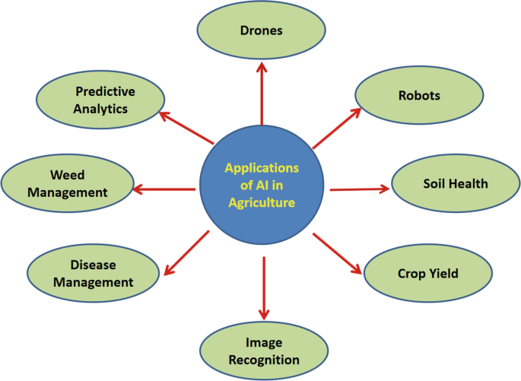
INTRODUCTION
Lately, the coordination of artificial intelligence (AI) and machine learning (ML) procedures has reformed horticultural practices, especially with regards to crop the executives and yield improvement.
One promising application involves the use of unmanned aerial vehicles (UAVs) equipped with hyperspectral imaging technology to capture detailed data on wheat crop traits.
These photos give extensive, high-resolution spectrum information that standard approaches cannot match, allowing the extraction of exact agricultural metrics like chlorophyll, leaf area index, and nutrient levels.
Figure 1: Applications of AI in Agriculture

Slide 3
Wheat Crop Traits and Their Significance
Wheat, a staple crop worldwide, exhibits diverse traits such as leaf chlorophyll content, biomass accumulation, and nitrogen status, which are crucial indicators of crop health and productivity. Monitoring these traits throughout the growing season is essential for optimizing agricultural practices, including irrigation scheduling, fertilizer application, and disease management. Traditional methods of trait assessment, such as manual sampling and laboratory analysis, are labor-intensive, time-consuming, and often provide limited spatial coverage.
Objectives of the study
To retrieve wheat crop traits (LAI and CCC) from UAV-borne hyperspectral images using hybrid machine learning models.
To implement a workflow with UAV imaging, PROSAIL simulations, GPR, and PCA for precise wheat crop monitoring.
To enhance trait retrieval accuracy by integrating non-vegetation spectra into the AL-optimized dataset.

Slide 4
LITERATURE REVIEW
Behera et al. (2010) Using the LAI-2000 Plant Canopy Analyzer, the study estimates Jatropha curcas leaf area index (LAI) indirectly. The canopy light transmittance method is essential for agricultural canopy structure and function assessment. The researchers used it to estimate LAI non-destructively, showing how technology-driven approaches can improve agriculture and forestry research precision and efficiency.
Francone et al. (2014) The Ceptometer and Pocket LAI Smart App estimated LAI differently for canopies with varying structures. The data suggest canopy design influences LAI measurements, emphasizing the necessity for canopy-specific methods. Agronomic and ecological LAI estimations may be more accurate and useful. The research optimizes LAI measurement for different canopy topologies and improves agricultural management.
Gonsamo and Pellikka (2008) Researchers corrected canopy LAI slope effects with hemispherical photography. The study indicated significant slope effects in LAI estimates, requiring adjustment. Statistics indicate that LAI estimate should employ topography to better ecological evaluations and management. The research improves hemispherical photography for varied environments, enabling ecological studies and conservation.

Slide 5
APPLICATIONS OF AI/ ML IN AGRICULTURE
Yield prediction
Machine learning methods estimate crop yield using remote sensing. The majority use Artificial Neural Networks (ANN), then Convolutional Ones. Regularizing Bayes BP, SVR, ELR, RFR, and PLSR operate well.
Red edge, canopy chlorophyll, and absorption ratio indices predict crop output. For efficient crop management, ML models with limited training data must estimate multi-stage crop production promptly.
Pest and diseases detection
Preventing output losses requires early crop disease identification. Accurate estimates require machine and deep learning. MLR models distinguished Maize Dwarf Mosaic Virus, wheat Powdery Mildew Disease, and Kiwifruit Decline Syndrome utilizing UAV information.
These findings enable smart farming by recognising diseased crops, reducing pesticide and chemical consumption, and preserving crop quality. Figure demonstrates major deep and machine learning models.

Slide 6
Soil health management
Food sustainability requires digital soil planning and shrewd supplement expectation. ML strategies like arbitrary woodland and profound learning beat traditional models for soil supplement expectation. Top soil nutrient prediction machine learning methods are compared.
Crop quality management
Detecting advances and machine learning algorithms to monitor crop nitrogen and chlorophyll condition is crucial. Radiative exchange methods and machine learning have been combined to consolidate SWIR ghastly hyperspectral information. Using hybrid models, especially radiative exchange models with Gaussian cycle relapse, these limits have been recovered quickly and precisely.
Figure 2: An illustration of the top 12 machine learning models for soil prediction
Figure 3: N content estimation using several techniques

Slide 7
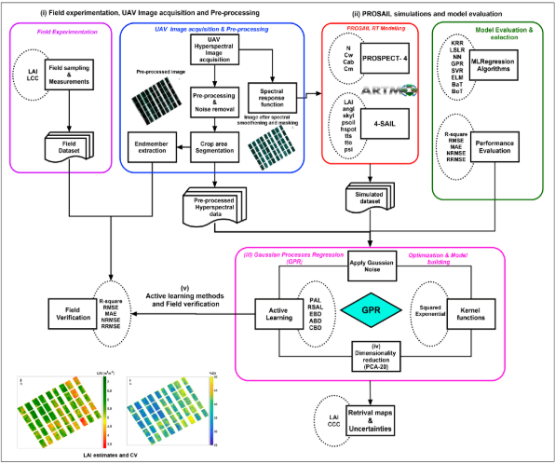
METHODOLOGY
The block chart of the procedure utilized for the proposed approach is shown. The main advances engaged with the workflow are (I) field trial and error, UAV picture procurement, and pre-processing; (ii) PROSAIL reenactments and model assessment; (iii) Gaussian process regression (GPR); (iv) dimensionality decrease utilizing principal component analysis (PCA); and (v) dynamic learning techniques and field check. Each step is explained exhaustively in the resulting segments.
Figure 4: Block schematic of the study's methodology

Slide 8
  Model Evaluation and Selection of GPR
A study assessed eight multivariate models for assessing LAI and CCC involving PCA as a dimensionality decrease technique. GPR beat any remaining models in foreseeing LAI with the most noteworthy R2 worth of 0.887, while KRR was appropriate for anticipating CCC with a R2 worth of 0.8889.
MAE values for LAI and CCC were 0.128 and 0.127, separately, while RMSE values were 0.254 and 0.135. The least qualities for assessing LAI and CCC were 1.857% and 0.544%, separately. Both GPR and KRR created more exact and strong outcomes in assessing crop traits.
The study shows smooth convergence and the usage of Non-Related Mean Square Error (NRRMSE) over R2 for LAI and CCC retrieval using Artificial Neural Network (ANN) methods. Validating with the field dataset shows that adding fresh samples to each AL iteration decreases RMSE and increases R2.
With a few samples, the GPR model performed best, achieving 97 and 119 for LAI and CCC. For LAI, RSAL outperformed other AL methods, whereas EBD excelled for CCC. Low sampling size may cause convergence due to a small number of training data points.
Table 1: Evaluation of MLRA models' accuracy in obtaining LAI and CCC
S. No. | Model | MLRA | MAE | RMSE | RRMSE (%) | NRMSE (%)
LAI
1 | GPR | 0.128 | 0.254 | 3.887 | 1.857 | 0.887
2 | KRR | 0.225 | 0.264 | 5.176 | 2.195 | 0.006
3 | NN | 0.230 | 0.343 | 7.261 | 3.264 | 0.099
4 | LS | 0.290 | 0.358 | 7.656 | 3.466 | 0.098
5 | ELM | 0.290 | 0.432 | 9.510 | 4.468 | 0.089
6 | BaT | 0.329 | 0.468 | 10.570 | 4.965 | 0.087
7 | BoT | 0.414 | 0.524 | 11.944 | 5.715 | 0.074
8 | SVR | 0.445 | 0.559 | 12.903 | 6.207 | 0.068
CCC
1 | KRR | 0.127 | 0.135 | 2.673 | 0.544 | 0.8889
2 | GPR | 0.142 | 0.154 | 3.867 | 0.857 | 1.000
3 | NN | 0.142 | 0.160 | 4.373 | 1.015 | 1.000
4 | LS | 0.149 | 0.160 | 4.403 | 1.023 | 1.000
5 | ELM | 0.153 | 0.174 | 5.226 | 2.25 | 0.999
6 | SVR | 0.186 | 0.104 | 7.110 | 2.710 | 0.996
7 | BaT | 0.179 | 0.210 | 8.216 | 2.080 | 0.996
8 | BoT | 0.240 | 0.287 | 12.632 | 4.203 | 0.991

Slide 9
RESULTS
Table 2 (a): Model Performance Metrics for LAI Prediction
  Performance and evaluation criteria (including KPIs)
The GPR models' 9.7% and 15.9% NRMSE values after field check demonstrate great recovery precision and more modest planning uncertainties for LAI and CCC. ARTMO, a free programming device, is utilized to recover wheat crop biophysical qualities from UAV datasets using a refined kernel-based and adaptable hybrid procedure.
Parameter | LAI
NRMSE | 8.58%
RMSE | 0.735%
MAE | 0.481%
R² | 0.998%
Improved NRMSE | 9.7% (from 17.9%)
Figure 6 (a): Graphical presentation of the Model Performance Metrics for LAI Prediction

Slide 10
GPR models for LAI and CCC recovery have RMSEs of 0.735 and 0.668. LAI and CCC have MAE upsides of 0.481 and 0.423, individually, and R2 upsides of 0.998 and 0.767.
NRMSE upsides of 8.589% and 15.953% for LAI and CCC recovery are the most basic measurable elements. NRMSE further developed essentially subsequent to adding nonvegetation spectra to the AL-upgraded dataset and retraining.
From 17.9 to 9.7%, LAI NRMSE improved, and 19.4 to 15.9%, CCC diminished. Five uncovered soil or non-vegetation spectra (10% of in situ estimations) were added to the AL-advanced dataset before crop trait approval.
Table 2 (b): Model Performance Metrics for CCC Prediction
Parameter | CCC
NRMSE | 15.95%
RMSE | 0.668%
MAE | 0.423%
R² | 0.767%
Improved NRMSE | 15.9 % (from 19.4%)
Figure 6 (b): Graphical presentation of the Model Performance Metrics for CCC Prediction

Slide 11
CONCLUSION
AI and ML can upset crop the board and yield enhancement in agriculture. This study shows how hybrid machine learning models can recover wheat crop ascribes from UAV-borne hyperspectral pictures utilizing ARTMO programming.
Field tests, UAV picture gathering, and high-level information processing strategies including PROSAIL reenactments, Gaussian process regression (GPR), and PCA are utilized.
Brilliant recovery exactness and diminished uncertainties were shown by low normalized root mean square error (NRMSE) upsides of 9.7% for leaf area index (LAI) and 15.9% for canopy chlorophyll content (CCC).
The dynamic learning-upgraded dataset including non-vegetation range works on model accuracy, making vegetation item observing adaptable, quantitative, and constant. This strategy further develops accuracy agriculture by checking crop wellbeing precisely and productively.

Slide 12
ACKNOWLEDGEMENT
We are thankful to the Indian Council of Agricultural Research-Indian Agricultural Research Institute (ICAR-IARI) for giving the exploratory wheat field to this study. Field personnel helped with crop collection and LAI measurements, so thank you. We also thank the Headwall Nano-Hyperspec hyperspectral camera team for UAV image capture and the UgCS Mission planning software team for mission route planning. Additionally, we thank the ARTMO software developers for their important tool for data processing and analysis. Finally, we thank our colleagues and collaborators for their helpful criticism and assistance throughout the research process.

Slide 13
REFERENCES
Behera, S. K., Srivastava, P., Pathre, U. V., & Tuli, R. (2010). An indirect method of estimating leaf area index in Jatropha curcas L. using LAI-2000 Plant Canopy Analyzer. Agricultural and Forest Meteorology, 150, 307–311.
Francone, C., Pagani, V., Foi, M., Cappelli, G., & Confalonieri, R. (2014). Comparison of Leaf Area Index Estimates by Ceptometer and PocketLAI Smart App in Canopies with Different Structures. Field Crops Research, 155, 38–41.
Gonsamo, A., & Pellikka, P. (2008). Methodology Comparison for Slope Correction in Canopy Leaf Area Index Estimation Using Hemispherical Photography. Forest Ecology and Management, 256, 749–759.
Liang, L., Geng, D., Yan, J., Qiu, S., Di, L., Wang, S., Xu, L., Wang, L., Kang, J., & Li, L. (2020). Estimating Crop LAI Using Spectral Feature Extraction and the Hybrid Inversion Method. Remote Sensing, 12(21), 3534.
Nie, C., Shi, L., Li, Z., Xu, X., Yin, D., Li, S., & Jin, X. (2023). A Comparison of Methods to Estimate Leaf Area Index Using Either Crop-Specific or Generic Proximal Hyperspectral Datasets. European Journal of Agronomy, 142, 126664.

Slide 14
THANK
YOU

