Slide 1
COMPARISON OF DIFFERENT PARAMETERS OF SOLAR CELL USING PC1D SIMULATION SOFTWARE
Yogesh Patel, Sachin Desai,
Dr. Nimish Vasoya*
Department of Balbhvan, Children Research University,
Gandhinagar, 382021

Slide 2
ABSTRACT
In order to build a solar cell that has a high degree of efficiency, it is necessary to conduct an in-depth investigation of the impact that a variety of physical and electrical qualities have on the overall efficiency of the cell. For the purpose of this investigation, a PC1D computer simulation was applied to evaluate the effect that altering key characteristics of a silicon solar cell has on the performance of the cell. For the purpose of determining the ideal values for the absorber, emitter, antireflection coating, and back surface field layers, we carried out a simulation. We paid particular attention to the doping levels as well as the thicknesses of each particular layer. A measured result acquired from an industrial scale manufactured solar cell that had the same specifications was used to assess the simulated solar cells that were produced as a consequence. There was a good degree of agreement between the results of the measurements and the data from the models. It is useful and practical to comprehend and forecast the impacts of these essential components and in order to get their ideal values through the utilization of a simulation tool, based on the research that has been undertaken and the discoveries that have resulted from it. This is necessary in order to design a solar cell structure that has a high efficiency.

Slide 3
INTRODUCTION
The plentiful solar energy that reaches the surface of the Earth has the ability to supply all of the energy requirements that mankind will have in the future and need in the present.
Solar cells that use photovoltaic technology are extremely efficient in converting sunlight into energy because they are able to capture and transform light particles.
Crystalline silicon (c-Si) solar cells are responsible for 93 percent of the entire revenue generated by the solar cell industry, as indicated by studies carried out by the Fraunhofer Institute.
These packages include Silvaco TCAD, Sentaurus TCAD, AFORS-HET, and PC1D.
The result highlights how important it is to evaluate and determine the perfect value of each parameter in order to achieve the best possible efficiency from the device.
One of the most impressive aspects of this research is that the optimized parameters of the simulated device were confirmed by comparing the findings to those of a commercially produced solar cell that had the same physical and electrical properties as the simulated device.

Slide 4
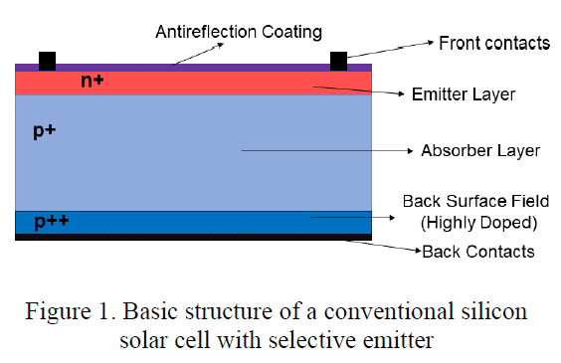
METHOD
The typical structure of a silicon solar cell, which is generally utilized in the industrial sector, is seen in Figure 1. It is essential to have a solid understanding of the effect that the various physical and electrical features of each layer have on the conversion efficiency in order to achieve high levels of efficiency. For the purpose of achieving the maximum possible conversion efficiency, the PC1D simulation tool was utilized to investigate the impact that a variety of device characteristics had on each layer within the system.

Slide 5
While the absorber, emitter, and rear surface field are responsible for producing and transferring mobile charge carriers, the front and back contacts are responsible for collecting them. The efficiency of solar cells may be improved by using an antireflection coating, which reduces the amount of surface reflection while simultaneously increasing the amount of light that is transmitted and absorbed. A silicon nitride antireflection coating with a refractive index of 1.873 was utilized in order to achieve the goals of minimizing the quantity of light that was reflected at wavelengths that had high spectrum irradiance and providing efficient surface passivation. The standard specifications of the solar cell that was utilized in the experiment are presented in Table 1.
Table 1: Parameters of Solar Cell by Using PC1D
Internal optical reflectance | Enabled
Emitter Sheet Resistance | 71.85 Ω/sq
Front surface texture depth | 3 μm
Shunt Resistance | 50000 Ω
Intrinsic concentration @300k | 1×10¹⁰ cm⁻³
Front diffusion (N-type) | 2×10²⁰ cm⁻³ peak
Thickness (Absorber Layer) | 180 μm
Rear diffusion (P-type) | 3×10¹⁸ cm⁻³ peak
Front SRV | 2×10⁵ cm/s
Bulk recombination | τ_{n} = τ_{p} = 30 μs
Device Area | 1 cm²
Rear SRV | 1×10⁷ cm/s
Temperature | 25ºC

Slide 6
THICKNESS OF THE ABSORBER LAYER AND ITS IMPACT ON SOLAR CELL EFFICIENCY
When determining whether or not to manufacture a photovoltaic device, one of the most important considerations to take into account is the cost of the materials used in semiconductors. In order to save expenses while simultaneously optimizing the efficiency of the gadget, it is essential to use materials that have the thickness that is most appropriate on the market. When it comes to the process of converting light into mobile charge carriers, the absorber layer, which is the component of commercial silicon solar cells that is the thickest, makes a significant contribution. These charge carriers are then transmitted and collected by the contacts, which results in the generation of energy by the process. When it comes to improving efficiency, a bigger absorber layer is not useful because of the contradicting effects it has on Voc (open-circuit voltage) and Jsc (short-circuit current). In this part of the article, we examined a solar cell that had absorber layers of varying thicknesses. The performance of the device is analyzed in Table 2, which displays the impact that different bulk thicknesses of silicon have on the device. As can be observed in Figure 2, the thickness of the absorber layer has an effect on several parameters, including V_{oc}, J_{sc} (Figure 2a), and efficiency (Figure 2b). The parameters 'T_{bulk}', 'FF', and 'η' are used to represent the bulk thickness fill factor, and conversion efficiency, respectively.

Slide 7
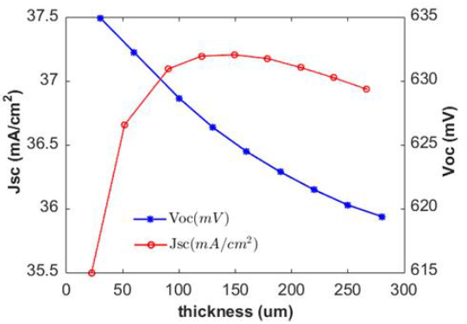
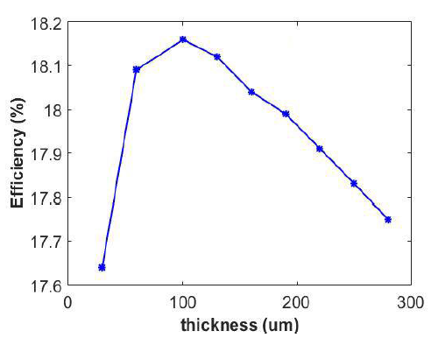
Table 2: Device performance depends on absorber thickness
J_{sc} | V_{oc} | η (%) | T_{bulk} | FF (%)
36.94 | 619.4 | 17.75 | 280 | 77.56
37.03 | 620.3 | 17.83 | 250 | 77.62
37.11 | 621.5 | 17.91 | 220 | 77.65
37.18 | 622.9 | 17.99 | 190 | 77.66
37.21 | 624.5 | 18.04 | 160 | 77.64
37.20 | 626.4 | 18.12 | 130 | 77.76
37.10 | 628.7 | 18.16 | 100 | 77.86
36.66 | 632.3 | 18.09 | 60 | 78.06
35.50 | 635.0 | 17.64 | 30 | 78.25
Figure 2 (a)
Figure 2 (b)

Slide 8
OPTIMISING DEVICE PERFORMANCE WITH VARYING EMITTER DOPING CONCENTRATIONS
A considerable amount of the light is absorbed at the surface of the solar cell, which provides the solar cell with the ability to produce a high output rate. In order to achieve the highest possible level of light absorption, it is essential to make precise adjustments to the thickness of the emitter as well as the doping concentration. It is possible for an increase in the concentration of doping in these layers to result in a drop in efficiency due to a decrease in light transmission and absorption as well as an increase in the rate of recombination. However, in order to make the drift transport process easier and to get a reduced sheet resistance, it is also important to have a concentration that is suitably high. Table 3 illustrates the effect that different doping concentrations have on the sheet resistance as well as the overall performance of the device. The relationship between the concentration of emitter doping and the resistance of the emitter sheet and V_{oc} is seen in Figure 3. Doping concentration (C_{dop}) and sheet resistance (R_{sht}) are two examples of measures that are extremely important in this industry.

Slide 9
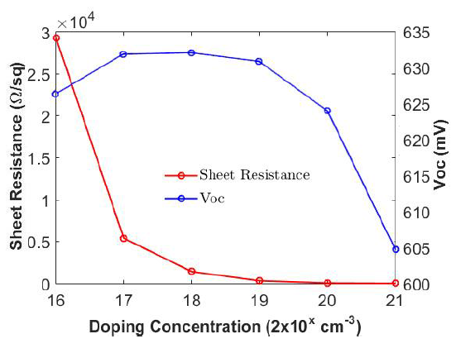
Table 3: Sheet resistance & device performance as a function of emitter doped concentrations
J_{sc} (mA/cm²) | V_{oc (mV)} | η (%) | R_{sht} (Ω/sq.) | C_{dop} (cm⁻³) | FF (%)
34.33 | 604.3 | 17.75 | 8.7 | 2X10²¹ | 77.48
37.22 | 623.6 | 17.83 | 71.85 | 2X10²⁰ | 77.70
37.49 | 630.5 | 17.91 | 421.7 | 2X10¹⁹ | 77.80
37.52 | 631.7 | 17.99 | 1751 | 2X10¹⁸ | 77.79
37.52 | 631.5 | 18.04 | 7852 | 2X10¹⁷ | 77.78
37.52 | 625.9 | 18.12 | 79650 | 2X10¹⁶ | 77.73
Figure 3: Impact of Concentration of Emitter Doping on Emitter Sheet Resistance & V_{oc}

Slide 10
ANTIREFLECTION COATING: AFFECTS ON DEVICE FUNCTION
The antireflection coating, which is also commonly referred to as ARC, is an important component that is necessary for improving the efficiency of solar cells, a thin coating of dielectric material is put to the surface of a solar cell in order to increase the amount of charge carriers that an individual solar cell is capable of producing. Because of this coating, the overall reflectance of the light that is coming in is decreased, and the transmission is improved. In current solar cells, ARCs are made up of stacked layers of dielectric materials that have various refractive indices. These layers can be either single-layered or double-layered, depending on the application need.
By simulating silicon samples with no anti-reflective coating (ARC), one layer of ARC, two layers of ARC, and three layers of ARC, researchers were able to study the effect that applying varying numbers of ARC layers had on the performance of the device. We made use of a single layer of anti-reflective coating (ARC), which was made up of titanium dioxide (TiO2) and had a thickness of 67 nanometers. The refractive index of this coating was 2.116. Both magnesium fluoride (MgF2) and zinc sulphide (ZnS) were utilised in the production of the double layer antireflection coating (DLARC), which had refractive indices of 1.39 and 2.371, respectively. The thickness of the DLARC was 107 nm for magnesium trifluoride and 60.5 nm for zinc sulphide, respectively.

Slide 11
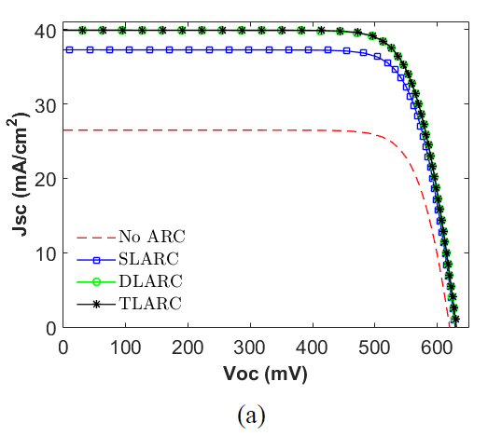
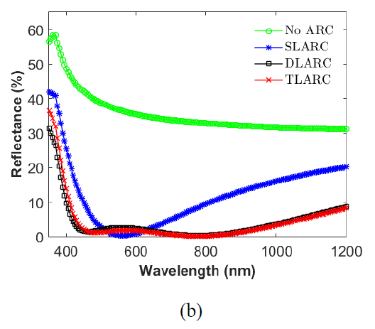
Table 5: Effect of different levels of ARC on device performance
J_{sc} (mA/cm²) | V_{oc (mV)} | η (%) | ARC | FF (%)
39.96 | 630.6 | 19.79 | TLARC | 78.53
39.90 | 630.6 | 19.77 | DLARC | 78.56
37.30 | 628.8 | 18.5 | SLARC | 78.88
26.50 | 619.8 | 13.1 | None | 79.79
Figure 4 (a)
Figure 4 (b)

Slide 12
EVALUATION OF THE BEST MODELLED AND REALISED SOLAR CELL
To ensure that the results of the simulation are accurate, the actual measurements of solar cells were compared to the measurements of a virtual device that had the same characteristics as the real one. There is a comparison of the electrical properties of a real solar cell and a simulated solar cell that is presented in Table 6.
This is demonstrated by the data that is presented in Table 6, which reveals that the simulation results have the capacity to accurately anticipate the actual cell values. When compared to the real cell values, the simulated results were shown to be considerably more favourable overall. The doping concentration of the cell's emitter was found to be 5×1020 cm-3, while the doping concentration that was wanted for a uniform emitter in the simulation was found to be 2×1020 cm-3. The diameters of the emitters in the cell were 0.6 micrometres and 0.1 micrometres, respectively. When recombination losses are kept to a minimum, even a minor improvement in the performance of the simulated cell has the potential to fall within a range that is considered acceptable. Once resistive losses have been eliminated, the simulation is able to produce an accurate assessment of the cell's potential efficiency, which was found to be 18.48% by the use of the Suns-Voc measuring tool.
Table 6: Analysing the electrical characteristics of a manufactured solar cell in comparison to an ideal simulated one
J_{sc} (mA/cm²) | V_{oc (mV)} | η (%) | Type of Data | FF (%) | Pseudo η (%)
37.3 | 628.8 | 18.5 | Simulated | 78.88 | -
36.6 | 617.0 | 17.7 | Real | 78.30 | 18.48

Slide 13
CONCLUSION
According to the findings of this study, in order to achieve the best possible conversion efficiency, it is necessary to investigate and determine the settings that are most beneficial for each device parameter. The use of PC1D simulation software is what allows this to be performed. When utilising simulation software, it is of the utmost importance to take into consideration the features of the device. These qualities include the device's stability, durability, capacity to withstand circumstances of severe weather, and the constraints of the manufacturing process. Overall, this study demonstrates that it is possible to use PC1D and other simulation software as a practical alternative throughout the research and development stage of making crystalline silicon solar cells. This is due to the fact that these software programmes are accurate and reliable.

Slide 14
REFERENCES
Basic Photovoltaic Principles and Methods, Solar Information Module (1982), SERI/SP-290-1448.
S. Philipps, Photovoltaics Report, Fraunhofer ISE and Werner Warmuth, PSE AG, https://www.ise.fraunhofer.de/content/dam/ise/de/documents/publications/studies/PhotovoltaicsReport.pdf
M. A. Green, Y. Hishikawa, W. Warta, E. D. Dunlop, D. H. Levi, J. Hohl-Ebinger and A. W. H. Ho-Baillie, “Solar Cell Efficiency Tables (version 50)”, Prog. Photovoltaics, vol. 25, pp. 668- 676, 2017.
K. Yoshikawa, H. Kawasaki, W. Yoshida, T. Irie, K. Konishi, K. Nakano, T. Uto, D. Adachi, M. Kanematsu, H. Uzu and K. Yamamoto, “Silicon heterojunction solar cell with interdigitated back contacts for a photo conversion efficiency over 26%,” Nat. Energy, vol. 2, no. 5, 2017.
J. Benick, A. Richter, R. Müller, H. Hauser, F. Feldmann, P. Krenckel, S. Riepe, F. Schindler, M. C. Schubert, M. Hermle, A. W. Bett and S. W. Glunz “High-Efficiency n-Type HP mc Silicon Solar Cells,” IEEE J. Photovoltaics, vol. 7, no. 5, pp.1171–1175,2017.
J. Hofstetter, C. Del Cafiizo, S. Ponce-Alcantara and A. Luque, “Optimisation of SiNx: H anti-reflection coatings for silicon solar cells”, Spanish Conference on Electron Devices, pp.131-134, 2007.

Slide 15
THANK
YOU

