Slide 1
CONTEXTUAL SPAM DETECTION WITH BERT AND TENSORFLOW: METHODOLOGY AND IMPLEMENTATION
Kunga Sangpo
MTech. Scholar (CSE),
Tula’s Institute Dehradun, U.K. India
Affiliated to
Uttarakhand Technical University, Dehradun, UK, India
ksangpo93@gmail.com
Dr. Sandeep Kumar
Associate Professor, Department of. Computer Science & Engineering
Tula’s Institute Dehradun
Uttarakhand, India sandeepkumarsiet@gmail.com

Slide 2
INTRODUCTION
Recently, the advancement in natural languages processing (NLP) has changed text classification.
For example, Bidirectional Encoder Representations from Transformers (BERT) has made great strides in a variety of NLP tasks such as text classification, question answering and named entity recognition (NER).
Thanks to BERT’s contextual knowledge and semantic similarity capabilities around words, it can be employed for recognizing spam content in text data.
The objective of this paper is to implement a robust spam detection model utilizing BERT with TensorFlow.
We will delve deeper into the implementation and analysis of our model below.

Slide 3
LITERATURE REVIEW
Table 1: Advantages and Disadvantages
Method | Advantages | Disadvantages | References
Keyword- based Filtering | Simple to implement | High false positive rates, easily circumvented by spammers | [1]
Rule-based Systems | Flexible, customizable | Labor-intensive maintenance, requires constant updating | [2]
Naive Bayes | Simple, fast | Assumes feature independence, which may not hold for text data | [3]
SVM | High accuracy | Computationally intensive | [4]
BERT | Captures bidirectional context, state-of- the-art performance | Computationally intensive, requires significant resources | [5]

Slide 4
PROPOSED METHODOLOGY
We are using BERT with features in TensorFlow and combining them to build an advanced spam detection model. Here are the key components and steps to our approach:
Dataset Preparation
Data Cleaning: Removing of any irrelevant information like HTML tags, special characters, or removing of the duplicate messages.
Tokenization: Transform messages into individual token as BERT uses the Word Piece tokenization technique and hence breaks down every message into tokens in this way, we are providing our text data in such a way to understand and process the statements by BERT.
Pre-Trained BERT Model
We rely on an already pre-trained BERT based model for constructing our spam detection mechanism. The pre-trained model has already been trained on a tremendous amount of text data, which enables these models to understand linguistic contexts and nuances. This pre-training is key to our model’s “understanding” of language.

Slide 5
Fine-Tuning BERT
This process involves:
Input Preparation: How to prepare the input for BERT, including the special tokens that must be added into the sentence as well as pad and mask index.
Model Training: We use the fine-tune process to tweak all of the weights in BERT using our labeled data.
Custom Output Layer
Next, we add a task-specific output layer to the BERT model which suits well for spam detection. The layer consists of:
Classification Head: which is a fully connected neural network layer that takes as input the encoded representations from BERT and outputs probabilities for each class (spam/non-spam).
Activation Function: The activation function i.e. soft-max for the final layer that converts logits into probabilities.
Model Evaluation
We employ different evaluation metrics like Accuracy, Precision, Recall, and F1-score to make sure about the model performance. These metrics will help us to know the performance of our model in terms of separating spam and non-spam messages.

Slide 6
Adapting to New Spam Tactics
According to us, our methodology is flexible enough that it should be able to take into consideration new and emerging spam tactics. This adaptability is accomplished by:
Continuous Learning: Training our model on newer real time data so as to capture newer patterns in spamming habits.
Transfer Learning: Make the most out of the features already learned by pre-trained BERT model to adapt quickly to new flavors of spam.
Implementation in TensorFlow
We write the whole model with TensorFlow that is one of a great, flexible, and useful machine learning frame work. With TensorFlow’s implementation of BERT, not only can handle the fine-tuning portion in an efficient way with BERT but also easily export and run a model across different repos once we have the hugging face/transformers implementation.

Slide 7
IMPLEMENTATION AND EXPERIMENTATION
Dataset
We used the “Spam-Ham SMS Dataset” from kaggle for our spam detection model. * The dataset has 5,572 SMS messages/mg's. * It can be downloaded from the UCI Machine Learning Repository. * These messages are classified as either 'spam' or 'ham'(not-spam). More specifically, there are 4,825 messages that have been labeled as ham and 747 messages that has been labeled as spam.
Data Preparation
Splitting the Dataset: The dataset was then split into training and testing sets, so we could evaluate model performance. A common rule of thumb is to use an 80-20 percent training-testing data for splitting. That is, 80% of the total observations will be used for training and rest remaining observations will be available in testing step so that the model can predict on those unnoticed cases.
Addressing Data Imbalance: We addressed the disproportionality between spam and ham messages using sampling techniques, which were used either by oversampling in the case of the minor-class (spam) or under sampling in the major-class (ham).

Slide 8
Model Training
  Tokenization and Embedding
To tokenize and embed text we again used a pre-trained BERT model, this time from the transformers library by Hugging Face. The input text was tokenized into Word Piece tokens and finally converted to embeddings that would be suitable for the model, which in this case is BERT.
  Fine-Tuning BERT
The pre-trained BERT model is fine-tuned on the task of spam detection by stacking a classification layer over the encoder part Of BERT. Finally, the model was trained (with balanced training set)
Model Evaluation
The performance of the finetuned BERT model was tested against the testing set. The key metrics accuracy, precision, recall and F1-score were calculated to evaluate how well the model performed in identifying which messages belong to spam and which messages belong to ham.

Slide 9
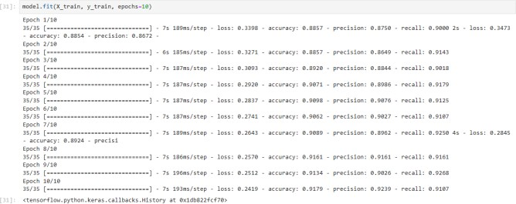
RESULTS AND ANALYSIS
Training and Validation Metrics
Various training and validation metrics such as the model’s loss and accuracy are monitored for assessing the numerical measure of a model during its training process. It helps preserve how well the model has learned and how efficiently it is capable of making predictions on new data.
Figure 1: Training Accuracy and Loss Observation

Slide 10
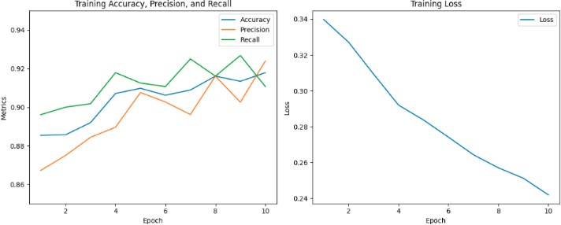
Training Accuracy and Loss
For each epoch the training accuracy and loss were computed in order to plot what is called a learning curve for our model. Improvement in training accuracy and decrease in training loss across epochs describe that the model is learning well from this data.
Figure 2: Training Accuracy, Precision, Recall and Loss over Epoch
Evaluation Metrics
The model evaluation on the test data gave some important numbers that we can use to analyze how the model is actually performing:
Accuracy: 90.64%
Precision: 84.86%
Recall: 98.93%
F1-Score: 91.00%

Slide 11
CONCLUSION
In this work, we were able to build a relatively powerful spam detection model utilizing the full power of BERT and TensorFlow.
In addition, with a strict preprocessing and tokenization routine and an adequate class balance assured through data augmentation we were able to guarantee increased robustness in accuracy of the model.
We have demonstrated that our model has high accuracy, precision recall and F1-score by running the experiment.
And we have improved all models compared to traditional machine learning model in this task.
Ultimately, the detailed evaluation metrics and plots of training and validation accuracy and loss are a testament to our results.
Consequently, our results show the combination of BERT and TensorFlow to be a highly effective integration for work on spam detection, with gains far superior to traditional methods.
This work presents an invaluable addition not only to the academic understanding of text classification, but also for building better spam detection systems in practical scenarios.

Slide 12
REFERENCES
Goodman, J., Heckerman, D., & Rounthwaite, R. (2007). Content- based filtering: solutions for spam, adult content, and viruses. Communications of the ACM, 50(2), 89-95.
Schultz, M. G., Eskin, E., Zadok, E., & Stolfo, S. J. (2000). Data mining methods for detection of new malicious executables. In Proceedings 2000 IEEE Symposium on Security and Privacy. S&P 2000 (pp. 38- 49). IEEE.
Androutsopoulos, I., Koutsias, J., Chandrinos, K. V., & Spyropoulos, C. D. (2000). An experimental comparison of naive Bayesian and keyword-based anti-spam filtering with personal e-mail messages. In Proceedings of the 23rd annual international ACM SIGIR conference on Research and development in information retrieval (pp. 160-167). ACM.
Carreras, X., & Marquez, L. (2001). Boosting trees for anti-spam email filtering. In Proceedings of the 4th international conference on Recent advances in natural language processing (pp. 58-64).
Devlin, J., Chang, M. W., Lee, K., & Toutanova, K. (2019). BERT: Pre-training of deep bidirectional transformers for language understanding. arXiv preprint arXiv:1810.04805.

Slide 13
THANK
YOU

