Slide 1
IDENTIFICATION MICRO AND MACRO NUTRIENTS IN (SOIL)
LAND USE PLANNING OF VARIOUS FARM OF SELECTED
DISTRICT YAVATMAL,MAHARASHTRA
R.P.Bhagat,
Dr,L.K.Pandey ,
Dibyendu Gangopadhyay
1Dept.of Biotechnology, Mansarovar Global University, Shehore,(MP)46611,India
2Prof.Faculty of Life Science, Mansarovar Global University, Shehore,(MP)46611,India
3Dept.of Microbiology, Mansarovar Global University, Shehore,(MP)46611,India

Slide 2
INTRODUCTION
The soil word is derived from Latin word, ‘Solum’ meaning the earthy material in which plant growth occurs.
The major and micro nutrients govern the fertility of the soils and control the yield of crops.
With the introduction of high yielding crop varieties and intensive agriculture with modern agro-techniques and less use of on farm organic manures, most soils becoming deficient in major and micro nutrients.
Essential nutrients required for proper growth of plants is supplied by soil. Hence the yield and quality of crop depends on the quality of soil.
Productivity of crop is increased by use of various chemical fertilizers on large scale, but it is decreasing the quality of soil.

Slide 3
MATERIALS AND METHODS
25 farms of each village were selected for physico-chemical analysis of soil.
Total sixteen talukas situated in Yavatmal district were selected for study. Average value of parameter selected farms of a talukas was reported.
The study area comes under assured rainfall zone. Soil samples were collected in the depth of 5-20cm from the surface of soil and were taken in polythene bags.
The oil samples were collected in the month of June 2022 from different sampling stations. Sample stations used from selected ‘Yavatmal district selected region’
The soil samples were collected and brought to the laboratory for the study of physic-chemical parameters.

Slide 4
AVAILABLE NUTRIENT AND SECONDARY NUTRIENTS IN SOIL OF DISTRICT YAVATMAL
The results of study presented in this table indicated that all the soil samples from various farm of district Yavatmal, were moderately alkaline in soil and within safe limit of electrical conductivity. The pH of soil varied from 7.5 to 8.7. Moderately alkaline nature of soil may be due to formation of these soils from basaltic parent material rich in basic cations.

Slide 5
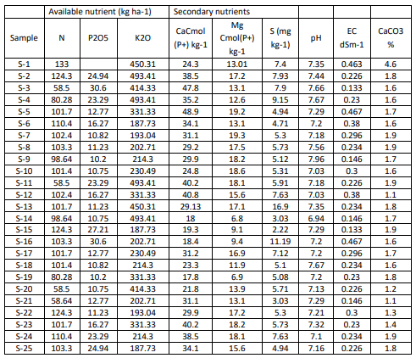
AVAILABLE NUTRIENT AND SECONDARY NUTRIENTS IN SOIL OF DISTRICT YAVATMAL

Slide 6
RESULT AND DISCUSSION
The organic carbon content varied from 0.8 to 6.9 g kg-1.
It indicates that majority of these soils were low to moderately high in organic carbon content. This might be due to increased rate of decomposition of organic matter .
The available N was found low to moderate in soils of various farm of district
Yavatmal, (28.3 to 78.4 kg ha-1) farm of various farm of district Yavatmal, It may be due low organic matter content of soil as well as rapid loss of applied N in soil.
The available P content varied from 10.20 to 30.60 kg ha-1 in soils of various talukas farm of district Yavatmal, was categorized as low to moderate range, the low amount of available P may be due to application of lower doses of P fertilizer, fixation of P on clay minerals or CaCO3 surfaces with the time elapsed between fertilizer application and crop uptake.
All soil samples were found high with respect to available K content which ranged from 187.73 to 493.41 kg ha-1.

Slide 7
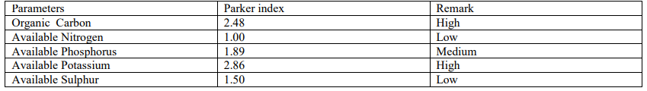
NUTRIENT INDEX VALUES OF VARIOUS TALUKAS FARM OF DISTRICT YAVATMAL.
Soil nutrient index value : As per the NIV developed by the nutrient index value for this table Parkers nutrient index was used to compare the level of soil fertility in the study of various farm of selected district of Yavatmal as it is the measure of nutrient supplying capacity of soils. The nutrient index value (NIV) of organic carbon (2.48) and available potassium (2.86) were high in farms of Yavatmal. NIV of P was medium (1.89) while N and S were low with values of 1.00 and 1.50 , respectively in this table. Pathak (2010) also reported similar results while assessing temporal soil fertility changes in Maharashtra.

Slide 8
CONCLUSION
The study indicated that the soils of Yavatmal district farm slightly alkaline to alkaline in reaction with safe limit of soluble salt content.
The OC was medium to high and low in available N.
The area showed low to medium in available P and S and high in available K content.
The DTPA extractable Zn and Fe was deficient and Mn and Cu were sufficient in the area.
The NIV for N and S were low, medium for P and high for K.
The results of the study area having potential to identify soil site suitability properties of selected district Yavatmal farm observed that these soils were highly suitable for agriculture planning and growing crops of soybean, wheat, Channa and cotton crops and production at various farm of selected district Yavatmal.

Slide 9
REFERENCES
A.N.Kulkarni,J.B.Balkhande,B.D.Waghamare,P.U.Ratnakar and V.S.Kanwate,Studies of some physic-chemical factors of teak forest from Kinwat area, Nanded(Maharashtra).International journal of life science(2011)page437-438.
.Chadar, B., Vaidya, H., Kachave, R., & Aundhkar, V. (2018). Characterizations, classifications and soil site suitability evaluation of soils of farm College of Agriculture, Latur, Maharashtra. Journal of Pharmacognosy and Phytochemistry, 166–170.
Bagdi, G. L., & Kurothe, R. S. (2014). People’s participation in watershed management programmes: Evaluation study of Vidarbha region of Maharashtra in India. International Soil and Water Conservation Research, 2(3), 57–66. https://doi.org/10.1016/S2095-6339(15)30023-X
.Jagdish Prasad,Nagraju,Raveev Shrivastava,S.K.Ray and P.Chandran,Characteristic and Classification of some soil in Nagpur district.I.India Soc. Soil sci.49(4),2001,page 735-739
Wankhade R.R.(2015), Physico-Chemical Analysis of soil from some Farms of Digras Region ofDistrict Yavatmal in Maharashtra,India. Scholedge International journal of Multidisciplinary and Allied Studies ISSN 2394-336X,2(10),1-4

Slide 10
THANK
YOU

