Slide 1
HEAVY METALS IN ALIGARH'S URBAN SOILS: AN OVERVIEW OF HEALTH RISKS AND POLLUTION ASSESSMENT
Geeta¹, Sandhya Chaudhary², Ravikant³
Research scholar, Mangalayatan University Aligarh¹
Co-supervisor, N.R.E.C COLLEGE KHURJA-Bulandshar ²
Supervisor, Mangalayatan University Aligarh³

Slide 2
INTRODUCTION
Heavy metal contamination is a global concern due to the growing population and industrial, agricultural, and domestic activities.
Aligarh, located in the Indo-Gangetic basin, has a predominantly agricultural population with a total harvested area of 565,553 acres.
This study evaluates heavy metal pollution in the soil, water, and vegetation of Aligarh, highlighting potential health risks associated with human exposure to these metals.
Effective management techniques are crucial to reduce these risks and ensure sustainable growth in urban areas.
Understanding the degree and dispersion of contaminants helps evaluate environmental hazards and develop effective mitigation solutions.

Slide 3
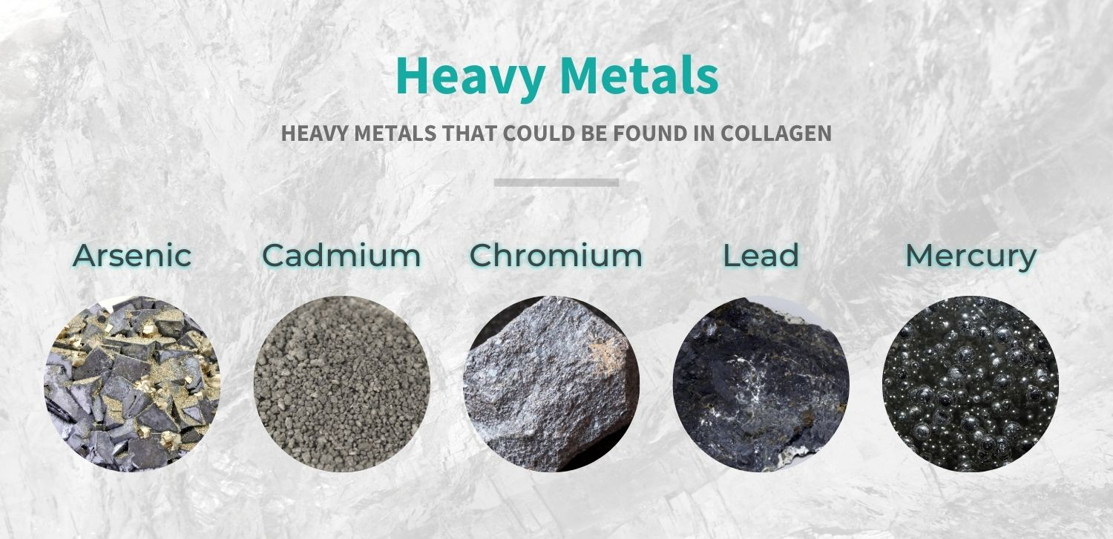
HEAVY METALS IN ALIGARH'S URBAN SOILS
Heavy metals, such as chromium, lead, cadmium, iron, arsenic, cobalt, mercury, copper, and zinc, are classified as necessary or non-essential.
Figure: Heavy Metal

Slide 4
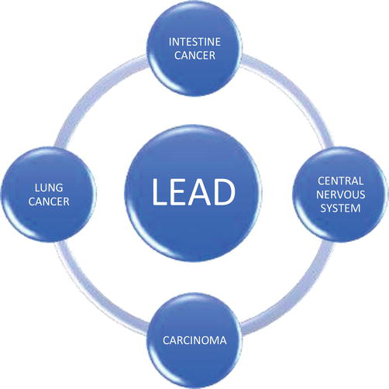
HEALTH RISKS ASSOCIATED WITH HEAVY METALS
Heavy metals can negatively impact soil, water, and the air, affecting pH, variety, porosity, and composition.
Animals exposed to heavy metals may experience decreased body weight, kidney and liver damage, shortened life spans, increased oxidative stress, changes in cell composition, and DNA damage.
In humans, heavy metals can cause lung effects, liver abnormalities, renal damage, and various cancers.

Slide 5
POLLUTION ASSESSMENT METHODS
Urban soil pollution assessment methods use meticulous sampling and analytical processes to monitor pollutant levels and evaluate environmental risks.
Sampling tactics include selecting representative locations based on factors like topography, soil composition, and proximity to pollution sources.
Analytical procedures like GC-MS, ICP-MS, and AAS measure heavy metals, organic pollutants, and contaminants.
Soil contamination in metropolitan areas necessitates strict regulations and rules from government and international organizations.
Case studies and research on soil pollution in metropolitan areas provide valuable insights into the complex nature of the issue.

Slide 6
MITIGATION AND REMEDIATION STRATEGIES
Current Practices | Challenges
Monitoring and Evaluation of Soil | Expense and Resources
Prevention and Control of Pollution: | Technical Difficulty
Technologies for Remediation | Participation of Stakeholders and Regulatory Compliance
 | Effects on the Environment and Society

Slide 7
Potential Solutions for Reducing Heavy Metal Contamination
Authors | Construct | Methods | Service Context | Key Findings
Liu et al. (2018) | Overview of remediation techniques for heavy metal-contaminated soils | Phytoremediation, chemical stabilization, bioremediation | Principles and applicability of remediation strategies like phytoremediation, chemical stabilization, and bioremediation. Emphasizes effectiveness and limitations in diverse environmental contexts. | Comprehensive discussion on various remediation strategies and their applicability in different environmental conditions.
Wang et al. (2021) | Green remediation strategies for heavy metal-contaminated soils | Phytoremediation, biochar application, microbial remediation | Review of environmentally friendly approaches focusing on sustainability and benefits for soil health and ecosystem restoration. | Emphasis on evaluating the feasibility and sustainability of green remediation strategies such as phytoremediation, biochar application, and microbial remediation.

Slide 8
RoyChowdhury et al. (2018) | Heavy metal pollution and remediation from a green chemistry perspective | Nanotechnology-based remediation, electrokinetic remediation, combined approaches | Discussion on innovative methods to mitigate heavy metal pollution using green chemistry principles, aiming to minimize environmental impact and effectively treat contaminated sites. | Coverage of advanced remediation approaches like nanotechnology-based and electrokinetic remediation, highlighting their potential in reducing environmental impacts.
Rajendran et al. (2022) | Various remediation approaches for heavy metal contaminants removal | Chemical precipitation, physical separation, phytoremediation, electrokinetic remediation, nanoremediation | Critical review evaluating efficiency, applicability, and sustainability of remediation methods across different environmental settings. | Comprehensive evaluation of conventional and advanced remediation techniques such as phytoremediation, electrokinetic remediation, and nanoremediation, emphasizing the importance of selecting appropriate methods based on specific site conditions and types of contaminants.

Slide 9
Wang et al. (2021) | Electrokinetic technology for remediation of heavy metal-contaminated soils | Electrokinetic remediation | Review of mechanisms underlying electrokinetic remediation and factors influencing its effectiveness. Case studies and experimental findings provided. | Focus on understanding the mechanisms and practical application of electrokinetic remediation in treating heavy metal-contaminated soils, including insights into key factors influencing its efficiency and limitations in real-world scenarios.

Slide 10
CONCLUSION
Heavy metal pollution in urban soils, especially in Aligarh, is a serious risk to the environment and public health because of industrial processes, car emissions, and past land usage.
This review emphasizes how dangerously heavy metals like lead, cadmium, and arsenic affect ecosystems and human health in addition to building up in urban soils.
Establishing guidelines and enforcing compliance are crucial functions of regulatory frameworks, which guarantee that soil quality stays within acceptable bounds.
By tackling these concerns thoroughly, policymakers and urban planners may limit the detrimental consequences of heavy metal contamination and support sustainable urban growth globally.

Slide 11
REFERENCES
Khan, S., & Malik, A. (2018). Toxicity evaluation of textile effluents and role of native soil bacterium in biodegradation of a textile dye. Environmental Science and Pollution Research, 25, 4446-4458.
Alinia-Ahandani, E., Hajipour, S., Selamoglu, Z., & Selamoglu, M. 3. The Position of Heavy Metals in Environmental Pollution and the Importance of Their Assessment. CLIMATE CHANGE AND HUMAN HEALTH, 9.
Ahamad, A., Siddiqui, S. E., & Singh, P. (Eds.). (2021). Contamination of water: health risk assessment and treatment strategies. Elsevier.
Bansal, O. P. (2020). Health impacts of the potentially toxic metals present in milk, dairy products, chocolates, alcoholic and non-alcoholic beverages: A review. Dairy Products, 14(7), 35-46.
Ahamad, A., Siddiqui, S. E., & Singh, P. (Eds.). (2021). Contamination of water: health risk assessment and treatment strategies. Elsevier.

Slide 12
THANK
YOU

