Slide 1

COLLECTION & IDENTIFICATION OF WILD MEDICINAL PLANTS OF
DHUMKHAL & DHUMKHAL FOREST, DANG DISTRICT, GUJARAT

Slide 2
INTRODUCTION
From so many years ago the human being depends on the plants for their basic needs like food, shelter, cloths and medicine. Herbal medicines have traditionally been used because of easily accessible, affordable and there is no evidence of resistance to whole plant extracts of effectiveness.
In India the traditional system of medicine is one of the oldest systems of medical practice in the world and has played an essential role in providing health care service to human civilization right from its inception.
India has the exclusive distinction of its own recognized traditional medicine; Ayurveda, Yoga, Unani, Siddha, and Homoeopathy (AYUSH). This sort of traditional medicinal knowledge has been regularly practiced in homes and is transferred from generation to generation with the passage of time.
India is one among the 12- megabioversity countries and having 3 out of 25 hot spots of origins and diversity of several plant species in the world. The 17,000 sq km long strip of forests along the sea ward side of Western Ghats is enriched with 4,050 plant species, of which nearly 40% (1,600 species) are endemic.
Gujarat State is the western part of India having nearly 4,320 plant species, which accounts for almost 9.33% of the total floral wealth of India. The tribals in the state use about 750 medicinally Important and 450 economically important plant species.

Slide 3
The Dangs is the southernmost district in Gujarat, which starts from the rugged mountain chains of the Sahyadri range of the Western Ghats in the southwest and descends on the western side of extending undulating tract.
The Dangs is a tribal district, with the Bhil, Konkani (kunvi), Varli, Kotwalia, Kathodi and Gamit being the major tribal groups. The Bhils have historically been residing in the Dangs whereas the other tribes came to the Dangs in search of a livelihood.
These tribal people mainly depend on forest for their shelter, housing material, food, fuel, fibre, medicine and feed. These ethnic groups through their observations and experiences with the nature have developed their own indigenous systems of treating ailments using different plants.
The degradation of forest and hilly habitat many medicinal species are facing threats for their existence. Along with the medicinal species of plants, the knowledge of ethnomedicinal practices is also losing in the local community.

Slide 4
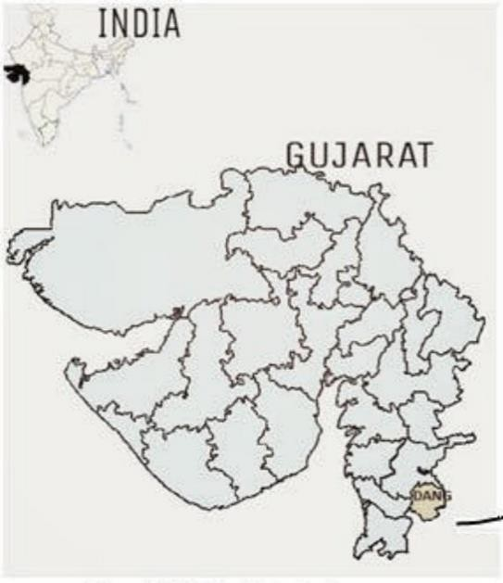
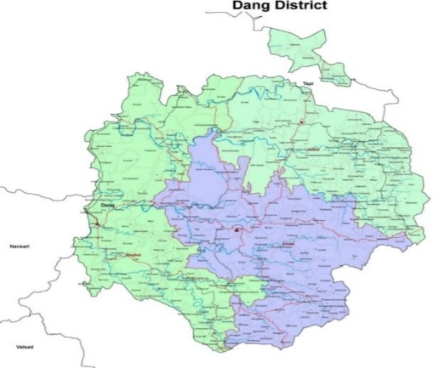
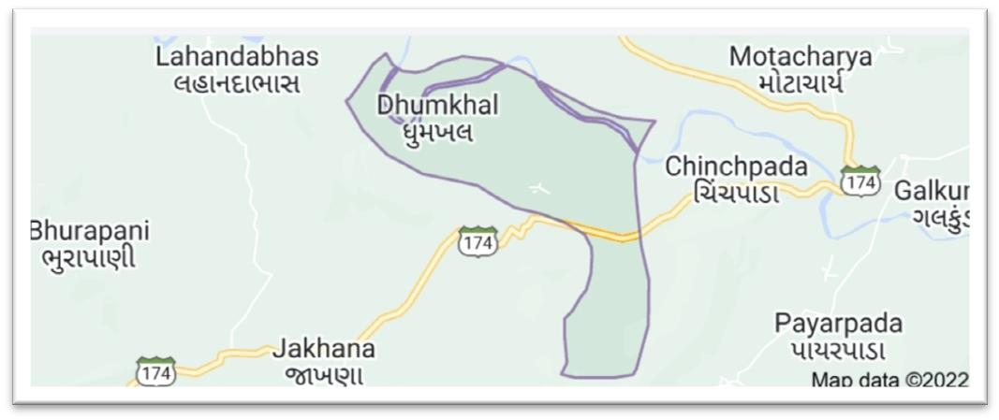
MATERIALS AND METHODS
Study Area
Located in the Southern part of country, state of Gujarat. The area Dhumkhal forest lies between 20°.631926‟N latitude and 73°.770586‟E longitude, map report and data sets of Dhumkhal on topography, land use, land cover, watershed/hydrological parameters etc.
Total area of Dhumkhal forest and Dhumkhal is 334.09 hectares as per the Data available for the year 2021. At Dhumkhal village is home of 100% scheduled Tribes (ST) Population. The Dhumkhal are one such as tribe that have inhibited the Dhumkhal forest, the medical men “Bhagat” (vaidya) indigenous plant knowledge.
Figure 1: Study Area

Slide 5
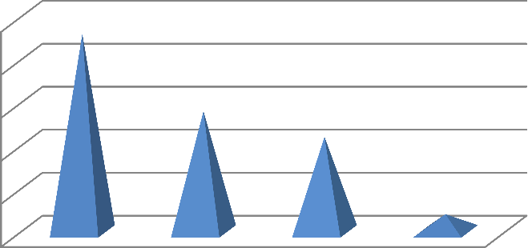
Collection of specimens and herbarium preparation
The work on collection and documentation of wild medicinal plant of Dhumkhal forest was initiated in 2022 in month February to April. If present work about dhumkhal forest were undertaken for extensive and intensive and collection of wild medicinal plants species from dhumkhal forest. Over 50 species were collected.
Morphology and Identification
The made a brief vegetative morphological description of each wild medicinal plant species, The photographs were taken by using android redmi note 6 pro android mobile camera, Identification of all wild medicinal plant species have been identified using flora of Maharashtra (Singh & Karthikeyan, 2000). All species were arranged alphabetically.
Species
25
20
15
Species
10
5
0
Tree
Shrubs
Herbs
Climber
Figure 2. Habit wise distribution of plants in study region.

Slide 6
RESULTS
Systematic Treatment
ABRUS Adans.
Abrus precatorius L.
Family:- Fabaceae
Local Name:- Gunj
Perennial Twiners. Leaves 8–12 cm long; leaflets 0.5–1.8 x 0.3–0.8 cm, oblong or elliptic–oblong, glabrous above, appressed–hairy beneath. Flowers pinkish–purple, fading white in racemes. Pods 2–4 cm long, Linear–oblong, beaked. Seeds 3–5, ellipsoid, bright scarlet with a black spot.
Flowering & Fruiting: - August–March.
Plant part use: Leaves
Medicinal uses: - The leaves of the herb are used to cure fever, cough and cold.

Slide 7
ACACIA Willd.
Acacia catechu (L. f.) Willd.
Family:- Mimosaceae
Local Name:- Khair
Deciduous trees, 5–10 m tall. Leaves bipinnate, 24–25 cm long, pinnae 10–30 Pairs; leaflets 30–50 pairs 0.5 x 0.1. cm linear. Flowers pale yellow or greenish–white in spikes, 6–8 cm, long. Pods 8.5–14.0 x 1.5–2.0 cm, flat, brown, stalked, beaked; reticulately veined. Seeds 3–10.
Flowering & Fruiting: - July–February.
Plant part use: Bark
Medicinal uses:- Its heartwood extract is used in asthma, cough, bronchitis, colic, diarrhea, dysentery, boils, skin afflictions, sores and for stomatitis.

Slide 8
FLEMINGIA Roxb. Ex W. Ait. & W. T. Ait. (nom. Cons.)
Flemingia strobilifera (L.) Ait. & Ait. F. Hort. Kew.
Family: Fabaceae
Local Name: Fokali
Shrubs, 1–2 m high. Leaflets 6.0–15.5 x 2.3–7.5 cm, Ovate–lanceolate or oblong, silky pubescent beneath, apex acute, base Rounded. Flowers in axillary and terminal racemes. Pods oblong, Mucronate, densely pubescent. Seeds 12, dark–brown or black.
Flowering & Fruiting:-August–April.
Plant parts use: Roots, Flowers
Medicinal uses: Root of the plant is used for various ailments such as insomnia, epilepsy, ulcer, inflammation and microbial infection. flowers use for small pox.

Slide 9
DISCUSSION
A total 50 Wild medicinal important plant species belonging to 45 genera and 26 families have been reported from both the study areas.
Highly represented families were Fabaceae with 9 species, Euphorbiaceae and Asteraceae with 5 species each Moraceae 4 species each and Combretaceae 3 species each and Apocynaceae, Rubiaceae and Lamiaceae 2 species each and Amarantheceae, Annonaceae, Boraginoceae, Bixaceae, Cappariceae, Caesalpiniaceae, Dilleniaceae, Sapinadaceae, Mimosaceae, Sapotaceae, Rubiaceae, Menispermacaeae, Phyllanthaceae, Lythraceae, Papaveraceae, Polygnoceae, Rhamnaceae, Sterculiaceae and Tiliaceae with 1 species each. Pandey (2022) and Kumar (2015) also reported highly use of Fabaceae species in Kaccha area and Dang district of Gujrat.
During the present study, a smaller number of climber (2), Herb (11) and Shrub species compared to number of tree species (23) were recorded (fig. 2).
Similar report was recorded by Patel and Varshney (2017) in saputara hills, Gujrat. Tribal peoples use different plant part for various medicinal purposes.

Slide 10
Sometime paste is also prepared from plant part and applied to cure various skin diseases, inflammation, swellings, insect bites, snake bites etc.
In table the medicinal plants species are descried and arranged in alphabetical order, local name along with family and plant part used as medicinal purpose.
The study has brought out to light the traditional and indigenous knowledge. A collected 50 wild medicinal species belongs to 45 genera and 27 families used by trible of dhumkhal for treating and controlling the disease. Nearly 70-80 percent world population relies upon traditional medicines.
Documentation of the indigenous knowledge and plants is the need of the hour. The transect studies were also carried out in study areas to substantiate the gathered information on wild medicinal plant. A total of 50 wild medicinal plant species were collected and identified from the study area for treated various human aliments.

Slide 11
CONCLUSION
We collected 50 wilds medicinal species from dhumkhal forest and focus on collection and identification of wild medicinal plants species.
The present survey of the dhumkhal forest through corers a small area but reveals rich traditional information.
This indicates that the tribals still depends largely on the natural wealth on their surroundings.
The wild medicinal plants studies of these small tribals dhumkhal hill and forest of the duration of 4 months may lead to following data collection. We feel that there is need of extensive investigation of all the forest areas.
Wild medicinal species investigated would be helpful in identifying basic need of tribals peoples that reflected.

Slide 12
REFERENCES
Adhikari P P, Paul SB (2018) History of Indian traditional medicine: a medical inheritance. Asian J Pharm Clin Res 11 (1): 421. doi:10 .22159/ajpcr.2018.v11i1.21893.
Barkaoui M, Katiri A, Boubaker H, Msanda F (2017) “Ethnobotanical survey of medicinal plants used in the traditional treatment of diabetes in Chtouka Ait Baha and Tiznit (Western Anti-Atlas), Morocco. Journal of Ethnopharmacology 198:338-350.
Chandrakar AK (2014) Conservation of medicinal plant diversity in Gujarat. International Journal of Environment and Natural Sciences 1:44-64.
Kokni F, Hitesh K, Solank A, LanceolateD’ C (2017) Documentation of Ethno-Medicinal Plants Used by Different Tribes of Dangs District, Gujarat, India. International Association of Biologicals and computational Digest 2(1):23-33.
Kumar V (2015) Ethno-medicinal plants in five forest ranges in dang district, south gujarat, india. Indian Journal of Tropical Biodiversity 23(2): 148-156.

Slide 13
THANK YOU

