Slide 1
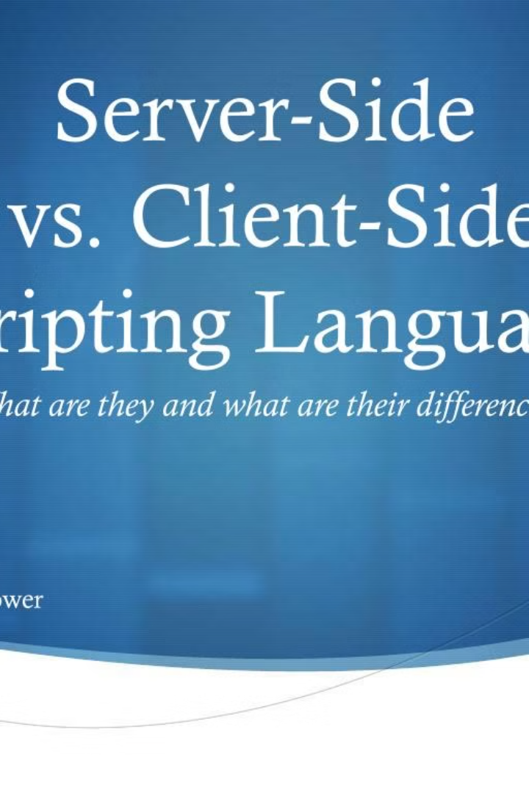

Comparison of JSP & PHP Based on Page Load Time
Vatsya Tiwari1, Manoj kr. Varshney2, Kishan Pal Singh3 and Santosh Kumar Bharti4
Department of Computer Science & Engineering, Mangalayatan University, Aligarh, UP
Department of Computer Science & Engineering, Mangalayatan University, Aligarh, UP
Department of Mechanical Engineering, Mangalayatan University, Aligarh, UP
Department of Computer Science & Engineering, Pandit Deendayal Petroleum University,
Gandhinagar, Gujrat
Email: vatsyatiwari@gmail.com

Slide 2
Introduction
Server-side scripting languages play a crucial role in web development. This research paper focuses on comparing two open-source server-side scripting languages, JSP and PHP, based on their page load time. The study aims to provide insights into the performance of these languages and help programmers make informed decisions when selecting a server-side scripting language.

Slide 3
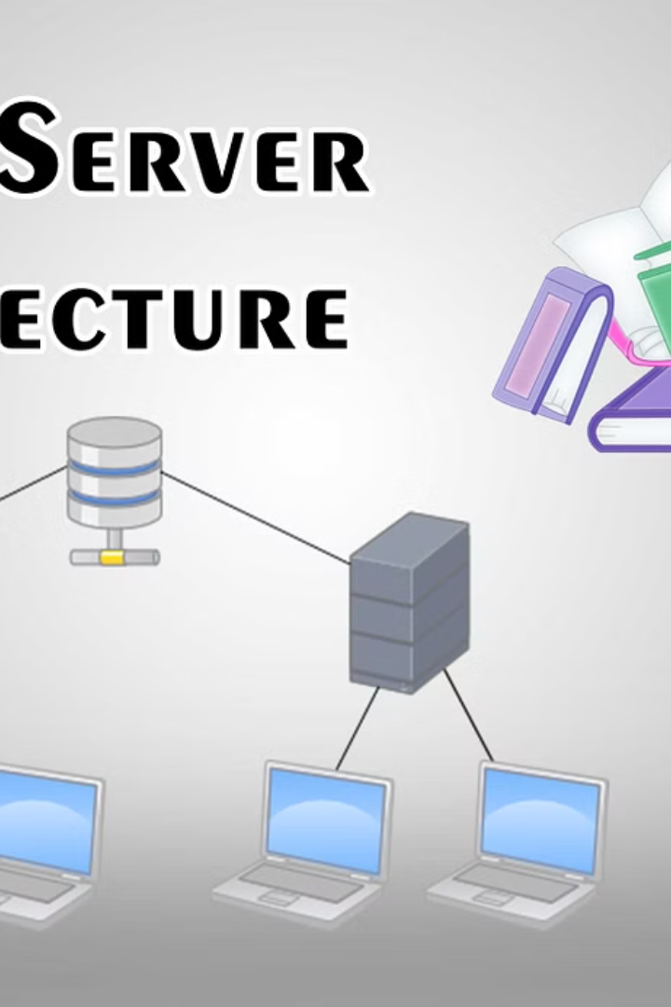
Client-Server Architecture
The client-server architectural model is fundamental to website functionality. It involves one computer functioning as a server and others as clients, with the server responding to client computers' HTTP requests.
Client-Server Model
One computer acts as a server, responding to client computers' HTTP requests.

Slide 4

Open-Source Server-Side Scripting Languages
Open-source server-side scripting languages like PHP and JSP provide developers with the freedom to use them without purchasing a license. This section explores the benefits of using open-source server-side scripting languages.
Benefits of Open-Source
Developers can use open-source languages like PHP and JSP freely without purchasing a license.

Slide 5
Comparison of JSP and PHP
The comparison between JSP and PHP involves analyzing their performance based on page load time. This section delves into the specific attributes and characteristics of each language.
JSP
Uses Java as a supporting language and aims to allow developers to utilize Java features in web applications.
PHP
Used in lightweight web development and provides access to various databases and middleware.

Slide 6
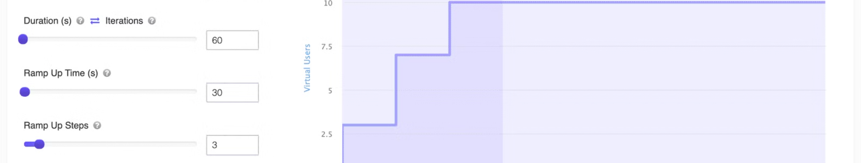
Load Testing and Results
Load testing was performed using Apache JMeter Testing tools to compare the page load time of projects developed in JSP and PHP. This section presents the detailed results and findings of the load testing.
Web ID Web Project URL Computer Configuration W1 Hyper Text Pre-processor (PHP) http:/localhost/wolf safari Processor: Core (TM) i3 3.00GHz, RAM: 8.00 GB, HDD:300 GB W2 Java Server Page (JSP) http://localhost/vatsya Processor: Core (TM) i3 3.00GHz, RAM: 8.00 GB, HDD:300 GB

Slide 7
Page Load Time Comparison
Page load time is a critical factor in web development, influencing user experience and website performance. This section presents the average page load time comparison between the PHP and JSP web projects.
PHP
Average Page Load Time (POST): 197ms
JSP
Average Page Load Time (POST): 237ms

Slide 8

Conclusion: Performance Analysis
The research study concludes that PHP outperforms JSP in terms of page load time. It also highlights the complexities of JSP programming and the direct interpretation of PHP by web browsers, contributing to its faster page load time.
PHP
Less page load time compared to JSP

Slide 9

References
Anon., 2023. Benefits and Drawbacks of PHP You Should Know When Starting a New Project. [Online]
Available at: https://anywhere.epam.com/business/pros-and-cons-of-php
[Accessed 11 May 2023].
[2]Botwe, D. A. & Davis, J. G., 2015. A Comparative Study of Web Development Technologies Using Open Source and Proprietary Software. International Journal of Computer Science and Mobile Computing, 4(2), p. 154 – 165.
[3]David A. Botwe, J. G. D., 2015. A Comparative Study of Web Development Technologies Using Open Source and Proprietary Software. International Journal of Computer Science and Mobile Computing, 4(2), pp. 154-165.
[4]foundation, A. s., n.d. usermanual:Apache JMeter. [Online]
Available at: https://jmeter.apache.org/usermanual/glossary.html
[Accessed 29 06 2023].
[5]Hanna, P., 2002. JSP 2.0: The Complete Reference. New York: McGraw-Hill Companies.

