Slide 1
REMOTE SENSING USING UAVS FOR DETECTING CROP DISEASES: AN OF MACHINE LEARNING AND DEEP LEARNING APPROACH
Gajanan Ankatwar^{*1} and Dr. Chitra Dhawale²
Ph.D., Scholar, Datta Meghe Institute of Higher Education and Research, Sawangi(Meghe), Wardha, Maharastra, India.
Research Supervisor, Professor & Head. Faculty of Science and Technology,
Datta Meghe Institute of Higher Education and Research, Sawangi(Meghe), Wardha, Maharastra, India.

Slide 2
INTRODUCTION
Environmental stresses that reduce crop productivity are common and can be divided into two categories: biotic (such as pests and diseases like fungi, bacteria, and nematodes) and abiotic (such as drought, floods, and extremely high temperatures) causes.
Crop scouting has historically involved farm workers manually examining disease indicators, frequently with assistance from a plant pathologist or crop disease specialist. Because it necessitates pathogen isolation, microscopy, and symptom observation, this approach takes time.
UAVs, the Internet of Things (IoT), and artificial intelligence (AI) are examples of cutting-edge technology that present viable, easier-to-use, and quicker alternatives for disease detection.
Because of their adaptable field coverage and capacity to obtain high-resolution images closer to plants than other airborne techniques, unmanned aerial vehicles (UAVs) are preferred in PA research .
To predict yield and stress levels, these sensors gather data on crop attributes like covering thickness, biomass, and level. Furthermore, a couple of studies have confirmed the accuracy of UAV-based remote sensing in assessing disease
Advances in UAV platforms and sensors, which have made image collection more frequent and inexpensive, have enhanced the accuracy of agricultural disease forecasting via predictive tactics, such as classical (ML) and (DL) approaches.

Slide 3
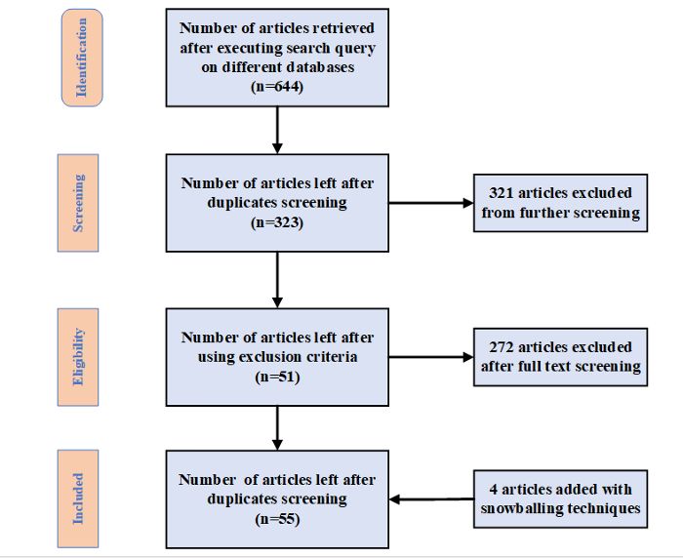
THE SURVEY'S METHODOLOGY
We tried to determine current research holes and explore the conceivable outcomes of machine learning and deep learning techniques in agricultural disease ID utilizing (UAV) remote sensing
To gather and incorporate research articles pertinent to the concerns of our review, we carried out a methodical review of the literature utilizing laid out procedures
PRISMA criteria [29] were continued in this review, and the purposeful strategy displayed in Figure 1 was used to track down relevant distributions.
Figure 1. A methodical approach was utilized to obtain publications for the purpose of systematic review.

Slide 4
BACKGROUND
Using energy that is reflected or transmitted from distant objects, remote sensing collects physical attribute data on an object without causing damage.
In active remote sensing, an object is interacted with, reflected energy is recorded, and the resulting images are transmitted, received, and analyzed. Precision agriculture (PA), which depends on precise temporal and geographical field data for sound decision-making, requires this method.
Modern technologies are essential for managing PA, including networking, aerial sensors, and field-based sensors. Appropriate pesticide application yield calculation , and irrigation management are just a few examples of PA operations where remote sensing has proven worthwhile
Large-scale data collection using field-based sensors necessitates frequent relocation, which raises labor and expense expenses . Spectral imaging from satellites or airplanes is frequently costly and might not always be available.
UAVs) are utilized in remote sensing to gather light spectrum reflections off diverse objects, including plants, soil, and water. Data on reflectance are fundamental for tracking crop growth .

Slide 5
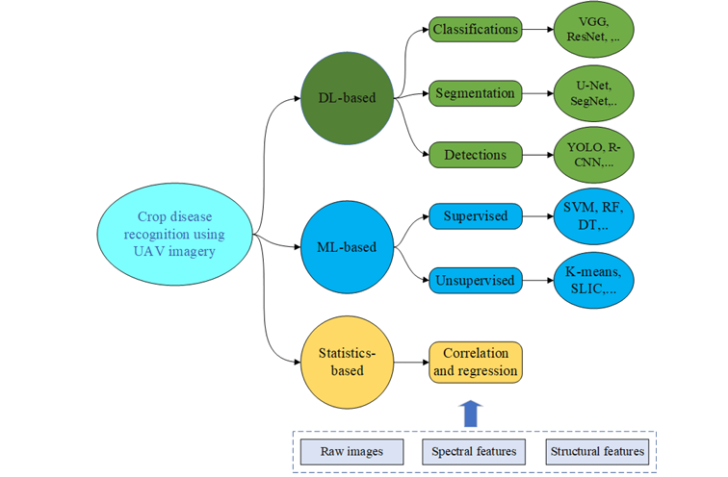
CLASSIFICATION OF CROP DISEASE ASSESSMENT USING UAV IMAGERY
We divided the current techniques for identifying agricultural diseases using UAV data into three main categories. Statistical techniques leverage a variety of (VIs) to extract agricultural attributes and apply regression and correlation studies to build linear correlations between disease and spectral data from UAV imagery.
Second, classic (ML) approaches construct disease estimation models by utilizing vegetation indexes as input characteristics and applying conventional supervised or unsupervised procedures. Lastly, deep learning techniques train end-to-end models for illness recognition employing UAVs using raw photos and other characteristics.
Crop-related features from UAV data are utilized as the autonomous variables in language model-based approaches to appraise crop illnesses, with the disease score serving as the target variable
Figure 4. A classification system for assessing agricultural illnesses by unmanned aerial vehicle remote sensing. The visual components used in one or more branches are represented by the items within the dotted box.

Slide 6
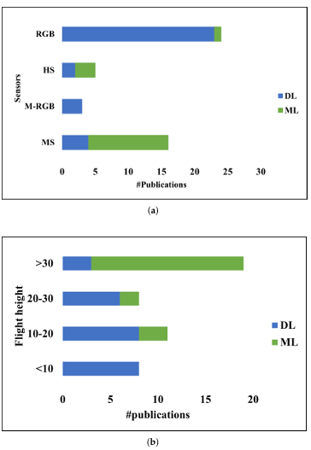
RESULTS AND DISCUSSION
Figure 8. Please provide the sentence you would like me to rephrase for better language quality and clarity. I am unable to generate a response without a specific sentence to work with.
By responding to the review questions, this section offers an overview of the material examined in section 2. The first section covers different UAV platforms and sensors, along with configurations like flying height. Next, we look at how these platforms affect the taxonomy's crop disease estimation techniques.
The most successful vegetation indices and how well they can identify particular crop diseases are then determined. It also assesses the effectiveness of several variables, such as vegetation indices, in conjunction with sophisticated data-driven crop disease estimating techniques, such traditional ML and DL
In the last several years, UAV sensing systems have developed to such an extent that they are now essential tools for monitoring crop health, spotting diseases early on, and helping to limit crop disease outbreaks [40].
This implies that high detail images are needed for DL techniques, and RGB sensors can provide these images at closer ranges. However, due to their high cost and complicated data processing, hyperspectral sensors are used less in both ML and DL techniques (Figure S)
This indicates that RGB sensors at lower altitudes are sufficient for high-resolution imagery required by DL methods.

Slide 7
SUMMARY OF FINDINGS
We summarize our findings from a survey conducted on UAV-based crop disease estimation, highlighting the following aspects: (a) strengths and current research focus, (b) emerging trends in research and technology, and (c) challenges and potential solutions
Compared to diseases brought on by bacteria, viruses, and pests, our meta-analysis showed that fungal diseases have been researched the most using UAV-based remote sensing
Factors such as flight altitude, payloads, and sensors affect the effectiveness of UAV sensing systems for crop disease estimation. To address this, it is necessary to develop cost-effective, high-payload sensing technologies for small UAVs, which are limited in their payload capacity
A significant challenge in the field is the lack of labeled data, as labeling requires expensive expert involvement. Future research should focus on unsupervised and semi-supervised techniques to mitigate this issue
To compare performance, a benchmark dataset for various agricultural diseases must be created. To overcome the high computational resource needs, lightweight deep learning models appropriate for edge computing platforms, like IoT, should be developed.

Slide 8
CONCLUSIONS
The overflow of data acquired by various imaging sensors and UAVs has driven data-driven approaches, like deep learning (DL) and conventional machine learning (ML), to outperform traditional statistical strategies in crop disease estimation
Support vector machine (SVM), random forest (RF), multilayer perceptron (MLP), and gradient boosting machine (GBM) are the most often used classical ML models for agricultural disease assessment using UAVs
The visual geometry group (VGG) is the most widely used model in deep learning (DL), closely followed by ResNet, CNN, and Inception.
The goals of various UAV platforms, sensors, and data processing methods for remote agricultural disease monitoring are made clear by this comprehensive evaluation.
Another intriguing path is to develop deep learning models that are small and suitable for edge computing platforms such as the Internet of Things. Every author contributed to the ideation, writing, method, data curation, and visualization of the paper

Slide 9
REFERENCES
Suzuki, N.; Rivero, R.M.; Shulaev, V.; Blumwald, E.; Mittler, R. Abiotic and biotic stress combinations. New Phytol. 2014, 203, 32–43. [CrossRef] [PubMed]
Khakimov, A.; Salakhutdinov, I.; Omolikov, A.; Utaganov, S. Traditional and current-prospective methods of agricultural plant diseases detection: A review. In Proceedings of the IOP Conference Series: Earth and Environmental Science; IOP Publishing: Bristol, UK, 2022; Volume 951, p. 012002.
Kalischuk, M.; Paret, M.L.; Freeman, J.H.; Raj, D.; Da Silva, S.; Eubanks, S.; Wiggins, D.; Lollar, M.; Marois, J.J.; Mellinger, H.C.; et al. An improved crop scouting technique incorporating unmanned aerial vehicle–assisted multispectral crop imaging into conventional scouting practice for gummy stem blight in watermelon. Plant Dis. 2019, 103, 1642–1650. [CrossRef] [PubMed]
Wang, Y.M.; Ostendorf, B.; Gautam, D.; Habili, N.; Pagay, V. Plant Viral Disease Detection: From Molecular Diagnosis to Optical Sensing Technology—A Multidisciplinary Review. Remote Sens. 2022, 14, 1542. [CrossRef]
Singh, V.; Sharma, N.; Singh, S. A review of imaging techniques for plant disease detection. Artif. Intell. Agric. 2020, 4, 229–242. [CrossRef]

Slide 10
THANK YOU
THANK YOU

