Slide 1
UNDERSTANDING ECONOMICS OF RAIN SHELTER METHOD OF TOMATO CULTIVATION
Bhaskar Pathak¹ and Dr. Munindra Kakati²
1. Research Scholar, School of Entrepreneurship and Management, Assam Rajiv Gandhi University of Cooperative Management, Basic Tinali, Joysagar, Sivasagar, Assam, India, 785665
2. Professor, Department of Business Administration, Guwahati University, Assam, India, 781014
*bhaskar72pathak@gmail.com
*munink@yahoo.com

Slide 2
INTRODUCTION
The tomato, (Solanum lycopersicum), is a member of the Solanaceae family and is one of the most widely grown, significant, and profitable vegetables in India.
In 2018, tomatoes were grown in Assam on 18.28 thousand hectares of land and produced 396.024 thousand MT (Agricultural Statistics at a Glance, 2019)
In recent times, Assam has witnessed notable progress and prosperity in the field of tomato cultivation, both in area and production.
Tomatoes grow best in well-drained, sandy or red loam soils that have a pH range of 6.0 to 7.0 and are high in organic matter
Temperatures between 21 and 24°C are ideal for tomato cultivation. Frost and temperatures above 32 °C can have a negative impact on plants (Indian Council of Agricultural Research).
The amount of land available for agriculture is running out daily. The increasing population's need for food will require more productive and intensive agricultural methods.
In Assam, a farmer cannot grow vegetables during periods of high rainfall,high temperature, humidity, rainfall, strong winds, and high incidence of diseases.

Slide 3
MATERIALS AND METHODS
The study was conducted in Bebejia Likson village, Marangi block of Golaghat district in the state of Assam (26.47° North latitude and 93.86 East longitudes) for the agricultural year 2021-22.
The plot of the cultivation belonged to one farmer named as Mr. Dibyajyoti Gogoi. To establish a consistent understanding of the costs associated with the entire operation throughout the crop cycle in both methods, one experimental Rain Shelter (RS) plot covering an area of 100 square meters (sqm) was employed
In addition, the same plot was used for Open Field (OF) method in the same farmer’s another plot in the same village
The order of the actions involved in the cultivation process was used to categorize the entire operation
A field register was used to record the costs associated with each activity for both RS and OF. The tomato variety used in the experiment was Anup produced by Syngenta India Private Limited
The standard cost concept, which includes costs A1, A2, B1, B2, C1, C2, and C3, was used to determine the economics of tomato cultivation in the research area under both RS and OF conditions.

Slide 4
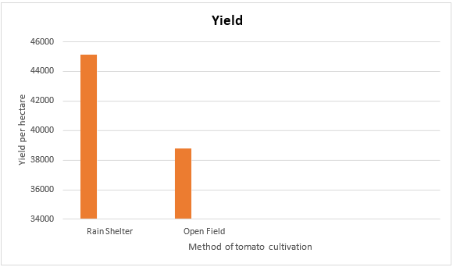
COST A1
The producer's real out-of-pocket and in-kind production expenses. The cost of item A1 includes the following elements.
Cost A2= Cost A1+ The amount of rent paid on account of acquiring the land on lease purpose.
Cost B 1= Cost A 1+ The amount of interest paid that is accrued on the own fixed capital which does not include value of rent for using the own land that belongs to the farmer.
Cost B 1=Cost A 1 or Cost A 2 +The amount of interest paid that is accrued on the owned capital utilized in the farm operation which does not include the value of the own land that belongs to the farmer.
Cost B2= Cost B1 + The value of rent of the owned land that belongs to the farmer -The amount of revenue paid for the land + Rent paid for leased in land
Cost C1= Cost B1 + The imputed (estimated) value of utilizing family labor in the farm operation.
Cost C2= Cost B2 + The imputed (estimated) value of utilizing family labor in the farm operation.
Cost C3= Cost C2 + 10 percent of Cost C2
Fig 1: The tomato yield comparison per hectare under Rain Shelter and Open Filed methods of cultivation

Slide 5
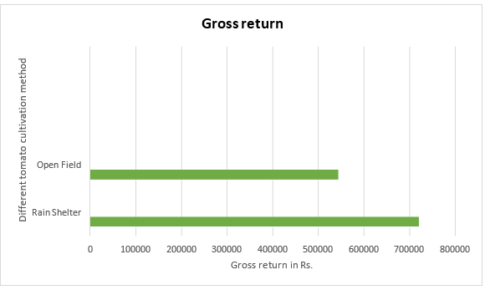
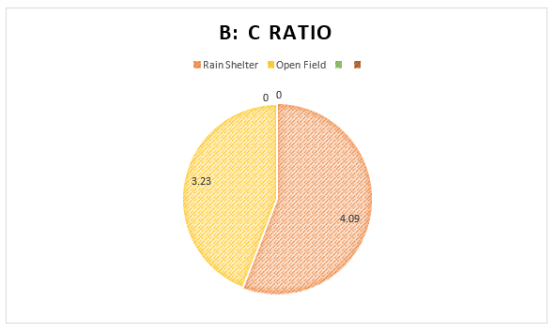
Fig: Comparison of gross return per hectare o tomato farming under Rain Shelter and Open Field methods of cultivation
Fig 3: Comparison of B: C ratio of tomato farming under Rain Shelter and Open Field method of cultivation

Slide 6
RESULTS AND DISCUSSION
This difference was mainly seen due to the polyhouse structure required in RS method. Other major contributors of the cost were hired human labor (12.41 and 17.44 percent), inorganic fertilizers (13.88 and 16.61 percent) and imputed value family labor (13.61 and 19.73 percent) in both the farming methods respectively.
The market price of tomatoes varied significantly with the methods of cultivation. From the table, we can see that the price realization under RS method were quite high as Rs. 16 per kg while the farmers cultivating tomatoes under open field condition got a fairly low price as Rs. 12 per kg.
The reason of high sale difference is that the tomatoes cultivated under RS method can be sold in the market when the demand for tomato is high and supply is insufficient, i.e. in off season
The study found that tomato cultivation in Rain Shelter method ismore profitable than the Open Field farming, with a benefit-cost ratio of 4.09 in the protected farming as against 3.23 in the traditional method.
The gross returns were Rs. 7,21, 920 and Rs. 4, 65, 000 and net return over cost were Rs. 5, 45, 434 and Rs. 3, 21, 073 in RS and OF method respectively
Although the initial investment in Rain Shelter method is a bit high but the high profitability of tomato cultivation in this method mitigates the cost and offer good pay-off benefit the farmers to enhance the income in the long run

Slide 7
CONCLUSION AND RECOMMENDATION
This new method of producing tomatoes under rainfed conditions in Rain Shelter method was found to be economically profitable, environmentally sound, and suitable for human life under farmer circumstances in the plain tomato production area of Golaghat district, Assam, India
It was also found to be better at producing fresh tomatoes with high quality and yield during the rainy season.
A partial budget analysis was also conducted
As a result, the holders of the stack and responsible bodies work hard to develop this technology and establish connections between the various players in the tomato production value chain in order to guarantee a sustainable supply and enhance farmers' livelihoods
The Golaghat area is suitable for the production of vegetables, more specifically tomatoes.

Slide 8
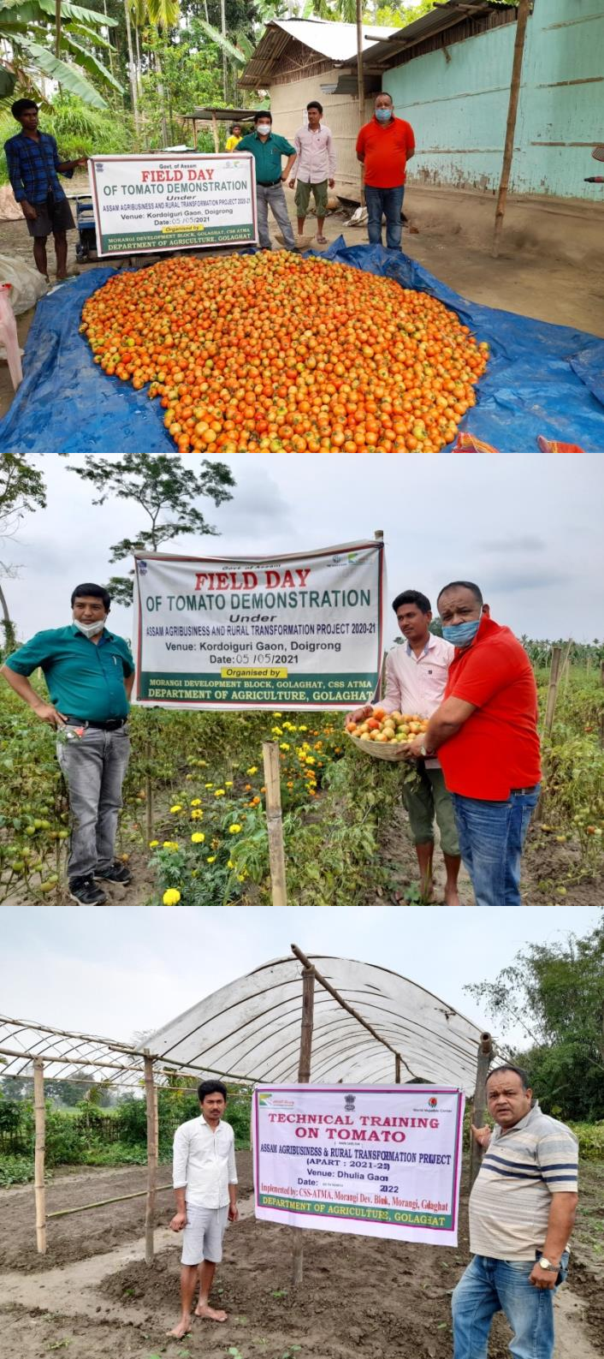
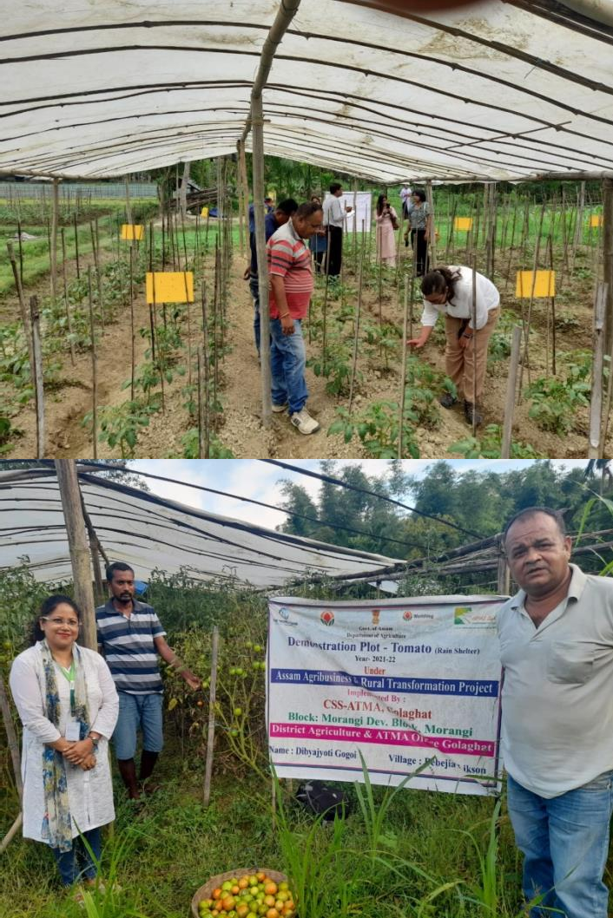
PHOTOGRAPHS

Slide 9
REFERENCES
Agricultural Statistics at a Glance. (2019). Agricultural Statistics at a Glance 2019, Ministry of Agriculture and Farmers Welfare, Department of Agriculture Cooperation and Farmers Welfare Directorate of Economics and Statistics Government of India. In Government of India (p. 314). http://agricoop.nic.in/agristatistics.htm
Das, P., Bordhan, S., & Sethi, L. N. (2016). Effect of Low-Cost Poly House on Production of Tomato in a Hillock of Assam. Journal of Agricultural Engineering and Food Technology, 3(3), 242–247. Farming innovations feed the world and protect the planet _ World Economic Forum. (n.d.).
Heckman, J. J., Pinto, R., & Savelyev, P. A. (2015). Sustainable Food Production Practices in the Caribbean 2.
Kalita, H., Angami, T., Makdoh, B., & Touthang, L. (2023). Low-Cost Plastic Rain-Shelter and Poly- Tunnel for Protected Vegetable Cultivation in High Rainfall. February, 23–25. https://doi.org/10.13140/RG.2.2.21732.45444
Kratky, B. . (2006). Plastic-covered rainshelters for vegetable production in the tropics. Proc. of the 33rd National Agricultural Plastics Congress. American Society for Plasticulture, Bellafonte, PA, August, 1–

Slide 10
THANK YOU

