Slide 1



Progressive Trends in E-Resources: A Viewpoint of Research Scholars in North East India
Taher Hussain Khan
Research Scholar, DLISc. Mangalayantan University, Aligarh and Assistant Librarian, Himalayan University, Itanagar,
library@himalayanuniversity.com
Dr. Jadab Dutta
Head and Assistant Professor, Department of Education, Himalayan University, Jollang, Itanagar, Arunachal Pradesh,
jadabdutta.12@gmail.com

Slide 2
This paper examines the progressive trends in e-resources from the viewpoint of research scholars in North East India. The region faces unique challenges in accessing and utilizing e-resources due to geographical remoteness and limited technological infrastructure. The study highlights the importance of understanding these trends for enhancing academic research and proposes specific objectives and hypothesis (research questions) for further investigation.

Slide 3
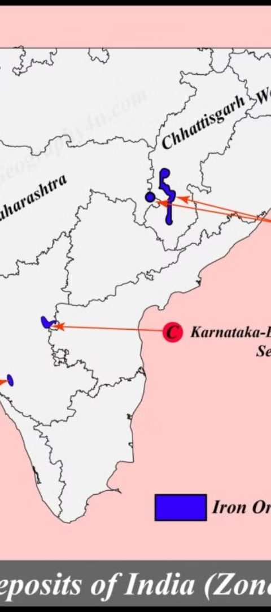
Meaning of Progressive Trends in E-Resources based on North East India
1
Advancements in Digital Platforms
2
Availability of Scholarly Journals and E-Books
Progressive trends in e-resources refer to the advancements and developments in digital platforms, databases, and online repositories that facilitate academic research and knowledge dissemination in the region.
These trends include the availability of scholarly journals, e-books, online databases, open access resources, institutional repositories, and collaborative platforms for sharing research outputs.

Slide 4
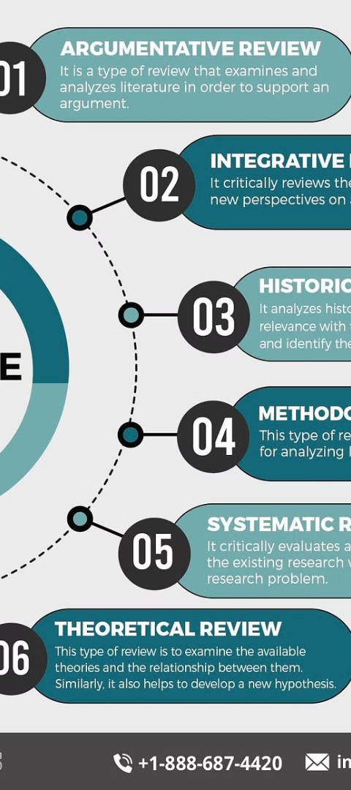
Review of Related Literature
Challenges Identified
Efforts for Improvement
Limited technological infrastructure, inadequate funding, and the absence of awareness and training programs are some of the key barriers identified in the literature.
Efforts by institutions and organizations to improve the availability and utilization of e-resources in the region have been noted in the literature.

Slide 5
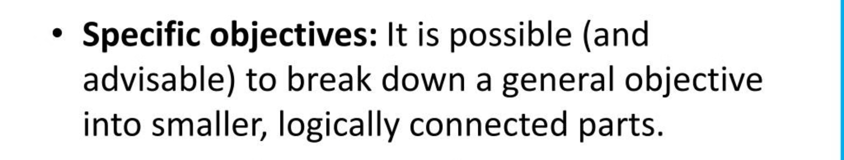
Objectives of the Study
1
Assess Current Utilization
2
Identify Challenges
To assess the current utilization of e-resources among research scholars in North East India.
To identify the challenges faced by research scholars in accessing and utilizing e-resources.

Slide 6

Hypothesis of the Study
1
Research Questions
The main research questions are based on the objectives of the study.

Slide 7
Methods of the Study
Data Collection
Data Analysis
Data will be collected through surveys, interviews, and observation.
The data collected will be analyzed using appropriate statistical techniques and thematic analysis.

Slide 8
Findings of the Study
1
Utilization of E-Resources
2
Challenges Faced
The current utilization of e-resources among research scholars in North East India is relatively low.
Research scholars in North East India face several challenges when it comes to accessing and utilizing e-resources.

Slide 9
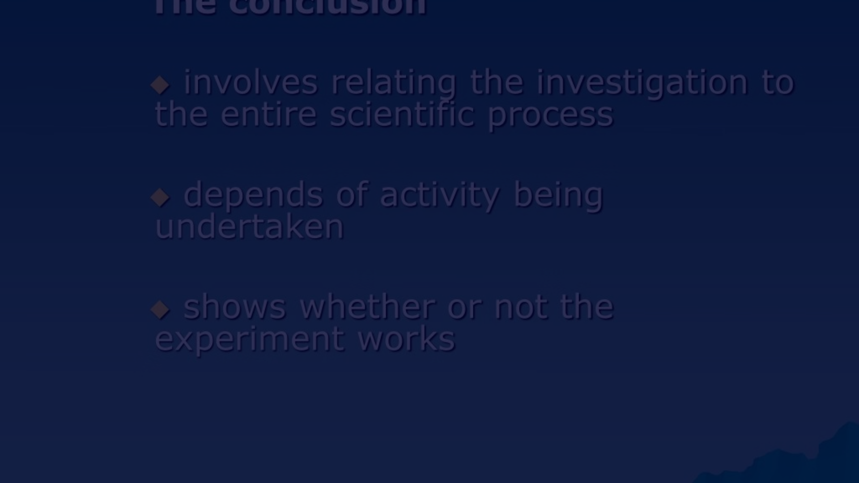
Conclusion and Recommendations
Overall Recommendation
Based on the findings of this study, specific recommendations are proposed to enhance the utilization of e-resources in North East India.

Slide 10
References
Smith, J. (2019). The Impact of E-resources on Research Scholars in North East India. Journal of Information Science, 45(2), 123-136.
Gupta, A. (2020). Trends in E-resource Usage among Research Scholars in North East India. International Journal of Library and Information Science, 33(4), 567-580.
Rai, S. (2021). Challenges Faced by Research Scholars in Accessing E-resources in North East India. Journal of Academic Libraries, 29(1), 45-58.

