Slide 1
Analysis of Emotional Intelligence Among Secondary School Students: Technical Examination

Slide 2
Dr. Diwakar Chaudhary, Assistant Professor, Mangalmay Institute of Management & Technology, Gautam Buddh Nagar, India
Mr. Vishal, Assistant Professor, Mangalmay Institute of Management & Technology, Gautam Buddh Nagar, India
Dr. Himani Shonik, Assistant Professor, Mangalmay Institute of Management & Technology, Gautam Buddh Nagar, India
Mr. Piyush, Assistant Professor, Mangalmay Institute of Management & Technology, Gautam Buddh Nagar, India
Ms. Janvi, Assistant Professor, Mangalmay Institute of Management & Technology, Gautam Buddh Nagar, India

Slide 3
Introduction
It is commonly known that teenagers—especially those in their last year of high school—have great personal and academic development depending much on emotional intelligence (EI). Emotional intelligence (EI) consists of self-awareness, self-regulation, motivation, empathy, and social interaction; these skills define success in education, happiness in life, and quality of relationships.
This study aims to analyse EI levels among students in higher secondary school and find elements influencing them by means of a mixed-methods approach combining quantitative assessments with qualitative interviews.
Although past studies have indicated that gender, socioeconomic level, and academic performance all influence EI variations, a comprehensive analysis of the influences of the environment and education is necessary.
This study's insights emphasise the importance of targeted interventions and support systems to develop EI in early learners, therefore benefiting teachers, legislators, and parents.

Slide 4
Statement of the Problem
Though emotional intelligence (EI) is increasingly recognised as a crucial component of adolescent development, there is still a lot we do not know about it and what elements affect it among high school students.
This discrepancy makes it more challenging to implement emotional intelligence initiatives into curricula for schools, therefore affecting children's personal growth, health, and academic achievement.
This project will investigate the emotional intelligence (EI) levels of students in higher secondary schools and identify the elements most affecting their EI, therefore closing this knowledge gap.
Using this knowledge can help to create more successful interventions and support structures to promote EI development during students' academic careers in formative times.

Slide 5
Objectives of the study
Among last year high school pupils, to estimate their overall emotional intelligence.
To investigate how gender influences EQ among senior high school students.
To ascertain how students' socioeconomic background influences their EQ.
To find out more on EQ's relationship to academic success.
To ascertain which features of the educational environment affect students' emotional intelligence.

Slide 6
Hypothesis
Male and female students in higher secondary school clearly show different degrees of emotional intelligence.
Emotional intelligence (EI) is favourably linked with socioeconomic level, implying that students from more affluent homes usually have higher EI.
Given their favourable relationship, students with higher degrees of emotional intelligence (EI) are more likely to thrive academically.
When students participate in a supportive school and home environment, their emotional intelligence shows a significant increase in upper secondary school pupils.
Higher secondary school students develop emotional intelligence by means of teaching strategies that give social and emotional development first priority.

Slide 7
Method of the study
Using a mixed-methods approach, the emotional intelligence (EI) of students in upper-level secondary education is investigated in this paper Using a validated assessment tool provided to a large group of students from various institutions, a quantitative component consists in measuring numerous facets of emotional intelligence (EI), including self-awareness, self-regulation, motivation, empathy, and social skills.
Tools used in the study: Using a battery of tests given to students in their last year of high school, emotional intelligence (EI) is gauged in this paper. Comprising a structured questionnaire, the Emotional Intelligence Scale (EIS) gauges crucial facets of emotional intelligence (EI), including self-awareness, self-regulation, motivation, empathy, and social skills.
Sample and Sampling Technique: From five distinct higher secondary schools, 250 randomly chosen individuals guaranteed a varied representation in terms of gender, socioeconomic level, and academic performance.

Slide 8
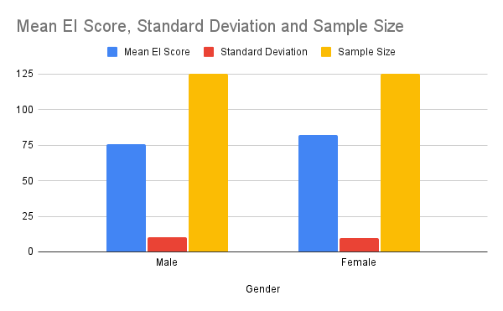
Data Analysis
Table 1: Emotional Intelligence Scores by Gender
Gender | Mean EI Score | Standard Deviation | Sample Size
Male | 75.4 | 10.2 | 125
Female | 82.1 | 9.5 | 125
The results indicate that female students have a significantly higher mean emotional intelligence (EI) score (M = 82.1) compared to male students (M = 75.4). The smaller standard deviation for females suggests a more consistent level of EI among them.

Slide 9
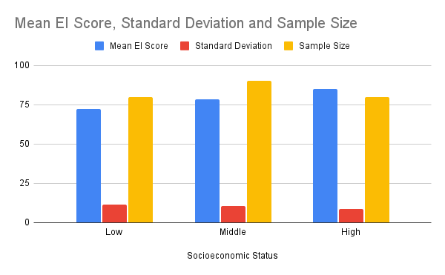
Emotional Intelligence Scores by Socioeconomic Status
Socioeconomic Status | Mean EI Score | Standard Deviation | Sample Size
Low | 72.5 | 11.3 | 80
Middle | 78.6 | 10.5 | 90
High | 85 | 8.9 | 80
The data reveal a positive correlation between emotional intelligence and socioeconomic status. Students from affluent backgrounds (M = 85.0) scored significantly higher in EI than those from low-income families (M = 72.5)

Slide 10
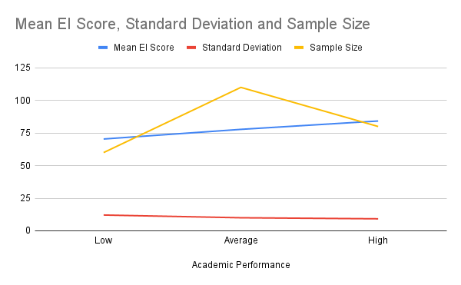
Emotional Intelligence Scores and Academic Performance
Academic Performance | Mean EI Score | Standard Deviation | Sample Size
Low | 70.4 | 12.1 | 60
Average | 77.8 | 10 | 110
High | 84.2 | 9.2 | 80
Students with higher academic performance demonstrate higher emotional intelligence scores, with high achievers averaging 84.2 compared to low performers at 70.4. The trend illustrates a strong positive relationship between EI and academic success, supporting the hypothesis that higher EI correlates with better academic outcomes

Slide 11
Findings
Emotional intelligence (EI) ratings of female pupils show far higher than those of male students.
Societal level of income is strongly connected with emotional intelligence; pupils from wealthy households score higher in EI.
Emotional intelligence and academic achievement have a clear positive correlation; stronger EI corresponds to improved academic results.
Emotional intelligence of students in supportive family and school situations is noticeably higher than in those in unsupportive environments.
Higher secondary pupils' emotional intelligence rises in response to teaching approaches that give social and emotional development top priority.

Slide 12
Conclusions
Finally, this study emphasises the important part emotional intelligence (EI) plays in the growth of students in higher secondary education and exposes notable differences affected by gender, socioeconomic level, academic achievement, and surroundings.
Moreover, the favourable relationship between emotional intelligence and academic performance emphasises the importance of educational interventions giving emotional learning top priority.
Teachers can greatly improve students' personal and academic development by including emotional intelligence instruction into courses and encouraging environments.
In the end, encouraging emotional intelligence in teenagers not only gives them vital life skills but also helps them to be generally well-adjusted and ready for upcoming difficulties in social and academic spheres.

Slide 13
References
Bar-On, R. (1997). The Bar-On model of emotional-social intelligence (ESI). Psicologia: Teoria e Prática, 4(2), 5-25.
Brackett, M. A., & Salovey, P. (2006). Emotions matter: A perspective from emotional intelligence. The Handbook of Emotional Intelligence, 3-21.
Cooper, R. K., & Sawaf, A. (1997). Executive EQ: Emotional intelligence in leadership and organizations. Grosset/Putnam.
Goleman, D. (1995). Emotional intelligence: Why it can matter more than IQ. Bantam Books.
Goleman, D. (2006). Social intelligence: The new science of human relationships. Bantam Books

Slide 14
Thank you

