Slide 1
EXPLORING WORKPLACE EMOTIONAL INTELLIGENCE: TECHNICAL INSIGHTS
Ms. Janvi, Dr. Himani Shonik, Mr. Piyush Kumar, Mr. Vishal, Dr. Diwakar Chaudhary
Assistant Professor,
Mangalmay Institute of Management & Technology,
Gautam Buddh Nagar, India

Slide 2
INTRODUCTION
Regarding enhancing organisational performance and understanding dynamics in the workplace, emotional intelligence (EI) has grown to be a very important issue.
Emotional intelligence—that is, the capacity to recognise, comprehend, and manage one's own emotions as well as be sensitive to the emotions of others—defines much of the effect interpersonal contacts in the workplace have on Emotional intelligence (EI) is mostly responsible for both personal and team performance; it has become more and more important as businesses realise the need of soft skills alongside technical ability.
Beyond its clear influence on personal satisfaction, emotional intelligence affects the success or failure of any given company in a variety of ways. Higher test of emotional intelligence scores translate into a leg up for handling pressure, problem-solving, and clear communication.
Businesses that make investments in the emotional intelligence of their workers not only become more effective generally but also help to create a team capable of gracefully and poisely managing challenges.
The significant value of emotional intelligence in the workplace is underlined even more by the radical changes in the nature of employment throughout the last few years.

Slide 3
OBJECTIVE OF THE STUDY
Studies of EQ in the workplace seek to achieve the following:
To ascertain how EQ affects output in many kinds of companies.
More especially, we want to know how EQ influences team communication and cooperation.
The aim is to ascertain how EQ influences team and employee conflict resolution.
To look examine how emotional intelligence relates to the effectiveness of many leadership approaches in motivating groups.

Slide 4
LITERATURE REVIEW
Organisational behaviour research has focused considerably on the value of emotional intelligence (EI) in the workplace. Emotional intelligence, according to Goleman (1995), is a collection of qualities that enable one to properly interact with others including self-awareness, motivation, self-regulation, empathy, and social skills.
Studies on EQ's relationship with work performance abound and demonstrate that it is favourable. For instance, Carmeli (2003) discovered a positive link between emotional intelligence and personal performance, implying that employees with great degrees of emotional competency excel in their employment.
In the realm of leadership, emotional intelligence has also been the focus of considerable study. Research by Boyatzis and Goleman (2001) shows that employees are more committed in the success of the organisation when its CEOs have strong emotional intelligence.
Teams with emotionally intelligent leaders had more cohesive work environments, according to Zaccaro, Kemp, and Bader (2018), who supported this point of view as their leaders helped members address issues more successfully. Research by Lopes et al. (2006) shows that emotionally intelligent leaders improve the performance of their staff and contribute to creating a more pleasant workplace.

Slide 5
RESEARCH METHODLOGY
Combines quantitative and qualitative techniques to study emotional intelligence in the workplace.
Standardized tests (MSCEIT, EQ-i) and surveys on job satisfaction, performance, collaboration, and leadership.
Statistical analysis (regression, correlation) of emotional intelligence and workplace outcomes.
Semi-structured interviews with employees to explore emotional intelligence’s impact.
Thematic analysis to interpret interview data and identify trends.
Focus groups to discuss emotional intelligence’s role in team dynamics and corporate culture.
Tests and refines research tools for validity and reliability.
Ensures informed consent, anonymity, and clear research objectives.

Slide 6
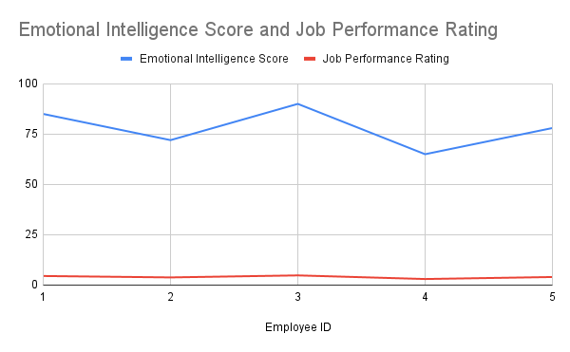
DATA ANALYSIS
Table 1: Emotional Intelligence Scores and Job Performance Ratings
Employee ID | Emotional Intelligence Score | Job Performance Rating
1 | 85 | 4.5
2 | 72 | 3.8
3 | 90 | 4.8
4 | 65 | 3
5 | 78 | 4
The data indicates a positive correlation between emotional intelligence scores and job performance ratings. The table illustrates that employees with higher emotional intelligence scores tend to receive higher job performance ratings.

Slide 7
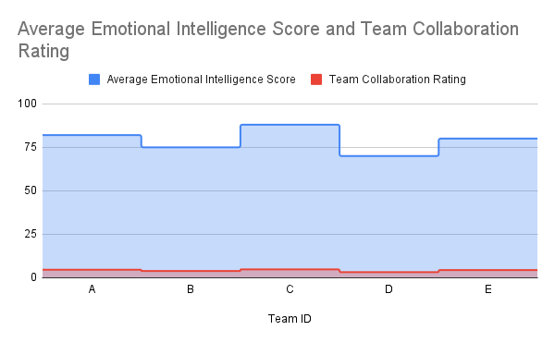
The data suggests a strong relationship between emotional intelligence and team collaboration ratings.
Table 2: Emotional Intelligence and Team Collaboration Ratings
Team ID | Average Emotional Intelligence Score | Team Collaboration Rating
A | 82 | 4.6
B | 75 | 3.9
C | 88 | 4.8
D | 70 | 3.2
E | 80 | 4.4
In this table, teams with higher average emotional intelligence scores consistently report better collaboration ratings. For example, Team C, with an average EI score of 88, has a collaboration rating of 4.8, indicating strong teamwork and communication. Conversely, Team D, which has a lower EI score of 70, exhibits a significantly lower collaboration rating of 3.2

Slide 8
FINDINGS
Results of this research indicate that emotional intelligence influences employee performance, team relationships, and organisational success. First of all, the research clearly shows a favourable correlation between emotional intelligence and opinions of personal performance on the employment.
Higher average EQ team members reported improved team cohesion, greater communication, and closer relationships.
The qualitative data gathered from interviews, where participants underlined the need of emotionally intelligent people being more sympathetic and competent at conflict resolution, confirmed this finding. These qualities help to create a better workplace and better team interactions.
This research also revealed effects of emotional intelligence training. Following structured emotional intelligence training, staff members' degrees of involvement increased noticeably.
The pre- and post-training assessments revealed that the trainees had higher degrees of motivation and were more involved in their employment.
The studies also underlined the need of emotional intelligence in effective leadership. Higher emotional intelligence leaders were also more likely to motivate their employees to great heights, promote honest comments, and create a supportive environment.

Slide 9
CONCLUSION
This study emphasises the need of emotional intelligence in enhancing workplace dynamics by demonstrating how it influences employee performance, collaboration, and general organisational effectiveness.
Moreover, the studies reveal that emotionally intelligent teams perform better together, which is suggestive of improved communication and closer relationships that result from which a more harmonic and productive workplace results.
If businesses want to see a return on their investment in emotional intelligence training for their staff members—more engagement and happiness in the workplace—they would be smart to do so.
In the complicated work environment of today, organisations might develop a competitive advantage by deliberately stressing emotional intelligence as a necessary ability.
By encouraging emotional intelligence at all levels, this study implies that companies may raise performance, retention, and employee well-being.

Slide 10
REFERENCES
Bar-On, R. (1997). Bar-On emotional quotient inventory (EQ-i): Technical manual. Multi-Health Systems.
Boyatzis, R. E., & Goleman, D. (2001). Emotional intelligence as a performance factor. In R. E. Boyatzis, & D. Goleman (Eds.), The emotional intelligence coaching handbook (pp. 97-118). Praeger.
Carmeli, A. (2003). The relationship between emotional intelligence and work attitudes: An exploratory study. International Journal of Organizational Analysis, 11(2), 160-180.
Goleman, D. (1995). Emotional intelligence: Why it can matter more than IQ. Bantam Books.
Kira, I. A., & Kira, R. A. (2011). Emotional intelligence and psychological well-being: A study of a multi-dimensional model. International Journal of Psychology, 46(5), 374-380.
Lopes, P. N., Grewal, D., Kadis, J., Gall, M., & Salovey, P. (2006). Emotional intelligence, social functioning, and well-being. Personality and Individual Differences, 40(5), 901-911.
Mayer, J. D., Salovey, P., & Caruso, D. R. (2004). Emotional intelligence: Theory, findings, and implications. Psychological Inquiry, 15(3), 197-215.

Slide 11
THANK-YOU

