Slide 1

MACHINE LEARNING ENABLED
PLANT DISEASE DETECTION
- A REVIEW
Dr. Rakesh Sharma
Associate Professor, Department of ECE
BMU, Rohtak
Amit Banga
Research Scholar, Department of ECE
BMU, Rohtak

Slide 2
INDEX
INTRIDUCTION
MOTIVATION
REVIEW OF LITERATURE
DATASETS
CONCLUSION

Slide 3
INTRODUCTION
Recent advancements in machine learning (ML) and deep learning (DL) have revolutionized plant disease detection, offering automated solutions to enhance agricultural productivity and food security.
This paper synthesizes current literature on ML and DL techniques applied to image-based plant disease classification. Key studies reviewed highlight the effectiveness of DL models, particularly convolutional neural networks (CNNs), in accurately identifying and classifying plant diseases from leaf images.
The integration of IoT devices for real-time data acquisition and datasets such as Plant Village has significantly improved disease detection capabilities. Comparative analyses of ML and DL architectures underscore the superior performance of DL in handling complex image features and achieving high accuracy rates.
Future research directions include optimizing model interpretability, scalability, and addressing data quality challenges to further enhance disease management systems in agriculture.

Slide 4
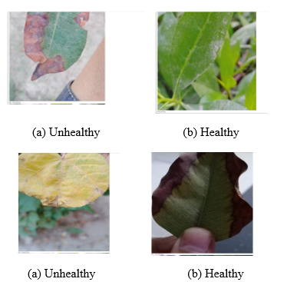
Agriculture stands as a cornerstone of human civilization, providing sustenance, economic stability, and cultural identity across the globe. Central to its success is the ability to ensure crop health and productivity. However, the threat posed by plant diseases looms large, significantly impacting crop yields and food security worldwide. Plant diseases, caused by various pathogens including fungi, bacteria, viruses, and pests, result in substantial economic losses each year. These losses not only affect farmers' livelihoods but also contribute to fluctuations in food availability and prices, ultimately impacting global food security.
As agriculture faces the dual challenge of feeding an ever-growing population while mitigating environmental impacts, the need for efficient disease management strategies becomes increasingly urgent. Automated disease detection using machine learning and deep learning techniques presents a promising avenue to bolster crop health monitoring and management practices. By enabling early and accurate detection of plant diseases, these technologies offer potential solutions to mitigate losses, optimize resource allocation, and sustainably enhance agricultural productivity.

Slide 5
MOTIVATION
The imperative for automated disease detection in agriculture using machine learning and deep learning methodologies arises from the increasing complexity and scale of modern agricultural systems. These technologies enable rapid and accurate analysis of large-scale agricultural data, detecting subtle patterns indicative of disease onset before symptoms become visually apparent. By facilitating early detection, farmers can implement timely interventions, optimizing resource usage and minimizing environmental impacts.
Automated disease detection systems also provide real-time monitoring across diverse geographical regions, supporting proactive disease management strategies and enhancing overall agricultural resilience. This integration not only revolutionizes disease detection but also bolsters global food security by safeguarding crop health more effectively than ever before.

Slide 6
REVIEW OF LITERATURE
AUTHOR | YEAR | CONTRIBUTIONS
Sajitha et al. | 2024 | Comprehensive review of ML and DL techniques for image-based plant disease classification tailored for industrial farming systems.

Slide 7
REVIEW OF LITERATURE
AUTHOR | YEAR | CONTRIBUTIONS
Adekunle et al. | 2024 | Application of DL techniques for plant disease detection, showing high accuracy of CNN-based models.

Slide 8
REVIEW OF LITERATURE
AUTHOR | YEAR | CONTRIBUTIONS
Prasad and Thyagaraju | 2024 | Comprehensive review of early plant disease detection using IoT, ML, and DL, emphasizing integration for enhanced accuracy.

Slide 9
DATASETS
Study | Focus | Methods/Architectures | Dataset Used | Key Findings
Demilie (2024) | Comparative study of disease detection techniques | Various ML, DL methods | Various datasets | Provides insights into strengths and limitations of different detection techniques for specific applications.
Reis and Turk (2024) | Hybrid DL model for potato leaf disease detection | Depthwise separable convolutions, transformers | Potato leaf disease dataset | Hybrid approach improves accuracy and efficiency in disease detection compared to traditional DL models.
Kulkarni and Shastri (2024) | ML techniques for rice leaf disease detection | SVM, RF | Rice leaf disease dataset | Evaluates SVM, RF for classifying rice leaf diseases, emphasizing algorithm performance in agriculture.
Bouacida et al. (2024) | DL for cross-crop disease detection | CNNs | Cross-crop disease dataset | Proposes a generalized model for detecting plant diseases across different crop species.
Dubey and Choubey (2024) | Adaptive feature selection with DL for paddy leaf diseases | DL with adaptive feature selection | Paddy leaf disease dataset | Enhances classification accuracy by selecting relevant features from leaf images.
Ahmed and Yadav (2023) | ML for plant disease detection | SVM, RF, Naive Bayes | Plant disease dataset | Emphasizes feature engineering and dataset augmentation in improving model performance.

Slide 10
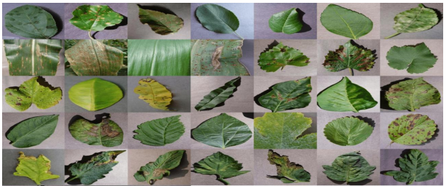
DATASETS
Dataset Name | Crop Type | Disease Types | Number of Images | Sources | Preprocessing Applied
PlantVillage Dataset | Tomato | Early Blight, Late Blight, Septoria | 10,000 | PlantVillage repository | Normalization, cropping
Wheat Rust Dataset | Wheat | Stripe Rust, Stem Rust | 5,000 | Research institution | Resizing, rotation
Grapevine Dataset | Grapevine | Downy Mildew, Powdery Mildew | 7,500 | Agricultural research project | Color adjustment, augmentation

Slide 11
CONCLUSION
The “application of machine learning (ML) and deep learning (DL) in plant disease detection represents a transformative advancement in agricultural technology.
This literature review has synthesized recent research that underscores the efficacy of ML and DL techniques in automating and improving the accuracy of disease identification across various crop species. Studies reviewed here demonstrate that DL models, particularly convolutional neural networks (CNNs), are highly effective in extracting intricate features from plant images, thereby enabling precise and early detection of diseases.
The integration of IoT devices for real-time data acquisition further enhances the scalability and efficiency of disease management systems in agriculture. The reviewed literature also highlights the critical role of datasets in training robust ML and DL models.
Diverse datasets such as specific crop disease collections and broader datasets like Plant Village have facilitated the development and benchmarking of these models, leading to significant improvements in disease classification accuracy and scalability. Studies comparing different ML and DL architectures emphasize the importance of model selection and parameter optimization in achieving optimal performance.
The reviewed literature underscores the transformative potential of ML and DL in revolutionizing plant disease management. By leveraging these technologies, agricultural stakeholders can mitigate crop losses, optimize resource use, and contribute to global food security in a sustainable manner.”

Slide 12
REFERENCES
Sajitha, P., Andrushia, A. D., Anand, N., & Naser, M. Z. (2024). A Review on Machine Learning and Deep Learning Image-based Plant Disease Classification for Industrial Farming Systems. Journal of Industrial Information Integration, 100572.
Khalid, M. M., & Karan, O. (2024). Deep learning for plant disease detection. International Journal of Mathematics, Statistics, and Computer Science, 2, 75-84.
Demilie, W. B. (2024). Plant disease detection and classification techniques: a comparative study of the performances. Journal of Big Data, 11(1), 5.
Adekunle, T. S., Lawrence, M. O., Alabi, O. O., Afolorunso, A. A., Ebong, G. N., & Oladipupo, M. A. (2024). Deep learning technique for plant disease detection. Computer Science and Information Technologies, 5(1), 55-62.
Reis, H. C., & Turk, V. (2024). Potato leaf disease detection with a novel deep learning model based on depthwise separable convolution and transformer networks. Engineering Applications of Artificial Intelligence, 133, 108307.
Prasad, S. R., & Thyagaraju, G. S. (2024). Leaf analysis based early plant disease detection using Internet of Things, Machine Learning and Deep Learning: A comprehensive review. Journal of Integrated Science and Technology, 12(2), 734-734.
Kulkarni, P., & Shastri, S. (2024). Rice Leaf Diseases Detection Using Machine Learning. Journal of Scientific Research and Technology, 17-22.
Bouacida, I., Farou, B., Djakhdjakha, L., Seridi, H., & Kurulay, M. (2024). Innovative deep learning approach for cross-crop plant disease detection: A generalized method for identifying unhealthy leaves. Information Processing in Agriculture.
Chin, P. W., Ng, K. W., & Palanichamy, N. (2024). Plant Disease Detection and Classification Using Deep Learning Methods: A Comparison Study. Journal of Informatics and Web Engineering, 3(1), 155-168.
Dubey, R. K., & Choubey, D. K. (2024). An efficient adaptive feature selection with deep learning model-based paddy plant leaf disease classification. Multimedia Tools and Applications, 83(8), 22639-22661.

Slide 13


