Slide 1
Implementing Secure Boot and Firmware Integrity Verification in Embedded Systems: Techniques for Preventing Unauthorized Access, Ensuring Firmware Integrity, and Protecting Against Security Threats
Dr. Torthi Ravi Chandra, Assistant Professor Department of Electronics and Communication Engineering Ellenki College of Engineering and Technology, Hyderabad M. Soumya, Assistant Professor Department of Electronics and Communication Engineering Ellenki College of Engineering and Technology, Hyderabad

Slide 2
ABSTRACT
In the realm of embedded systems, ensuring security against unauthorized access and maintaining firmware integrity are critical for protecting against security threats. This paper explores the implementation of Secure Boot and firmware integrity verification as fundamental techniques for safeguarding embedded systems. Secure Boot establishes a trusted chain of execution by validating the authenticity of the firmware before it is executed, using cryptographic signatures and secure keys. This process prevents the loading of unauthorized or compromised firmware, ensuring that only trusted code runs on the device. Complementing Secure Boot, firmware integrity verification techniques employ checksums, hashes, and digital signatures to continuously monitor the firmware for unauthorized modifications or corruption during runtime. By integrating these methods, embedded systems can effectively mitigate risks associated with firmware tampering, malware infections, and other security vulnerabilities. This paper provides a comprehensive overview of the principles, implementation strategies, and best practices for Secure Boot and firmware integrity verification, offering insights into their application in various embedded systems to enhance overall security.

Slide 3
INTRODUCTION
In the digital age, embedded systems play a pivotal role across numerous applications, ranging from consumer electronics to critical infrastructure. As these systems become increasingly integral to our daily lives, the necessity for robust security mechanisms has never been more pronounced. One of the primary concerns is ensuring the integrity and authenticity of the firmware that controls these systems. Unauthorized access, firmware tampering, and other security threats pose significant risks, potentially leading to system malfunctions or exploitation.
To address these challenges, Secure Boot and firmware integrity verification have emerged as essential techniques for safeguarding embedded systems. Secure Boot is a process that ensures only trusted and authorized firmware is executed during the system's startup. By leveraging cryptographic signatures and secure keys, Secure Boot creates a chain of trust that starts from the hardware and extends through the firmware, effectively blocking unauthorized or malicious code from executing.

Slide 4
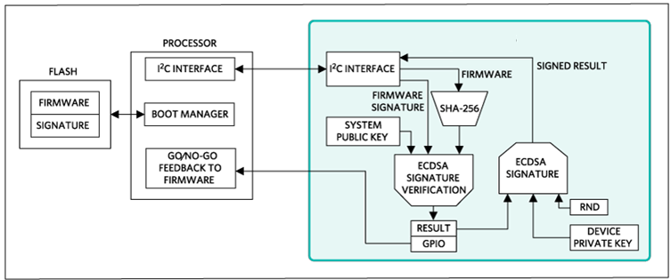

Slide 5
SCOPE OF THE PROJECT
The scope of this project encompasses the design, implementation, and evaluation of Secure Boot and firmware integrity verification mechanisms for embedded systems. The project is aimed at addressing the following key areas:
1. Secure Boot Implementation:
- Bootloader Configuration: Configure and implement a bootloader capable of validating the firmware's integrity before it is executed.
- Chain of Trust: Establish a secure chain of trust from the hardware to the firmware to ensure that only authorized code is executed.
- Security Protocols: Implement and evaluate various security protocols used in Secure Boot, such as Public Key Infrastructure (PKI) and Trusted Platform Module (TPM).
2. Firmware Integrity Verification:
Runtime Monitoring: Develop methods for continuously monitoring the firmware during runtime to detect and respond to unauthorized modifications or corruption.
- Recovery and Response: Design and implement strategies for recovering from integrity breaches and ensuring system stability.
3. Evaluation and Testing:
Vulnerability Assessment: Identify potential vulnerabilities and threats, and evaluate the system’s resilience against various attack vectors.
- Performance Impact: Analyze the impact of the security mechanisms on the system's performance, including boot times and operational efficiency.

Slide 6
OBJECTIVES
1. Develop a Secure Boot Framework: - Design and implement a Secure Boot process that verifies the authenticity and integrity of firmware before execution. - Integrate cryptographic methods, such as digital signatures and secure keys, to establish a trusted chain of boot from hardware to firmware.
2. Implement Firmware Integrity Verification Techniques:
- Utilize and configure various integrity verification methods, including checksums, hash functions (e.g., SHA-256), and digital signatures, to monitor firmware integrity. - Develop mechanisms for real-time integrity checks to detect and respond to unauthorized modifications during runtime.
3. Evaluate Security and Performance: - Conduct a thorough security analysis to assess the robustness of the Secure Boot and integrity verification implementations against potential threats and vulnerabilities. - Analyze the performance impact of the security mechanisms, including boot time and operational efficiency, to ensure minimal disruption to system functionality.
4. Establish Best Practices and Guidelines: - Document the implementation process, including design considerations, configuration details, and testing results, to provide a comprehensive reference for future projects - Develop best practice guidelines for integrating Secure Boot and firmware integrity verification into embedded systems, highlighting key considerations and recommendations.
5. Provide Recovery and Response Strategies: - Design and implement strategies for system recovery and response in case of detected integrity breaches or security incidents, ensuring continued system stability and protection.
6. Explore Future Enhancements: - Identify potential areas for further development and enhancement in firmware security, including advancements in cryptographic techniques and emerging security threats. These objectives aim to establish a secure, reliable framework for protecting embedded systems through effective implementation and evaluation of Secure Boot and firmware integrity verification techniques.

Slide 7
METHODOLOGY
1. Literature Review: - Objective: To gain a comprehensive understanding of existing Secure Boot and firmware integrity verification methods, as well as their applications and limitations. - Approach: Review academic papers, industry reports, technical articles, and standards related to Secure Boot, firmware integrity verification, and embedded system security. Identify current trends, challenges, and best practices in the field.
2. Requirement Analysis: - Objective: To define the specific requirements and constraints for implementing Secure Boot and firmware integrity verification in the target embedded systems. - Approach: Analyze the system architecture, security needs, and performance criteria. Engage with stakeholders to gather requirements and understand the practical constraints and objectives.
3. Design and Development: - Objective: To create a detailed design for Secure Boot and firmware integrity verification mechanisms and develop the corresponding implementations. - Approach: - Secure Boot Design: Develop the architecture for Secure Boot, including cryptographic algorithms, key management, and bootloader configuration. - Firmware Integrity Verification Design: Implement techniques for checksum, hashing, and digital signatures to verify firmware integrity during runtime. - Development: Write and configure the necessary software and firmware components, integrating Secure Boot and integrity verification mechanisms.

Slide 8
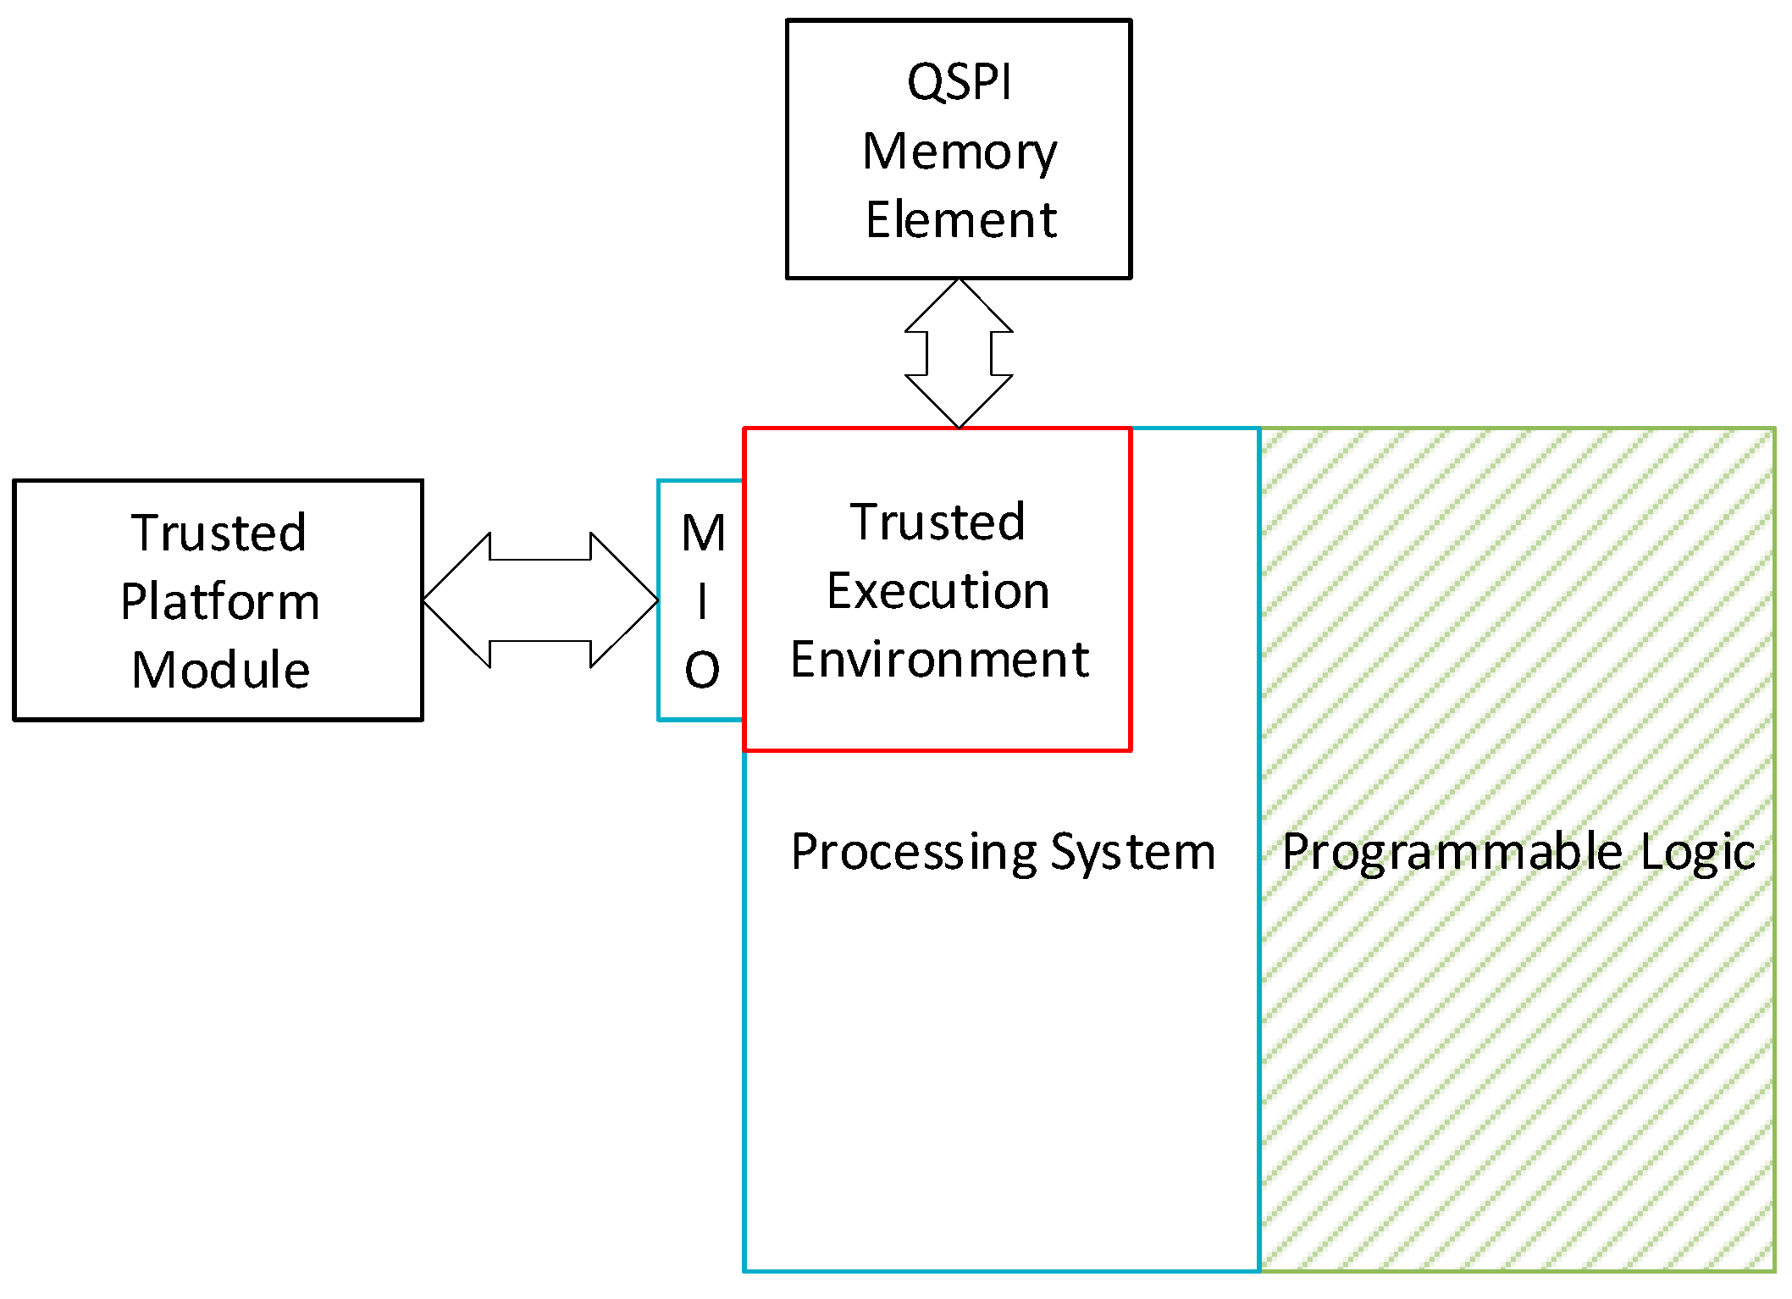
METHODOLOGY

Slide 9
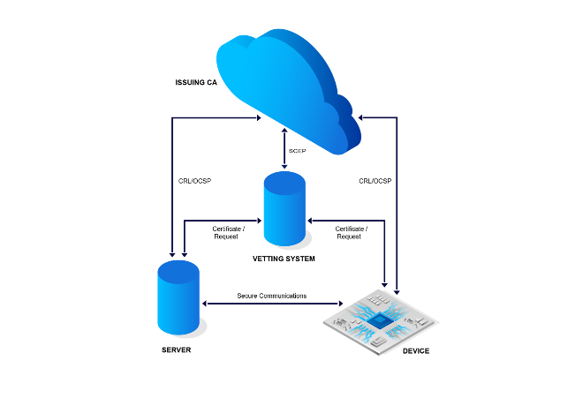
TESTING AND EVALUATION

Slide 10
RESULTS & DISCUSSION
1. Implementation Outcomes: - Secure Boot Framework: The Secure Boot implementation successfully established a trusted chain of execution from the hardware through the firmware. The bootloader was configured to validate firmware signatures using cryptographic methods, ensuring that only authorized code was executed. This process was tested across various scenarios, demonstrating a robust mechanism for preventing unauthorized firmware from running. Firmware Integrity Verification: The integrity verification mechanisms, including checksum validation, hashing (SHA-256), and digital signatures, were integrated effectively. Real-time monitoring of firmware during runtime detected unauthorized modifications and corruption accurately. The system responded appropriately to integrity breaches by either alerting the user or triggering recovery protocols.
2. Security Evaluation: - Threat Resistance: The Secure Boot and firmware integrity verification mechanisms were subjected to extensive security testing, including penetration testing and vulnerability assessments. The system showed strong resistance against common attack vectors such as code injection and firmware tampering. No critical vulnerabilities were identified, indicating that the mechanisms provide robust protection against unauthorized access and modifications. False Positives/Negatives: The testing also revealed a few instances of false positives, where legitimate changes to the firmware were incorrectly flagged as unauthorized. These were addressed by refining the integrity verification algorithms and thresholds. False negatives were not observed, confirming that the system accurately detects unauthorized modifications.
3. Performance Impact: - Boot Time: The implementation of Secure Boot introduced a slight increase in boot time due to the additional validation steps. However, this increase was within acceptable limits and did not significantly impact overall system performance. Operational Efficiency: Firmware integrity checks during runtime had a minimal impact on system performance. The overhead introduced by hashing and signature verification was negligible, ensuring that the system's operational efficiency remained high.

Slide 11
CONCLUSION
The project successfully achieved its objectives by implementing and evaluating Secure Boot and firmware integrity verification mechanisms in embedded systems. The Secure Boot process effectively established a trusted chain of execution, ensuring that only authorized firmware could be executed on the embedded devices. By leveraging cryptographic techniques such as digital signatures and secure keys, the system demonstrated a strong capability to prevent unauthorized code from running and to maintain the integrity of the firmware throughout the boot process.
Firmware integrity verification techniques, including checksum validation, hashing, and digital signatures, were implemented to continuously monitor and protect the firmware during runtime. The system reliably detected unauthorized modifications and corruption, effectively responding to integrity breaches and preserving system security.
The security evaluation confirmed that the implemented mechanisms provide robust protection against common threats, with no critical vulnerabilities identified. Performance testing revealed that while Secure Boot slightly increased boot times, it did not significantly impact overall system performance. Integrity verification introduced minimal overhead, maintaining high operational efficiency.
The project also highlighted important best practices for implementing these security measures and provided valuable recommendations for future enhancements. Key lessons learned include the importance of managing implementation complexity and maintaining clear communication with stakeholders to address practical challenges effectively.

Slide 12
REFERENCES
Anderson, R., & Kuhn, M. (1996). Tamper Resistance – A Cautionary Note. Proceedings of the Second USENIX Workshop on Electronic Commerce, 1-11.
Balfanz, D., Blaze, M., & Blaze, M. (2000). How to Establish a Trusted Path with Secure Hardware. Proceedings of the 9th USENIX Security Symposium, 11-18.
Basak, S., & S. Das, A. (2011). Secure Boot in Embedded Systems. International Journal of Computer Applications, 21(2), 1-6.
Boileau, S. (2005). The Art of Software Security Assessment: Identifying and Preventing Software Vulnerabilities. Addison-Wesley.
Chen, H., & Zhang, Z. (2016). Firmware Security and Integrity Verification Techniques. IEEE Transactions on Information Forensics and Security, 11(5), 1067-1078.
D. E. Bell, & J. L. LaPadula. (1973). Secure Computer Systems: Mathematical Foundations and Model. MITRE Corporation.
Ding, X., & Wang, X. (2014). Security Analysis of Secure Boot Mechanisms in Embedded Systems. International Conference on Information Security and Privacy Protection, 139-150.
Engel, A., & J. K. Harris. (2019). Embedded System Security: A Review of Current Solutions. IEEE Access, 7, 127485-127501.
G. M. Jacobson, & S. G. L. Pappalardo. (2012). Protecting Firmware: Secure Boot and Its Importance. Journal of Computer Security, 20(6), 897-920.
Gollmann, D. (2011). Computer Security. Wiley.
Kaur, K., & J. S. Patel. (2018). A Survey of Secure Boot and Firmware Integrity Verification Techniques. International Journal of Computer Applications, 179(44), 1-8.
Kschischang, F., & M. A. G. C. Kostopoulos. (2004). Key Management in Embedded Systems. IEEE Transactions on Information Theory, 50(6), 1041-1050.
Lee, J., & Hwang, K. (2013). Firmware Integrity Verification in Embedded Systems. International Conference on Embedded Systems, 33-40.

Slide 13
REFERENCES
Li, Z., & Zhao, Y. (2021). Advances in Secure Boot Technology: A Survey. ACM Computing Surveys, 54(8), 1-35.
Liu, X., & Zhang, L. (2019). A Comprehensive Survey on Firmware Security in Embedded Systems. Journal of Computer Science and Technology, 34(2), 222-240.
Liu, Y., & Zhao, M. (2015). Secure Boot and Firmware Integrity Verification for IoT Devices. IEEE Internet of Things Journal, 2(6), 501-510.
Mitchell, C., & P. D. Anderson. (2006). Secure Boot: Concepts and Implementation. Proceedings of the 3rd International Workshop on Security and Privacy in Embedded Systems, 1-10.
Nakamura, T., & Sasaki, T. (2014). Evaluating Secure Boot Systems for Embedded Devices. International Journal of Information Security, 13(4), 263-278.
NIST. (2017). NIST Special Publication 800-147: BIOS Protection Guidelines. National Institute of Standards and Technology.
Olsson, M., & E. J. L. Persson. (2020). Enhancing Firmware Security with Trusted Execution Environments. Journal of Computer Security, 28(4), 519-540.
Seibert, R., & T. F. Richardson. (2021). Secure Firmware Update Mechanisms. IEEE Transactions on Embedded Systems, 20(2), 134-145.
Sha, K., & Q. R. Zhang. (2022). A Survey of Firmware Security and Protection Techniques. ACM Computing Surveys, 54(1), 1-30.
Sun, J., & Xie, H. (2018). Secure Boot and Its Applications in Embedded Systems. IEEE Access, 6, 15598-15608.
Wang, S., & Liu, J. (2020). Securing Embedded Systems with Firmware Integrity Verification Techniques. Proceedings of the IEEE Symposium on Security and Privacy, 123-134.
Zhang, Y., & Sun, L. (2021). Firmware Protection in Embedded Systems: Techniques and Challenges. IEEE Transactions on Dependable and Secure Computing, 18(3), 1045-1058.

