Slide 1
UTILZATION OF PLASTIC WASTE FOR MAKING PLASTIC BRICKS
PRESENTED by Mtech scholar Paching Anjali
Dept : Civil engineering in structural engineering
Himalayan university ,Itanagar (A.P)

Slide 2
CONTENT
Introduction
Objective.
Sample 1 using plastic waste and rivers send bricks.
Sample 2 using plastic waste and Organic wood ash bricks.
Sample 3 using plastic waste and sawdust bricks.
Advantages and disadvantage eco bricks.
Conclusion.

Slide 3
INTRODUCTION
Plastic is a very useful substance. We use plastic in our day to day life work. But once it is being used it becomes a major crisis to the environment because it does not degrade or decomposed easily.
After the plastic is used it becomes a hazardous material.
By using plastic waste in making the bricks, the total cost of the bricks is much cheaper as compared to normal brick. Waste polyethylene is being reused. Brick earth is costly and digging of brick earth poses some damage to the environment.
Hence using plastic to make bricks is not only cost effective and eco-friendly but also the plastic bricks have a smooth finish, devoid of cracks and have low water absorption value, and will not have problems like efflorescence in future.

Slide 4
OBJECTIVE
To develop an efficient way and to effectively utilized the waste plastic
To reduce the amount of waste plastics
Safe for environment.
Lower the cost of construction materials.
High strength.

Slide 5
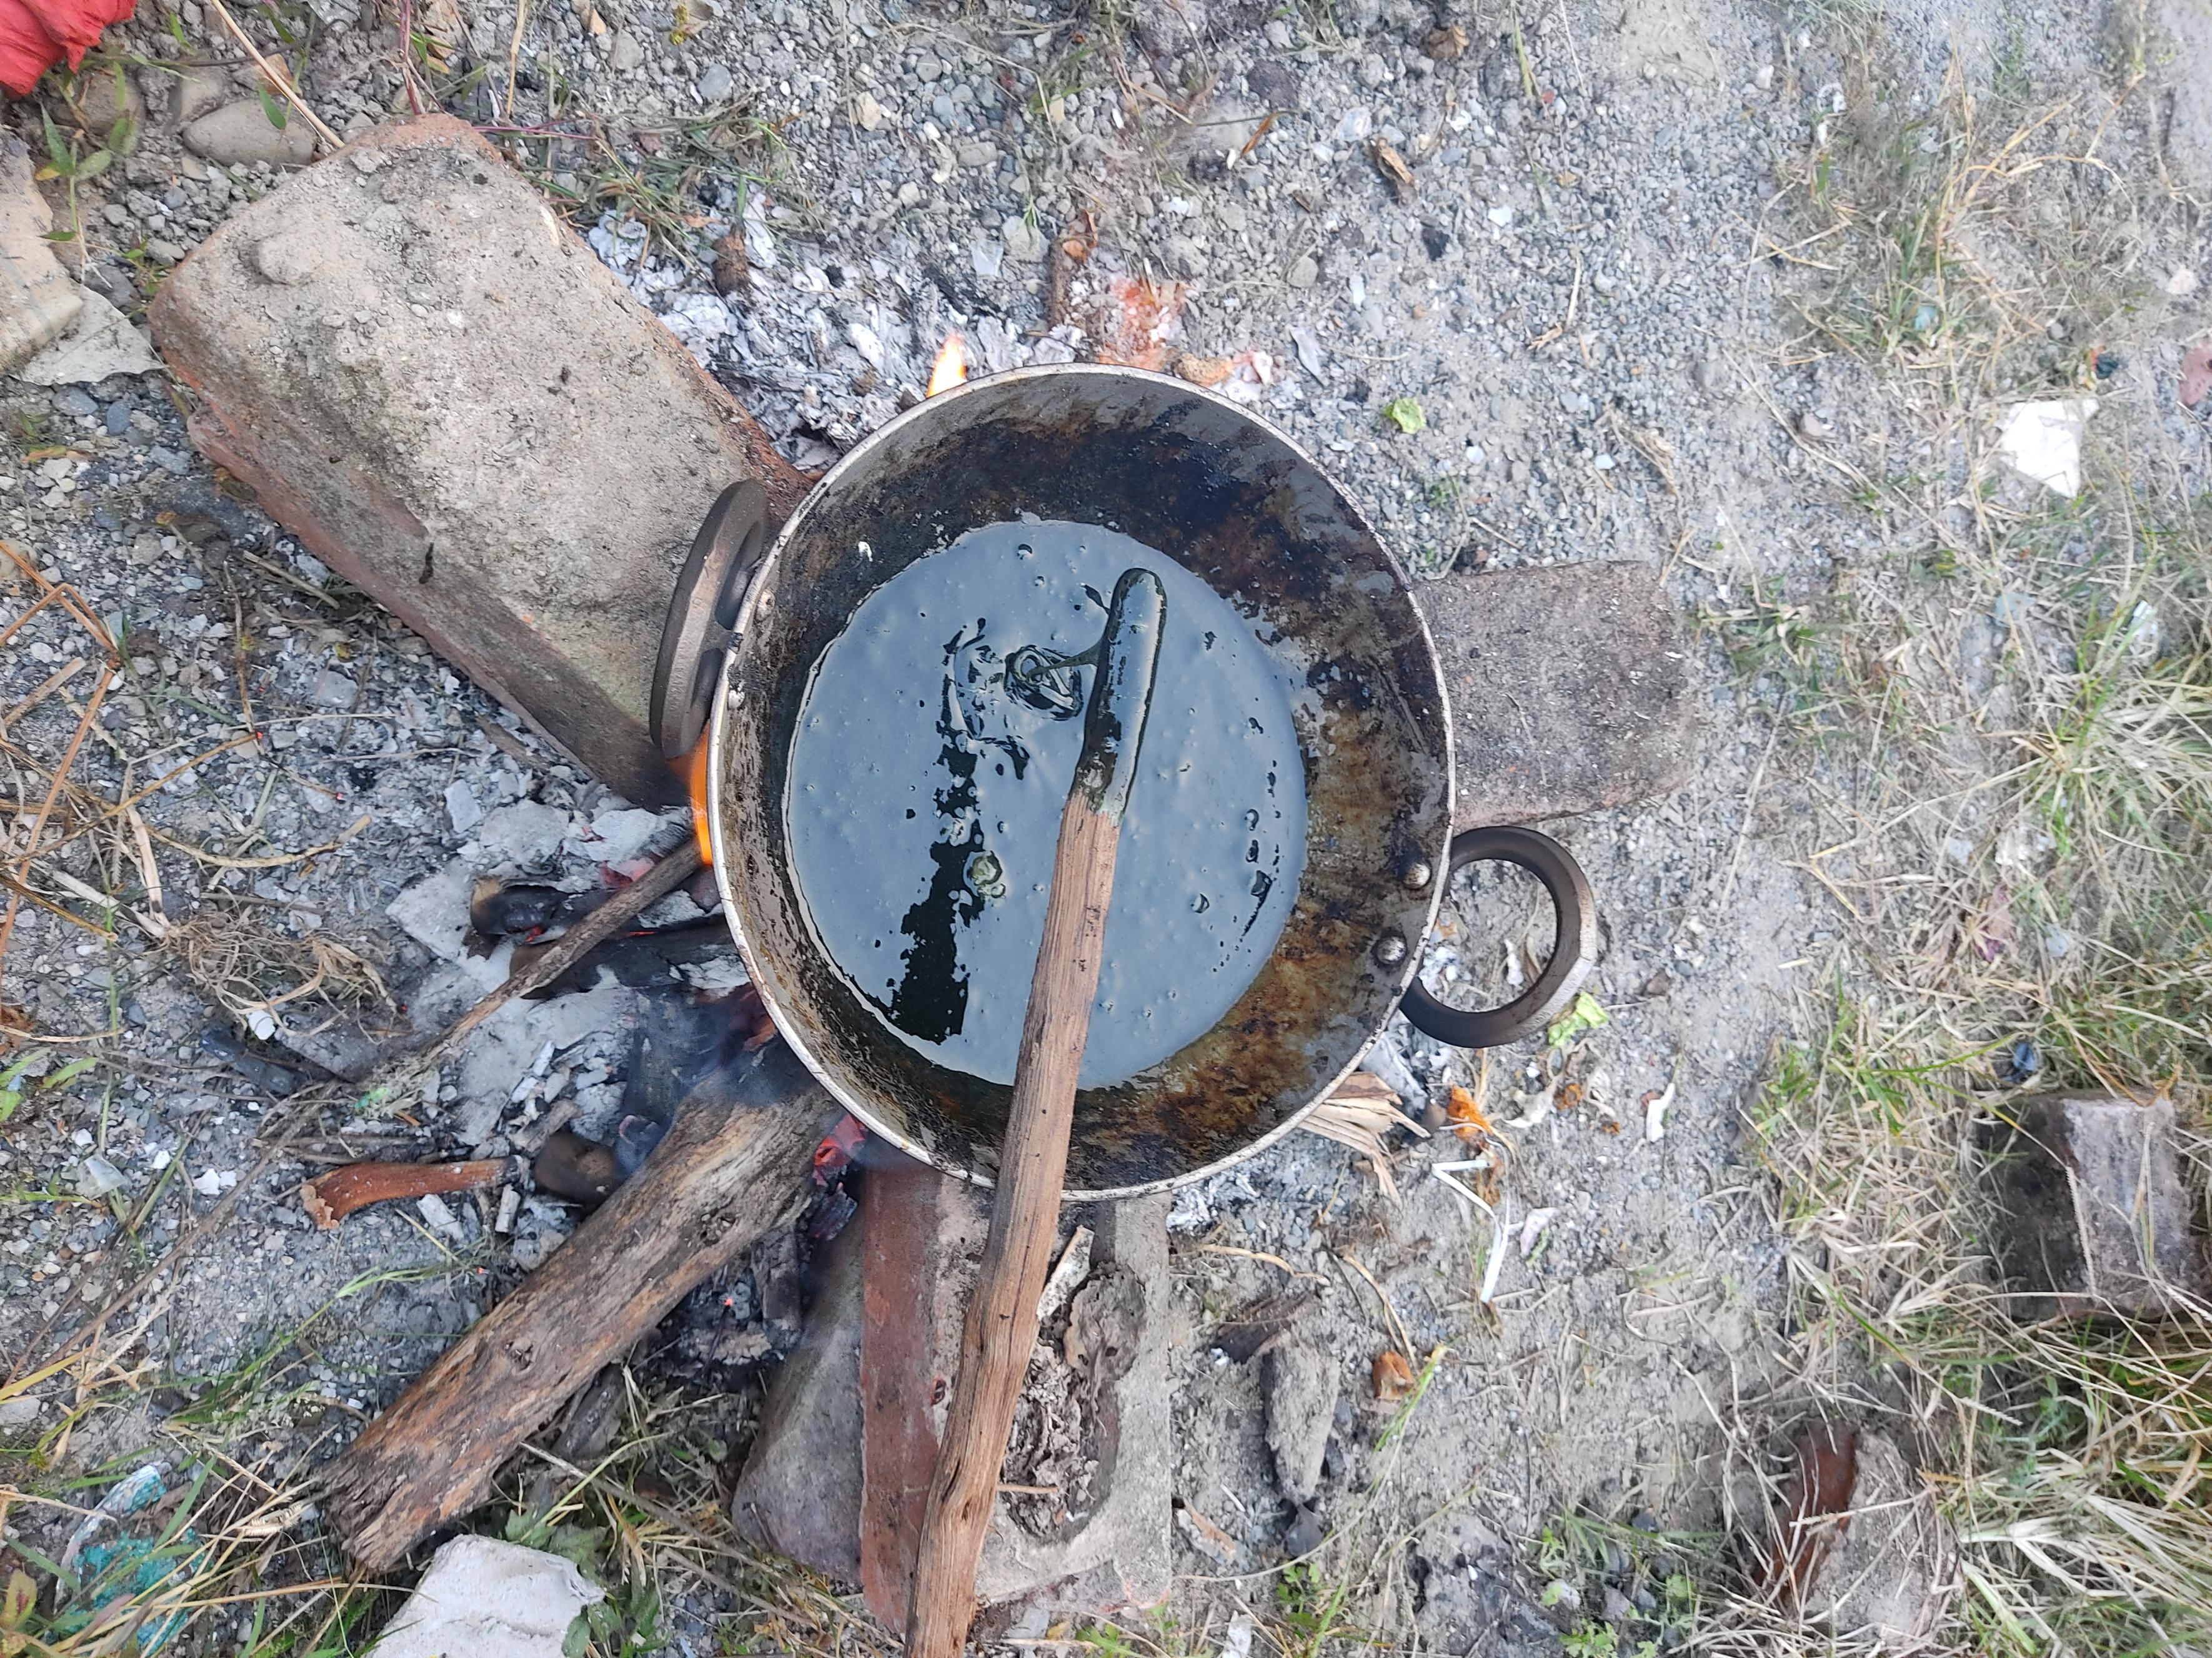
SAMPLE 1 USING PLASTIC WASTE AND RIVERS SAND BRICKS
Frist plastic are melting in pan and after melt we add River sand.
Ratio sample 1:2
600 kg plastic and 1.2 kg of river sand.
Bricks mould
Length and breadth and depth
18 cm × 8 cm × 5.5 cm
Final setting time 40 minutes
Weight 2 kg.

Slide 6
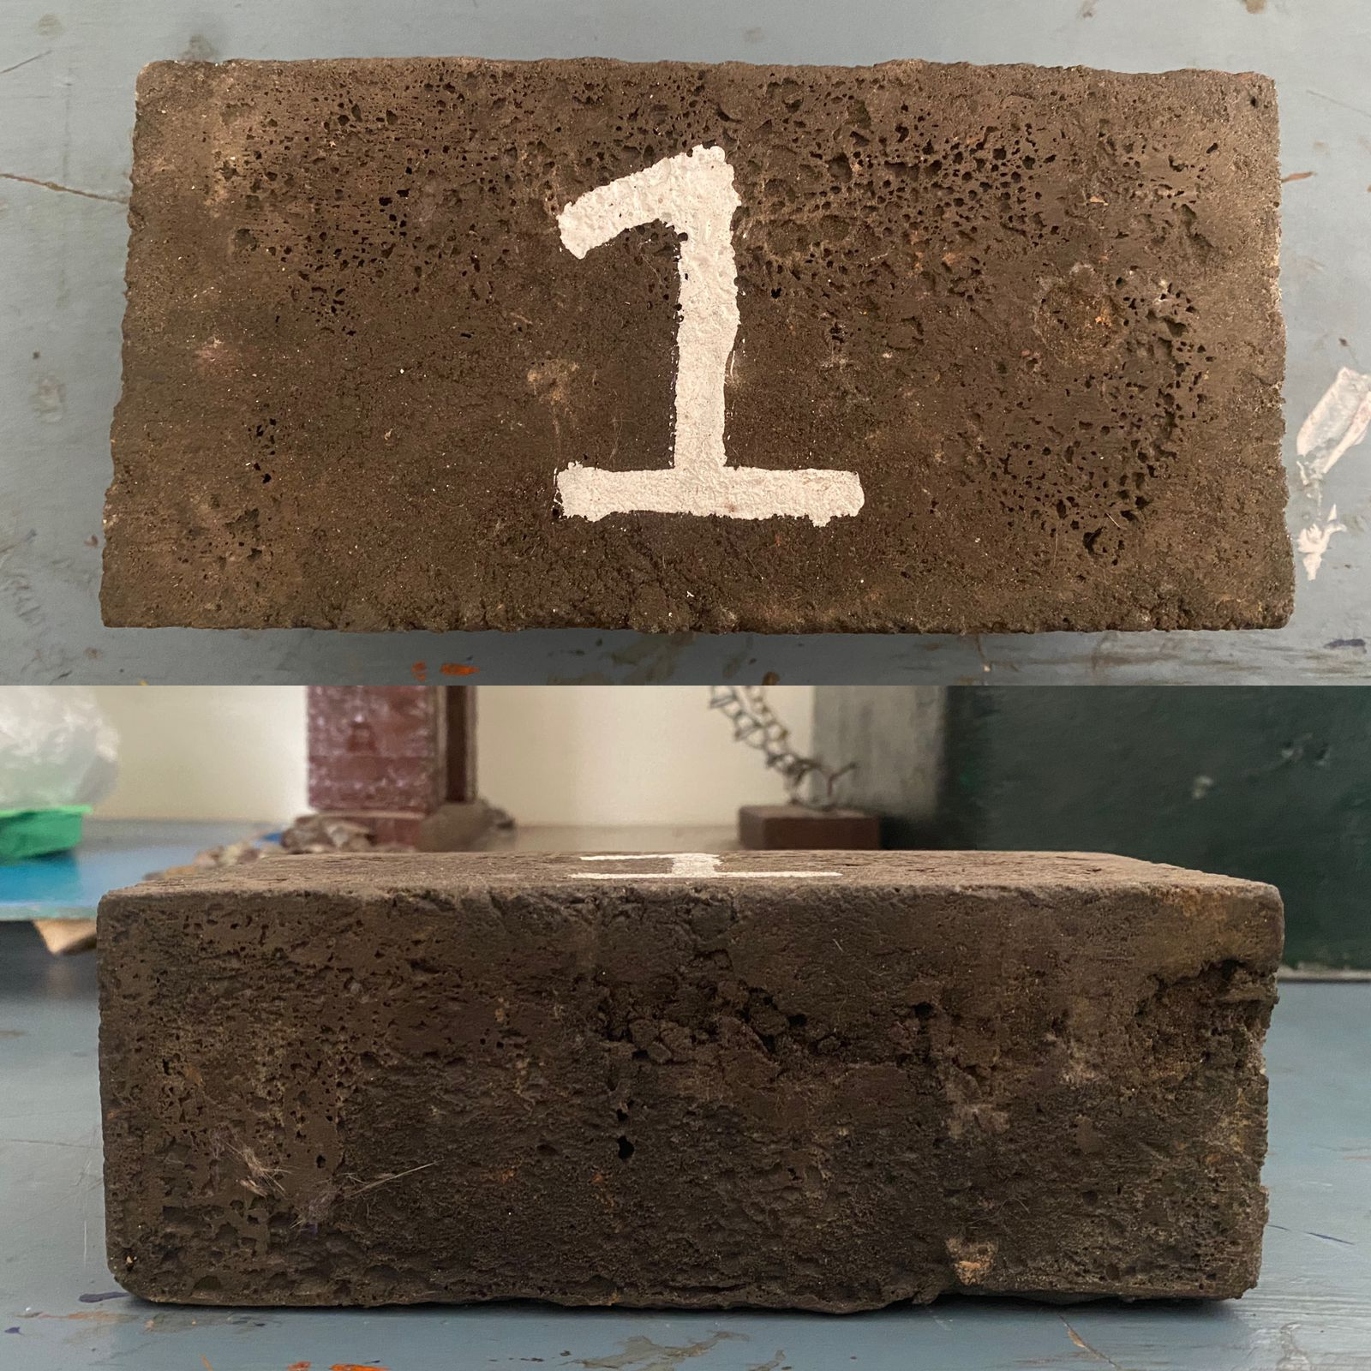
SAMPLE 1 USING PLASTIC WASTE AND RIVERS SAND BRICKS

Slide 7
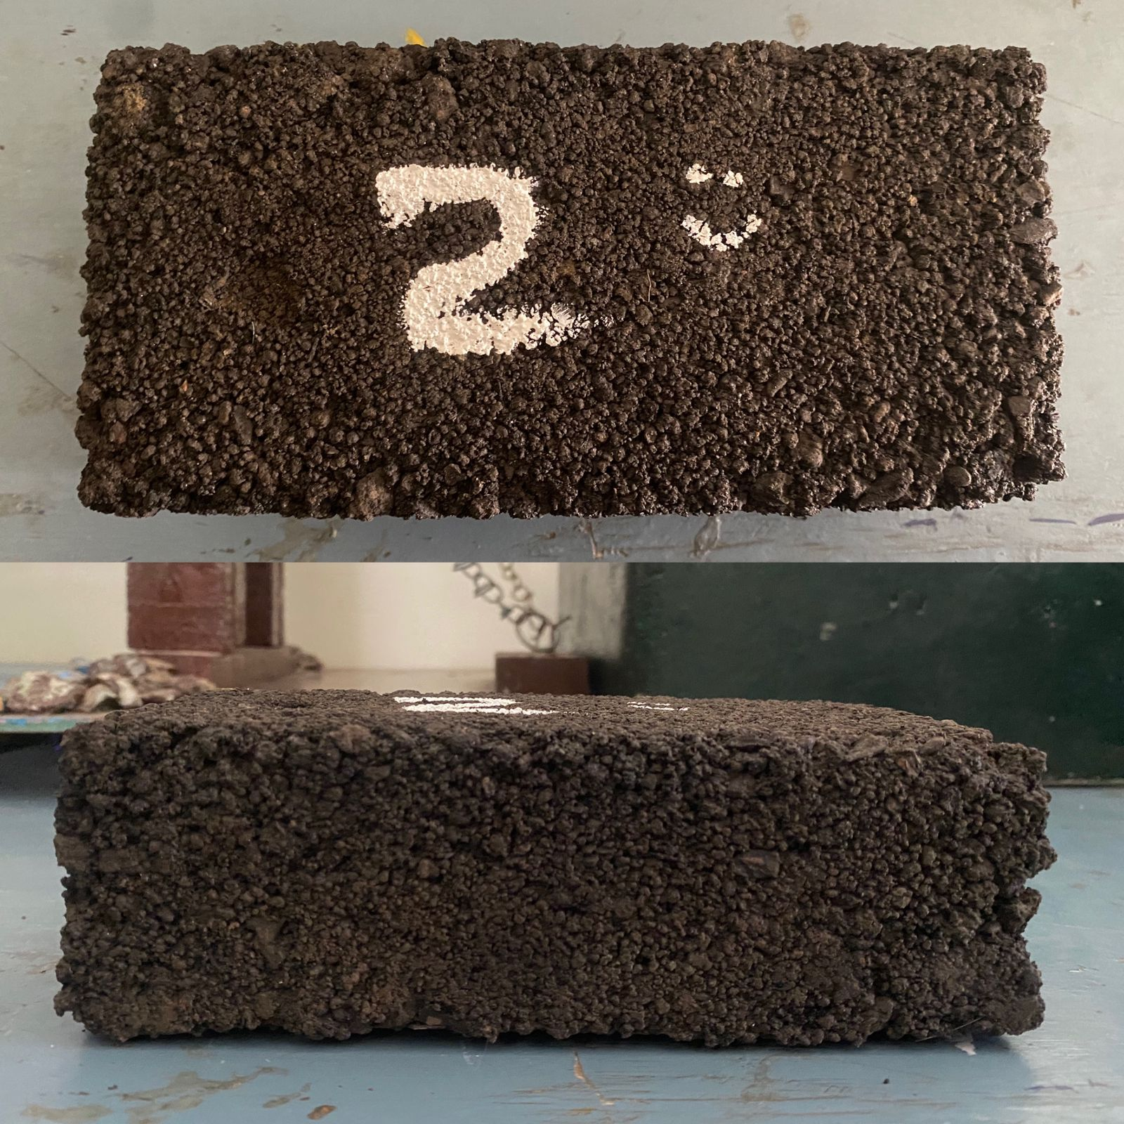
SAMPLE 2 USING PLASTIC WASTE AND ORGANIC WOOD ASH BRICKS
Again plastic are mixed with organic wood ash .
Ratio 1:2
Plastic waste 800 gm
Organic wood ash 1 kg
Mould
Length × Breadth × Depth
18 cm × 8 cm × 5.5 cm
Final setting time 36 minutes
Weight 1.26O kg.

Slide 8
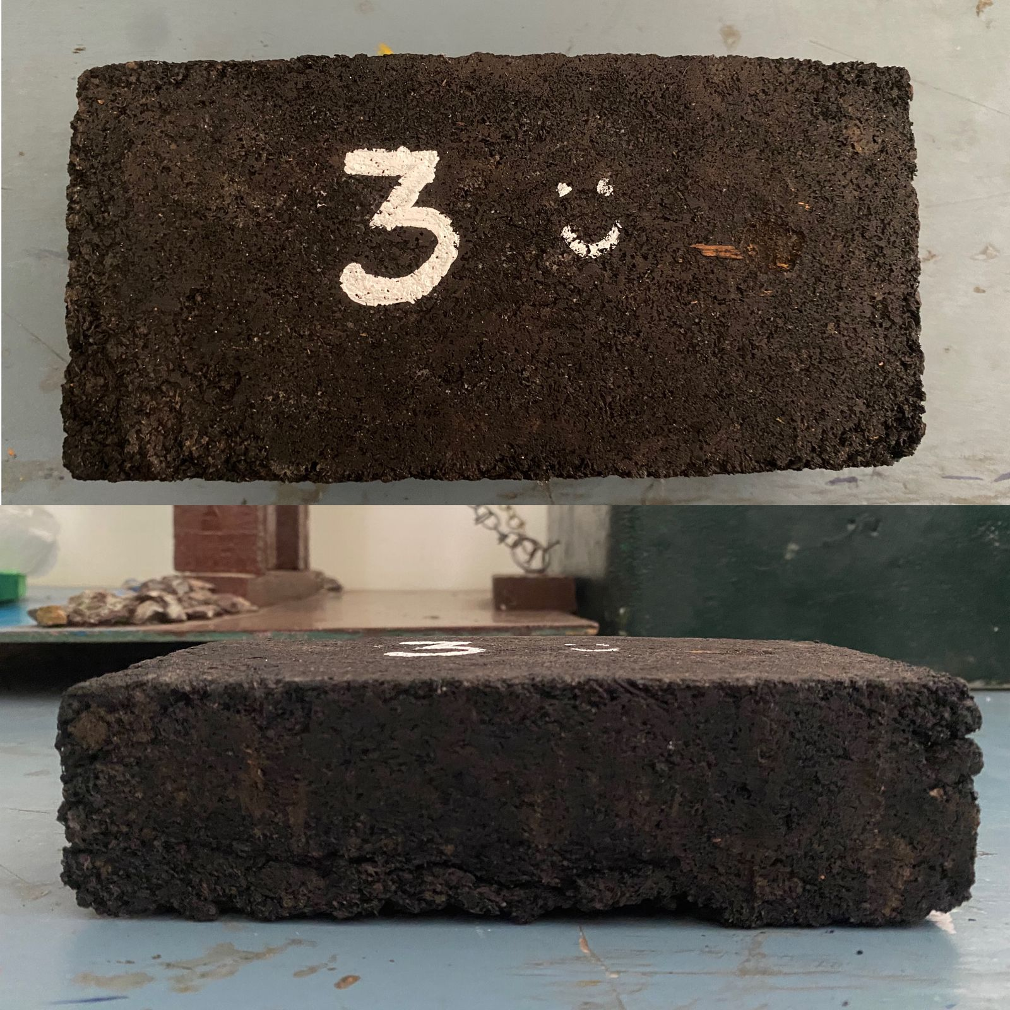
SAMPLE 3 USING PLASTIC WASTE AND SAWDUST BRICKS
Again plastic waste are mixed with sawdust.
Ratio 1:2
Plastic waste 717 gm
Sawdust 400 gm
Bricks mould
Length x Breadth x Depth
18 cm x 8 cm x 4.5 cm
Final setting time 45 minutes
Weight 750 gm.

Slide 9
ADVANTAGES AND DISADVANTAGES OF ECO BRICKS
Eco bricks have many advantages over conventional construction materials. They’re zero cost, absorb abrupt shock loads, are reusable, easy to work with, lightweight, and repurpose the plastic that’s rapidly threatening to take over our ecosystem .
There are also downsides. Because Eco bricks are plastic, like the plastic they’re comprised of, they don’t decompose. If they melt, they release gases that are harmful to human health and the environment. Plastic is made from oil, a fossil fuel.

Slide 10
CONCLUSION
Plastic waste which is available everywhere has become more advantage
for civil engineers to innovate new things which are eco-friendly.
Plastic waste bricks reduces environmental pollution.
Water absorption of plastic waste bricks as compared to normal bricks.
Plastics waste bricks are more economical in which common people can afford it.
It is convenient, as it shows better value than ordinary bricks.
It is thinner and lighter, have superb heat insulating properties.
Required less energy and helps conserve natural resources.

Slide 11
THANK YOU

