Slide 1

Dynamic Behaviors of Gravity Dams in interaction with Reservoirs and Foundation
Corresponding Author :- Dusu Tassang
Under the guidance of
Co-Author Talkeshwar Ray (Assistant Professor) and
Dr. Taku Muni (Assistant Professor)
Department of Civil Engineering
Himalayan University , Itanagar (A.P).

Slide 2
BACKGROUND AND MOTIVATION
a concrete gravity dam is defined as a structure, which is designed in such a way that its own weight resists the external forces.
It is primarily the weight of a gravity dam which prevents it from being overturned when subjected to the thrust of impounded water.
This type of structure is durable, and requires very little maintenance. Gravity dams typically consist of a non-overflow section(s) and an overflow section or spillway.

Slide 3
Literature Review
GENERAL - The first part of this chapter describes briefly some important aspect of concrete gravity dam, e.g., typical cross section profiles, types of loads and conventional design methodology.
CONCRETE GRAVITY DAM - A typical cross-section of a concrete gravity dam is shown in Fig. 1. The upstream face may by kept throughout vertical or partly slanting for some of its length as shown. A drainage gallery may be provided in order to relieve the uplift pressure exerted by the seeping water. Fig. 1, presents photograph of an existing concrete gravity dam.

Slide 4
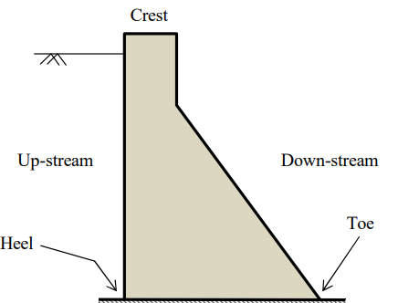
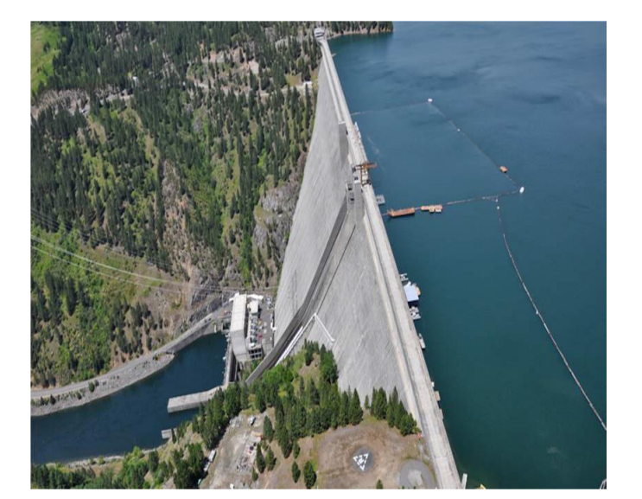
Typical cross-section of concrete gravity dam – fig 1.1 and 1.2

Slide 5
Many loads act over the gravity dam in lateral and vertical direction. These loads are summarized as follows:
• Self-weight of the dam
• Surcharge or live load on the dam
• Ice Pressure
• Uplift Pressure
• Water Pressure from the Upstream and downstream
• Earthquake load on Dam
• Slit Pressure
• Wave Pressure

Slide 6
ANALYSIS OF DAM AGAINST EARTHQUAKE FORCES
In India for seismic design is based on the standard IS 1893 issued by Bureau of Indian Standard, New Delhi. Revised IS 1893 is planned to have five parts as follows:
a) Part 1: Building and General Guidelines (2002)
b) Part 2: Liquid retaining tanks
c) Part 3: Bridges and retaining walls
d) Part 4: Industrial Structures (2004) Department of Civil Engineering, Himalayan University (A.P.) Page 11
e) Part 5: Dams and embankments.

Slide 7
PROFILE OF THE DAM FOR PRACTICAL CONSIDERATIONS
Dynamic properties of any structures are function of its mass and stiffness distribution. Again, the stiffness and mass distribution is defined by the geometric profile of the structure. If we assume the gravity dam is uniform along its longitudinal axis then the cross-sectional profile plays an important role for dynamic properties of the dam. Fig. 1.3 presents a typical section of a low gravity Dam (Garg, 2013).

Slide 8
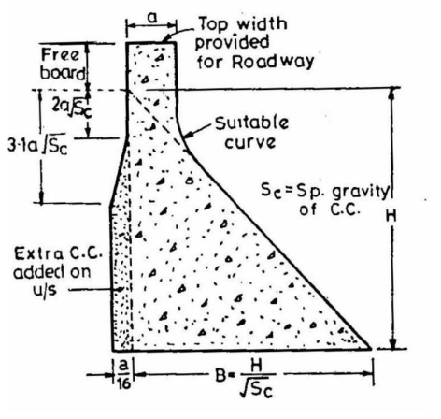
Fig 1.3: Typical section of a low gravity Dam (ref. Garg, 2013)

Slide 9

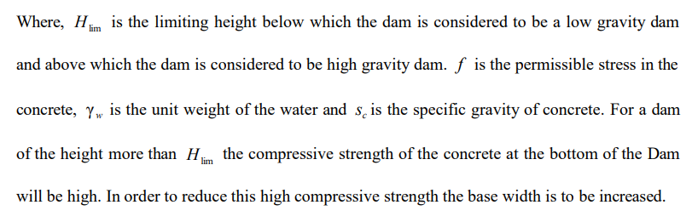
Garg (2013) proposed following relation to distinguish the low and high gravity dam.

Slide 10
RESEARCH ON SEISMIC ANALYSIS OF CONCRETE GRAVITY DAM
A detailed literature review in the seismic analysis of concrete gravity dam revealed five papers.
A two-stage procedure has been proposed by Løkke (2013) for the elastic analysis phase of seismic design and safety evaluation of concrete gravity dams: (i) response spectrum analysis (RSA) and (ii) response history analysis (RHA) of a finite element idealization of the dam monolith. Both analysis procedures include the effects of dam-water foundation interaction. These procedures are added to computer software EAGD-84 and MATLAB program.
Leclerc et. al. (2002) presents the main features and organization of CADAM, a computer program that has been developed for the static and seismic stability evaluations of concrete gravity dams. CADAM is based on the gravity method using rigid body equilibrium and beam theory to perform stress analyses, compute crack lengths, and safety factors.

Slide 11
Seismic hazard assessment of roller compacted concrete (RCC) gravity dam is investigated by Thanoon (2008) considering the effects of dam-reservoir-foundation-sediment-interface interaction. Using finite and infinite element coupled method; two-dimensional seismic analysis is performed to investigate the seismic response of RCC gravity dam. The results of nonlinear elasto-plastic analysis demonstrate that the maximum tensile stress occurs at the base of the dam on the upstream heel.
A dam is modeled and analyzed by Das et. al. (2011) with the help of ALTAIR HYPERWORKS 10 software and the seismic response is evaluated for a Koyna Earthquake ground acceleration data and the seismic response are computed for hydrodynamic pressure force for the duration of earthquake.
Yamaguchi et. al. (2004) discusses the role of nonlinear dynamic analyses in seismic evaluation problems for concrete gravity dam. A two-dimensional section of a concrete gravity dam is evaluated using various linear and nonlinear procedures and it serves as case study for the discussion.

Slide 12
RESULTS AND DISCUSSIONS
MODAL ANALYSIS OF BHAKRA DAM –
Bhakra Dam - Bhakra dam, a concrete gravity dam, is 740 feet (226m) high, spanning the V-shaped gorge in the lower Shivalik hills, across Satluj river. The dam is 1700 feet long at the top and only 325 feet at the bottom. The width of the dam at the foundation is 1320 ft and it tapers to 30 ft at the top where a road runs. Bhakra dam was the highest concrete gravity dam of the world when built, thus surpassing the existing 221 m high Hoover dam. But the highest concrete gravity dam of the world, at present, is Grand Dixence dam in Switzerland (284 m high). Bhakra dam is situated in the Himachal Pradesh State of India near a village used to be called as Bhakra. It has been constructed on Satluj River. Satluj River coming from Himalaya is a Perennial river but carries enormous water during floods and rain.

Slide 13
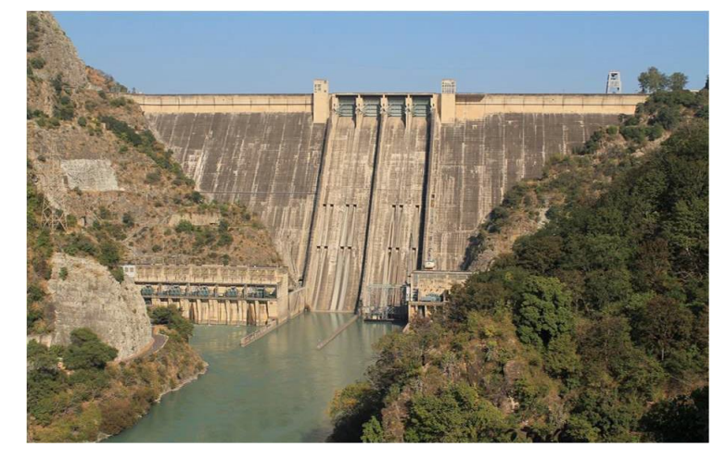
Photoview of Bhakra Dam, Fig. – 2.1

Slide 14
Properties of Bhakra Dam
Depending on the material availability and dimensions, grade of the concrete is decided for the construction of dam. After getting the grade of the concrete all the properties of the dam are determined such as specific gravity of concrete, density of concrete etc. Detail material properties of the Bhakra Dam were not available in literature. These were assumed for all the analyses carried out in the present study and listed in Table 2.1:

Slide 15
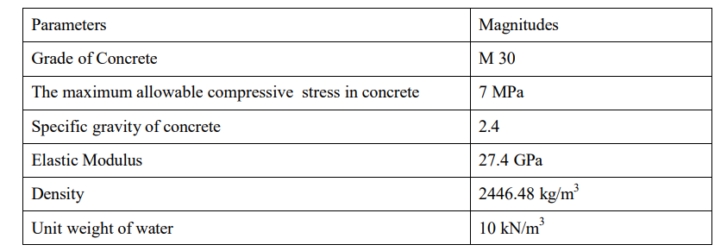
Assumed material properties for the Bhakra Dam

Slide 16
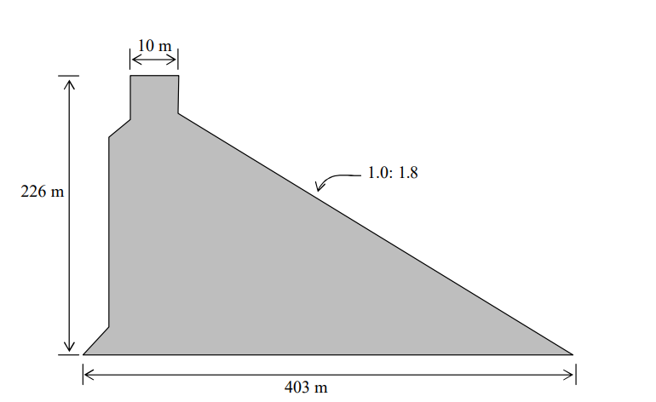
A Typical cross-section of Bhakra Dam (Garg, 2013)

Slide 17
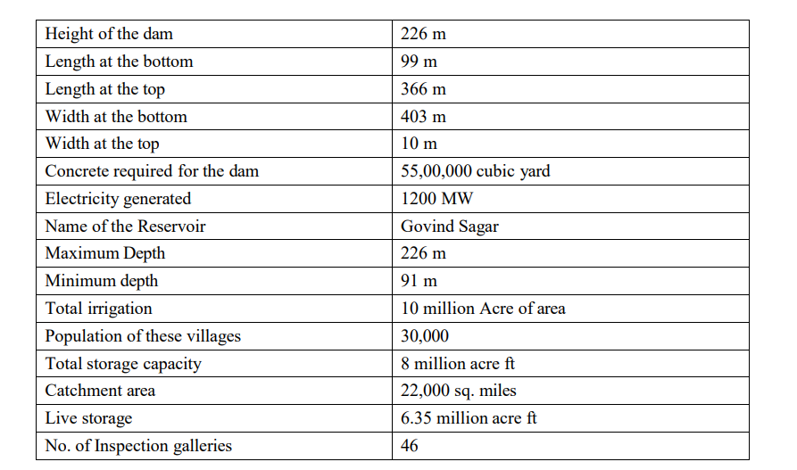
Some details about Bhakra Dam

Slide 18
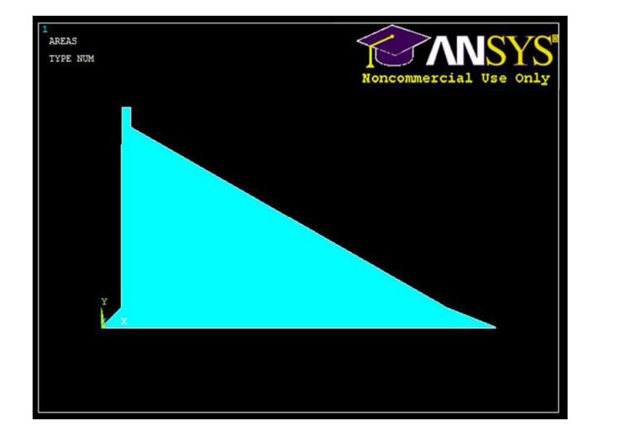
FE Model of Bhakra Dam in ANSYS

Slide 19
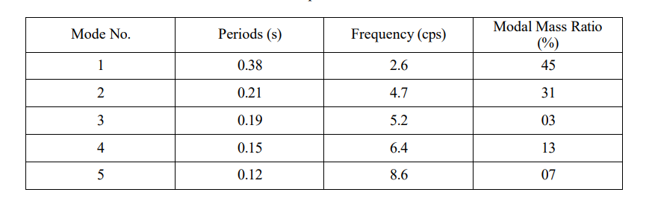
Modal Properties of the Bhakra Dam

Slide 20
From these table we get the Modal Mass ratio for 1st mode is 45% and for the 2nd mode is 31%. It shows that unlike the building the modal mass for the 1st mode is not above 90% in case of dam. It is much less than that. So, in case of building we can take the 1st mode for the Calculation of Base Shear of the building. But in case of Dam it is not feasible. For Dam other modes are equally important.

Slide 21
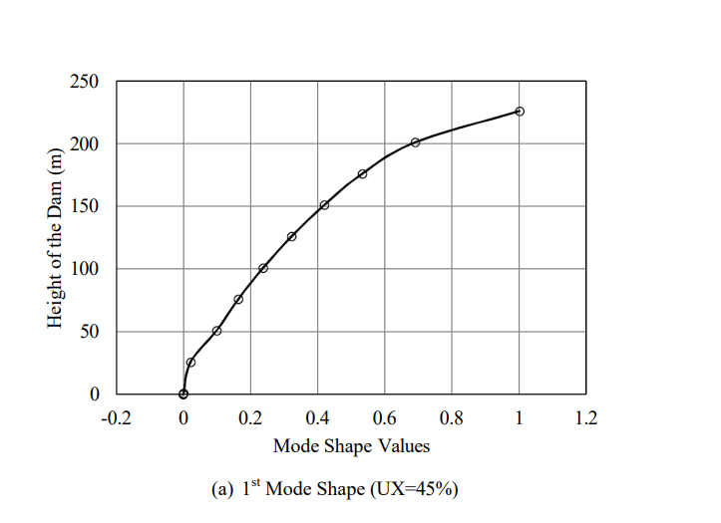
Mode Shapes of Bhakra Dam

Slide 22
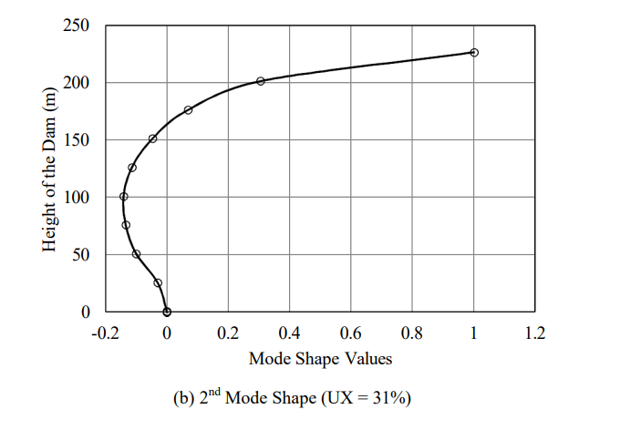
Different modes shapes of Bhakra Dam

Slide 23
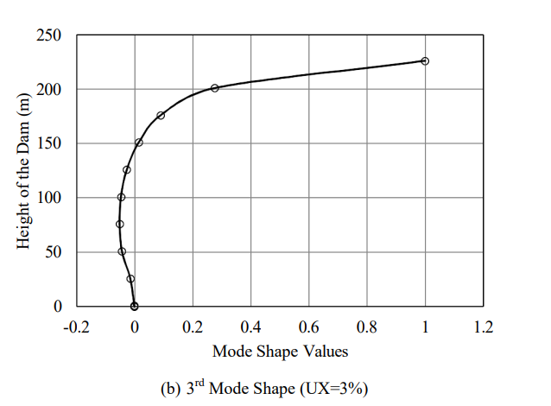

Slide 24
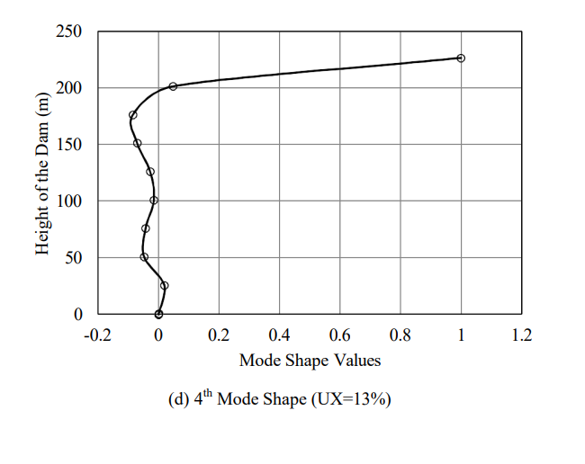

Slide 25
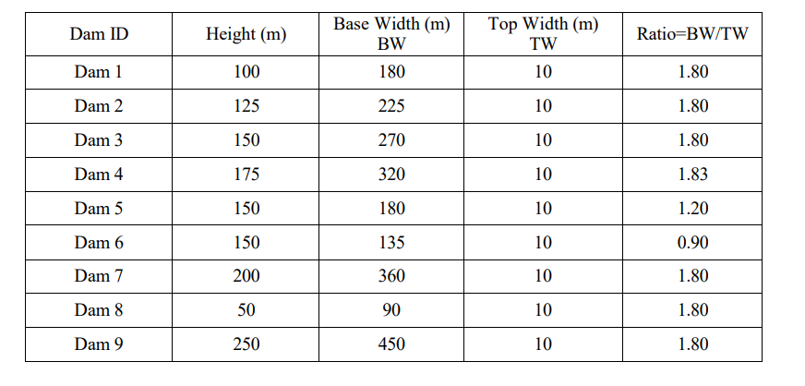
Dimension of Dams

Slide 26
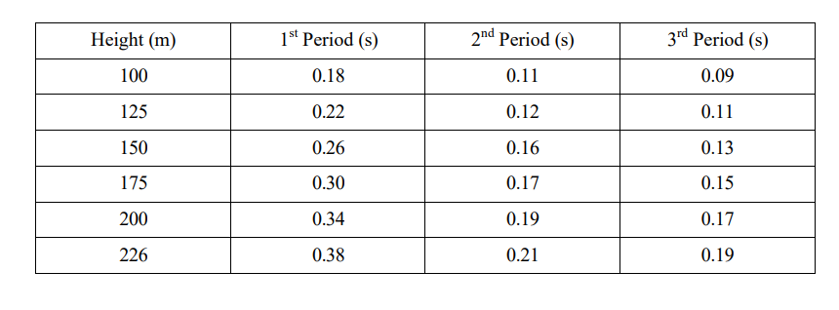
Relation between the dam height and time period

Slide 27
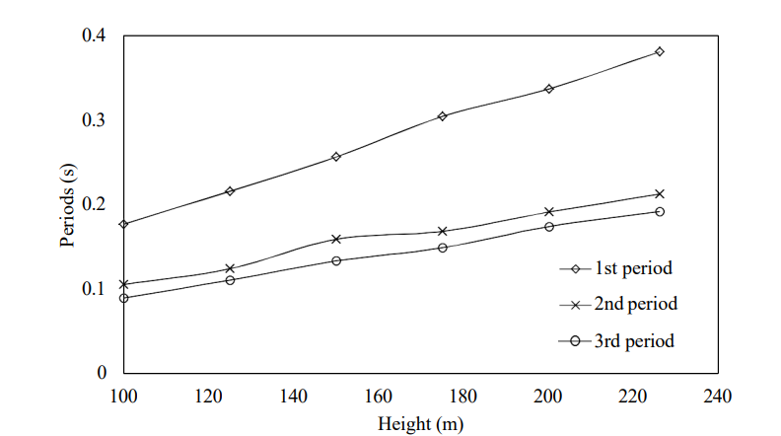
Plot between heights vs. period

Slide 28
CONCLUSION
The conclusions presented here are limited to the salient contributions made in the present study:
We can check different dam dimensions by software ANSYS 13.0.

Slide 29
Thank you !

