Slide 1
Exploring Necropolitics in Temsula Ao’s Laburnum for My Head
Presented By Loder Dulley
PhD Scholar
Department of English
Himalayan University

Slide 2
Overview
  Examines necropolitics in Northeast India through Temsula Ao's stories.
  Focus on "Sonny," "The Letter," and "A Simple Question."
  Theoretical Framework: Michel Foucault, Achille Mbembe, Giorgio Agamben.
  Explores possible sites of resistance against Necropolitical structure of sovereignty.
  Objectives: To explore how Ao's narratives illuminate power, violence, and survival in a conflict-ridden region
  Understand the manifestation of necropolitics in everyday life
  Examine the impact of prolonged conflict on individuals and communities

Slide 3
Introduction
Necropolitics, a term coined by Cameroonian philosopher Achille Mbembe in 2003, represents a critical expansion of Michel Foucault's concept of biopolitics. While biopolitics focuses on how power structures govern life, necropolitics examines how these same structures decide who may live and who must die.
In the context of Northeast India, necropolitics provides a powerful lens for understanding the complex interplay of power, violence, and survival in a region marked by prolonged conflict and political instability. The area has witnessed insurgencies, separatist movements, and inter-ethnic clashes, often driven by demands for autonomy, self-determination, and recognition of indigenous identities. Amidst this backdrop, the imposition of the Armed Forces (Special Powers) Act (AFSPA) has been particularly controversial. Enacted in 1958, AFSPA grants the military sweeping powers, including the authority to arrest without warrants, shoot to kill, and search properties without consent. This law has created what Giorgio Agamben and Achille Mbembe refers to as a "state of exception," where normal legal protections and civil rights are suspended. As a result, it has drawn widespread criticism for human rights violations, contributing to a climate of impunity and deepening grievances among local populations.

Slide 4
Temsula Ao, a prominent Naga writer, poet, and academic, is celebrated for her evocative exploration of the socio-political realities of Northeast India. Her writing often delves into themes of identity, memory, and the complexities of life in conflict-torn regions. Laburnum for My Head, a collection of short stories, is deeply rooted in Northeast Indian experiences the collection was published in 2009, and offers contemporary perspective on regional issues. Ao presents poignant narratives that capture the everyday struggles, aspirations, and resilience of the people of Nagaland. Blending the personal with the political, her stories are marked by a deep connection to place, the tensions of tradition and modernity, and an underlying reflection on humanity's relationship with nature. The title story, Laburnum for My Head, is a powerful meditation on life, death, and the desire for beauty in a troubled world, showcasing Ao’s lyrical prose and her ability to find grace even in the midst of chaos.
  Literature as a lens to understand complex socio-political realities
  Each story: Sonny, The Letter", and A Simple Question" provides unique insights into different aspects of necropolitics
  The stories represent diverse scenarios and characters affected by conflict

Slide 5
Methodology
Theoretical Application:
Application of necropolitics and biopolitics frameworks to literary texts
Use of Agamben's concepts of state of exception and bare life
Contextual Analysis:
Examination of historical and socio-political context of Northeast India
Examination of the Integration of native cultural modes of resistance
Interdisciplinary Perspective:
Incorporation of insights from political science, sociology, and cultural studies
Bridging literary analysis with broader social and political theories

Slide 6
Context of the study
Protracted armed conflict spanning decades
Complex ethnic tensions among diverse groups
Violence perpetrated by both state and non-state actors
Armed Forces (Special Powers) Act (AFSPA):
Controversial law granting sweeping powers to military, which creates space for a climate of impunity
Rise of numerous insurgent groups with ethnic roots
Socio-economic consequences: disrupted economies, displaced populations

Slide 7
Exploring Necropolitics in Temsula Ao’s Laburnum for My Head

Slide 8
"The Letter": Necropolitics in Everyday Life
Village caught between government forces and insurgents
  Illustrates the precarious existence of civilians in conflict zones
  Demonstrates how necropolitics affects ordinary people
Normalization of violence as means of asserting power
  Violence becomes a common language for all parties
  Blurring of lines between oppressor and oppressed
Villagers' violent resistance:
  Decision to kill extortionist as complex manifestation of power
  Reflects desperate attempt to assert agency in absence of justice
Blurring lines between resistance, survival, and complicity
  Villagers become entangled in the web of violence they seek to escape
  Highlights moral ambiguities in conflict situations
Moral dilemmas faced by those in conflict zones:
  The character Long Legs' lifelong guilt over the letter
  Illustrates the psychological toll of participating in violence
Cycles of violence perpetuating suffering
  Actions taken in self-defense lead to further violence
  Demonstrates the self-perpetuating nature of conflict
Ao’s narratives emphasizes the impact of surveillance, “grouping”, “combing” and the drastic interpellation of the Naga community under the AF(SP)A.
The “grouping” of the villagers by the armed forces to create a manageable space and to disrupt the insurgent logistic supplies is a reminiscent of a similar policy mandated by the U.S. during the Vietnam conflict, termed as “Strategic Hamlet Program” during the 1960.

Slide 9
"A Simple Question": Precarity and Bare Life
Villagers existing in a state of exception: Suspension of normal legal and social protections Illustrates Agamben's concept of 'bare life’
Double bind faced by villagers: Pressured by both government forces and underground groups The Villagers face impossible situation where every choice leads to potential harm
Internalization of exceptional circumstances: Acceptance of "taxes" and relocation orders shows how state of exception becomes normalized over time
Physical manifestation of precarity: Tekaba's deterioration under strain of his position
Bodily inscription of political violence and stress
Mbembe's concept of "death-worlds": A social space where populations are subjected to living conditions that confer upon them the status of the living dead.
Village as a microcosm of larger necropolitical landscape

Slide 10
"Sonny": Necropolitics within Resistance Movements
Explores freedom fighters' complex relationship with mortality and constant proximity to death which shapes psychological landscape
Death becomes a performative agency in resistance
Transformation of death into martyrdom: Sonny becomes a "hero and intellectual 'guru'" to younger generation
Death elevated to symbolic significance within the movement
Internal power struggles and violence within resistance movements: Rivalries leading to "senseless deaths of leaders and cadres alike“ Illustrates how necropolitics permeates even resistance structures
Disillusionment and betrayal within the movement: Sonny's assassination by rival faction reveals the expendability of lives within ideological struggles
Personal cost of resistance: Impact on relationships and individual lives
Tension between personal desires and commitment to the cause

Slide 11
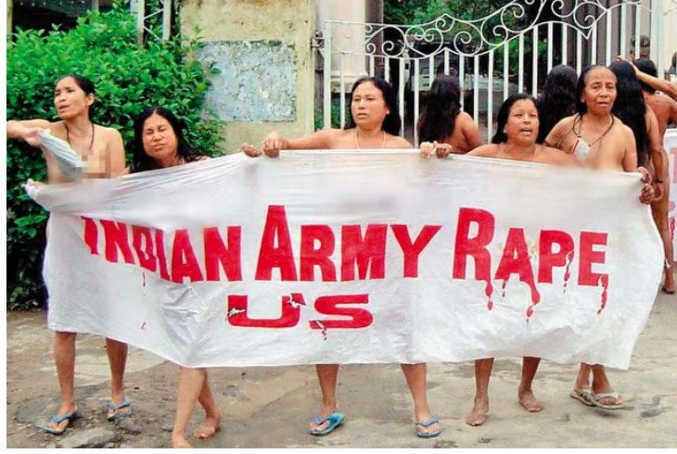
Resistance and Agency
Imdongla's strategic acts of defiance:
  Clever intervention to save husband from beating
  Confrontation with army captain
  Demonstrates possibility of agency even in oppressive contexts
  Cultural significance of threatened disrobing:
  "Ultimate insult a Naga woman could hurl at a man"
Use of cultural norms as a tool of resistance
  Echoes real-life protest against AFSPA in Manipur (2004)
  Connection between fictional narrative and actual political events
  Literature reflecting and commenting on real-world resistance
  Possibilities for challenging necropolitical power structures:
  Individual actions reasserting humanity in dehumanizing circumstances
  Importance of cultural knowledge in acts of resistance
Women protesters in front of Kangla Fort (Manipur) protesting the unwarranted killing and suspected rape of Thangjam Manorama by the Indian paramilitary unit, 17th Assam Rifles on 11 July 2004 under AF(SP)A

Slide 12
Conclusion
Necropolitics extends beyond simple state vs. resistance binary, there exists a complex interplay of power involving multiple actors which challenges simplistic understandings of conflict dynamics.
Ao's work reveals intricate power dynamics in conflict zones: Permeates multiple layers of society: State forces, insurgent groups, and ordinary villagers and Illustrates how power over life and death is exercised at various levels , She offers a nuanced portrayal of how individuals navigate these power structures while highlights both possibilities and limitations of resistance.
Cultural and tribal distinctiveness as site for strategic challenges: Naga cultural practices (e.g., Imdongla's threatened disrobing) serve as powerful tools of resistance. Traditional social structures (e.g., role of village elders) both constrain and enable resistance while Linguistic and cultural knowledge provide resources for navigating complex power dynamics. However, cultural distinctiveness can also be a source of vulnerability and target for oppression.
Ao's stories provide unique insights into lived experiences under conflict zones, her narratives are centered on the ordinary people's experiences. Ao’s stories create shared cultural memory, crucial for identity in times of upheaval, and by writing and preserving stories she offers a defiance against erasure under a necropolitical sovereignty.

Slide 13
References:
Ao, Temsula. Laburnum for My Head. Penguin Books India, 2009.
Agamben, Giorgio. Homo Sacer: Sovereign Power and Bare Life. Stanford University Press, 1998.
Mbembe, Achille. Necropolitics. Translated by Steven Corcoran, Duke University Press, 2019.
Foucault, Michel. The History of Sexuality: Volume 1: An Introduction. Translated by Robert Hurley, Vintage, 1990.
Bhattacharyya, R. “Living with Armed Forces Special Powers Act (AFSPA) as Everyday Life.” GeoJournal, vol. 83, 2018, pp. 31–48. https://doi.org/10.1007/s10708-016-9752-9.
Hazarika, Sanjoy. Strangers No More: New Narratives from India's Northeast. Aleph Book Company, 2018.

