Slide 1
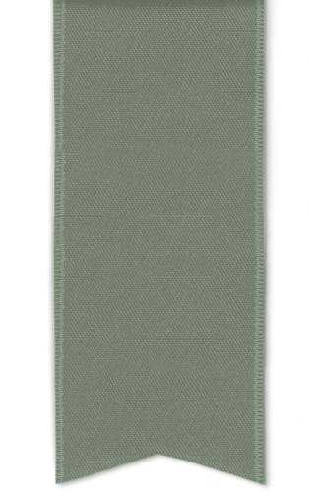

Analysis Of
Mechanical Behaviour in
Al-SiCp Metal Matrix Composites Formed Through Stir Casting
Mr. Amol Ashok Chavan
Research Scholar,
Production Engineering Department VJTI

Slide 2
ABSTRACT
Aluminum-Silicon Carbide (Al-SiC) metal matrix composites (MMCs) have gained considerable interest due to their superior mechanical properties, making them suitable for use in industries such
as automotive and aerospace.
This research focuses on evaluating the mechanical characteristics of Al-SiC composites produced through the stir casting method, a popular technique known for its simplicity and cost efficiency.
Various weight fractions of SiC particles were added to the aluminum matrix, followed by a
controlled stirring process to achieve uniform distribution of the reinforcement.
The resulting composites underwent mechanical testing, including tensile strength, hardness, and
impact toughness assessments.
Findings reveal that increasing SiC content significantly enhances mechanical performance,
particularly in terms of strength, hardness, and wear resistance, compared to unreinforced aluminum.
However, challenges such as particle clustering and porosity were observed to influence the overall properties of the composite.
This study concludes that the stir casting process is an effective approach for producing Al-SiC composites with improved mechanical properties, ideal for demanding applications.

Slide 3
INTRODUCTION
Composite materials have gained substantial prominence in advanced engineering sectors due to their superior mechanical and physical properties.
These materials, formed by the combination of two or more distinct constituents, synergize the beneficial characteristics of each component, resulting in enhanced performance.
In particular, metal matrix composites (MMCs) have shown significant potential, especially in high-
performance applications, owing to their high stiffness, strength, and wear resistance.
Traditionally, continuous-fiber-reinforced composites dominated the landscape; however, their high manufacturing costs and complex processing methods have steered focus toward particulate-reinforced composites, which offer a more cost-effective and efficient alternative.

Slide 4
INTRODUCTION Continued…
Aluminum and its alloys, known for their excellent properties such as low density, high plasticity, ductility, and superior corrosion resistance, are widely used in industries including aerospace, automotive, and high-speed rail systems.
Despite these advantages, the inherent low hardness and suboptimal impact resistance of aluminum alloys limit their application in high-stress, heavy-duty environments.
The development of aluminum matrix composites (AMCs), particularly those reinforced with ceramic
particles, provides a robust solution to these limitations.
By incorporating reinforcements such as silicon carbide (SiC), the mechanical properties of aluminum alloys are significantly improved, achieving a tailored balance of strength, stiffness, thermal conductivity, and wear resistance.

Slide 5
INTRODUCTION Continued…
Silicon carbide (SiC) is a ceramic material characterized by a tetrahedral arrangement of carbon and silicon atoms, leading to an exceptionally hard and thermally stable structure.
SiC exhibits excellent resistance to chemical attack, maintaining stability against acids, alkalis, and molten salts up to temperatures of 800°C.
Additionally, SiC forms a protective silicon oxide layer in air at temperatures exceeding 1200°C, allowing
it to function at extreme temperatures up to 1600°C without significant strength degradation.
These properties, coupled with its high thermal conductivity and low coefficient of thermal expansion, make SiC an ideal reinforcement material for metal matrix composites.
SiC-reinforced aluminum MMCs exhibit remarkable thermal shock resistance, high wear resistance, and mechanical stability at elevated temperatures, making them suitable for critical applications in aerospace, automotive, and defense industries.

Slide 6
INTRODUCTION continued…
Among the various fabrication methods, stir casting is widely recognized as an effective and economical technique for the production of particulate-reinforced MMCs.
The process involves the incorporation of reinforcement particles into a molten metal matrix, followed by vigorous mechanical stirring to achieve uniform distribution of the reinforcement phase.
Stir casting offers several advantages, including scalability, cost-efficiency, and the ability to control the
volume fraction and size of the reinforcing particles.
This study focuses on the fabrication of aluminum-silicon carbide (Al-SiC) metal matrix composites through the stir casting route, with an emphasis on evaluating their mechanical properties, such as tensile strength, hardness, and impact resistance.
By systematically investigating the influence of SiC content and distribution on the mechanical behavior of Al-SiC composites, this research aims to provide insights into optimizing the material for high- performance applications.

Slide 7
Experimental
This study focused on the development of aluminum (Al-6061)/silicon carbide (SiC) metal matrix composites (MMCs) using the stir casting technique.
The stir casting method involves the mechanical dispersion of reinforcement particles (in this case, SiC) into a molten metal matrix (Al-6061).
The MMC plates were fabricated with varying weight fractions of SiC reinforcement (5%, 10%, and 15%)
to investigate the influence of reinforcement content on the composite's properties.
The SiC particles were of a fine size (325 mesh), which can enhance the interfacial bonding between the reinforcement and the matrix. The stirring process was conducted at a rotational speed of 200 revolutions per minute to ensure adequate dispersion of the SiC particles within the molten aluminum.

Slide 8
Outcomes and Interpretation
Stir casting method for Al6061/SiC metal
matrix composites (MMCs)
Al-SiC composites were synthesized by systematically varying the weight
fraction of SiC from 5% to 15%. A base sample mass of 400 grams was utilized, with the SiC content adjusted in proportion to the
specified weight percentages.
No. | Al (grams) | SiC (grams) | Remarks
1 | 385 | 20 | Al-5%SiC
2 | 365 | 40 | Al-10%SiC
3 | 345 | 60 | Al-15%SiC

Slide 9
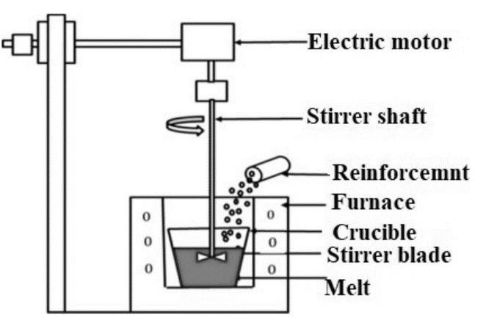
Experimental
Stir casting method for Al6061/SiC metal matrix composites (MMCs)
The system includes a furnace for melting the metal, along with a stirrer and motor for mixing the particles

Slide 10
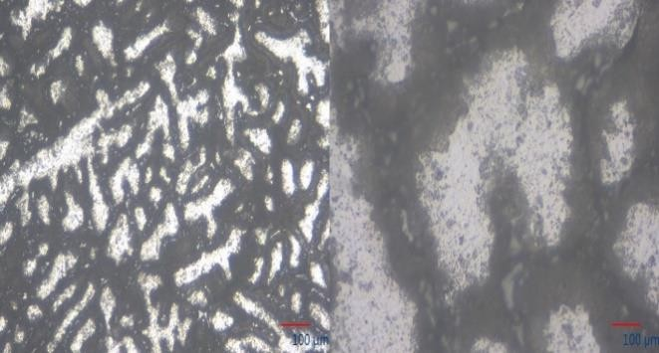
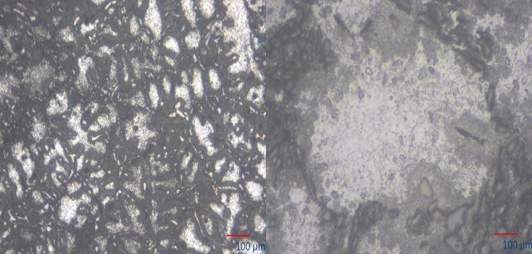
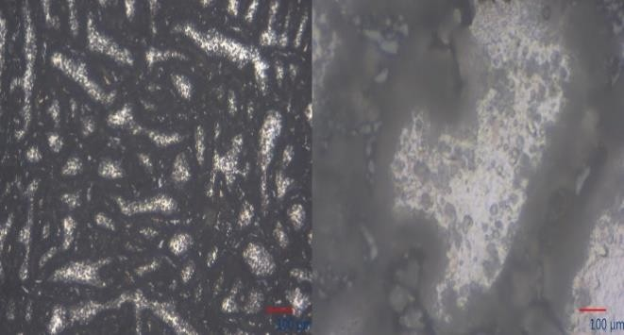
Outcomes and Interpretation
Metallurgical and microstructure examination
Micrographs reveal a noticeable improvement in the uniformity of the SiC particle distribution as the
weight percentage of reinforcement increases.
Al-5% SiC
Al-10% SiC
Al-15% SiC

Slide 11
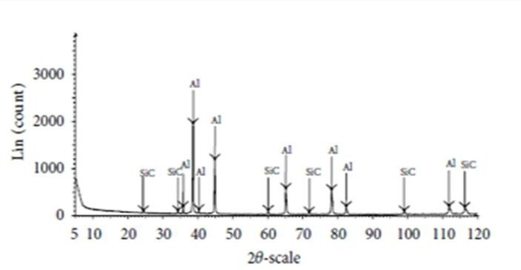
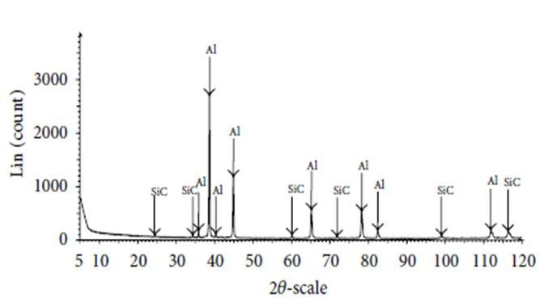
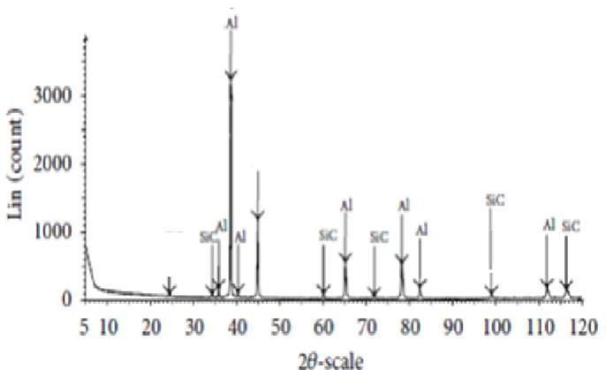
Outcomes and Interpretation
XRD analysis
Scanning range ensures a comprehensive evaluation of the material's phase composition, reinforcing the purity and successful incorporation of SiC particles within the Al matrix without the formation of unwanted by-products.
Al-5% SiC
Al-10% SiC
Al-15% SiC

Slide 12
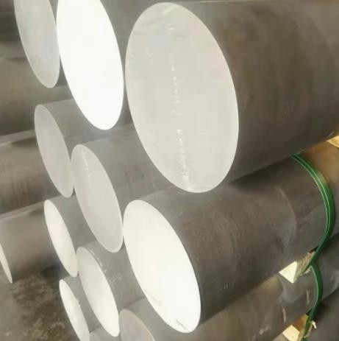
Outcomes and Interpretation
XRF analysis
It has been concluded that the SiC is uniformly dispersed throughout the matrix. Moreover, compositional analysis reveals the presence of Silicon and carbon.

Slide 13
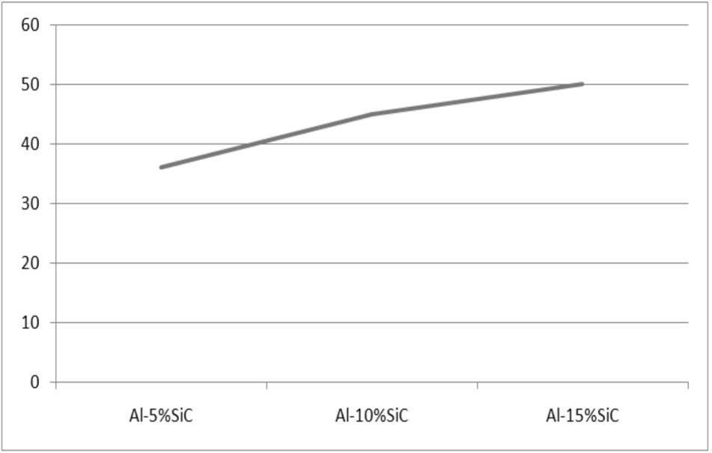
Outcomes and Interpretation
Hardness
It has been concluded that the SiC is uniformly dispersed throughout the matrix. Moreover, compositional analysis reveals the presence of Silicon and carbon.
Sr. No. | Samples | Hardness (HV10)
1 | Al-5%SiC | 38
2 | Al-10%SiC | 47
3 | Al-15%SiC | 52
Vickers hardness measurement of Al-SiC metal matrix composites (MMCs).
Relationship between hardness values VS the SiC content percentage."

Slide 14
Outcomes and Interpretation
Tensile Testing:
It has been concluded that the SiC is uniformly dispersed throughout the matrix. Moreover, compositional analysis reveals the presence of Silicon and carbon.
Samples | %Elongation | 0.2% Y.S (Mpa) | UTS (Mpa)
Al-5%SiC | 2.1 | 53.9 | 53.1
Al-10%SiC | 14 | 41.2 | 40.4
Al-15%SiC | 0.6 | 52 | 56.1

Slide 15
CONCLUSION
Al-SiC metal matrix composites (MMCs) were successfully fabricated using the stir casting technique, which is recognized for its efficiency in integrating ceramic reinforcements into metallic matrices.
Several critical processing parameters influence the quality and mechanical properties of the cast MMCs.
Comprehensive microstructural investigations, complemented by X-ray diffraction (XRD) analysis, revealed a uniform distribution of SiC particles within the aluminum matrix, which is essential for achieving enhanced mechanical properties.
X-ray fluorescence (XRF) analysis provided detailed information regarding the chemical composition
and spectrum of the fabricated composites.
The addition of SiC particles significantly contributes to improving the mechanical properties of the aluminum matrix, notably enhancing hardness and tensile strength.
Additionally, the resulting Al-SiC MMCs exhibit high-temperature stability, making them suitable for use in environments subjected to elevated thermal conditions.
The incorporation of SiC not only improves wear resistance but also enhances corrosion resistance, thus broadening the application range of these composites in various industries

Slide 16
Thank You

