Slide 1
THE TRENDS OF JUVENILE DELINQUENCY IN ARUNACHAL PRADESH
Ms. Yakang Nani,
Ph.D. Scholar Department of Law,
Himalayan University,
Jullang, Arunachal Pradesh, India

Slide 2
INTRODUCTION
Arunachal Pradesh, meaning the ‘the land of rising sun’ and popularly known also known as the ‘Land of Dawn lit Mountains’ is situated in the extreme North-East of India. The word 'Aruna' means charioteer of Sun god and 'Achal' means Mountain. In this state Sun appears first in India.
The North–East Frontier Agency (NEFA), originally known as the North-East Frontier Tracts (NEFT), was one of the political divisions in British India and later the Republic of India until 20 January 1972, when it became the Union Territory of Arunachal Pradesh and some parts of Assam.
The total area of Arunachal Pradesh is 83,743 square kilometers (32,333 sq mi). The State is bounded by independent countries on three sides and by Assam and Nagaland states by one side. There are Bhutan, Tibet, China and Myanmar to the west, north-east, north and east of this state respectively.
Arunachal Pradesh is home to dozens of distinct ethnic groups, most of which are in some ways related to the peoples of Tibet and the hill region of western Myanmar.

Slide 3
METHODS OF ANALYSIS
The various methods are used for analyzing the crime distribution of this state. These methods have developed the researchers to reach the correct conclusion. The raw data have been processed and a percentage of juvenile crimes to total crimes have been calculated using the area.
The nature and statistics of Juvenile delinquency are published by the National Crime Record Bureau (NCRB), Delhi. It is the main source of data from where the researcher has collected the maximum data.
Juvenile statistic is usually hard to find as the family hardly disclose the name of the juvenile offender. The crime committed by Juvenile goes mostly unnoticed by the court and police.
And most of time even parents don’t want to disclose the crime committed by the delinquents as a matter of prestige.

Slide 4
ARUNACHAL PRADESH AND JUVENILE DELINQUENCY
The Society has many problems in today’s modern era. Among various problems, one of the major problems is the Juvenile delinquency. The Children is the asset of the state. And if thechildren are going astray or out of the normal path, it is a major cause of concern.
Juvenile Delinquency is a major security problem in the North East in general and Mizoram and Arunachal Pradesh in particular. It can become a major security/law and order problem at a later date if it is not addressed at right time, as a petty thief at tender age may become a hardcore criminal/dreaded terrorist in days to come.
To study the gravity of the Juvenile Crime in Arunachal Pradesh, the researcher has collected data related to the child population of India and Arunachal Pradesh along with the Juvenile Crimes. The figures have been prepared in the tabulation for easier understanding.
The analysis of the data has been made to the various crime committed by the Juveniles in the state. And the crimes are categorized one by one.

Slide 5
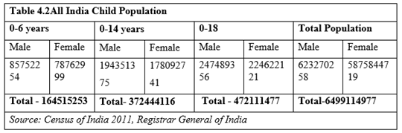
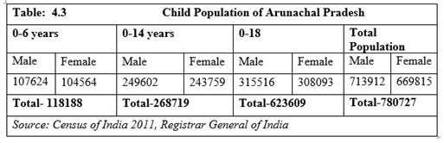
Child Population of India

Slide 6
JUVENILE JUSTICE SYSTEM IN ARUNACHAL PRADESH
There are no coded customary laws with regard to the punishments to the Juvenile delinquents in the State of Arunachal Pradesh. The simple case of thefts etc., were punished in the kinds or goods such as ornaments or animas (Mithuns).
The JJA 2000 introduced a revolutionary change in the constitution of the Juvenile Court, renamed it as the Juvenile Justice Board consisting of three members- One Magistrate designated as Principal Magistrate, and two social workers as the members of the Board vested with the powers of the Magistrate. Similar Provision has been made in JJA 2015.
The JJB Board is functional in all the 25 districts of Arunachal Pradesh including the Itanagar Capital Complex(ICC).¹⁹
(except for the two newly created Keyi Panyor and Bichom), The Juveniles in Conflict with Law (Sec.2(i)) as soon as, is apprehended by the police, such child shall be placed under the charge of thespecial juvenile police unit or the designated child welfare police officer,who shall produce the childbefore the Board without any loss of time but within a period of twenty-four hours of apprehending thechild excluding the time necessary for the journey, from the place where such child was apprehended.

Slide 7
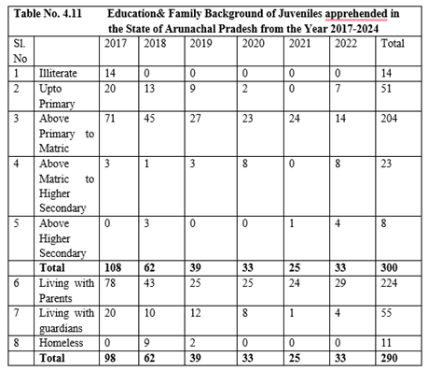
NUMBER OF JUVENILE CASE DISPOSED FROM 2017-2022
The Educational level of the Juveniles so presented before Juvenile Justice Board (JJB)from the year 2017-2022 shows that from total of 300 Juveniles apprehended both in IPC & SLL Crime, the highest number of Juveniles from above Primary to Matric were 204 in numbers, up to the Primary level, had around 51 Juvenile delinquents, above matric had 23 Juveniles, 14 Juveniles who were Illiterate and 8 Juveniles above Matric respectively.
The Data Shows that person with above matric had lowest crime rate, which means that good education matters a lot in the Juveniles life.
But the person who were in between primary to Matric had highest number of delinquents.
Every effort has to be made at primary level itself to retain the children once admitted and make them complete their studies.

Slide 8
CONCLUSION
The tabulation of the reports from the NCRB data has been studied in this chapter. Crime such as Theft, Burglary, Hurt, Grievous Hurt are some of the highest intensity crimes committed by the Juveniles under Indian Penal Code.
Burglary i.e., House breaking by night is also a common crime. The youth between 12 to 18 years are more involved in the Burglary.
In Arunachal Pradesh, scooty, bike etc. has also been stolen and reported may a times in the newspaper. Kitchen items specially the gas cylinder is the most common thing to have been carried away by the Juveniles.
The IPC crimes affecting women are also one of the major crimes that has come up in the study. The Juveniles in this modern era, has an easy access to the mobile phones. They get easy prey to the pornography sites.
Rape charges against juveniles are very complex and sensitive issue that demands a balanced approach. While it is essential to protect the rights of victims and ensure justice, it is equally crucial to offer a chance for reform and rehabilitation to young offenders.

Slide 9
REFERENCES
Arunachal Pradesh https://en.wikipedia.org/wiki/Arunachal_Pradesh
North East Frontier Agency https://en.wikipedia.org/wiki/North-East_Frontier_Agency
(Choudhury, Ratnadip (23 September 2020). "Arunachal Residents Write To PM On Road Project, Quote National Security". NDTV.com. Archived from the original on 30 October 2020. Retrieved 27 January 2021.)
Arunachal Pradeshhttps://en.wikipedia.org/wiki/Arunachal_Pradesh
North East Frontier Agency https://en.wikipedia.org/wiki/North-East_Frontier_Agency.

Slide 10
THANK YOU

