Slide 1
Presentation
on
Relationship between Socio-personal Profile and Entrepreneurial Behaviour of Vegetable Growers of Lower Subansiri District, Arunachal Pradesh
Presented By,
Hage Manty
PhD Research Scholar
(Agricultural Extension Education)
Department of Agriculture
Himalayan University, Jollang (A.P)

Slide 2
INTRODUCTION:
- Vegetables are essential for a healthy diet.
- Source of income for small and marginal farmers.
- India: wide variety of vegetables grown under diverse agro-climatic
conditions.
- Arunachal Pradesh:Vital role in socio-economic development.
- Provides year-round income for small and marginal farmers.
- 94% of population rural (Source: Dept. of Agriculture, Arunachal Pradesh).
- Scope for entrepreneurship development.

Slide 3
Entrepreneurship
**Entrepreneurship Defined:
- Mobilizes resources to meet market demands (Timmons, 1989).
- Creating value by combining unique resources (Stevenson, 1985).
**Entrepreneurial Behaviour:
- Influenced by personal and social factors.
- Doing things in innovative ways.
- Key factor in economic growth and development.

Slide 4
Objectives
To study the relationship between socio - personal profile of
vegetable growers with their entrepreneurial behaviour.

Slide 5
METHODOLOGY
RESEARCH DESIGN/TYPE
In the present investigation ‘Ex-post facto’ research design was employed since the phenomenon had already occurred and the design was considered appropriate.
Ex-post-facto research is the most systematic empirical enquiry in which the researcher does not have any control over independent variables as their manifestation has already occurred or as they are inherent and not manipulatable. Thus, inferences about relation among variables were made without direct intervention from concomitant variation of independent and dependent variables (Kerlinger, 1973).

Slide 6
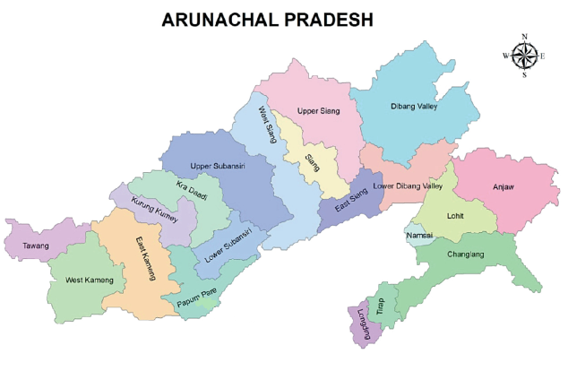
LOCALE OF THE STUDY
Fig 1: Map of Selected District

Slide 7
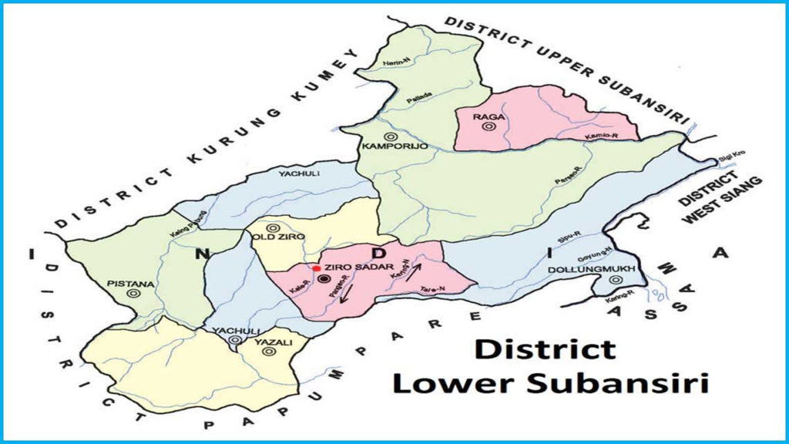
Fig 2: Map of Selected Circle (CD Block) / Tehsil

Slide 8
Selection of Study Area and Respondents
Lower Subansiri District (Arunachal Pradesh)
Sl. No. | Selected Village | No. of Respondent | Selected Circle(CD Block)
1. | Hari | 20 | ZIRO
2. | Kalung | 20
3. | Tajang | 20
4. | Reru | 20
5. | Lempia | 20
6. | Bamin Michi | 20
7. | Hong | 20
8. | Gano | 20
9. | Siiro | 20
Total | 9 | 180
DATA COLLECTION :- Personal interview method using structured pre-tested
questionnaire

Slide 9
VARIABLES OF THE STUDY
Socio- personal profile
(Independent Variables)
1. Age
2. Education
3. Occupation
4. Land holding
5. Annual income
6. Training Received
7. Mass Media Participation
8. Extension Contact
9. Extension participation
10. Scientific orientation
II. Entrepreneurial Behaviour
(Dependent Variables)
Innovativeness
Decision making ability
Economic Motivation
Risk orientation
Management orientation

Slide 10
STATISTICAL TOOLS USED
Correlation: Karl Pearson’s simple correlation test was used to calculate ‘r’ value facilitated to know the strength and nature of the relationship between dependent and independent variables.

Slide 11
RESULTS
Table 1:- Correlation coefficient between Socio - Personal profile and Entrepreneurial behavior
N = 180
Sl. No. | Independent variables | Correlation coefficient ( ‘r’ value )
1. | Age | 0.657**
2. | Education | 0.428**
3. | Occupation | - 0.158^{NS}
4. | Land Holding | 0.737**
5. | Annual Family Income | 0.764**
6. | Training Received | 0.258**
7. | Mass Media Participation | 0.976**
8. | Extension Contact | 0.866**
9. | Extension Participation | 0.991**
10. | Scientific Orientation | 0.918**
**: Significant at 0.01 probability level, NS: Non-significant

Slide 12
CONCLUSION
The study revealed that certain variables such as age, education, land holding, annual
family income, mass media participation, extension contact, extension participation and
scientific orientation were found to be positively and significantly correlated with
entrepreneurial behaviour. The Government and private organizations should aim at
manipulating these variables to their advantage for promoting entrepreneurial behaviour
among vegetable growing farmers.
Intensive training programmes need to be conducted by government and non-government.

Slide 13
References
Gupta, R. (2022). Entrepreneurial behaviour of vegetable growers in hardoi district of utter pradesh.M.Sc. thesis (Unpublished), College of Agriculture, Acharya Narendra Deva University of Agriculture and Technology, Kumarganj, Ayodhya (U.P).
Karat, S. (2019). Entrepreneurial behaviour of Hi-Tech farmers in Kerala, Doctoraldissertation, Department of Agricultural extension, College of Horticulture, Vellanikkara).
Kumar, N. N. and Narayanaswamy, B. K. (2000). Entrepreneurial behaviour and socio-economic characteristics of farmers who adopted sustainable agriculture in India. Karnataka Journal of Agricultural Sciences, 13(1), 83-90.
Nagesh (2006). Study on entrepreneurial behaviour of pomegranate growers in Bagalkot district of Karnataka. M. Sc. (Agri.) Thesis, University of Agricultural Sciences, Dharwad.
Sabale, A. N., Suradkar, D. D. and Thombre, B. M. (2014). Entrepreneurial behaviour of farmers in Marathwada region. Agriculture Update, 9(1), 25-30.
Savitha, C.M., Siddaramaiah, B.S., andNataraju, M.S. (2009). Development of a scale to measure the entrepreneurial behaviour of rural and urban women entrepreneurs. Mysore journal of agricultural sciences, 43, 119-121.
Stevenson, H. H. (1985). New business ventures and the entrepreneur. Homewood, IL : Irwin.
Subramanyeswari, B. and Veeraraghava Reddy, K. (2003). Enterpreneurialbehaviour of rural dairy women. Madras Agricultural Journal, 30(1-3), 173-175.
Thyagarajan, S. and Vasanthakumar, J. (2000). Constraints to high yield in rice at farm level. Journal of Extension Education, 11(2), 2747-2753.
Timmons, J. A. (1989). The entrepreneurial mind. Brick House Pub.

Slide 14
THANK YOU ALL

