Slide 1
TITLE : Effects of different sowing dates on yield performance of hybrid Maize (Zea mays L.) under Namsai condition.
Author:
Mr. Tarian Nabam Katung,
PhD Scholar
Department of Agriculture
Himalayan University
Itanagar
Co-Author
Dr. Sonbeer Chack
Assistant Professor
Department of Agriculture
Himalayan University
Itanagar

Slide 2
Abstract
The study on “effects of different sowing dates on yield performance of hybrid maize (Nem-33) under Namsai condition” was conducted in Namsai of Arunachal Pradesh during the period 10th February to 11th September 2023 in a randomized block design-RBD method. First Sowing dates was started from 10th February followed by 20th February, 2nd March, 12th March, 22nd March, 1st April, 11th April, 21st April, 1st May and 11th May respectively at 10 days interval. The yield parameters like number of cobs per plant, number of grains per cob,100 grain seed index, grain yield per plot and grain yield per hectare have been observed and evaluated. On evaluation it was noted that maize sown on 1st April gave maximum number of 8.00 cobs per plant, maximum number of 31.27 grains per cob, highest seed index of 41.33 and highest grain yield of 23.867 qtl/ha when compared to all other sowing dates. Thus, sowing on 1st April has paramount effect on production of hybrid Maize (Nem-33) in Namsai condition. Further study may be needed to investigate precise sowing dates of local maize in Namsai region.
Keywords: maize, yield, sowing dates.

Slide 3
INTRODUCTION
Maize (Zea mays L., 2n= 20) belongs to the family Poaceae and is one of the most important cereal crops of the world after the wheat and rice as food for human beings and feed for poultry, piggery and farm animals. Several industries both in rural and urban areas rely on maize and maize by-products such as for starch milling, cornmeal, flour, snack making etc.
Nutritionally maize is rich in carbohydrate (70-80%), protein (6-13%), fat (4%) and oil (2-6%). It has a very high yield potential and because of which it is called as “Queen of cereals”.
The actual period of maize cultivation is hardly mobilized among the farmers of the Namsai district of Arunachal Pradesh. The growers are concerned about the yield response of the maize to sowing dates and the maize production is temporal to fulfil value addition products, food security and revenue generation of the people of Namsai region. Moreover, previous researchers in different parts of the world also stated that sowing dates is effective in increasing the yield of maize. Keeping in view of the farming community concern of the region a field investigation was conducted at finding out suitable time for sowing hybrid maize in the Namsai district of Arunachal Pradesh.

Slide 4
OBJECTIVES
To evaluate effects of different sowing dates on yield performance of hybrid Maize and to suggest precise sowing date of hybrid maize under Namsai condition of Arunachal Pradesh.

Slide 5
METHODOLOGY
Experimental Site
The research experiment on the title “Effects of different sowing dates on yield performance of hybrid maize” under Namsai condition, Arunachal Pradesh was carried out Namsai from February to September 2023.
The site was situated at geo-coordinates of 27⁰30´ to 27⁰55´N and 95⁰45’ to 96⁰20’ E with elevation of 157 m above mean sea level.
The details of the weather parameters prevailed during the entire experimental period for Namsai is presented in Table 1 and Figure 1.
The experiment was laid out in randomized block design (RBD) with three replications and ten treatment having plot size of 2 m x 1.5 m each. Maize hybrid Nem-33 was sown at 10 days interval started from 10th February and lasted up to 11th May 2023. The field experiment was completed by 13th September 2023.

Slide 6
Table 1 : Weather data of the experimental period
Month | Rainfall (mm) |  | Temperature (⁰C) |  | Relative Humidity (%) |  | Sunshine (hours) |  | Total Rainfall (mm) | Total Rainy days | Total sunny days
 | Maximum | Minimum | Maximum | Minimum | Maximum | Minimum | Maximum | Minimum
Feb-23 | 36 | 0.5 | 29.8 | 8.5 | 100 | 38 | 510 | 7 | 126.5 | 14 | 14
Mar-23 | 26 | 1 | 33.9 | 10.6 | 100 | 28 | 502 | 18 | 150 | 17 | 14
Apr-23 | 23.5 | 0.1 | 36.9 | 13.7 | 100 | 25 | 422 | 25 | 117.4 | 19 | 11
May-23 | 46.1 | 0.2 | 37.5 | 17.4 | 100 | 18 | 335 | 5 | 175.6 | 20 | 11
Jun-23 | 48 | 0.5 | 37.8 | 20.9 | 100 | 46 | 335 | 1 | 408 | 21 | 9
Jul-23 | 80 | 1.5 | 39.5 | 23.8 | 100 | 52 | 403 | 19 | 463.5 | 22 | 9
Aug-23 | 64 | 0.5 | 38.6 | 23.7 | 100 | 54 | 493 | 3 | 502 | 22 | 9
Sep-23 | 52.7 | 1.5 | 31.7 | 12.5 | 100 | 51 | 498 | 9 | 476 | 17 | 13

Slide 7
Fig 1: Graphical representation of weather data of the experimental period

Slide 8
Experimental designs and layout
The design chosen for the experiment was the randomized block design (RBD) with three replications and ten treatments including control. The different sowing dates and design of the experiment are presented in Table 2 and Figure 2.
The details of technical program and layout of the experimental design is given below.
Name of crop : Maize
Variety : Nem-33
Design : RBD
Number of replications : 3
Number of treatments : 10
Experimental area : 90 m²
Plot size : 1.5 m x 2 m
Spacing : 60 cm x 40 cm
Seed rate : 20 kg/ha

Slide 9
Table 2 : Details of different sowing dates of Hybrid Maize
Treatments | Sowing dates
S₀D₀ | 10th February 2023
S₁D₁ | 20th February 2023
S₂D₂ | 2nd March 2023
S₃D₃ | 12th March 2023
S₄D₄ | 22nd March 2023
S₅D₅ | 1st April 2023
S₆D₆ | 11th April 2023
S₇D₇ | 21st April 2023
S₈D₈ | 1st May 2023
S₉D₉ | 11th May 2023
Legend : SD = Sowing dates

Slide 10

R1 | R2 | R3
S₀D₀ | S₉D₉ | S₆D₆
S₁D₁ | S₈D₈ | S₇D₇
S₂D₂ | S₇D₇ | S₈D₈
S₃D₃ | S₆D₆ | S₉D₉
S₄D₄ | S₅D₅ | S₀D₀
S₅D₅ | S₄D₄ | S₁D₁
S₆D₆ | S₃D₃ | S₂D₂
S₇D7 | S₂D₂ | S₃D₃
S₈D₈ | S₁D₁ | S₄D₄
S₉D₉ | S₀D₀ | S₅D₅
Treatment details:
S₀D₀: Control, 10th Feb’2023
S₁D₁: 20th Feb2023+NPK@ RD
S₂D₂: 2nd March2023+NPK@ RD
S₃D₃: 12th March’2023+NPK@ RD
S₄D₄: 22nd March 2023+NPK@RD
S₅D₅: 1st April’2023+NPK@RD
S₆D₆: 11th April’2023+NPK@RD
S₇D₇: 21st April’2023+NPK@ RD
S₈D₈: 1st May’2023+NPK@ RD
S₉D₉: 11th May 2023 +NPK@ RD
Fig.2 : Treatment with Symbols:

Slide 11
Land Preparation
The land was ploughed using tractor mounted with rotovator and with hired labourers. 30 sub-plots of size 1.5 m x 2m each were well prepared and were raised 30 cm above to avoid water logging as maize being very sensitive to excessive water. 100 cm space was allowed between the sub-plots for easy movement and inter-culture operations like weeding, watering etc., maintaining randomized block design (RBD) chosen for the field experiment
Fencing was provided (Plate 2) using local materials around the experimental plots to protect the crop from the possible damage by animals. All the stubbles, weeds, gravels etc were removed off and soils broken into pieces.

Slide 12
Seed Sowing
Fertilizers (NPK) were applied @ 120:60:40 kg/ha. Full dose of Phosphorus and Potassium and half dose of Nitrogen was applied immediately before sowing seeds and remain half of nitrogen was applied in two split doses one at knee high stage and other at tasseling stage.
Line sowing of 12 seeds was done in each sub-plot maintaining planting distance of 60 cm between the rows and 40 cm between the plants at every 10 days interval starting from 10th February 2023 to 11th May 2023. However no nutrients were applied to control treatment (S0D0) which was sown on 10th February.

Slide 13
Weed Management
As pre-plant application one round of glyphosate 50 EC @ 15ml per water was sprayed 1 week before sowing of seeds to kill the germinated weeds as glyphosate non-selective broad spectrum herbicide (Plate 3). A three rounds of manual weeding were done one each at 30 DAS, 60 DAS and 90 DAS (Plate 4) to keep the weeds under control which otherwise would cause 50-60 per cent of yield reduction.
Water Management
Experimental site being flat land with no drainage provision to drain out excess water especially during rainy days. The drainage problem was further compounded by the clayey loam nature of soil having high water retentive capacity. However to evade the problem of water logging the seed beds were raised 30 cm from the ground.
During extreme hot dry day irrigation was provided to the crops by bringing water from the nearby dug out ponds especially at tasseling and silking stages.

Slide 14
Tagging
Five plants were randomly selected from each treatment of the three replications and were tagged (Plate 5). The number of cobs per plant was recorded (Plate6).
Harvesting
Harvesting of cobs was done from the each tagged plants when the plants attained fully maturity and started drying. The number of grains of the harvested cobs was counted and weighed using electronic weighing balance to determine the fresh weight of grains and then dried in the shade to bring down the moisture level.
After shade drying the again weighed (Plate 7a, 7b) and counted the number of seeds per cob (Plate 8) and averaged. Then weight of 100 grain seeds was recorded (Plate 9).

Slide 15
Yield Parameters
Yields of the randomly selected and tagged plants such as number of cobs/plant, number of grains/cob, 100 grains seed index, grain yield ( kg/plot) and grain yield (qtl/ha) were recorded which were later subjected to statistical analysis using grapes RBD software.
Number of cobs per plant
Number of cobs each tagged plant for all the treatments were counted at maturity and harvested and averaged which were then subjected to statistical analysis.
Number of grains per cob
Number of grains from each harvested cob of all the treatments were counted manually and recorded for statistical analysis.

Slide 16
Seed Index
100 grains from each treatment were counted and measured and statistically analyzed for finding seed index.
Grains yield per plot (kg)
Grains yield of each treatment was recorded with digital electronic weighing balance of whole three replications and took the average yield of each replication.
Grains yield (qtl/ha).
Finally the grain yield was converted into quintals per hectare and statistically analyzed using Grape RBD software.

Slide 17
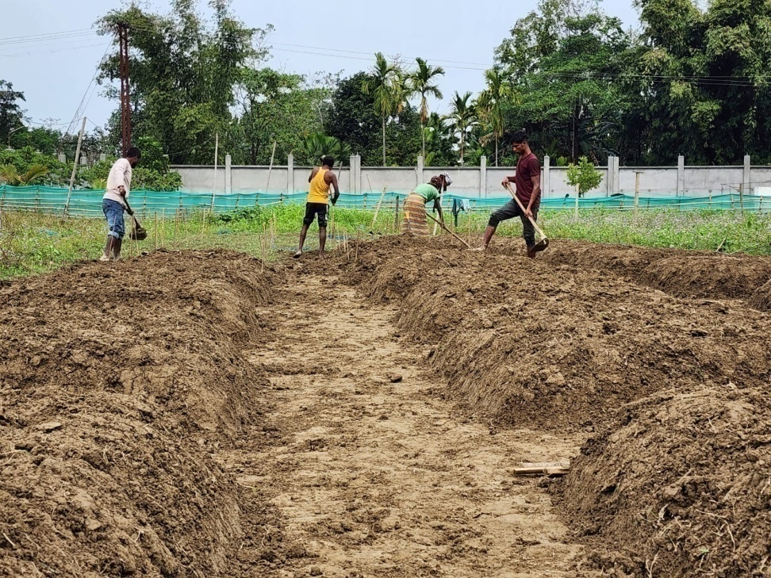
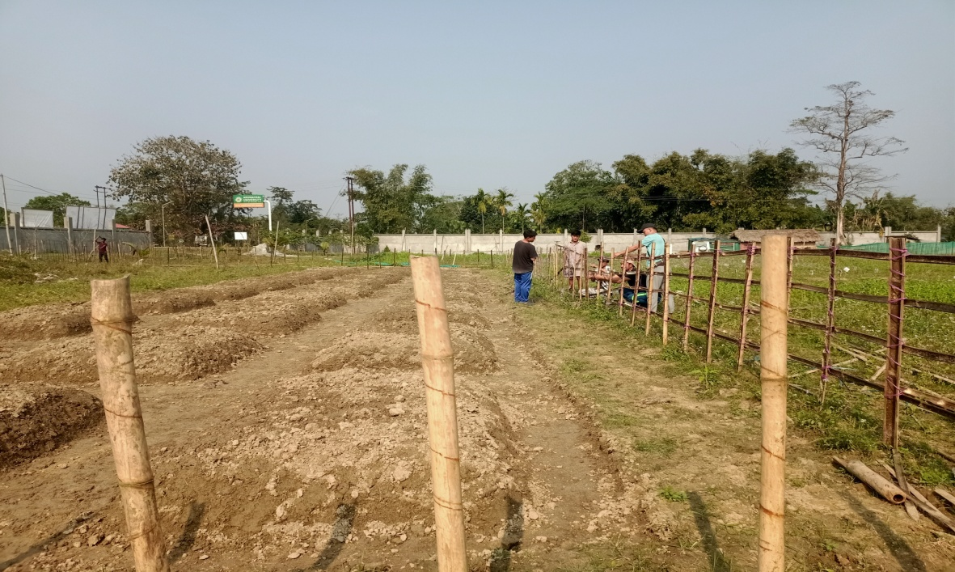
Plate 1 : Preparation of land in RBD
Plate 2 : Fencing erection

Slide 18
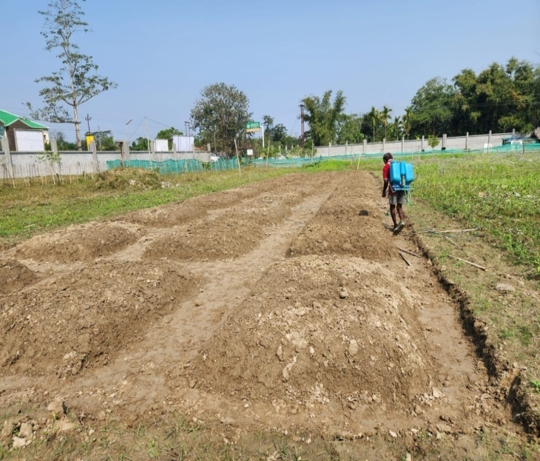
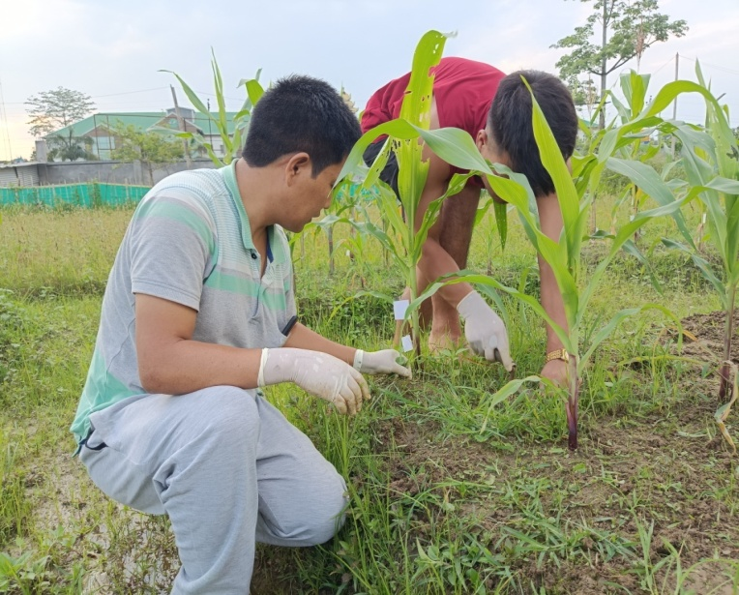
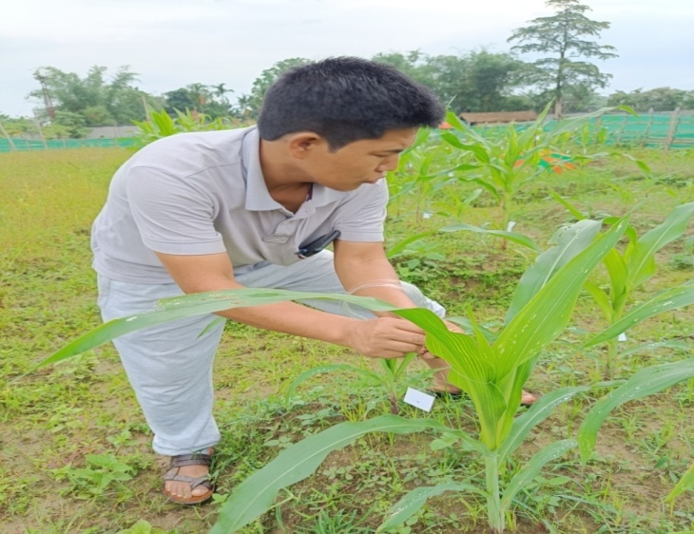
Plate 3: Soil sterilization before sowing
Plate 4: Plot wise weeding
Plate 5 : Tagging of selected plants

Slide 19
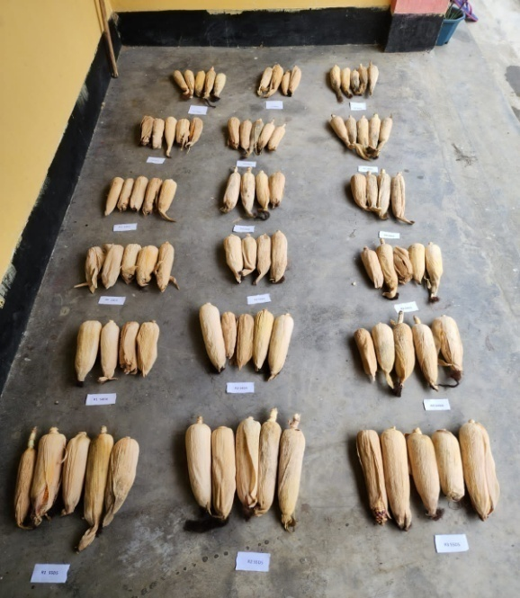
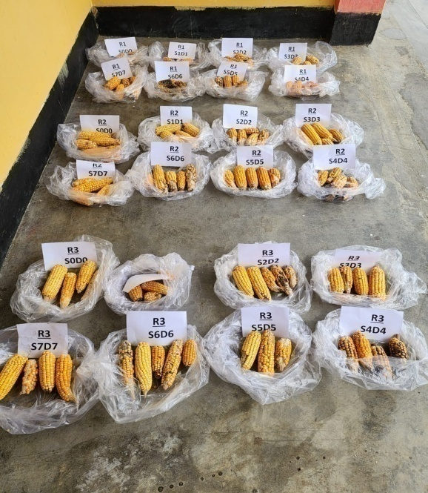
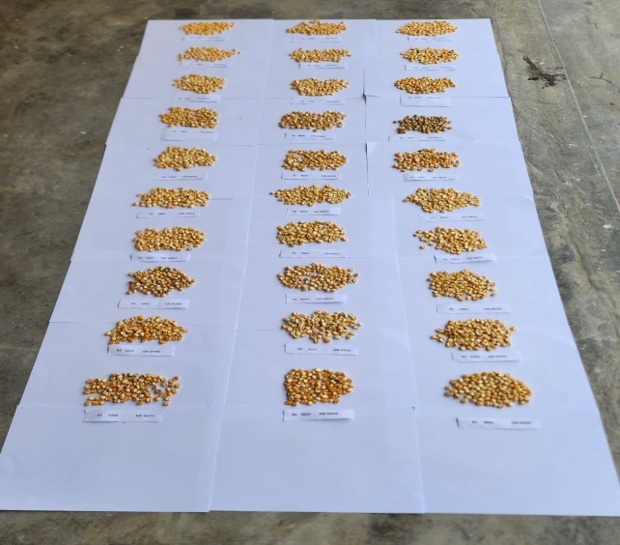
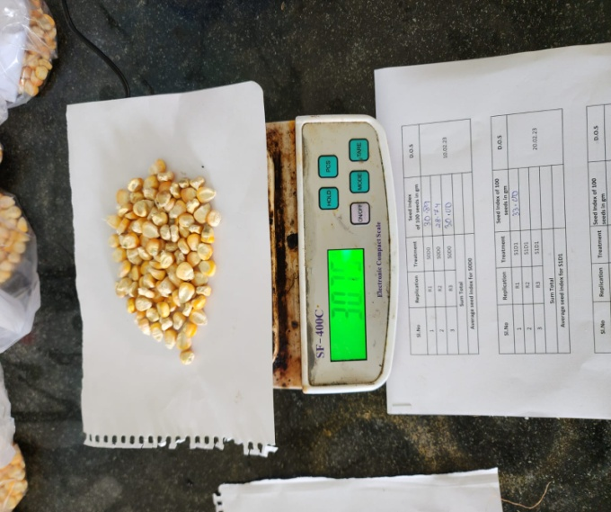
Plate 7 (a) Shade drying of harvested Maize cobs
Plate (b) Dehusked Maize cobs
Plate 8:Number of grains per cob
Plate 9: 100 Grain seed index

Slide 20
RESULTS & DISCUSSION
Number of cobs per plant
Number of grains per cob
Seed index
Grains yield per plot (kg)
Grains yield per ha (qtl)

Slide 21
Number of Cobs
In the present study sowing dates significantly influenced number of cobs per plant. The maximum number of cobs per plant (8.00) was observed in 1st April sown crop, followed by 11th April sown crop (7.00) (Table 2 and Figure 2).
The reason for highest number of cobs per plant in 1st April and 11th April sown crops might be due to favourable rainfall and other weather parameters during that month for better seed germination, plant stand and subsequent crop growth and cob formation and development in the later phase.

Slide 22
Table 2: Observation on Number of Cobs per plant in Hybrid Maize
Treatments | Number of Cobs per plant
S0D0- 10th Feb’ | 0.33
S1D1- 20th Feb’ | 2.16
S2D2- 2nd March’ | 3.16
S3D3- 12th March’ | 4.17
S4D4- 22nd March’ | 5.16
S5D5- 1st April | 8.00
S6D6- 11th April | 7.00
S7D7- 21st April | 6.00
S8D8- 1st May | 0.66
S9D9- 11th May | 1.00
SEm ± | 0.16
CD (P=0.05) | 0.50

Slide 23
Fig. 2: Mean number of cobs per plant of hybrid maize with different sowing dates

Slide 24
Number of Grains per Cob
A significant difference in grains per cob of Maize variety Nem-33 was observed due to difference in sowing dates. Positive effects on grains per cob was observed in 1st April sowing (31.27) and 10th April sowing (26.16) (Table 3 Figure 3).
This might be April sown crop had optimum growing period and the temperature and other growth factors were favourable during April. While the February sown crop being too early and that sown after April had unfavorable growing conditions which resulted in low grains per cob and low grain yield. The result of the present study is to some extent agrees with the results of many earlier workers such as Ahmed et al. (2011) who revealed that sowing dates cause variation in grains per cob of Maize.

Slide 25
Table 3 : Observation on Mean number of grains per cob in Hybrid Maize
Treatments | Number of grains per cob
S0D0- 10th Feb’ | 6.83
S1D1- 20th Feb’ | 8.33
S2D2- 2nd March’ | 10.16
S3D3- 12th March’ | 13.50
S4D4- 22nd March’ | 17.90
S5D5- 1st April | 31.27
S6D6- 11th April | 26.16
S7D7- 21st April | 23.00
S8D8- 1st May | 21.50
S9D9- 11th May | 19.20
SEm ± | 0.28
CD ( P=0.05) | 0.84

Slide 26
Fig. 3: Mean number of Grains per cob in Hybrid Maize

Slide 27
Seed Index
The seed index of 100 grains of maize seed from each treatment was also determined in the present study. On statistical analysis it was observed that 1st April sown crop gave highest seed index (47.33) which was followed by 11th April sown crop (41.33). The previous workers Ahmed et al. (2011), Babak and Mohammadreza (2012) and Kolo et al. (2012) also reported sowing dates significantly affect seed index.
The result indicated that sowing date also significantly affect the seed index. It was observed that planting in April gave the highest 100 grain seed index (Table 4 and Figure 4).

Slide 28
Table 4: Observation of Seed index in Hybrid Maize
Treatments | Seed Index (100 grain seeds)
S0D0 - 10th Feb’ | 18.28
S1D1 - 20th Feb’ | 21.83
S2D2 - 2nd March’ | 25.73
S3D3 - 12th March’ | 30.06
S4D4 - 22nd March’ | 34.13
S5D5 - 1st April | 47.50
S6D6 - 11th April | 41.33
S7D7 - 21st April | 37.51
S8D8 - 1st May | 14.16
S9D9 - 11th May | 10.16
SEm ± | 0.36
CD (P=0.05) | 1.08

Slide 29
Fig. 4: Mean seed index of maize with different sowing dates

Slide 30
Average Yields of Maize (kg/plot)
Significant variation in grain yield was observed in each treatment due to different sowing dates of hybrid maize Nem-33. Statistical analysis of data indicated highest grain yield for crop sown on 1st April (9.31 kg/plot) followed by 11th April (8.16 kg/plot) and 21st April (7.03 kg/plot). Data regarding grain yield are presented in the Table 5 and Figure 5.

Slide 31
Table 5 : Observation of mean grain yields of Maize (kg/plot)
Treatments | Average Yield (kg/plot)
S0D0 - 10th Feb’ | 0.53
S1D1 - 20th Feb’ | 3.26
S2D2 - 2nd March’ | 4.34
S3D3 - 12th March’ | 5.20
S4D4 - 22nd March’ | 6.18
S5D5 - 1st April | 9.31
S6D6 - 11th April | 8.16
S7D7 - 21st April | 7.03
S8D8 - 1st May | 2.01
S9D9 - 11th May | 1.48
SEm ± | 0.17
CD (P=0.05) | 0.52

Slide 32
Fig.5 : Mean grains yield (kg/plot) with different sowing dates

Slide 33
Grains yield (qtl/ha)
Statistical analysis of data indicated highest grain yield for crop sown on 1st April (23.86 qtl/ha) and 11th April (21.19 qtl/h). Data regarding grain yield per hectare are presented in the Table 6 and Figure 6.

Slide 34
Table 6 : Evaluation of yield in hybrid maize with different sowing dates
Treatments | Yield (qtl/ha)
S0D0 -10th Feb’ | 0.88
S1D1-20th Feb’ | 10.16
S2D2-2nd March | 12.00
S3D3-12th March | 14.18
S4D4-22nd March | 16.18
S5D5-1st April | 23.86
S6D6-11th April | 21.19
S7D7-21st April | 19.45
S8D8-1st May | 17.41
S9D9-11th May | 13.11
SEm ± | 0.18
CD (P=0.05) | 0.55

Slide 35
Fig 11 : Mean grains yield (qtl/ha) of hybrid maize with different sowing dates

Slide 36
Summary and conclusion
Observation on all the yield parameters viz. number of cobs per plant, number of grains per cob, 100 grain seed index , grains yield per plot (kg) and grain yield per hectare (qtl). On evaluation it was noted that maize sown on 1st April gave maximum number of cob 8.00 cobs/plant, number of 31.27 grains/cob, highest seed index of 41.33 and highest grain yield of 23.867 qtl/ha compared to all other sowing dates.
It was revealed that sowing on 1st April has paramount effect on production of hybrid Maize (Nem-33) in Namsai condition. Thus, it is concluded from the above findings that 1st April sowing gives better performance over other sowing dates in case of hybrid maize in Namsai agro-climatic condition.
Further study may be needed to investigate precise sowing dates of local maize in Namsai region.

Slide 37
REFERENCES
Abbas, G., Ahmad, S., Hussain, M., Fatima, Z., Hussain, S., Iqbal, P. and Farooq, M. (2020). Sowing date and hybrid choice matters production of maize–maize system. International Journal of Plant Production, 14, 583-595.
Abbas, G., Fatima, Z., Riaz, F., Iqbal, P., Hussain, S., Zakir, I.and Ahmad, S. (2019). Study of sowing dates and Hybrids effect in Maize-based Cropping System under Arid conditions of Southern Punjab, Pakistan. Pakistan Journal of Life & Social Sciences, (2019), 17: 24-31
Ahmad, N., Waheed, A., & Hamid, F. S. (2000). Performance of maize cultivars under late sowing conditions. Pak. J. Biol. Sci, 3, 2098-2100.
Ahmed, A., Munsif, F., Arif, M., Ullah, I. and Nuaman, M. (2011). Yield and yield components of maize as affected by sowing dates and sowing methods. FUUAST Journal of Biology, 11, 75-80.
Akhtar, S., Ullah, M. J., Hamid, A., Islam, M. S., Ahamed, M. K. U., and Masum, S. M. (2021). Influence of sowing dates on the phenological development, growth and yield of white maize genotypes. Bangladesh Agronomy Journal, 24, 57-70.

Slide 38
THANK YOU

