Slide 1
NUTRIENT UPTAKE MECHANISMS IN BLACK SOYBEAN (GLYCINE
MAX) : FACTORS FOR AGRICULTURE AND NUTRITION
Sanchung Lida and Kasinam Doruk
Himalayan University, Jollang,Itanagar, Arunachal Pradesh, India Black Soybean Variety – VL Bhat
201 Corresponding author : sanchunglida2@gmail.com

Slide 2
INTRODUCTION
Soybean (Glycine max (L.) Merrill) is considered to be an important grain legume and oil crop.
It is called as vegetarian meat and wonder crop because it is a rich and cheap source of protein 40-42% and oil 18-20% (Ferrier 1975).
The studies of Osaki (1991) and Tanaka et al., (1993) investigated nutrient uptake by soybeans in Brazil and were used as references for several fertilization and liming recommendation guidelines in Brazil.
However, soybean cultivars have improved since their publications and now soybean cultivars have increased yields, shortened crop cycles and growth habits to allow cropping systems with corn as second harvest.

Slide 3
MATERIALS AND METHODS
Present study was conducted during 2023-2024 in Kharif season at experimental site of Himalayan University ,Jollang, Arunachal Pradesh, India (23°10′N, 79°57′E), with soybean (Glycine max (L.) Merrill) as rainy season crop .
The region has a semi-arid and sub-tropical climate, with a mean annual temperature of 25.7°C and precipitation of 1350 mm. Soil was medium black soil classified as Vertisol.

Slide 4
The experiment consisted of 8 treatments replicated three times in a randomized block design consist of gross plot size 17x10.8 m with 1 m spacing between plots and 2 m spacing between the replications With soybean variety VL Bhat 201;
Included; T2=100% NPK + Coir compost at 2.5 kg/ha + Phosphate solubilizing bacteria at 2.5 kg/ha, T3 =100% NPK + Coir compost at 5 kg/ha + Rhizobium at 2.5 kg/ha, T4= 100% NPK + Vermicompost at 2.5 kg/ha + Phosphate solubilizing bacteria at 2.5 kg/ha, T5= 100% NPK + Vermicompost at 5 kg/ha + Rhizobium at 2.5 kg/ha, T6= 100% NPK + Biochar at 2.5 kg/ha + Vermicompost at 5 kg/ha + Rhizobium at 2.5 kg/ha , T7= 100% NPK + Biochar at 5 kg/ha + Phosphate solubilizing bacteria at 2.5 kg/ha , T8 = 100% NPK + Coir compost at 2.5 kg/ha + Vermicompost at 2.5 kg/ha + Biochar at 2.5 kg/ha and T1 = control . Inorganic fertilizers include urea (0.3036 g/l N kg-1 of Urea), super phosphate (1.28 g/l P kg-1 of Super phosphate), and potassium (2.4 g/l g K kg-1 of MOP) as the sources of N, P, and K respectively.

Slide 5
RESULT AND DISCUSSION
The Nutrient uptake recorded at harvest, is presented in Table no.1. The data shows that there was a significant effect of different treatments on the nutrient uptake and graphically depicted in figure no. 1.
The significant and highest nitrogen uptake was recorded in treatment T4 ( Vermicompost at 2.5 kg/ha + Phosphate solubilizing bacteria at 2.5 kg/ha) i,e., 156.22 kg ha-1 ,T5 (Vermicompost at 5 kg/ha+ Rhizobium at 2.5 kg/ha) i,e., 150.13 kg ha-1 , T6 (Biochar at 2.5 kg/ha+ Vermicompost at 5 kg/ha + Rhizobium at 2.5 kg/ha) i,e., 147.77 kg ha-1 ,T7 (Biochar at 5 kg/ha + Phosphate solubilizing bacteria at 2.5 kg/ha)i.e., 146.01 kg ha-1, T8 (Coir compost at 2.5 kg/ha + Vermicompost at 2.5 kg/ha+ Biochar at 2.5 kg/ha) i,e.,143.98 kg ha-1, T3 (Coir compost at 5 kg/ha + Rhizobium at 2.5 kg/ha)i.e., 141.59 kg ha-1 and T2 (Coir compost at 2.5 kg/ha + Phosphate solubilizing bacteria at 2.5 kg/ha) i.e., 130.84 kg ha-1. Lowest nitrogen uptake was observed in treatment T1 (control) i,e., 125.14 kg ha-1.

Slide 6
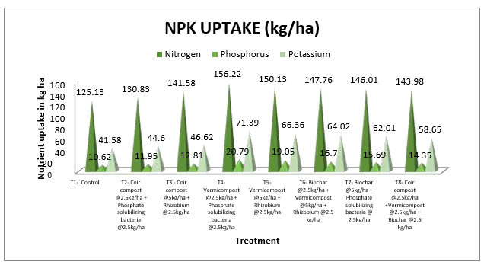
Figure 1: Effect of compost and biofertilizer on nutrient uptake of black soybean

Slide 7
CONCLUSION
Finally, it could be concluded that the integration of biofertilizers, compost , nitrogen phosphorus and potassium enhanced the yield attributes such as pod length, pod weight, weight of 100 seeds, seed index and seed yield of black soybean .
The highest grain yield was recorded in the treatment (T4- Vermicompost at 2.5kg/ha + Phosphate solubilizing bacteria at 2.5kg/ha)1.88 t ha -1 through phosphorus , nitrogen and potassium and biofertilizer.
Similarly, the highest nutrient content was also obtained from the integration 100% RDF + Vermicompost at 2.5kg/ha + Phosphate solubilizing bacteria at 2.5kg/ha through inorganic fertilzers coupled with organic fertilizers. Thus the objective of maximizing yields as well as maintaining soil health and productivity can be furnished by a balanced use of inorganic fertilizers conjunctively with fertilization and organic biofertilizers.

Slide 8
REFERENCES
Ferrier, L.K. (1975-1989). Simple processing of whole soybean. Processing of Conference for Scientists of Africa and South Asia on Soybean Production, Protection International Agriculture Publication. Urbana, Champaign, USA, Soybean 3 Report, 178-182.
Maheshbabu, H.M., Hunje, R., Patil, N.B. and Babalad, H.B. (2008).Effect of organic manures on plant growth, seed yield and quality of soybean. Karnataka Journal of Agricultural Sciences, 21(2);219-221, 20.
Osaki, M., Morikawa, K, Shinano, T., Urayama. M. and Tadano. T.(1991). Productivity of high- yielding crops: II Comparison of N, P, K, Ca, and Mg accumulation and distribution among high-yielding crops. Soil Science and Plant Nutrition ,37;445-454.
Raghuwanshi, C., Khamparia, N.K., Thakur, R., Sahare, S.K., Sharma, V. and Dwivedi, B.S. (2016).Impact of long term application of inorganic fertilizers and organic manure on yield attribute characters, yield of soybean and soil fertility in a Vertisol. Ecology ,Environment and Conservation , 22(2); 745-753.

Slide 9
THANK YOU

