Slide 1
WITHANIA SOMNIFERA L: AN OVERVIEW
Lishi Kaki and Joram Yari
Department of agriculture,
Himalayan University, Itanagar, Arunachal Pradesh

Slide 2
INTRODUCTION
The meaning and origin of the word Withania is doubtful, whereas somnifera refers to the narcotic property of the leaves of plant.
Withaniasomnifera is an erect, evergreen (green in whole year), branching, and tomentose shrub of 30 to 150 cm in height. Leafs are simple, petiolate with the leaf blade varying in shape from elliptic-ovate to broadly ovate, entire along margins, acute to obtuse at apex, oblique at base, clothed with a persistent grayish tomentum on sides, 4-10cm long and 2-7cm broad (Mirjaliliet al., 2009).
Leaves on vegetative shoots are alternate and large and those on floral branches are opposite, arranged somewhat laterally in pairs of one small leaf and one large leaf, bearing in their axil a cymose cluster of 4-25 inconspicuous pale green monoceous flowers.

Slide 3
MORPHOLOGY
According to the Dattaet al.,2011 based on its cultivation in experimental field plots of the University of Kalyani,
West Bengal plains, elevation on 48 feet above sea level, sandy loamy soil, organic carbon0.76%, soil pH 6.85 during the period of September to February,
(max. temperature 24.03-32.17 ºC, Min. temperature 11.24-25.51 ºC, rain fall 0.0-12.46 mm; relative humidity max. 93.96- 98.28% min. 44.43-86.85%).
The species is perennial (can be sown twice a year , in march to August and September to Feb (Das et .al., 2009 ), branched, terrestrial herb (plant height: 69.58-75.22 cm); tap root , long(17.52 to 19.28 cm), unbranched, 2-3 cm thick,
terate,rootlets many, confirmed within 1-5 cm, angular and branched; stem terate, hairy to the younger part and glabrous at maturity;

Slide 4
ANATOMY
Stem
Transverse section (4.0-5.0) of stem (main stem, 75 days old plant at vegetative stage; hand sectioned and double strained as per Johansen 1940) showed the lowing features:
epidermis 1 cell layer thick, cells more or less rounded to barrel shaped rarely rectangular, medianly thick walled, cells compact arranged: hypodermis 1 cell layered thick, cells compact, rounded, medianly thick, smaller than the epidermal cells, at maturity hypodermal layer may be indistinct
Roots
Transverse section (main root of 75 days old plant, 5-6 cm below the top; double stained) of root documented the following: periderm (phellem, phelogen and phelloderm:
3 layers evident) present; phellem 3-5 cell layered thick, tetra to polygonal, thin walled, compactly arranged with contents within;

Slide 5
SEED GERMINATION
The germination of the ashwagandha seed is irregular and takes more than 15 days, so there is urgent need to study on germination aspect of this crop.
In order to have better germination and seedling quality parameters of ashwagandha, it is necessary to conduct germination treatments for breaking the dormancy in the laboratory conditions.
Some research on physico-chemical treatments like storage, temperature, photoperiod and growth regulators (GA3, IAA, IBA, 2–4 D and BA) on germinability were also done by different researchers and they found that the most effective treatment is GA3 at 150 μg/ml concentration at 25 °C.
The optimal temperature for germination is 25 °C and continuous light favored germination showing that photoperiod has a significant role. The seedlings derived from seeds performed well when grown in a glasshouse.

Slide 6
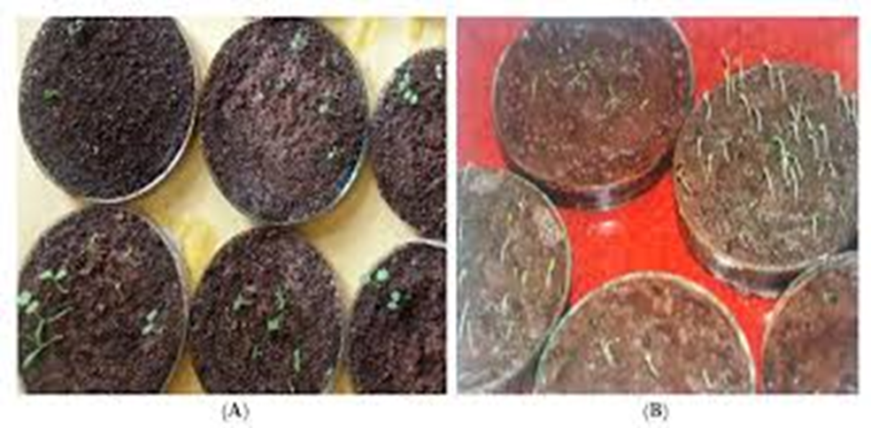
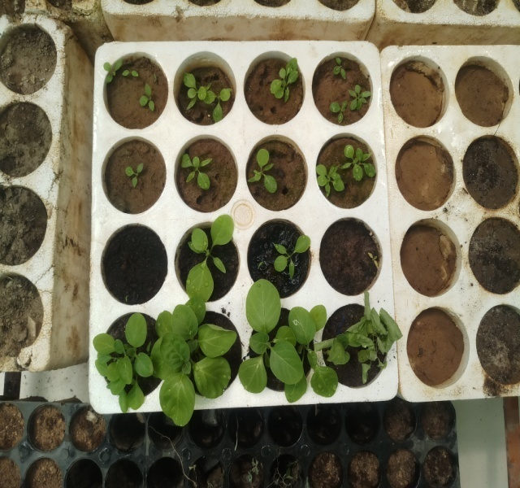
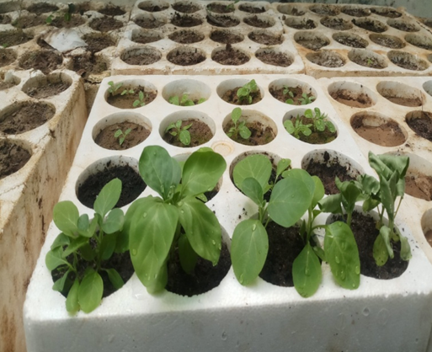
Fig. Seed germination and seedling

Slide 7
ALLELOPATHIC POTENTIAL
The rationale of the study is to to use allelochemicals as a control measure for weed distribution in Himalayan areas.
The present study was premeditated to evaluate the herbicidal activity of Withaniasomnifera using plant extracts against germination and growth of noxious weeds of Himalaya i.e. Ageratum coenyzoides, Chenopodium album and Achyranthusaspera in a laboratory and foliar spray bioassay so as to present a bioherbicidal method for the management of weeds in the Himalayan regions.
An experiment revealed the fact that many medicinal plants can be used as a bio herbicide to control some weeds as well as invasive weeds.
The phyto-chemical present in plants act as allelochemicals for the weeds and provide a safe and natural meanof weed management. Earlier initiatives have been proved successful, for examples, Artemisinin, a sesquiterpene lactone from the Artemisia annumL. is a patent plant growth inhibitor

Slide 8
SECONDARY METABOLITES
Medicinal plants are a source of naturally active compounds used extensively by tribal people worldwide for many ailments.
Withaniasomnifera (WS) is one such plant used to treat many ailments from the time of Ayurveda. Extraction of the bioactive plant constituents from the whole plant or from the different parts of the plant has always been a challenging task.
Phytochemical screening of different extractions revealed the presence of phenols, flavonoids, tannins, saponins, alkaloids, steroids, terpenoids, glycosides and reducing sugars which could account for its varied medicinal properties like anti-inflammatory, anti-spasmodic, anti-analgesic, neuroprotective and diurectic effects.

Slide 9
MEDICINAL PROPERTIES
The medicinal plants are widely used by the traditional medical practitioners for curing various diseases in their day to day practice. In traditional systems of medicine, different parts (leaves, stem, flower, root, seeds, bark and even whole plant) of Withaniasomnifera ( Ashwagandha ),
a small herb seen throughout India, have been recommended for the treatment of aphrodisiac, liver tonic, anti-inflammatory agent, astringent, and more recently to treat bronchitis, asthma, ulcers, emaciation, insomnia, and senile dementia etc.
Clinical trials and animal research support the therapeutic use of ashwaganda for anxiety, cognitive and neurological disorders, inflammation, and Parkinson’s disease. Ashwaganda’schemopreventive properties make it a potentially useful adjunct for the patients undergoing radiation and chemotherapy.
Ashwaganda is also used therapeutically as an adaptogen for patients with nervous exhaustion, insomnia, and debility due to stress, and as an immune stimulant in patients with low white blood cell counts in blood.

Slide 10
CULTIVATION
In natural conditions W. somnifera occurs on disturbed soil, along roadsides, in cultivated land, on termite mounds in grassland, in open woodland and riverine vegetation, from sea level up to 2300 m altitude.
It is grown in areas with 600- 750 mm annual rainfall and prefers well drained soil; water logging is harmful (Patraet al.,2004). It grows well in sandy loams and stony red clay soils with pH 7.5-8.0 (Thomas et al.,2000). However, Obidoska and Sadowska (2003) suggested the preference of the species to acidic soil. It thrives in full sun but tolerates some shade (PROTA 2008).
Patraet al.,(2004) suggested that the species is a rainfed crop requiring dry season (1-2 winter rains are conducive for root development) and grows well in semi-arid subtropical areas receiving good rainfall.
The species can be cultivated between 600-1200 m altitudes. Misraet al.,(2001) suggested that W. somnifera is a potential cash crop greening dry-land zones and making waste land more productive.

Slide 11
DISCUSSION
Ashwagandha traditionally was used as a rejuvenative tonic for both children and the elderly.
It grows in various parts of the world and is readily available, easy to store, and easy to formulate. It is one of the most utilized plants in Ayurvedic medicine and the most studied rasayana.
Ashwagandha is widely accepted to be safe though would benefit from further systematic research into the safety profile. It is best administered as a churna mixed with ghee, milk or honey but other formulations are also effective.
Standard dosages vary with the most common being 1-2 grams, three times per day. Ashwagandha is formally classified as an adaptogen.
The primary pharmacological effect is derived from the roots which contain withanoloids and are attributed with giving the plant its impressive versatility.
It is known as the “Indian Ginseng” and may be widely applied to many disorders and imbalances.

Slide 12
CONCLUSION
Withania somnifera commonly known as Ashwagandha in Ayurveda medicine possesses numerous pharmacological activities supported by experimental and clinical studies. Further studies will enhance the support of its multifarious action on living organisms.
As modern medicine continues to expand, so do the uses of botanical medicines. Withania somnifera shows great potential as a safe and effective in Immunomodulation and Hematopoiesis.
More research is needed to determine if Withania somnifera can duplicate this activity in humans, and to determine an optimal dosage range for achieving these effects.
The potential beneficial effects of Withania in anxiety, cognitive and neurological disorders, inflammation, and Parkinson’s disease. Experienced natural medicine practitioners, working hand-in-hand with oncologists, could increase effectiveness and decrease side effects of conventional treatments with the use of Withania somnifera.

Slide 13
REFERENCES
W.C.C.N., China, 10. 43. Singh, N., Singh, V. and Abbas, S.S. (2003). Anti-stress (Ayurvedic Plants) Ocimum sanctum (Tulsi) and Withaniasomnifera (Ashwagandha) in prevention and treatment of cardiovascular disorders. Proc. Vth
Archana, R., Namasivayam, A (1999). Antistressor effect of Withaniasomnifera. J. Ethnopharmacol., 64: 91–93.
Dr. Sudhanshu Kumar Meher, Dr. Banmali Das, Dr. Purnendu Panda, Dr. G.C. Bhuyan, Dr. M.M. Rao(2016) Uses of Withaniasomnifera (Linn) Dunal (Ashwagandha) in Ayurveda and its Pharmacological Evidences. National Research Institute of Ayurvedic Drug Development, Bhubaneswar, Odisha.
Experimental evaluation of ‘adaptogenic’ properties of Withaniasomnifera. XIIth Scientific Seminar on Indian Medicine, Institute of Medical Sciences. Varanasi. 4. 31. Singh, N. (1981)
Experimental methods tools for assessment of anti-stress activity in medicinal plants. Journal of Biomedical Research., 12(182): 124-127. 41. Singh, N. (1995a).

Slide 14
THANK YOU

