Slide 1
A REVIEW ON THE THIAZOLE DERIVATIVES: SYNTHESIS,CHARACTERIZATION AND BIOLOGICAL ACTIVITIES
Vikas Kumar¹, Dr.K.Saravanan²
¹PhD Scholar, Pharmaceutical Science, Bhagwant Global University, Kotdwar
²Principal of Faculty of Pharmacy, Bhagwant Global University, Kotdwar
Corresponding author’s E-mail: v.kumarvikas032@gmail.com

Slide 2
ABSTRACT
The continuous review gives a blueprint of the natural activities of thiazole during the earlier years. It is heterocyclic blends, Thiazole, conceivably of the most generally perceived five-membered heterocyclic compound, has a nitrogen particle at position 3 and a sulfur bit at position 1. It is a critical arrangement of a gigantic number of made compounds. Its different pharmacological development is reflected in many clinically upheld thiazole-containing particles with, broad assortment of normal activities, similar to antibacterial, antifungal, antiviral, anthelmintic, antitumor, and quieting influences.

Slide 3

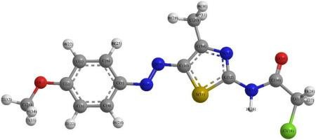
INTRODUCTION
Nitrogen-containing heterocyclic blends expect a critical part in the medicine revelation process, as practically 75% of FDA (Food and Association) upheld little iota drugs contain no less than one nitrogen-based heterocycles (1).
Thiazole, generally called 1, 3 - thiazole, has a spot with the get-together of combinations known as azoles and has sulfur and nitrogen particles in places 1 and 3, independently. The thiazole center is an astoundingly fundamental heterocycles in various naturally unique blends that makes it one of the extensively considered heterocycles1-3. Thiazole accepts urgent parts in numerous medicine structures. Tiazofurin and dasatinib (Antineoplastic trained professionals), ritonavir (unfriendly to HIV drug), ravuconazole (antifungal subject matter expert) nitazoxanide (antiparasitic trained professional), fanetizole, meloxicam and fentiazac (moderating subject matter experts), nizatidine (antiulcer trained professional), and thiamethoxam (bug shower) are a couple of models for thiazole bearing things (2).
Figure A: 3D Structure of Thiazole

Slide 4
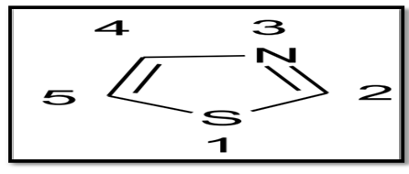

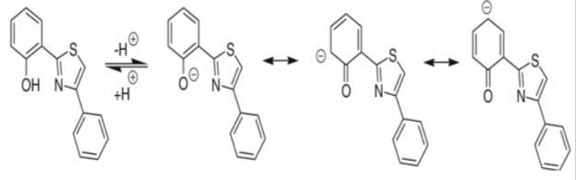
Structural Characteristics-
With the sub-nuclear condition C3H3NS, thiazole, generally called 1, 3-thiazole, is a sensible to light yellow ignitable liquid with a pyridine-like fragrance. It is a five-membered ring with two nitrogen-and sulfur-containing vertices and three carbon-containing people. The numeration scheme for naming thiazole subordinates is displayed underneath (4).
Thiazoles are a class of regular combinations associated with azoles with a run of the mill thiazole moiety is a critical piece of vitamin B1 and epothilone. It is a sweet-smelling compound, satisfies Huckel's norm. Delocalizations of singular arrangements of electrons from the sulfur particle complete the 6 π electrons. The resonation structures are Fig-C (5).
Properties-
Physical Properties
I. Thiazole generally pale-yellow flammable liquid.
II. It has pyridine like odour.
III. It is fairly soluble in ether and alcohol but sparingly soluble in water.
IV. It has a boiling point of 116-118˚c and pka of 2.5 (conjugated acid).
V. Its density is 1.2 gm/cm3 and its ionization potential is 9.50 Ev.
VI. It has a dipole moment of 1.61D.
Figure B: The Structure of thiazole
Figure C: Resonance forms of Thiazole

Slide 5
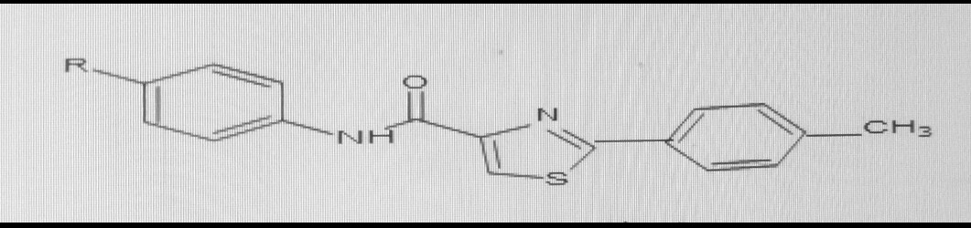
BIOLOGICAL ACTIVITIES OF THIAZOLE DERIVATIVES
Antifungal and Antibacterial Agents-
The resistance of developments and microorganisms towards the antimicrobial drugs is extending rapidly a direct result of the nonselective antimicrobial activities and a foreordained number of meds. To overcome what is happening, various thiazole containing particles are coordinated to fix bacterial and infectious illnesses.
Bera et al. organized pyridinyl thiazole ligand having hydrazone moiety by combining 2-bromo-4-methoxy acetophenone with 2-acetylpyridine thiosemicarbazone. They in like manner coordinated cobalt complex by treating this ligand with cobalt forerunner. Both the ligand and its marvelous were gone after for against bacterial properties towards gram positive infinitesimal organic entities including Bacillus subtilis, Streptococcus fecalis, Staphylococcus aureus and gram-negative microorganisms including Pseudomonas aeruginosa, Salmonella typhi, Escherichia coli, Klebsiella pneumonia and Proteus vulgaris (12).
R = o-NO2, m-NO2, p-NO2, m-Cl, p-Cl, p-F
Figure D: 2-Phenylthiazole-4-carboxamides having anticancer activities.

Slide 6
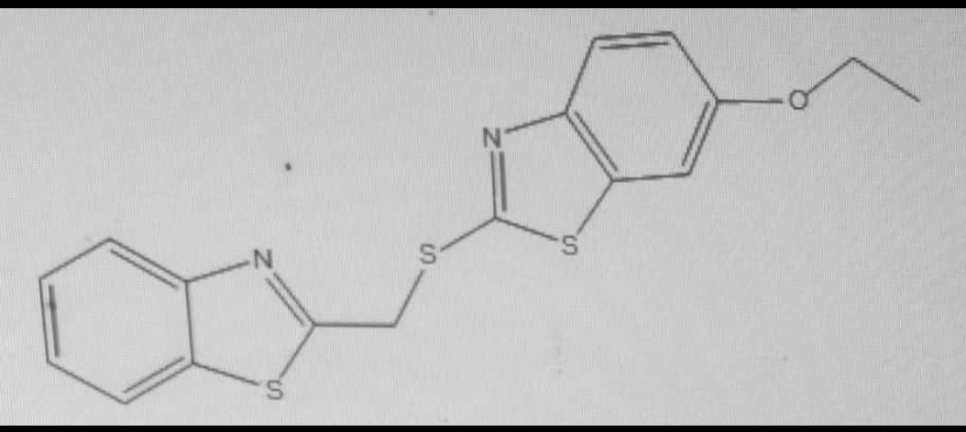
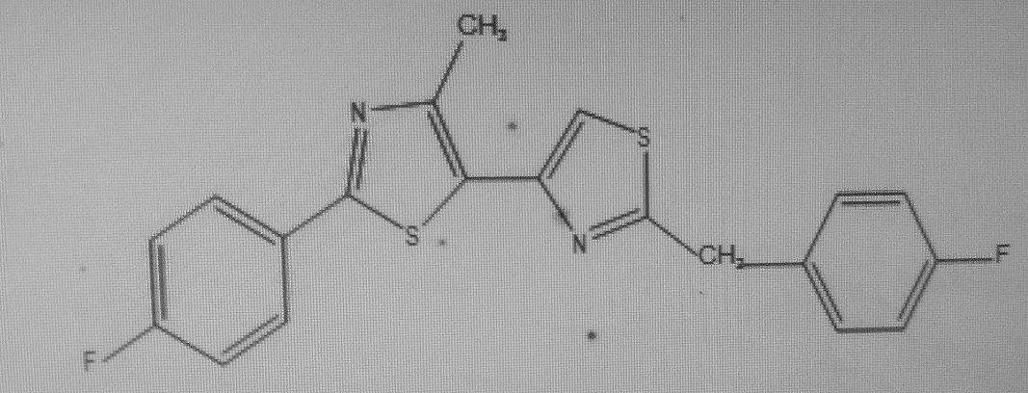
Antidiabetic Activity-
Bhagdev K. et al. coordinated and attempted a combination of subbed benzo-thiazole auxiliaries for hypoglycemic (antihyperglycemic) development. The ethoxybenzothiazole moiety in 2-(benzo[d]thiazol-2-ylmethylthio)- 6-ethoxybenzothiazole was seen as fundamental for redesigning glucose transport and AMPK order in L6 myotubes. 2-(benzo[d]thiazol-2-ylmethylthio)- ethoxy benzo[d]thiazole basically worked on the speed of glucose digestion in L6 myotubesat pharmacologically appropriate core interests. The effect of 2-(benzo[d]thiazol-2-ylmethylthio)- 6-ethoxybenzo[d] thiazole in on blood glucose levels in diabetic KKAy mice showed decrease in blood glucose level (13)
Anti-TB Activity-
Arshad M. et al. mixed a new bisthiazolyl auxiliary and attempted it for unfriendly to TB activity. These shrewd analogs were attempted against the Mycobacterium smegmatis MC2 155 strain. The basic displayed strong foe of tubercular feasibility at a piece of 30 mM. The SAR focuses on revealed that the presence of a fluoro-subbed phenyl ring is essential for lessening the M. smegmatis flood (14).
Figure E
Figure F

Slide 7
CONCLUSION
Thiazole center has involved a basic circumstance in the state of the art normal and supportive science due to its wide reach generally; Thiazole compounds are seen to have captivating natural components like anticancer and antimicrobial activities.
The presence of thiazole ring in numerous prescriptions such febuxostat, dasatinib and ravuconazole convince the logical specialists to design new thiazole systems.
It has been seen that changes to the thiazole moiety shown profitable natural capacities. More assessment is supposed to think about thiazole's reasonability rather than various issues.

Slide 8
REFERENCES
Namitha TH, Saranya S Nair, Dr. Arun Kumar, Dr. Vinod B, Dr. Daisy P A, A Review on Synthesis and Biological Activity of Thiazole and its Derivatives, Int. J. Pharm. Sci. Rev. Res., 70(1), September - October 2021; Article No. 29, Pages: 189-193.
Borcea AM, Ionuț I, Crișan O, Oniga O. An overview of the synthesis and antimicrobial, antiprotozoal, and antitumor activity of thiazole and bisthiazole derivatives. Molecules. Jan; 26(3): 624.
Vaishnavi R. Paithankar,Pravin R. Dighe, Nirmala V. Shinde, An Overview of Thiazole Derivatives and its Biological Activities, Int. J. Pharm. Sci. Rev. Res., ISSN: 0976 – 044X, 82(1), September – October 2023; Article No. 07, Pages: 42-47.
Hemaida AY, Hassan GS, Maarouf AR, Joubert J, El-Emam AA. Synthesis and Biological Evaluation of Thiazole-Based Derivatives as Potential Acetyl cholinesterase Inhibitors. ACS Omega. 2021; 6(29):19202–19211.
Abdu-Rahem LR, Ahmad AK, Abachi FT. Synthesis and Medicinal Attributes of Thiazole Derivatives: A Review. Systematic Reviews in Pharmacy, 12(1): 290-5.
Altıntop MD, Sever B, Akalın Çiftçi G, Turan-Zitouni G, Kaplancıklı ZA, Ozdemir A. Diverse biological activities of Thiazoles : A Retrospect. Eur J Med Chem. 2017; 48(11):01255.
De MGP, De OBM, Farias SE, De OC, Capistrano CN, Hernandes MZ. New 1, 3-thiazole derivatives and their biological and ultra structural effects on Trypanosoma cruzi. Eur J Med Chem. 2016; 121:387–398. Available from: - http://dx.doi.org/10.1016/j.ejmech.2016.05.050.

Slide 9
THANK
YOU

