Slide 1
In-vitro evaluation of cytotoxic, antioxidant, and anti-inflammatory potential of methanolic extract of Artemisia vulgaris on SHSY-5Y cells
Rahul Kumar¹, Nidhi Tyagi^{1*}
SRM Modinagar College of Pharmacy, SRM Institute of Science and Technology (Deemed to be University), Delhi-NCR Campus, Modinagar, Ghaziabad, Uttar Pradesh, 201204, India
Corresponding Author*
Dr. Nidhi Tyagi
Assistant Professor
Department of Pharmacology,
SRM Institute of Science and Technology
Mail: nidhityagi029@gmail.com, nidhit@srmist.edu.in

Slide 2
ABSTRACT
Artemisia vulgaris plant has been used as a folk medicine for a long time. Therefore, being rich in flavonoids, terpenoids, and Phyto steroids, it is reported to have various crucial activities, such as antioxidant, anti-inflammatory, analgesic, etc. In the present study, the antioxidant, cytotoxic, and anti-inflammatory ability of the methanolic extract of Artemisia vulgaris (AVME) was carried out using SHSY-FY human neuroblastoma cell lines. Following the operation, the aerial parts of Artemisia vulgaris were taken and successively extracted by the Soxhlet apparatus using methanol as solvent, and the percentage yield was calculated. A preliminary and phytochemical study was also performed which exhibited the presence of some compounds namely- carbohydrates, proteins, tannins, steroids, glycosides, phenols, and flavonoids. To evaluate the antioxidant capacity, the concentration of phenols and flavonoids was calculated and found to be 179.406 mg GA/gm 136.138 mg QE/gm. DPPH (2,2-diphenyl-1-picrylhydrazyl) method was used to determine the antioxidant capacity and the percentage inhibition was noted as 77.83±0.099 % in comparison to ascorbic acid (85.32±0.051 %). Furthermore, the MTT (3-(4,5-dimethylthiazol-2-yl)-2,5-diphenyltetrazolium) assay has revealed a significant reduction in the viability of cells from 200-1200 µg/ml concentration. Besides this, AVME manifested a potent anti-inflammatory activity and antioxidant activity by reducing the IL-6 concentration to 44.10 and 9.87 pg/ml at the dose of 100 and 200 µg/ml and increasing the % SOD (Superoxide dismutase) release at both doses (65.77 and 71.52 %) respectively. Eventually, all these findings suggested that Artemisia vulgaris could be a potential aid in the treatment of diseases linked with oxidation and inflammation.

Slide 3
INTRODUCTION
Artemisia is a shrub or little plant that thrives in arid and semi-arid environments. This genus is mostly found in the northern hemisphere and less often in the southern hemisphere. The genus Artemisia is a member of the Anthemideae tribe of the Asteraceae family. This genus comprises over 500 species of plants and shrubs (1). Artemisia vulgaris, often known as mugwort, is a perennial plant found in Europe, Asia, and North America. It has long been utilized in herbal medicine for its medicinal characteristics, which include treating digestive issues, and menstrual irregularities, and acting as an anti-inflammatory agent. The plant includes a variety of bioactive chemicals, including flavonoids, terpenoids, and essential oils, which contribute to its therapeutic qualities, including antioxidant, antibacterial, and antispasmodic activity. Artemisia vulgaris is an excellent topic for pharmacological study due to its rich phytochemical profile (2). Antioxidants are essential for controlling inflammation because they neutralize free radicals, which may cause inflammatory reactions. Chronic oxidative stress has been linked to the development of inflammatory illnesses such as arthritis, cardiovascular ailments, and neurological conditions. Antioxidants aid in reducing oxidative damage, which in turn helps to moderate inflammatory pathways and improve cellular health (3). The SH-SY5Y cell line, generated from human neuroblastoma, is often utilized in neurological research because of its propensity to develop into neuron-like cells. It is a useful model for investigating neurodegenerative disorders, neurotoxicity, and neuronal function. SH-SY5Y cells are especially useful for studying pathways behind Parkinson's and Alzheimer's illnesses (4).

Slide 4
MATERIAL AND METHODS
  Extract
Plant material (Aerial parts) was procured from Khari Baoli, Delhi, India, and validated at CCS University, Meerut, Uttar Pradesh. The material was washed, shade dried, powdered, and finally extracted by Soxhlet apparatus with methanol. The obtained extract was reduced with a rotary evaporator, weighed, collected in a container, and preserved in a refrigerator for further analysis.
Total phenol and flavonoid content
In plant extract, the concentration of phenols was analysed by the Folin Ciocalteu method used by Singleton et al., 1999 and total flavonoid concentration by the AlCl₃ method described by Ebrahimzadeh et al., 2008 (5,6).
Culture of cells
The SHSY-5Y cells were grown in Dulbecco’s Modified Eagle Medium (DMEM) supplemented with 10% fetal bovine serum (FBS), antibiotics, and growth factors at 37°C in a humidified environment with 5% CO2 (7)(8).

Slide 5
DPPH assay
The radical scavenging activity of AVME was assessed by the DPPH method used by Munda et. al., 2019 (9).
MTT Assay
SH-SY5Y cells were cultured at 37°C with 5% CO₂ in high-glucose DMEM supplemented with 10% fetal bovine serum. The cytotoxic effects of varying extract concentrations on SH-SY5Y cells were evaluated using the MTT assay reported by Shivani et. al., 2021 (8)(10).
IL-6 measurement
The concentration of interleukin-6 was determined by the method described by Shivani et. al., 2021 (8).
Measurement of SOD-2
The percentage of SOD release was determined with the help of the instructions given by the manufacturer in the kit (11)(10).
Statistical analysis
All the results were interpreted with the help of Graph Pad Prism software. Version 5.01 applying the T-test and One-way ANOVA method accompanied by the Tukey post hoc test. Results are expressed in mean ± SEM with p<0.05 probability value.

Slide 6
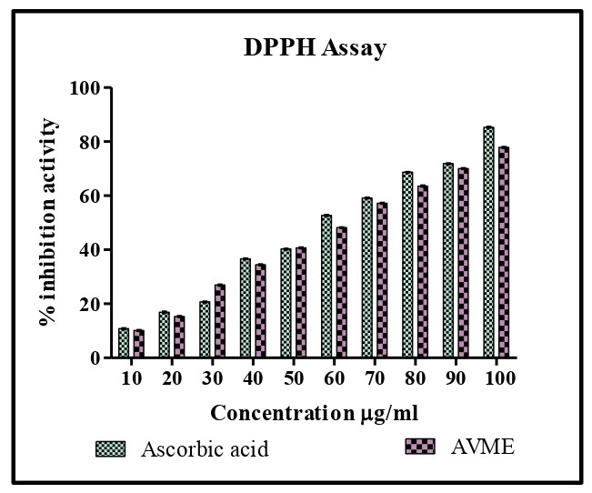
RESULTS
  Total phenol and flavonoid concentration in AVME
In both estimations, it was found that AVME contained 179.406 mg GAE/g phenols and 136.138 mg QE/g of flavonoids.
  Inhibitory actions of AVME on DPPH
Significant percentage inhibition was manifested by AVME (77.84%) in comparison to ascorbic acid (85.32%) (p<0.001). (Figure-1)
The sample cuvette contained DPPH solution with AVME in the U.V spectrophotometer and the % inhibition of the test sample was compared by Ascorbic acid at different concentrations. Data were measured by T-test and represented as mean±SEM, p<0.05.
Figure: 1 Antioxidant activity of AVME.

Slide 7
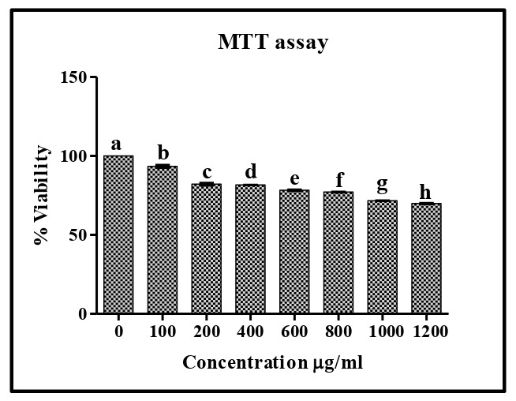
  Inhibitory actions of AVME on cell viability
The remarkable reduction was exhibited in the percentage of cell viability when treated with AVME at the dose of 200-1200 µg/ml (p<0.00001). (Figure-2)
After the treatment of the cells, viability was measured on the basis of the concentration of formazan produced by mitochondrial dehydrogenase enzymes in the cells and compared to the untreated cells. Data were measured by One-way ANOVA followed by Tukey post hoc test and represented as mean±SEM. p<0.05. b, c, d, e, f, g, h versus a.
Figure: 2 Cytotoxic effect of AVME on cell viability.

Slide 8
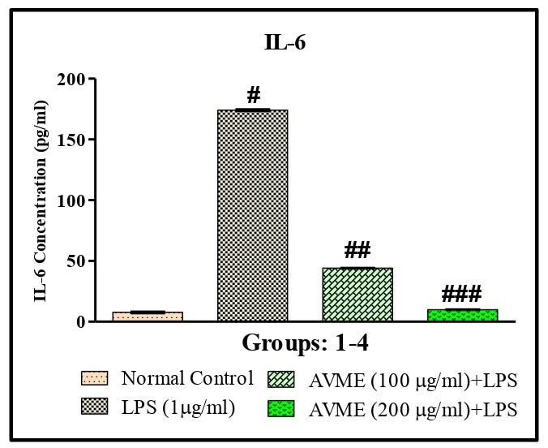
  Inhibitory actions of AVME on IL-6
A notable reduction was observed in IL-6 concentration when cells were treated with AVME at the dose of 100 µg/ml as compared to LPS-treated ones (p<0.0001). The AVME (200 µg/ml) has also reduced the concentration of IL-6 compared to AVME (100 μg/ml) (p<0.0001). (Figure-3)
Data were measured by One-way ANOVA followed by Tukey post hoc test and represented as mean ± SEM. # versus Normal control; ## versus LPS (1 μg/ml); ### versus AVME (100 μg/ml).
Figure: 3 Inhibitory action of AVME on IL-6 concentration.

Slide 9
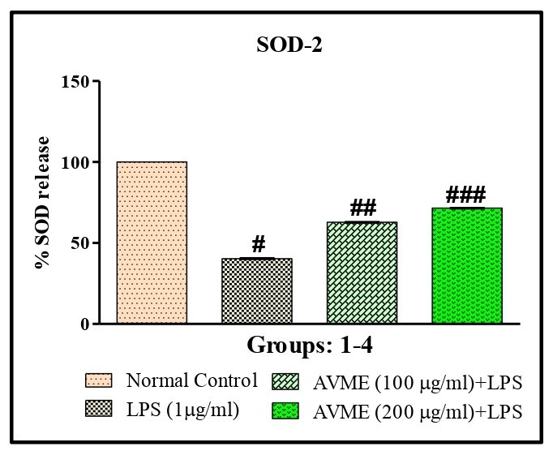
  Excitatory actions of AVME on SOD-2 release
In comparison to the normal control group, the LPS-treated cells showed a heavy reduction in the release of SOD (p<0.0001). On the other hand, AVME-100μg/ml treated cells significantly increased the % release as compared to the treated group. Along with it, the AVME-200μg/ml group manifested elevation in % release more significantly than AVME-100μg/ml (p<0.001). (Figure-4)
Group-1 was normal control, and the toxin group (Group-2) was given LPS (1 μg/ml), and both test groups (Group-3 & 4) were treated with AVME (100 and 200 μg/ml). Data were measured by One-way ANOVA followed by Tukey post hoc test and represented as mean±SEM. # versus Normal control; ## versus LPS (1 μg/ml); ### versus AVME (100 μg/ml).
Figure:4 Protective action of AVME on SOD release

Slide 10
CONCLUSION
The antioxidant and anti-inflammatory activity of methanolic extract of Artemisia vulgaris was evaluated. In the preliminary study, because of the non-aqueous nature of the solvent, the extract showed a good concentration of phenols and flavonoids which are known for their antioxidant and anti-inflammatory actions. Therefore, in the DPPH assay, AVME revealed a notable percentage of radical scavenging activity. Additionally, the extract considerably reduced the concentration of IL-6 and enhanced the % release of SOD at both doses which proclaimed its anti-inflammatory activity. Supplementary studies are needed to identify and find out the concentration of compounds responsible for these actions. All the interpretation has signalized that the aerial parts of Artemisia vulgaris could be a better alternative for the treatment of conditions associated with oxidation and inflammation.

Slide 11
REFERENCES
Vallès J ME. Artemisia systematics and phylogeny: cytogenetic and molecular insights. and DJ Fairbanks (eds.),. In: Proceedings of shrubland ecosystem genetics and biodiversity. 2001. p. 67–74.
Obistioiu D, Cristina RT, Schmerold I, Chizzola R, Stolze K, Nichita I, et al. Chemical characterization by GC-MS and in vitro activity against Candida albicans of volatile fractions prepared from Artemisia dracunculus, Artemisia abrotanum, Artemisia absinthium and Artemisia vulgaris. Chem Cent J. 2014;8(1).
Biswas SK. Does the Interdependence between Oxidative Stress and Inflammation Explain the Antioxidant Paradox? Oxid Med Cell Longev. 2016;2016:17–9.
Xicoy H, Wieringa B, Martens GJM. The SH-SY5Y cell line in Parkinson’s disease research: a systematic review. Mol Neurodegener [Internet]. 2017;12(1):1–11. Available from: http://dx.doi.org/10.1186/s13024-017-0149-0
Ebrahimzadeh MA, Pourmorad F, Bekhradnia AR. Iron chelating activity, phenol and flavonoid content of some medicinal plants from Iran. African J Biotechnol. 2008;7(18):3188–92.
Vernon L. Singleton, Rudolf Orthofer A. Analysis of Total Phenols and Other Oxidation Substrates and Antioxidants by Means of Folin-Ciocalteu Reagent. Lipids. 1968;3(6):561.

Slide 12
THANK
YOU

