Slide 1

DETERMINATION OF ANTIOXIDANT AND ANTI-INFLAMMATORY ACTIVITY OF ETHANOLIC EXTRACT OF AILANTHUS EXCELSA ON SHSY-5Y CELLS
Bharti Verma1, Nidhi Tyagi1*
1. SRM Modinagar College of Pharmacy, SRM Institute of Science and Technology (Deemed to be University), Delhi-NCR Campus, Modinagar, Ghaziabad, Uttar Pradesh, 201204, India
Corresponding Author* Dr. Nidhi Tyagi Assistant Professor
Department of Pharmacology,
SRM Institute of Science and Technology
Mail: nidhityagi029@gmail.com, nidhit@srmist.edu.in
ORCID: https://orcid.org/0000-0001-7162-4601

Slide 2
INTRODUCTION
Ailanthus plants belonging to the Simaroubaceae family are of extremely valuable because of their numerous therapeutic benefits.
In traditional medicine, several portions of this plant are used to treat a wide range of diseases. It has been observed that the root bark has cytotoxic and anticancer properties in both animals and cell cultures. Extracts from stem bark shown strong antifungal and antibacterial properties.
The alcohol extract derived from the bark of leaves and stems demonstrates exceptionally strong anti-implantation and early abortifacient properties.
A. excelsa is filled with diverse chemical compounds with a wide range of possible biological uses such as sterols, alkaloids, phenols, terpenoids, flavonoids, and quassinoides.
Since free radicals can trigger inflammatory reactions, antioxidants play a crucial role in reducing inflammation. Inflammatory diseases like arthritis, heart problems, and neurological disorders have been related to chronic oxidative stress. By lowering oxidative damage, plant species containing antioxidant property help to promote cellular health and modulate inflammatory pathways.

Slide 3
MATERIAL AND METHODS
Preparation of Extract
Plant material (stem bark) was purchased from Khari Baoli, Delhi, India, and authenticated at CCS University, Meerut, Uttar Pradesh, India. Firstly, the stem bark was properly washed, shade dried, grinded in powdered form, and finally extracted by cold maceration method using ethanol as a solvent. The obtained extract was reduced with a rotary evaporator, weighed, collected in a air tight container, and preserved in a refrigerator for further work.
Evaluation of total phenol and flavonoid content
In this plant extract, the concentration of phenol was demonstrated by the Folin Ciocalteu method used by Singleton et al., 1999 and total flavonoid by AlCl3 method described by Ebrahimzadeh et al., 2008.
Culture of cells
The SHSY-5Y cells were cultured at 37°C in a humidified atmosphere with 5% CO2 in Dulbecco's Modified Eagle Medium (DMEM) supplemented with 10% fetal bovine serum (FBS), growth factors, and antibiotics.

Slide 4
DPPH assay
The free radical scavenging activity of AEEE was evaluated by DPPH method used by Munda et. al., 2019 [11].
Cell viability Assay
SH-SY5Y cells were cultured in high-glucose DMEM with 10% fetal bovine serum. The cytotoxicity of extract doses was evaluated using the MTT test. After 24 hours, cells were treated with various extract doses. After a 24-hour break, MTT was applied to each well, and the iMarkTM Microplate Absorbance Reader determined the absorbance .
Determination of IL-6
The concentration of interleukin-6 was determined by the method described.
Determination of GSH
The study used SH-SY5Y cells to detect GSH levels, which were then stimulated with LPS for
23 hours. The DetectX Glutathione Fluorescence Detection Kit and iMARkTM microplate absorbance reader were used to detect total and free GSH from cell lysate, with excitation and emission wavelengths set to 370-410 nm and 450 nm, respectively.

Slide 5
Determination of MDA
Enzyme-Linked Immunosorbent Assay was used to quantify the cell-permeable concentrations of MDA. A twelve-well plate with 125 SH-SY5Y cells was pre-treated with NAC and LPS for 23 hours. Cell pelletization was done, and liquid was collected. The iMARkTM microplate absorbance reader was used to read the samples at 450 nm.
Statistical analysis
The study used Graph Pad Prismsoftware, Version 5.01, to interpret results using T-test, One- way ANOVA, and Tukey post hoc test, with p<0.05 probability value.

Slide 6
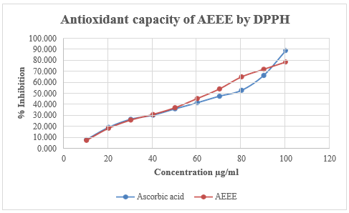
RESULTS
Total phenol and flavonoid concentration
The anti-oxidant potential which was observed as 39.51±0.167 mg GAE/gm and 24.92±0.261 mg QE/gm respectively
Inhibitory activity of AEEE on DPPH
Significant percentage inhibition was observed by AEEE (78.751±0.005 %) which was compared with ascorbic acid ((89.165±0.233 %). (Figure-1).
Inhibitory activity of AEEE on cell viability
The plant extract AEEE decreased the concentration the percentage of cell viability when treated with different doses (200-1200 µg/ml) (p<0.0001).(Figure-2).
Figure:1 Antioxidant potential of AEEE.

Slide 7
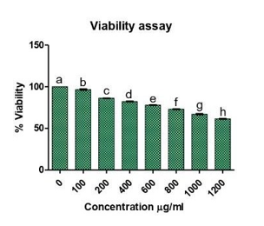
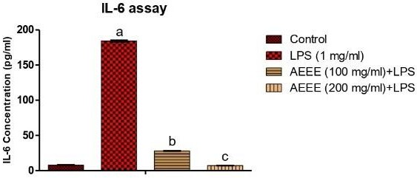
After treatment of the cells, cell viability was measured according to the concentration of formazan produced by mitochondrial dehydrogenase enzymes in the cells and compared to the untreated cells. Data were measured by One-way ANOVA followed by Tukey post hoc test and represented as mean±SEM. p<0.05.b, c, d, e, f, g, h versus a.
Inhibitory activity of AEEE on IL-6
The plant extract AEEE at a dose 200 µg/ml decreased the concentration of IL-6 more significantly than the dose 100 µg/ml as compared to LPS treated cells (p<0.001).(Figure-3).
Figure:2 Cytotoxic effect of AEEE.
Figure:3 Inhibitory activity of AEEE on IL-6 concentration.

Slide 8
CONCLUSION
The ethanolic extract of A. excelsa has demonstrated antioxidant and anti-inflammatory properties due to its high concentration of phenols and flavonoids, demonstrating notable radical scavenging activity in the phytochemical study.
The stem ark of this plant has also showed anti- inflammatory activity, reducing IL-6 concentration, MDA and increasing GSH. Further studies are needed to identify compounds responsible for these effects. The anti-oxidant and anti-inflammatory activity of this plant suggested that it could be a therapeutic potential for the treatment of various neurological diseases.
Acknowledgement
The authors would like to acknowledge SRM Institute of Science and Technology, Delhi-NCR Campus, India. We also acknowledge MIT College of Pharmacy and MET Faculty of Pharmacy to give us opportunity to publish work in their conference proceeding.

Slide 9
REFERENCES
Rashed K, Said A, Ho-kim C. Effect of Ailanthus altissima (Mill.) Swingle and Ailanthus excelsa (Roxb) stem bark extracts on streptozotocin induced diabetes. Reviews of Progress. 2013;1(14):1-5.
Cabrera W, Genta S, Said A, Farag A, Rashed K, Sánchez S. Hypoglycemic activity of Ailanthus excelsa leaves in normal and streptozotocin‐induced diabetic rats. Phytotherapy Research: An International Journal Devoted to Pharmacological and Toxicological Evaluation of Natural Product Derivatives. 2008 Mar;22(3):303-7.
Shrimali M, Jain DC, Darokar MP, Sharma RP. Antibacterial activity of Ailanthus excelsa (Roxb). Phytotherapy Research. 2001 Mar;15(2):165-6.
Joshi BC, Pandey A, Chaurasia L, Pal M, Sharma RP, Khare A. Antifungal activity of the stem bark of Ailanthus excelsa. Fitoterapia. 2003 Dec 1;74(7-8):689-91.
Dhanasekaran S, Suresh B, Sethuraman M, Rajan S, Dubey RA. Antifertility activity of Ailanthus excelsa Linn. in female albino rats. Indian journal of experimental biology. 1993 Apr 1;31(4):384-5.

Slide 10
THANK YOU

