Slide 1
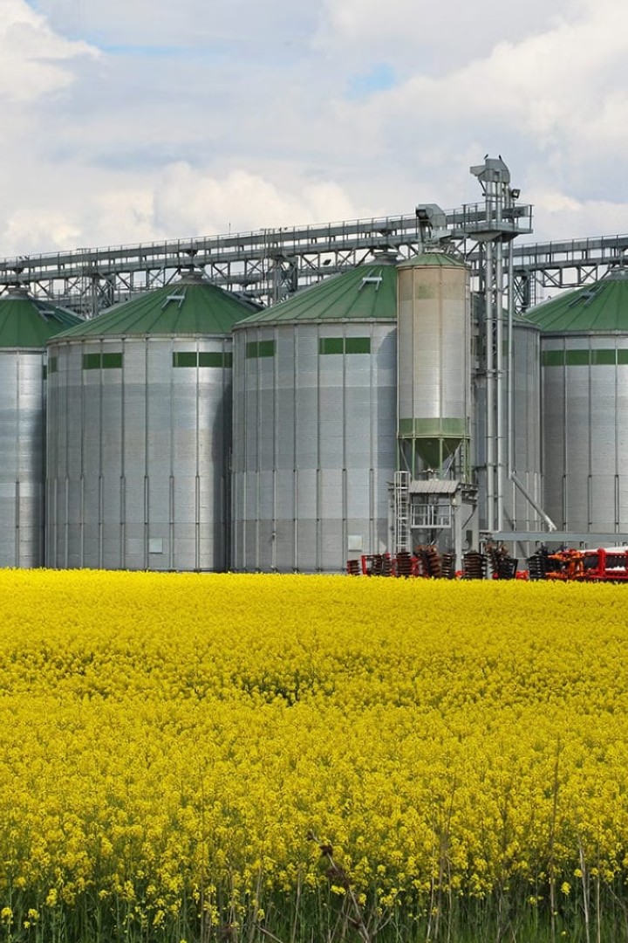
Eggshell-Derived Catalysts in Biodiesel Synthesis: Maximizing Efficiency and Environmental Benefits
The contemporary discourse on energy degradation has intensified the quest for sustainable alternatives, prompting extensive research into biodiesel as a viable substitute energy source. This research explores the catalytic efficacy of discarded eggshells in the transesterification procedure for producing biodiesel, employing reused cooking oil as the primary raw material.
Vartika Gupta
Mechnical Engineering

Slide 2


Identifying Strengths
1
Strengths
Identifying your strengths is the first step in leadership development. It's important to understand what you're naturally good at and where your skills lie. This can help you focus on areas where you can excel and contribute the most.
2
Goal Setting
Setting achievable goals is a crucial part of leadership development. Goals give you a clear direction and a target to aim for. They help you measure progress and keep you motivated. Remember to make your goals SMART - Specific, Measurable, Achievable, Relevant, and Time-bound.
3
Tools & Resources
Gathering the right tools and resources is essential for effective leadership development. This could include books, courses, mentors, and real-world experiences. The right resources can provide valuable insights and help you develop the skills you need to be an effective leader.

Slide 3
Challenges of Biodiesel
Escalating Demand for Petroleum-based Gasoline
Insufficient Availability of Appropriate Feedstock Sources
Reliance on Vegetable Oils and Animal-Derived Fats
The escalating demand for petroleum-based gasoline, fueled by burgeoning economies and a growing global population, has precipitated concerns regarding the finite nature of hydro-carbon based energy sources and their detrimental impact on the environment.
Notwithstanding its potential advantages, biodiesel faces considerable challenges, notably in nations like India, where the insufficient availability of appropriate feedstock sources poses a significant obstacle.
The reliance on vegetable oils and animal-derived fats utilized in the production of biodiesel has sparked debates regarding resource allocation and the potential for conflicts between food and fuel production sectors.

Slide 4
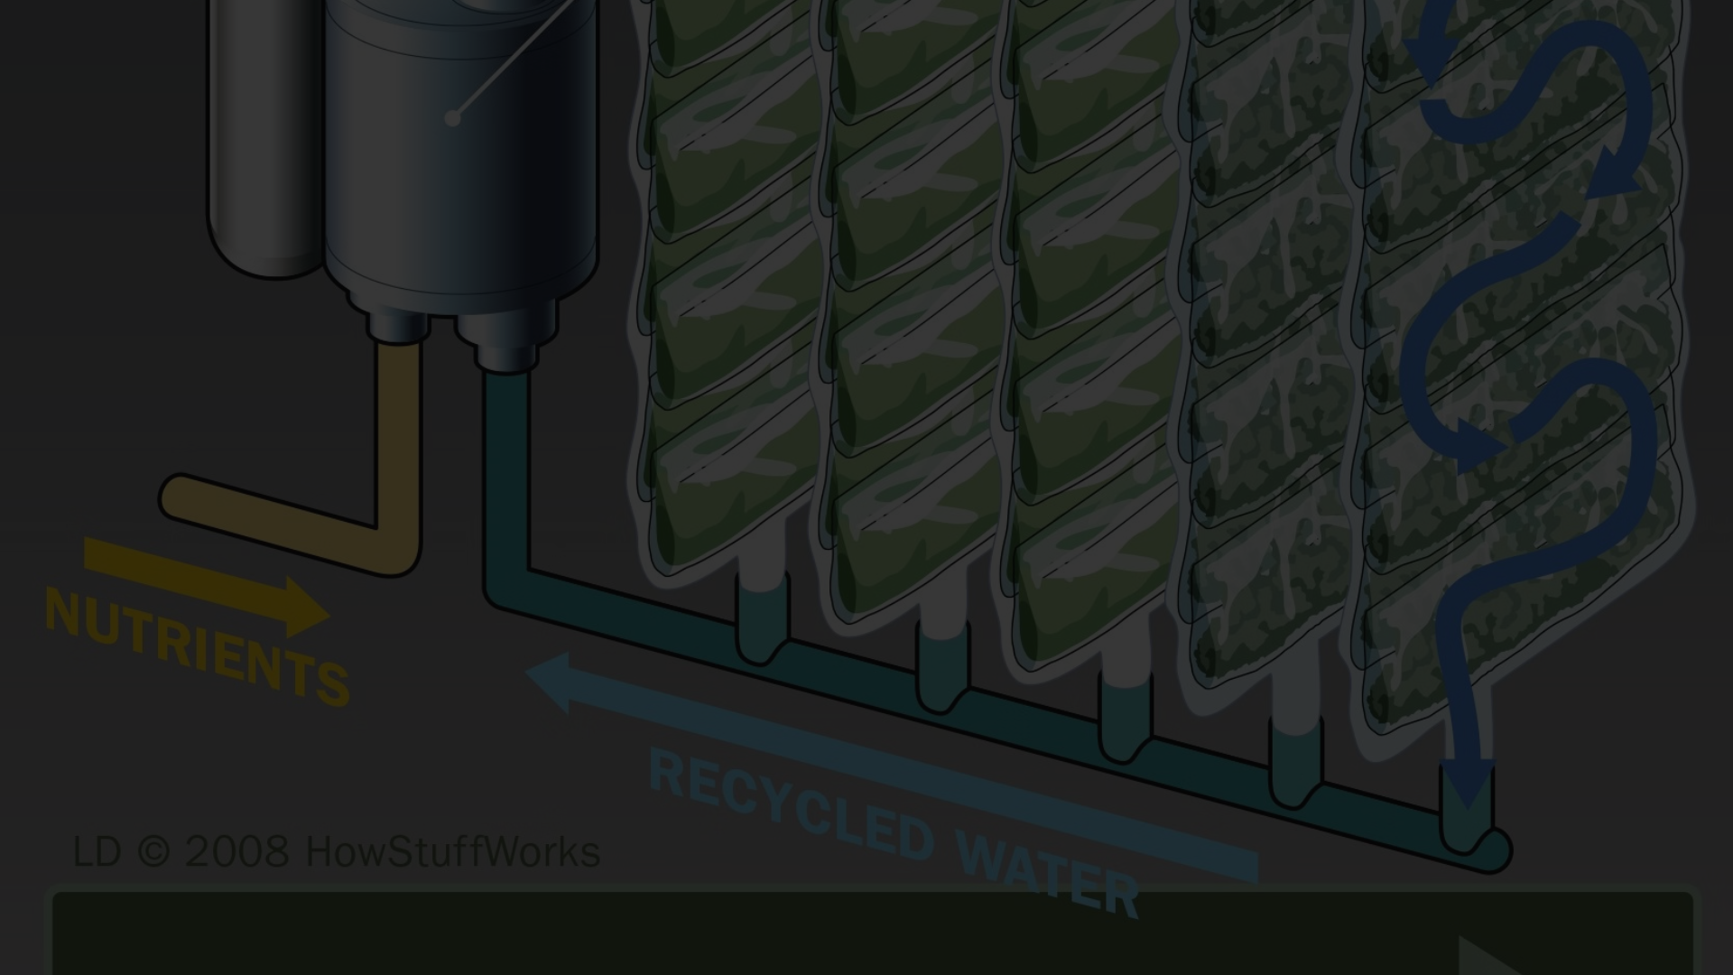
Advancements in Biodiesel Production
1
First-generation Biofuels
2
Second-generation Biofuels
First-generation biofuels, primarily obtained from agricultural crops such as vegetable oils, starch and sugar, have traditionally been produced using transesterification conversion methods.
In contrast, second-generation biofuels leverage non-edible feedstocks like waste frying oil, rubber seed oil, Pongamia pinnata, and Jatropha, offering greater sustainability and avoiding competition with food resources.

Slide 5
Waste Cooking Oil as Feedstock
4 wt%
65°C
Ideal Catalyst Loading
Optimal Reaction Temperature
3 hours
1:13
Reaction Duration
Proportional Ratio

Slide 6
Physical and Chemical Attributes
Iodine value
110–135
Moisture Content (wt %)
0.8
Saponification value
184–190
Density (15°C, kg/m3)
882

Slide 7
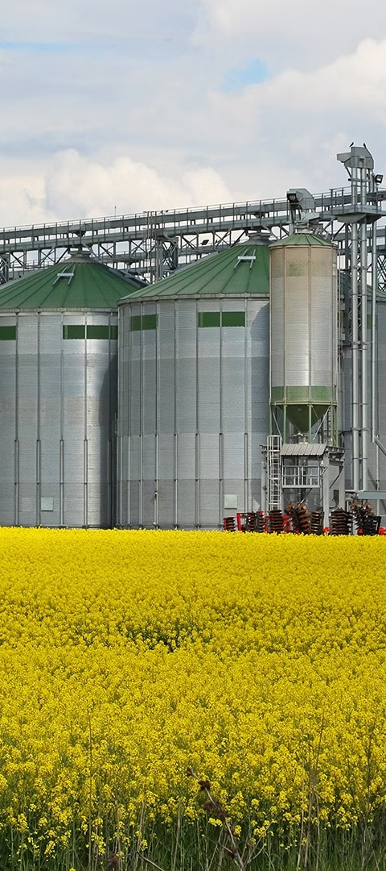
Evaluations of Biodiesel Manufacturing
Biodiesel Yield
Biodiesel Quality
Ideal operational parameters were determined, including a precise methanol-to-oil ratio of 13:1, a catalyst loading of 4 wt%, a reaction temperature maintained at 65°C, and reaction duration of 180 minutes, yielding a biodiesel yield of 75.32%.
Various critical parameters, including free fatty acid content, kinematic viscosity, flash point, cetane index, density, and calorific value, underwent thorough analysis and comparison against ASTM standard values.

Slide 8
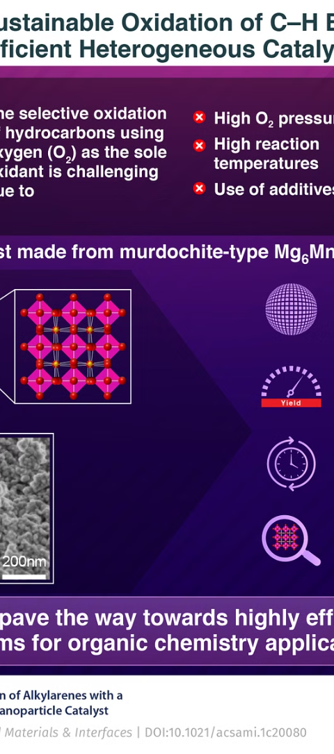


Reusability of Catalyst
Assessing Reusability
The efficacy of the catalyst in four consecutive cycles was assessed, with solid catalyst recovery and rinsing with n-hexane to remove any residual adsorbed contaminants after each cycle.
Decline in Biodiesel Yield
Analysis of changes in biodiesel yield across the cycles revealed a steady decrease from the baseline yield of 75.32% for eggshell-derived CaO to 41.1% with increasing reuse attempts.

Slide 9
Conclusion
The experimental investigation revealed the significant catalytic potential inherent in waste eggshells for facilitating the biodiesel synthesis via transesterification using recycled cooking oil. This study firmly establishes the superiority of eggshell-derived catalysts in the production of biodiesel domain. Noteworthy findings inferred from experimental dataset and anticipated outcomes indicate that optimal conditions, including a 4wt% catalyst loading, a reaction temperature of 65°C, reaction duration of 3 hours, and a molar ratio of 1:13, yielded an impressive maximum biodiesel production of 75.32%. However, over successive cycles, we observed a gradual decline in biodiesel output from the initial peak of 75.32% to 41.1%. This decline underscores the relevance of evaluating catalyst reusability, highlighting the potential advantages of employing the heterogeneous catalyst throughout multiple transesterification cycles. Moreover, our study reinforces the pertinence of biodiesel as a sustainable energy alternative, contributing to efforts aimed at reducing reliance on fossil fuels and mitigating environmental degradation. By utilizing waste eggshells as a renewable catalyst source, the study not only presents promising strides in biodiesel production technology but also emphasizes the crucial role of biodiesel in fostering environmentally friendly energy solutions for a sustainable future.

Slide 10
References
[1] El-Sherif A, Hamad A, Eldin E, Mohamed H, et al. Power of recycling waste cooking oil into biodiesel via green CaO-based eggshells/Ag heterogeneous nanocatalyst. Renewable Energy, 2023; 202:1412-1423.
[2] Ali N, Khairuddin N, Azmi T and Siddique MD. The Preparation of CaO Catalyst from Eggshells and Its Application in Biodiesel Production from Waste Cooking Oil. Arabian Journal of Chemistry, 2023; 48:383-388.
[3] Mahesh SE, Ramanathan A, Begum KM, Narayanan A. Biodiesel production from waste cooking oil using KBr impregnated CaO as catalyst. Energy Convers Manage. 2015;91:442–50.
[4] Zaini E. Eggshells ribbed tri – potassium phosphate fabricated catalyst for ethanolysis conversion of waste cooking oils to biodiesel fuel. AIP Conf. Proc.,2023; 2776.
[5] Naik S.N, Vaibhav V. Goud, Prasant K. Rout, Ajay K. Dalai. Production of first and second generation biofuels: A comprehensive review. Renew Sust Energ Rev, 14, (2010), 578-597.
[6] Rafael L, Juan C, James C. Hand Book of Biofuels Production Processes and Technologies. Woodhead Publishing Limited. (2011).
[7] Niju S, K. M. Meera S. Begum and N. Anantharaman. Continuous flow reactive distillation process for biodiesel production using waste egg shells as heterogeneous catalysts, RSC Adv. 4, (2014
[8] Bharadwaj A.V.S.L.Sai, Madhu S, Niju S, Meera Sheriffa Begum K.M, Anantharaman N. Biodiesel Production from Rubber Seed Oil Using Calcium oxide derived from Eggshell as Catalyst –Optimization and Modeling studies. Green Process Synth. 8, (2019), 430–44), 54109–54114.
[9] Nahas L, Dahdah E, Aouad S, Khoury B, et al., Highly efficient scallop seashell-derived catalyst for biodiesel production from sunflower and waste cooking oils: Reaction kinetics and effect of calcination temperature studies. Renewable energy. 2023; 202: 1086-1095.
[10] Ayatullahi SM, Muhammad C, Sokoto AM, Yusuf MM, Muhammad AU. Optimization of biodiesel production from used oil of fish procesor using sodium methoxide and sulphonated egg-shells as catalyst. FUDMA Jpurnal of Sciences, 2023; 7(4).

