Slide 1
MULTIDISCIPLINARY SCIENCE FOR DRUG DEVELOPMENT
Iram
M. pharma ( pharmacology)
six sigma institute Rudarpur

Slide 2
INTRODUCTION
Drug discovery has a long history and dates back to the early days of human civilization.
In those ancient times, treatments were often discovered by chance or resulted from observation of nature, typically but not exclusively, using ingredients extracted from plants/ animals , and not just used for physical remedy but also for spiritual healing. Modern drug discovery research started to being performed around the early 1900s.
Nowadays, the development of a new medicine usually starts when basic research, often performed in academia, identifies a macromolecule (i.e. a molecule with a large molecular weight lie genes/proteins), or a dysfunctional signaling pathway or a molecular mechanism apparently linked to a disease condition (pre-discovery stage).
To be nominated therapeutic target, scientists will also have to find therapeutic agents that modify the function of the perturbed target and restore health or alleviate symptoms.
The entire drug discovery and development process involves many disciplines, years of efforts and is very expensive. It also implies the generation and use of vast amount of data usually obtained via different types of high-throughput technologies.

Slide 3
Pre-clinical research
When a suitable drug candidate has been found, the next step is to carry out in vivo testing of the drug candidates to ensure its safety and efficacy using pre-clinical studies. This particularly involves testing on laboratory animal species like rats, mice, rabbits, monkeys, and guinea pigs to test the appropriate benefits and mechanism of action, routes of administration, dosage, adverse drug events, non- targeted interactions, comparison of efficacy, etc.
Clinical research
Before a drug is approved by the regulatory authority, it has to undergo extensive clinical trials that have been divided into few phases where each phase has its own relevance. Clinical trial is basically done to know whether a new drug in the verge of getting developed actually works or is it safe for the people. This research can be helpful in estimating the disease diagnosis, extent of a disease, detection, safety and presence of any side effects related to the drug. This application is known as Investigational New Drug (IND) application which contains results from pre- clinical studies, drug information, outline or study protocol to be carried out, and details about the research team who will be responsible for carrying out the trials

Slide 4
OBJECTIVES AND PURPOSE OF DRUG DISCOVERY
Key objectives of drug discovery and development research include:
Identifying a disease target: Understanding the molecular mechanisms underlying a disease to pinpoint specific proteins or pathways that can be targeted by a drug.
Lead compound identification: Screening large libraries of chemical compounds to find molecules that interact with the chosen target and exhibit desired biological activity.
Lead optimization: Modifying the chemical structure of a lead compound to improve its potency, selectivity, and pharmacokinetic properties (absorption, distribution, metabolism, and excretion).
Preclinical testing: Evaluating the safety and efficacy of potential drug candidates in animal models to assess their therapeutic potential and identify potential toxicities.
Clinical trials: Conducting human studies in different phases to evaluate the safety and efficacy of the drug in various patient populations, determining the appropriate dosage and treatment regimen.
Regulatory approval: Submitting comprehensive data to regulatory agencies to gain approval for marketing and distribution of the new drug.

Slide 5
Important aspects of drug discovery and development research:
Target validation: Confirming that the chosen molecular target is directly involved in disease pathogenesis.
Structure-activity relationship (SAR): Studying how changes in the chemical structure of a compound affect its biological activity.
High-throughput screening (HTS): Utilizing automated systems to rapidly screen large compound libraries against a target
Drug delivery systems: Designing methods to efficiently deliver drugs to the desired site of action in the body.
Pharmacokinetics (PK) and pharmacodynamics (PD): Studying how a drug is absorbed, distributed, metabolized, and excreted within the body, and how it interacts it’s a Strategies for improved success in the drug discovery and development process

Slide 6
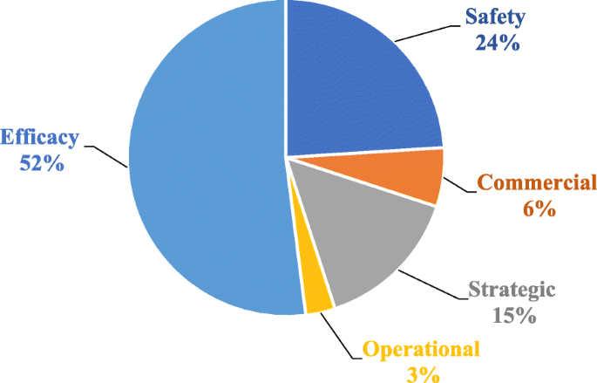
EXPLOITATION OF GENOMICS AND PROTEOMICS
It is an established fact that majority of diseases have a molecular or genetic etiology. Some conditions including sickle cell disease, cystic fibrosis, muscular dystrophy, and Huntington disease are caused by single gene mutations. Syndromic conditions such as diabetes and cardiovascular diseases have multifactorial causes including multiple gene mutations confounded by environmental and lifestyle factors.
The outcome so observed would therefore be attributable to the therapeutic intervention and shielded from other confounders. Genomics can also be used as a predictive tool to forecast potential toxicities emanating from a specific molecule.

Slide 7
COMPLEMENTARITY OF PHENOTYPIC AND TARGET-BASED SCREENING PLATFORMS
Phenotypic screening evaluates the effects of potential drugs on cultured cell lines (in vitro), isolated tissues/organs (ex-vivo), or in whole animals (in vivo) while target-based screening involves testing the molecules on purified target proteins in vitro.
On the contrary, target-based screening is hypothesis-driven, systematic, and rational. Of essence, it requires identification and isolation of a biochemical target whose modulation leads to a desired pharmacological effect. It employs advanced molecular technologies and biological methods that are facilitative of high throughput screening (HTS) platforms.
The significant decline in the discovery of first-in-class molecules has in part been attributed to an increasing emphasis on the target-based drug discovery approach. Analysis of data of the drugs registered by the US-FDA reveals that phenotypic drug discovery has yielded more first-in-class molecules than target-based screening.
These findings have been challenged by a study that established that 78 of 113 first-in-class molecules registered between years 1999 and 2013 were discovered using target-based screening approaches.

Slide 8
Collaborative research
  The pharmaceutical industry is competitive, with early market entrants gaining significant advantages such as brand recognition and market pricing control. However, overlapping research efforts waste resources that could be better utilized in addressing unmet medical needs. Collaborative arrangements like precompetitive research, pharma-academia partnerships, and public-private collaborations are proposed to enhance R&D efficiency.
Under-served therapeutic fields
  Pharmaceutical companies often focus on economically viable therapeutic areas, neglecting fields like neglected tropical diseases (NTDs) and rare diseases due to low financial returns. This lack of attention leaves significant opportunities for novel drug discoveries unexplored, particularly in resource-poor regions.
Pharmaceutical modelling and artificial intelligence
  Advancements in computational power have led to the use of in silico simulations in drug discovery, enhancing efficiency through computer-aided drug design (CADD). Techniques like ligand-based and target-based virtual screening help predict drug properties and optimize lead compounds, ultimately reducing the risk of costly late-stage failures in drug development. Integrating both screening approaches yields better outcomes in identifying promising drug candidates.

Slide 9
CONCLUSION
The ever-increasing costs of drug discovery projects have not translated into increased efficiency in delivering new medicines. On the contrary, fewer drugs are transiting through the drug development pipeline than ever before.
Scientific advancements allow the application of advanced molecular techniques that include genomics and lately proteomics in identification and validation of drug targets.
Carefully executed target identification and validation will reduce the attrition rates attributable to poor efficacy that currently accounts for more than 50% of drug failures.
Expansion of research activities into the underserved therapeutic areas covering rare and neglected diseases would offer a safeguard for companies whose blockbuster drugs are teetering on the patent cliff.
Pharmaceutical modelling and AI are expected to continue contributing significantly to improved efficiency in drug discovery and development in the years to come.

Slide 10
REFERENCES
Kiriiri, G. K., Njogu, P. M. & Mwangi, A. N. Exploring different approaches to improve the success of drug discovery and development projects : a review. 9, (2020).
Deore, A. B., Dhumane, J. R., Wagh, R. & Sonawane, R. The Stages of Drug Discovery and Development Process. Asian J. Pharm. Res. Dev. 7, 62 67 (2019).
Svennebring, A. M. & Wikberg, J. E. S. Net present value approaches for drug discovery. Springerplus 2, 1–7 (2013).
Nicolaou, K. C. Advancing the Drug Discovery and Development Process. Angew. Chemie 126, 9280–9292 (2014).
Berdigaliyev, N. & Aljofan, M. An overview of drug discovery and development. Future Med. Chem. 12, 939–947 (2020).

Slide 11
Thank You

