Slide 1
A Computational Approach to Medication Design: Illustrating The Physiochemical and Pharmacokinetic Characteristics of Linum Usitatissimum Against Breast Cancer”
Prakriti Maurya1*Salil Tiwari2
1*Department of Pharmaceutical Chemistry, Goel institute of Pharmacy & Sciences, Faizabad Road , Near Indira Canal, Luck now, U.P., India, Pin- 226028
2Department of Pharmaceutical Chemistry, Goel institute of Pharmacy & Sciences, Faizabad Road , Near Indira Canal, Luck now, U.P., India, Pin- 226028Corresponding
*Corresponnding Author Email Id: pkt99maurya@gmail.com

Slide 2
ABSTRACT
This study explores a computational approach to the design of a novel medication derived from Linum usitatissimum (flaxseed) for the treatment of breast cancer. L. usitatissimum is commonly referred to as flax and linseed and its Linaceae family. We examine the physiochemical properties and pharmacokinetic characteristics of bioactive compounds extracted from flaxseed. We employ ADMET analysis to predict the absorption, distribution, metabolism, excretion, and toxicity of these compounds with key cancer- related targets. Our findings indicate that certain lignans and fatty acids in Linum usitatissimum exhibit promising anti-cancer activities. We are using the SwissADME webtool for the ADME study and ProTox 3.0 for the toxicity profile. Over the past fifty years, ADME has played a significant part in the drug design process. Time and money could be saved by evaluating these qualities early in the process.Furthermore, we analyze their absorption, distribution, metabolism, and excretion (ADME) properties, confirming that lotaustralin and pantothenic acid are potential agents for effective systemic delivery. This research underscores the therapeutic potential of Linum usitatissimum in breast cancer treatment, paving the way for future molecular docking studies to validate binding energy and ligand-protein interactions. Ultimately, this approach may facilitate the development of more targeted and effective therapies for breast cancer, leveraging the rich pharmacological potential of natural compounds.

Slide 3
INTRODUCTION
The most frequent cause of cancer in women and the second leading cause of cancer- related deaths among women in the United States is breast cancer. Breast cancer is the term used to describe malignancies that start in breast tissue, usually the lobules that provide milk to the ducts or the inner lining of the milk ducts [1]. One of the most prevalent malignancies in women globally, breast cancer claimed around 570,000 lives in 2015. Every year, more than 1.5 million women worldwide receive a breast cancer diagnosis, accounting for 25% of all cancer-stricken women [2]. The two primary tissue types that make up the breast are glandular tissues and stromal (promoting) tissues. The ducts (the milk channels) and the lobules (the milk-producing glands) are located in glandular tissues, whereas the stromal tissues comprise the breast's fatty and fibrous connective tissues. Additionally, the immune system's lymphatic tissue, which eliminates waste products and cellular fluids, makes up the breast [3]. When DNA and/or RNA are altered or mutated, cancer cells are created from healthy cells [4]. A lump in the breast or armpit is the classic indication of breast cancer. Breast cancer can be identified by its general warning signs, which include breast swelling or lump (mass), swelling in the armpit (lymph nodes), clear or bloody nipple discharge, nipple pain, inverted (retracted) nipple, scaly or pitted skin on the nipple, persistent breast tenderness, and unusual breast pain or discomfort [5].

Slide 4
One of the oldest crop plants is flax, sometimes known as linseed. It is part of the Linaceae family and genus Linum. In his book "Species Plantarum," Linnaeus provided the botanical name Linum usitatissimum [6]. In North America and Asia, L. usitatissimum is commonly referred to as flax and linseed, respectively. This species has developed specific oilseed and fiber variants [7]. In addition to their various nutritional benefits, flaxseeds are rich in short-chain omega-3 fatty acids. Flax is grown mostly for its fiber, but its edible seeds can also help prevent diabetes, cancer, heart disease, and strokes. [8]. Flaxseed has 40–45% fatty acids and 20–25% protein. Since flaxseed also yields vegetable oils, it is also referred to as "linseed oil." Linseed oil is edible oil that is used in medicine and is regarded as one of the first commercial oils [9]. It has been demonstrated that α-linolenic acid possesses anti-inflammatory properties and antiproliferative effects in animal models of premenopausal (high estrogen) breast cancer [10]. In the Women’s Healthy Eating and Living Study, a large intervention study, a dietary pattern high in fiber was found to lower the risk of breast cancer recurrence, most likely through effects on hormone metabolism and disposal [11]. According to recent research, flaxseed may have anti-inflammatory and hormone-activity-modulating properties, among other protective factors, against breast cancer [12]. The purpose of this work is to assess the physiochemical and pharmacokinetic properties of bioactive substances in Linum usitatissimum by utilizing computational methodologies. We want to clarify the potential of these compounds as therapeutic agents against breast cancer by ADMET (Absorption, Distribution, Metabolism, Excretion, and Toxicity) profiling.

Slide 5
AIMS & OBJECTIVE
To perform in silico screening of natural bioactive compounds of Linum usitatissimum against breast canncer.
To draw the 2D chemical structure of bioactive compound of Linum usitatissimum using chemSketch tool.
To calculate ADME properties of natural bioactive compounds of Linum usitatissimum using SwissADME webtool.
To calculate toxicity profile of natural bioactive compounds of Linum usitatissimum using ProTox III tool.

Slide 6
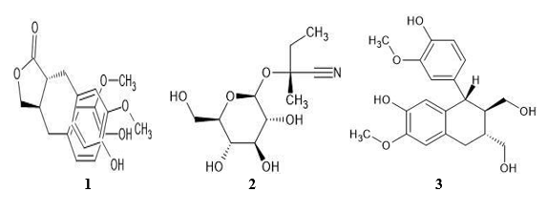
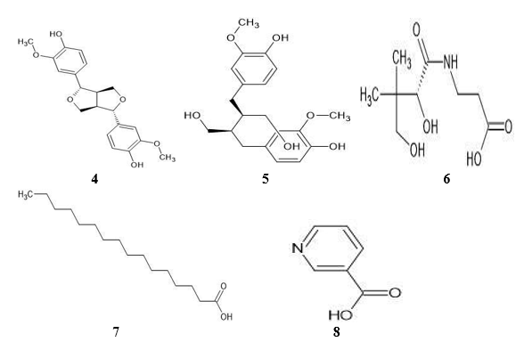
MATERIALS & METHODS
Restitution of Phytochemical Compounds
Determine and choose the phytochemicals in Linum usitatissimum that may be used to treat breast cancer. A literature review may serve as the basis for this choice. Linum usitatissimum phytochemical bioactive substances were obtained from IMPPAT (Indian Medicinal Plants, Phytochemicals, and Therapeutics) along with their molecular formula, PubChem ID, and SMILE (Simplified Molecular Input Line Entry System).
The 2D Molecular Structures of Phytochemical Compounds
Linum usitatissimum Phytochemicals are examined for their molecular structures, which are depicted in Figure 1. The two-dimensional structure of the phytochemicals of Linum usitatissimum was drawn using the chemsketch tool.
Figure 1 The 2D structure of phytochemical compounds

Slide 7
The number 1 to 8 stands for 1= Matairesinol, 2=Lotaustralin, 3=Isolariciresinol, 4=Pinoresinol, 5=Secoisolariciresinol, 6=Pantothenic acid, 7=Palmitic acid, 8=Palmitic acid.
The evaluation of Physiochemical Characteristics
The physicochemical properties like molecular weight, topological polar surface area, number of hydrogen bond donors/number of hydrogen bond acceptors, lipophilicity (logPO/w), percentage absorption, and drug likeness were predicted by SwissADME. The formula was used to determine the ligands' percent absorption (% Abs). [% Abs = 109-(0.345*TPSA)].
The evaluation of Pharmacokinetic Characteristics
The absorption, distribution, metabolism, and excretion (ADME) of substances within the body are all included in pharmacokinetics. Assessing the possible safety and effectiveness of therapeutic compounds made from Linum usitatissimum against breast cancer requires an understanding of these traits. The pharmacokinetic properties like GI absorption, BBB permeation, P-gp substrate, cytochrome-P enzyme inhibition, and skin permeation (log Kp) were evaluated by SwissADME.
The evaluation of Toxicity
It is essential to comprehend toxicity while assessing the potential of Linum usitatissimum (flaxseed) and its bioactive components as a treatment for breast cancer. The toxicity class and level of toxicity (LD50, mg/kg) as well as the toxicological endpoints such as hepatotoxicity, neurotoxicity, nephrotoxicity, respiratory toxicity, cardiotoxicity, carcinogenicity, immunotoxicity, mutationagenicity, cytotoxicity, ecotoxicity, clinical toxicity, and nutritional toxicity of the phytochemicals of Linum usitatissimum were evaluated using the ProTox 3.0 server.

Slide 8
RESULTS AND DISCUSSION
The Evaluation of physicochemical characteristics and drug-likeness of phytochemical compounds. The ADME-related physicochemical characteristics of phytochemical compounds like molecular weight, number of hydrogen bond donors, and number of hydrogen bond acceptors, log P, number of rotable bonds, TPSA (Topological Polar Surface Area), and percentage absorption are obtained via the SwissADME webtool with the help of SMILE. For the drug likeness and good oral bioavailability, all phytochemical compounds follow the ROF rule (Lipinski Rule of Five). According to ROF, the molecular weight of the compound less than 500 daltons, the number of hydrogen bond donors is less than 5, the number of hydrogen bond acceptors is less than 10, and logP is less than 5. We find that all of the phytochemical compounds follow the ROF rule.
TPSA value determines the drug polarity and lipid solubility. The ideal range of TPSA value for absorption is 60-140 Å². TPSA value <140 Å² indicates good intestinal absorption and <60 Å² indicates good blood-brain barrier penetration. The TPSA values of Lotaustralin, Pantothenic acid are 123.17 Å², 106.86 Å², respectively, which indicates good intestinal absorption, and Palmitic acid and Nicotinic acid are 37.30 Å², 50.19 Å², respectively, which are summarized in Table 1. The LogP value determines whether the compound is hydrophilic or hydrophobic. The negative value of log P indicates the compound is hydrophilic; a positive value indicates the compound is lipophilic; and a zero value indicates the compound is partitioned equally. In this study, we find that all of the phytochemical compounds are hydrophobic. The number of rotable bonds determines the flexibility that allows free rotation around them. In our study, the number of rotable bonds ranges from 1 to 14. The highest% absorption of phytochemicals like palmitic acid and nicotinic acid and the lowest% absorption like lotaustralin.

Slide 9
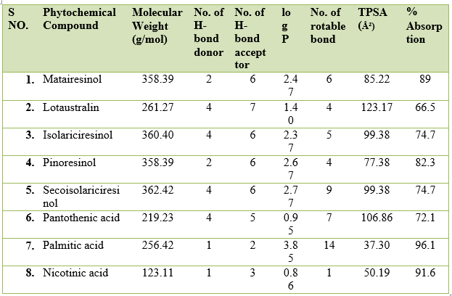
Table-1 The evaluation of physicochemical characteristics

Slide 10
The Evaluation of Pharmacokinetics characteristics of phytochemical compounds. The pharmacokinetic properties like GI absorption, BBB permeant, P-gp substrate, CYP1A2 inhibitor, CYP2C19 inhibitor, CYP2C9 inhibitor, CYP2D6 inhibitor, CYP3A4 inhibitor, and LogKp (cm/s) of phytochemical compounds were determined by the SwissADME webtool with the help of SMILE. In this study, we analyzed that all of the phytochemical compounds show the highest GI absorption, which is represented in Table
For the distribution of drugs, we determined the BBB permeant in which all of the phytochemicals do not permeate BBB except pinoresinol, palmitic acid, and nicotinic acid. The P-gp substrate was determined for the drug absorption and excretion.
In this study, we find that all of the phytochemicals are P-gp transporters except Matairesinol, pantothenic acid, palmitic acid, and nicotinic acid. Cytochrome P450 isoforms are very important parmeters for the metabolism of drugs. All of the phytochemicals were not found inhibitors for CYP1A2 inhibitor and CYP2C9 inhibitor except palmitic acid. There is no inhibitor for CYP2C19. Matairesinol, isolariciresinol, pinoresinol, and secoisolariciresinol were found to inhibitors for CYP2D6 and the rest of all phytochemicals are not inhibitors for CYP2D6. Matairesinol, and pinoresinol were found to inhibitors for CYP3A4, and the rest of all phytochemicals are not inhibitors for CYP3A4.
The LogKp value represents the skin permeability and its range from -8.0 to -1.0 cm/s. A lower log Kp value indicates the lower permeability through the skin. In this study, we found that palmitic acid (92.77 cm/s) shows the highest skin permeation and lotaustralin (9.13 cm/s) shows the lowest skin permeation.

Slide 11
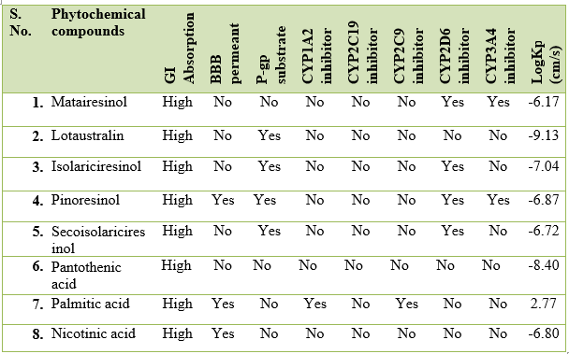
Table -2 The evaluation of Pharmacokinetics characteristics

Slide 12
The Evaluation of Toxicity Profile of phytochemical compounds. The toxicity of phytochemicals was determined by ProTox 3.0 with the help of SMILE. There are various types of toxicity endpoints like hepatotoxicity, neurotoxicity, respiratory toxicity, cardiotoxicity, nephrotoxicity, carcinogenicity, mutagenicity, cytotoxicity, immunotoxicity, clinical toxicity, nutritional toxicity, toxicity class, and LD50 value. All of the phytochemicals are inactive for hepatotoxicity and neurotoxicity except nicotinic acid. In nephrotoxicity, all of the phytochemicals are active except palmitic acid. Isolariciresinol, pinoresinol, and nicotinic acid are active for respiratory toxicity, and the rest of the phytochemicals are inactive for respiratory toxicity.
The result showed that all of the phytochemicals are inactive of cardiotoxicity except pinoresinol. Matairesinol, isolariciresinol, and pinoresinol are active for immunotoxicity, and the rest of the phytochemicals are inactive for immunotoxicity. In the ecotoxicity, all of the phytochemicals are inactive except palmitic acid. Pantothenic acid is active for clinical toxicity, and the rest of the phytochemicals are inactive for clinical toxicity. In this study, we found that all of the phytochemicals are inactive for carcinogenicity, mutagennicity, cytotoxicity, and nutritional toxicity.
The result showed that LD50 (median lethal dose) ranges from 900 to 29700 mg/kg, which are represented in Table 3. In this study, toxicity class 4 indicates that matairesinol, pinoresinol, secoisolariciresinol, and palmitic acid were harmful, and toxicity class 5 is isolariciresinol. Nicotinic acid may be harmful. Lotaustralin and Pantothenic acid belong to toxicity classes 6, which are nontoxic.

Slide 13
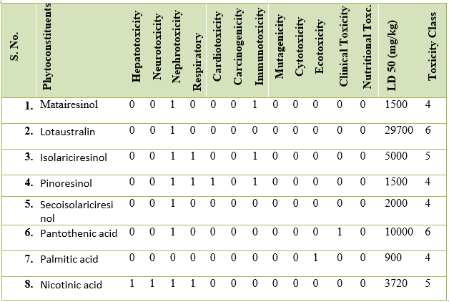
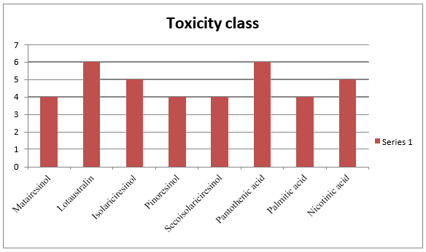
Table-3 The evaluation of Toxicity Profile
Figure 2 Graphical representation of toxicity class

Slide 14
CONCLUSION
The assessment of pharmacokinetic and physicochemical properties is the main responsibility for the drug design and development process. In this study, 8 phytochemicals were evaluated with in silico screening procedures based on ADMET parameters. The assessment of in silico computer research, such as ADME, showed that all of the phytochemicals have the highest GI absorption and obey the ROF rule for oral bioavailability of drugs. Lotaustralin and Pantothenic acid show good intestinal absorption and their toxicity class is 6, which is nontoxic. Our findings indicate that lotaustralin and pantothenic acid are potential agents for breast cancer. In the future, we will perform molecular docking of these compounds and observe the best binding energy and ligand-protein interactions.

Slide 15
REFERENCE
Cancer-Its various types along with causes, symptoms, treatments and stages, in: cancer info guide 200915 Mar. 2010
Stewart BW, Wild CP. World Cancer Report 2014. Geneva, Switzerland: WHO Press; 2014.
Breast cancer process india, Breast cancer cost india, Breast cancer, delhi India Breast cancer information and resources. 201014 April 2010
Mieszkowski M. R. Cancer – A biophysicist's point of view. In: Digital Recordings 200615 Mar 2010
Stephan P.. What you need to know about breast cancer symptoms. About.com: Breast cancer 200720 Mar 2010
Linnaeus, C., 1857. Species Plantarum. The Royal Society of London, London, UK, pp: 300.
Millam, S., O. Bohus and P. Anna, 2005. Plant cell and biotechnology studies in Linum usitatissimum - A review. Plant Cell Tissue Organ Cult., 82: 93-103.
Imran, M.; Sun, X.; Hussain, S.; Ali, U.; Rana, M.S.; Rasul, F.; Saleem, M.H.; Moussa, M.G.; Bhantana, P.; Afzal, J. Molybdenum-Induced Effects on Nitrogen Metabolism Enzymes and Elemental Profile of Winter Wheat (Triticum aestivum L.) Under Different Nitrogen Sources. Int. J. Mol. Sci. 2019, 20, 3009.

Slide 16
THANK
YOU

