Slide 1
RHODIOLA ROSEA: A PHYTOCHEMICAL POWERHOUSE FOR COSMECEUTICAL AND THERAPEUTIC USES
D Jayesh Kumar

Slide 2
ABSTRACT
Rhodiola rosea, a well-known adaptogen traditionally used in various cultures, has gathered significant attention over the years for its potential as a cosmeceutical ingredient due to its multi-therapeutic properties. In the current review, we have carried out a comprehensive analysis of R. rosea's pharmacological activities, such as antioxidant, anti-inflammatory, antistress, and immunomodulatory, highlighting its relevance in cosmetic applications. In addition, this present review also covers the microscopic characters, cultivation, and collection of the plant. We have also summarized the primary bioactive constituents, including salidroside, rosavin, tyrosol, and various flavonoids, which are known for their potent medicinal and cosmetic applications. Despite the various medicinal and cosmetic applications, plants also exhibit some minor adverse effects, which have been highlighted in the article. In summary, Rhodiola rosea presents a valuable opportunity for developing advanced cosmeceutical products, offering natural solutions for enhancing skin health and appearance. Continued exploration and clinical validation will be essential in realizing its full potential in the cosmeceutical industry.

Slide 3
INTRODUCTION
Ayurveda, the ancient system of medicine in India, underlines several approaches to maintaining the health of mankind. Thousands of medicinal plants, their benefits, phytochemicals and formulations have been listed in the Ayurveda. This traditional system of medicine, which is officially recognized in India, documents the uses of various plants and plant parts for the treatment of various ailments, as well as for their cosmetic value, such as enhancing skin health, promoting hair growth, and maintaining overall beauty [1]. It describes the specific herbs, their preparation methods, and application techniques for different cosmetic purposes such as complexion improvement, wrinkles reduction, managing acne, and hair strengthening. These formulations often involve the combination of multiple plants, each chosen for its unique properties, to provide a natural and sustainable solution for beauty and skincare needs [2].
Plant Rhodiola rosea is one of the well-acknowledged plants of Ayurveda studied for various cosmetic and medicinal purposes. It is a perennial herbaceous plant that belongs to family Crassulaceae. Plant is also known as “golden root”, “roseroot” or “arctic root” with synonyms Sedum rhodiola DC., Sedum roseum (L.) Scop). The plant is distributed throughout the arctic regions of Asia and Europe and coastal areas of North America [3,4]. Plant thrives at clefts of Rocky Mountains, and sandy soil of coastal regions. The common name of the plant roseroot is based on the yellow flowers that bear the essence of a rose. Roots of the plant exhibit huge medicinal properties and are hence exploited in many countries due to high demand. Industrial supply of the plant material is majorly met by harvesting wildly grown plant. Therefore, increased scarcity and lack of regulation has led to the adulteration, illegal marketing and habitat destruction of the species [4].

Slide 4
GEOGRAPHIC DISTRIBUTION, COLLECTION & CULTIVATION
As discussed in the previous section, this herbaceous plant grows in cold mountain regions throughout the Northern hemisphere. It is distributed along the various continents, including Europe, Asia, and North America.
In Europe, R. rosea is found across the Arctic and mountainous regions of Scandinavia, Iceland, the British
Isles, and the Alps. In Russia, the plant is particularly present in the Ural Mountains, Siberia, and the Altai Mountains, where it thrives in the harsh, cold climates of high altitudes. In Asia, R. rosea is widely distributed across the Himalayas, including regions of Bhutan, Nepal, and parts of northern India, where it grows at an altitude of 3,000 to 5,000 meters from sea level. In North America, R. rosea is native to Alaska and the mountainous areas of Canada [11].
Rhodiola rosea is well grown in sandy or rocky soils, and is commonly found in alpine meadows, slopes, and along the riverbanks. Its ability to thrive in these extreme conditions is attributed to its extensive root system, which is the integral part of plant support and allows it to absorb nutrients efficiently from the scarce soil. The plant's distribution is influenced by its preference for cool temperatures, high altitudes, and areas with sufficient sunlight, which is on the main region why this plant is predominantly found in regions with long, harsh winters and short, cool summers [12].
The plant reaches full bloom in the summer from June to August, which is the peak time for its highest bioactive compound. Most plant is harvested for their roots, which are the primary source of their therapeutic and cosmetic benefits. The plant collection is mostly carried out manually, as the plant grows in remote and unreachable locations, which require careful extraction to avoid and minimize disturbing the fragile alpine ecosystem. In traditional practices, the roots are dug up using simple tools, and only mature plants that are several years old are harvested to ensure sustainability. Further, the roots or required part is washed, sliced, and dried at low temperatures to preserve their active phytometabolites [11,13] Fig. 1 Shows the different parts of the plant [40].

Slide 5
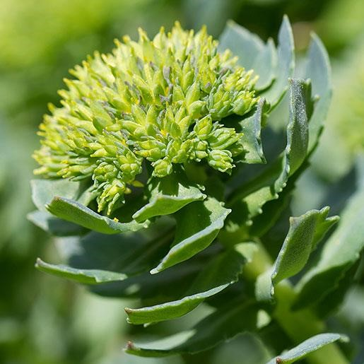
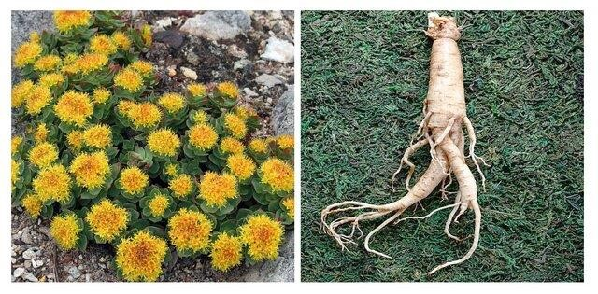
Due to the massive medicinal and cosmetic applications, global demand for Rhodiola rosea has increased over the years, resulting in overharvesting, which has become a significant concern, particularly in areas where the plant is collected in the wild. In regions such as the Altai Mountains, the Himalayas, and parts of Russia, unregulated harvesting practices have led to a decline in wild populations, threatening the plant's natural habitats and biodiversity. Several countries have initiated significant conservation efforts to promote sustainable collection practices to avoid damaging the plant's natural habitat. These efforts include cultivating R. rosea under controlled conditions, implementing stricter regulations on wild harvesting, and developing guidelines for the fair and sustainable use of natural resources [13,14].
Cultivation of Rhodiola rosea is gaining importance as an alternative to wild collection, especially in countries like China, Russia, and Canada, where research is focused on developing high-yield, high-quality plant varieties. Cultivation practices typically involve selecting suitable altitudes and climatic conditions that mimic the plant’s natural habitat, using organic farming techniques, and ensuring soil quality is optimized to maintain the concentration of active compounds in the roots. This controlled cultivation helps meet global demand and contributes to the conservation of wild populations [10].
While sustainable practices are necessary to prevent overexploitation, continued research and conservation efforts are essential to protect this valuable plant and ensure its availability for future generations.
Flower, leaves and stem Whole plant in natural habitat Roots
Fig 1: Images of different parts of Rhodiola rosea plant

Slide 6
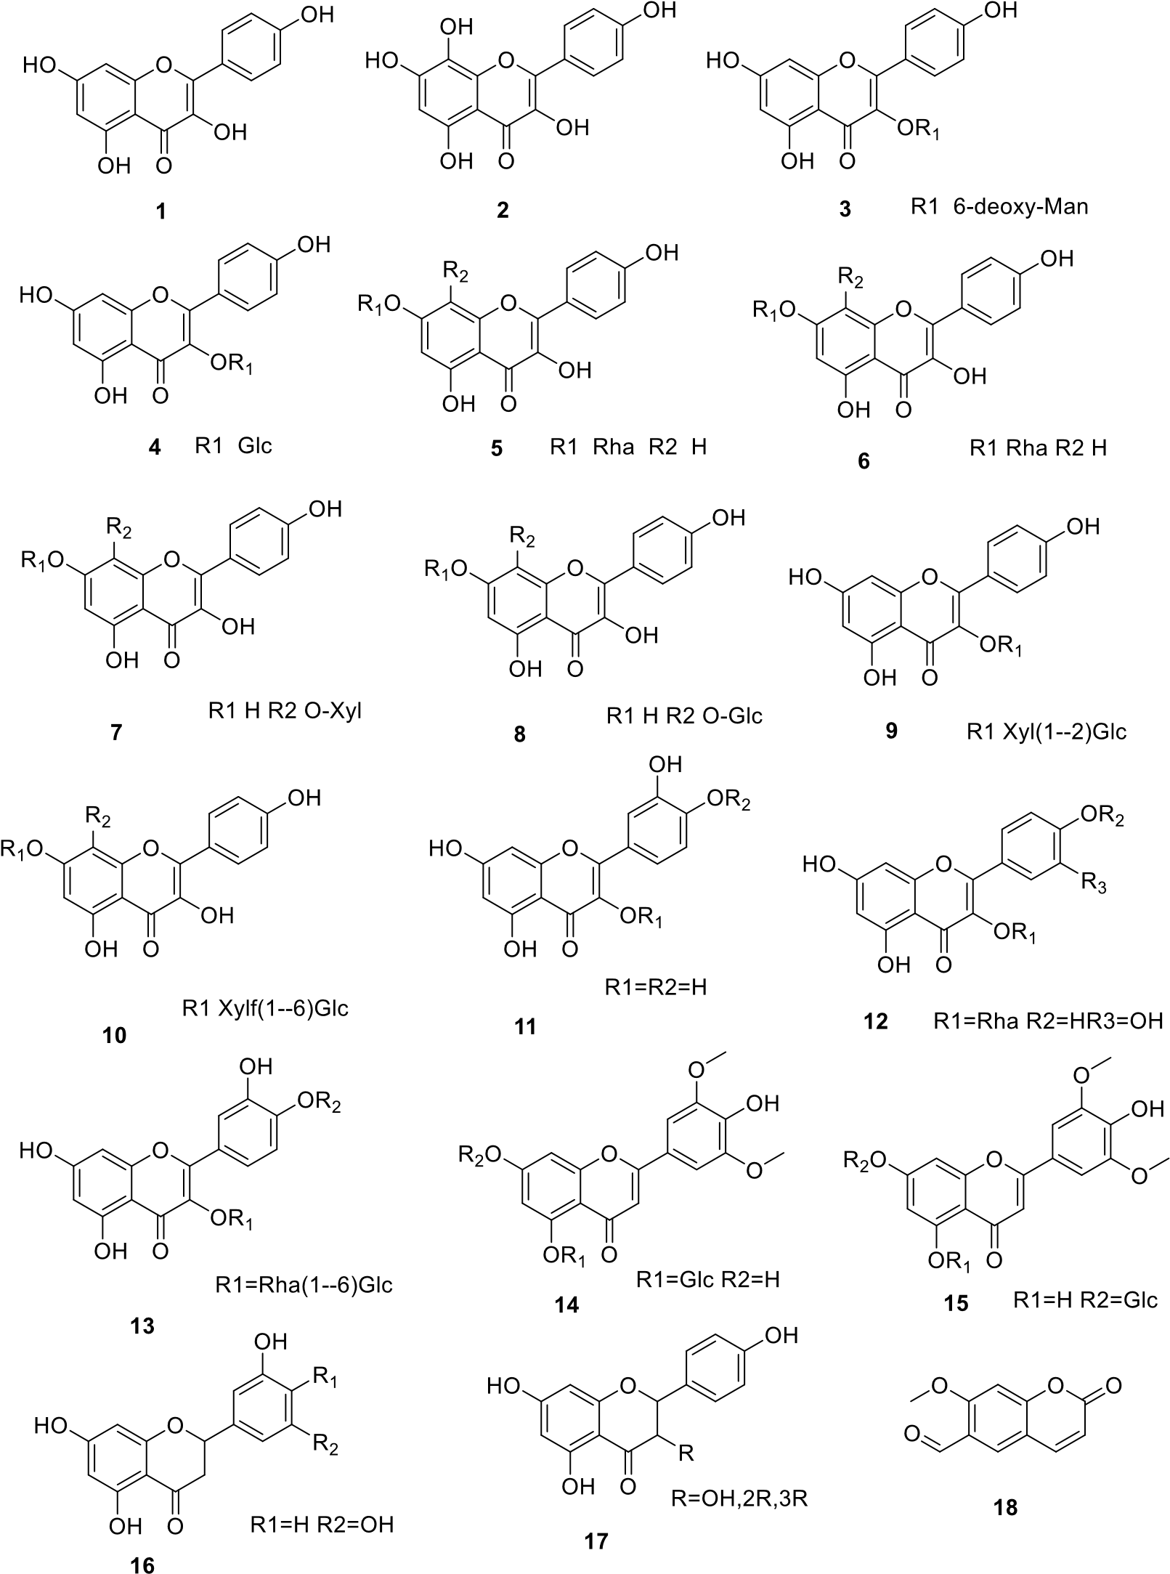
PHYTOCONSTITUENTS
R. rosea exhibits complex and rich phytochemistry that have been reported by researchers all over the globe. Till date around 120 compounds have been reported from the different parts of plant. These phytoconstituents belongs to different classes of compounds such as phenylpropanoids, lignans, terpenoids, flavonoids and their glycosides and gallic acid derivatives. Compounds such as salidroside, rosavin, rosin and rhodiolosides are the common biomarkers found in R. rosea that are reported for many pharmacological activities. Fig. 2 depicts the phytochemical profile of the R. rosea. In this review, we have discussed different classes of compounds present in the plant reported till date [15].
Fig. 2: Chemical structures of the phytoconstituents present in Rhodiola rosea Cont.

Slide 7
ADVERSE EFFECTS
While Rhodiola rosea is widely recognized for its beneficial properties, the literature also indicates that its consumption may be associated with certain adverse effects, particularly when taken in high doses or over extended periods. Although R. rosea is generally considered safe for most users, a few studies have reported mild to moderate side effects linked to its use. Some of the most commonly reported adverse effects of R. rosea and its compounds are gastrointestinal-related adverse effects. These effects include symptoms like nausea, dry mouth, and stomach upset. In clinical trials, these gastrointestinal disturbances were generally mild and selflimiting, occurring more frequently at higher doses of the plant extract. The symptoms resolve quickly upon discontinuation or reduction of the dose, indicating a dose-dependent response [38]. Adverse effects related to the central nervous system have also been noted, though they are relatively rare. Some users have reported symptoms such as dizziness, restlessness, agitation, or difficulty sleeping, which may be attributed to the stimulating properties of R. rosea. However, these symptoms are typically mild and diminish with continued use or dose adjustment [37].
Although uncommon, allergic reactions to R. rosea have been reported in some cases. These may present as skin rashes, itching, or swelling, and are thought to result from hypersensitivity to one or more of the plant's components. There is limited evidence in the literature on the prevalence or severity of such allergic reactions, but individuals with known allergies to plants in the Crassulaceae family should exercise caution when using R. rosea extracts [40]. Evidence suggests that R. rosea may influence hormonal balance, particularly concerning the thyroid gland. Animal studies have indicated that high doses of R. rosea extracts may affect thyroid hormone levels, potentially leading to hyperthyroid-like symptoms such as palpitations, anxiety, and weight loss. While these effects have not been widely documented in human studies, individuals with thyroid disorders should be cautious and consult a healthcare provider before using R. rosea supplements [39].

Slide 8
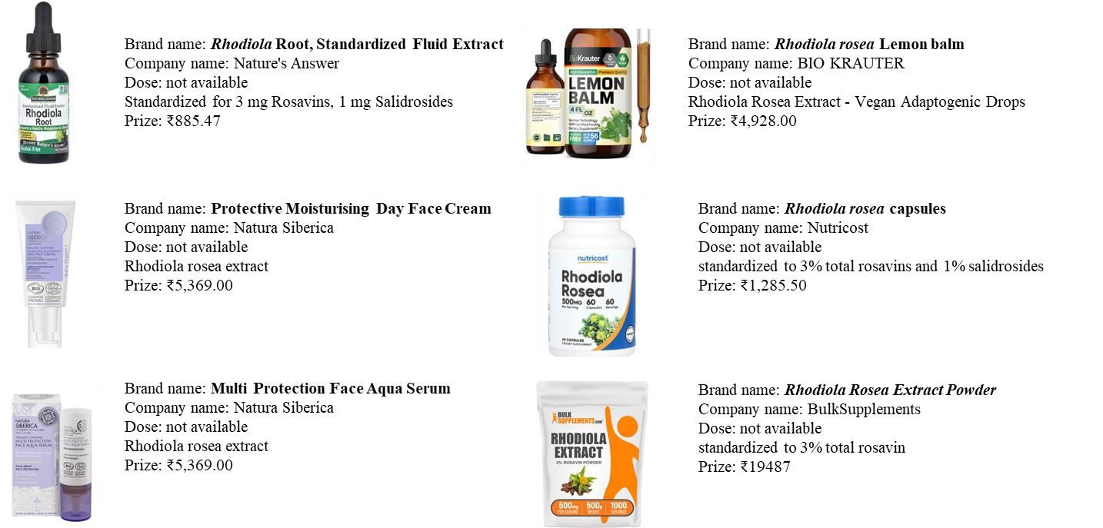
MARKETED FORMULATION
A number of Rhodiola rosea root extracts have been marked mostly for immunomodulatory and adaptogenic benefits. Cosmetic formulations available in the market are given in the fig. 4.
Fig. 4: Marketed formulations of the plant Rhodiola rosea

Slide 9
CONCLUSION
Rhodiola rosea, a renowned adaptogen, has emerged as a promising candidate for cosmeceutical applications, owing to its multi-therapeutic properties and rich phytochemical profile. This review has explored the extensive scientific literature on R. rosea, highlighting its antifatigue, anti-inflammatory, and antioxidant activities, particularly relevant for cosmetic and dermatological use. The plant’s bioactive constituents, including salidroside, rosavin, tyrosol, and various flavonoids, play a crucial role in its efficacy. Furthermore, R. rosea exhibits notable antioxidant, anti-inflammatory, antistress, and adaptogenic properties, which can be harnessed in cosmetic formulations aimed at revitalizing and rejuvenating the skin. The plant’s ability to enhance cellular energy production and reduce mental and physical exhaustion complements its use in products that promote a more vibrant youthfulness.
Altogether, Rhodiola rosea holds considerable promise as a cosmeceutical ingredient due to its extensive range of therapeutic properties. Its ability to combat oxidative stress, enhance energy levels, and reduce inflammation positions it as a valuable asset in skincare and cosmetic formulations. Continued research and clinical trials will be crucial in optimizing its use and ensuring its safety and efficacy in cosmeceutical applications. As the demand for natural and effective skincare solutions grows, R. rosea offers a compelling option for developing advanced and beneficial cosmeceutical products.

Slide 10
REFERENCES
Pandey MM, Rastogi S, Rawat AKS. Indian traditional ayurvedic system of medicine and nutritional supplementation. J Evid Based Complementary Altern Med. 2013; (1): 376327. https://doi.org/10.1155/2013/376327.
Pathak- Gandhi N, Vaidya ADB. Management of Parkinson’s disease in Ayurveda: Medicinal plants and adjuvant measures. J Ethnopharmacol 2017; 197: 46–51. https://doi.org/10.1016/j.jep.2016.08.020.
Panossian A, Wikman G, Sarris J. Rosenroot (Rhodiola rosea): Traditional use, chemical composition, pharmacology and clinical efficacy. Phytomedicine 2010; 17 (7): 481–93. https://doi.org/10.1016/j.phymed.2010.02.002.
Tao H, Wu X, Cao J, Peng Y, Wang A, Pei J, et al. Rhodiola species: A comprehensive review of traditional use, phytochemistry, pharmacology, toxicity, and clinical study. Med Res Rev. 2019; 39 (5): 1779– 850. https://doi.org/10.1002/med.21564.
Erst AA, Petruk AA, Zibareva LN, Erst AS. Morphological, Histochemical and Biochemical Features of Cultivated Rhodiola rosea (Altai Mountains Ecotype). Contemp Probl Ecol 2021; 14: 701–10. https://doi.org/10.1134/S1995425521060135.
Butenkova AN, Prokopyev AS, Yamburov MS. Anatomical and morphological features of leaves of Rhodiola rosea L. in natural conditions of the mountains in Southern Siberia (Altai Mountains). Acta Biol Sib. 2024; 10: 583–99. https://doi.org/10.5281/zenodo.12188668.

Slide 11
THANK
YOU

