Slide 1

PHYSICOCHEMICAL AND PHARMACOKINETIC STUDIES OF POTENTIAL DRUG TARGET AGAINST ANTI DIABETIC AGENT ZINGIBER OFFICINALE.
^{1*}Department Of Pharmaceutical Chemistry,Goel Institute Of Pharmacy And Sciences, Faizabad Road, Near Indira Canal,Lucknow, UP, India ,Pin – 226028
²Department Of Pharmaceutical Chemistry,Goel Institute Of Pharmacy And Sciences, Faizabad Road, Near Indira Canal,Lucknow, UP, India ,Pin – 226028
*Corresponding Author Email Id: amritayadavpharmacy@gmail.com

Slide 2
INTRODUCTION
Elevated blood glucose levels are the hallmark of diabetes, a chronic medical illness. It is mainly caused by problems with either the action or synthesis of insulin.
The hormone insulin, which is secreted by the pancreas, is essential for controlling blood sugar levels(1). Blurred vision, weariness, increased thirst, and frequent urination are among symptoms.
Type 1 Diabetes: Is an autoimmune disease in which the body is unable to manufacture glucose, a hormone that aids in blood sugar regulation.
Type 2 Diabetes: A more prevalent condition when the body either grows sensitive to insulin or produces insufficient amounts of it, frequently due to lifestyle reasons(2).
Zingiber officinale, commonly known as ginger, is a flowering plant whose rhizome (underground stem) is widely used as a spice and for its medicinal properties(3).
Reactivity of oxygen species (ROS), one type of free radical that is overproduced, have been linked to the onset of numerous chronic illnesses(4).

Slide 3
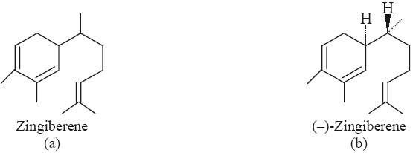
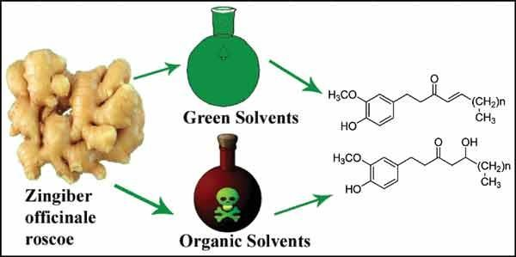
Many natural goods, including fruits, vegetables, cereals, edible flowers, medicinal herbs, and herbal infusions, have been shown to have antioxidant potential. Here’s an overview(5).
Biological Properties:
Family- Zingiberaceae, 2. Common Name- Ginger, Ginger Root, 3. Parts Used- Rhizome
Chemical contituents of zingiber officinale:
Uses: For millennia, ginger has been utilized in conventional medicine. Here are a few possible health advantages of it.
It can be consumed in the form of juice or oil, dried, powdered, or fresh. The medicinal properties are digestive aid, anti inflammatory, blood sugar regulation, menstrual pain relief(6).
Fig.1. Pant and chemical composition of ginger

Slide 4
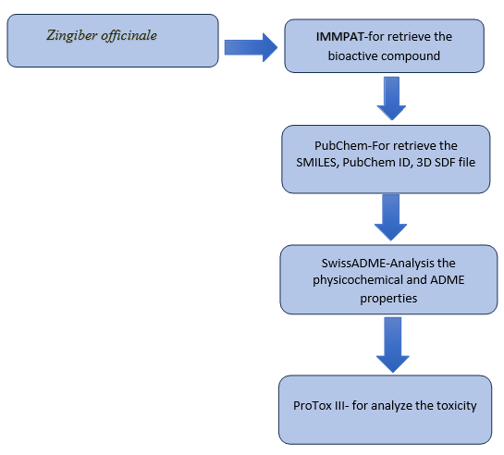
METHODOLOGY
  A flow chart of physiochemical properties and pharmacokinetic activity

Slide 5
To determine the bioactive compound by using the IMMPAT webtools:
The immpat wed tools was used for the determination of bioactive compound and its IMPPAT (2.0) is a hand curated database that includes 1742 Indian plants for medicinal purposes, 9596 phytochemicals, which and 1124 therapeutic uses. It spans 27074 plant- phytochemical connections and 11514 plant-therapeutic linkages.
This is the first step towards achieving our goals. And more data are collected from the Pubchem webtools. In Pubchem webtools we retrieved the SMILES, molecular formula and pubchem ID also. The retrieved data are mention in table.1.
Table .1- To retrieved the data by using the IMMPAT webtools.
S. No. | Bioactive compounds | Pubchem ID | Molecular formula | SMILE
1 | 3- Methylbutanal | 11552 | C5H10O | CC(C)CC=O
2 | Zingerone | 31to211 | C11H14O3 | CC(=O)CCC1=CC(=C(C=C1)O)OC
3 | Zingiberene | 92776 | C15H24 | CC1=CC[C@@H](C=C1)[C@@H](C)CCC=C(C)C
4 | Citral | 638011 | C10H16O | CC(=CCC/C(=C/C=O)/C)C
5 | Benzaldehyde | 240 | C7H6O | C1=CC=C(C=C1)C=O
6 | Eucalyptol | 2758 | C10H18O | CC1(C2CCC(O1)(CC2)C)C
7 | Camphor | 2537 | C10H16O | CC1(C2CCC1(C(=O)C2)C)C
8 | Menthone | 26447 | C10H18O | C[C@@H]1CC[C@H](C(=O)C1)C(C)C
9 | Menthol | 1254 | C10H20O | CC1CCC(C(C1)O)C(C)C
10 | Octanal | 454 | C8H16O | CCCCCCCC=O
11 | alpha-Santalol | 5281531 | C15H24O | C/C(=C/CCC1(C2CC3C1(C3C2)C)C)/CO
12 | 2-Heptanone | 8051 | C7H14O | CCCCCC(=O)C

Slide 6
RESULT AND DISCUSSION
To analysis the physical and chemical properties of bioactive compound
Table-2. To analysis the physicochemical properties:
S. NO. | Phytochemical compound | Molecular weight | Num. rotatable bonds | Num. H- bond acceptors | Num. H- bond donors | TPSA | %Abs. | Log Po/w (iLOGP)
1 | 3- Methylbutanal | 86.13 g/mol | 2 | 1 | 0 | 17.07 Å² | 103.11 | 1.49
2 | Zingerone | 194.23 g/mol | 4 | 3 | 1 | 46.53 Å² | 92.94 | 2.09
3 | Zingiberene | 204.35 g/mol | 4 | 0 | 0 | 0.00 Å² | 109 | 3.63
4 | Citral | 152.23 g/mol | 4 | 1 | 0 | 17.07 Å² | 103.11 | 2.51
5 | Benzaldehyde | 106.12 g/mol | 1 | 1 | 0 | 17.07 Å² | 103.11 | 1.36
6 | Eucalyptol | 154.25 g/mol | 0 | 1 | 0 | 9.23 Å² | 105.81 | 2.58
7 | Camphor | 152.23 g/mol | 0 | 1 | 0 | 17.07 Å² | 103.11 | 2.12
8 | Menthone | 154.25 g/mol | 1 | 1 | 0 | 17.07 Å² | 103.11 | 2.4
9 | Menthol | 156.27 g/mol | 1 | 1 |  | 20.23 Å² | 102.02 | 2.55
10 | Octanal | 128.21 g/mol | 6 | 1 | 0 | 17.07 Å² | 103.11 | 2.29
11 | alpha-Santalol | 220.35 g/mol | 4 | 1 | 1 | 20.23 Å² | 102.02 | 2.93
12 | 2-Heptanone | 114.19 g/mol | 4 | 1 | 0 | 17.07 Å² | 103.11 | 2.09
When we analysis the physicochemical properties by using the SwissADME webtools then they find the some datas like molecular weight, no. of hydrogen donor, no. of hydrogen acceptor , TPSA, and log Po/w.
After that we analysis all the data and find the best percentage of abs. is Zingiberene(3), Eucalyptol(6) and ehw the %of abs. is high the the TPSA value is low , the Standard TPSA value is 140 A2 AND above the % of abs. very poor and the TPSA value is 90 A2 and less the the % of abs. is best. In this all compound are follow RO5 rules.

Slide 7
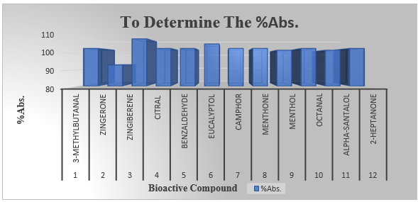
For optimal oral and intestinal absorption, an oral medication ought to have a LogP value <5, preferably between 1.35 and 1.8, in accordance with Lipinski's Rule of 5. According to this the best hydrophilic compound is Benzaldehyde(1.36), 3-Methylbutanal(1.49) and more lipophilic properties is Zingiberene(3.63) and alpha-Santalol(2.93) , all data are meantion in below table -2.
Fig. 3- To represent the % of abs. by using graph
To the analysis of pharmacokinetic properties:
  In this evalution we find the pharmacokinetic properties like- GI Absorption, BBB Permeant, P-Gp Substrate, CYP1A2 Inhibitor , CYP2C19 Inhibitor, CYP2C9 Inhibitor, CYP2D6 Inhibitor, CYP3A4 Inhibitor and Log Kp(Skin Permeation) by using the swiss ADME webtools with the help of SMILES.
  We find different parameter and different best bioactive compounds. In the GI absorption we analysis that only one compound is show the poor absorption is Zingiberene(3) and rest all the compound show the high GI absorption. Mentain in table-3.

Slide 8
Table-3. To the predication of pharmacokinetic properties:
  In the distribution, we retrieved the bioactive compound by using the swissADME . Than they found the only one compound Zingiberene(3) should not be cross the BBB Permeant and rest of all the compound are cross the BBB Permeant for the drug distribution. Mention in table-3.
  At last we evalute the metabolism and excretion we found the some of compound they do not show any Inhibitor like 3-Methylbutanal(3), Citral(4), Eucalyptol(6), Camphor(7), Menthone(8), Menthol(9), Octanal(10), 2-Heptanone(12).
S. No. | Bioactive Compound s | GI Absorpti on | BBB Permea nt | P-Gp Substra te | CYP1A 2 Inhibit or | CYP2C 19 Inhibito r | CYP2C 9 Inhibit or | CYP2D 6 Inhibit or | CYP3A 4 Inhibit or | Log Kp(Skin Permeatio n)
1 | 3- Methylbuta nal | High | Yes | No | No | No | No | No | No | -6.12 Cm/S
2 | Zingerone | High | Yes | No | Yes | No | No | No | No | -6.70 Cm/S
3 | Zingiberene | Low | No | No | No | Yes | Yes | No | No | -3.88 Cm/S
4 | Citral | High | Yes | No | No | No | No | No | No | -5.08 Cm/S
5 | Benzaldehy de | High | Yes | No | Yes | No | No | No | No | -5.90 Cm/S
6 | Eucalyptol | High | Yes | No | No | No | No | No | No | -5.30 Cm/S
7 | Camphor | High | Yes | No | No | No | No | No | No | -5.67 Cm/S
8 | Menthone | High | Yes | No | No | No | No | No | No | -5.08 Cm/S
9 | Menthol | High | Yes | No | No | No | No | No | No | -4.84 Cm/S
10 | Octanal | High | Yes | No | No | No | No | No | No | -5.15 Cm/S
11 | Alpha- Santalol | High | Yes | No | No | Yes | Yes | No | No | -4.83 Cm/S
12 | 2- Heptanone | High | Yes | No | No | No | No | No | No | -5.59 Cm/S

Slide 9
CONCLUSION
In the final when we retrieved all the data like physicochemical, pharmacokinetic and toxicity than they found the some best compound out of twelve. The all bioactive compound are followed RO5 rules. And the high GI absorption of all compound except Zingiberene. Zingiberene is a low GI absorption.
In pharmacokinetic study we find the best Log kp value is Zingiberene(-3.88 cm/s) and the toxicity class is 3-Methylbutanal, Zingerone, Camphor, Menthone are 5,5,4 and 4 respectively.
Overall research that indicated the best potential for the Anti Diabetic are 3-Methylbutanal, Zingiberene and Benzaldehyde. In future we perfome the molecular docking of these compounds.
ACKNOWLEDGEMENT
I am truly appreciative to my esteemed supervisor, Mr. UMA SHANKER MAURYA, an Associate Professor, for his excellent guidance, and to my parents, friends, and seniors who have always been there for me.
Dr. O.P. VERMA, Director, Goel Institute of Pharmacy and Sciences, Lucknow, has opened my eyes to a new world and level of medicine.

Slide 10
REFERENCES
National Diabetes Data Group (US), National Institute of Diabetes, Digestive, and Kidney Diseases (US). Diabetes in America. No. 95. National Institutes of Health, National Institute of Diabetes and Digestive and Kidney Diseases, 1995.
Zimmet, Paul Z., Dianna J. Magliano, William H. Herman, and Jonathan E. Shaw. "Diabetes: a 21st century challenge." The lancet Diabetes & endocrinology 2, no. 1 (2014): 56-64.
Dhanik, Jyotsna, Neelam Arya, and Viveka Nand. "A review on Zingiber officinale." Journal of Pharmacognosy and phytochemistry 6, no. 3 (2017): 174-184.
Mbaveng, A. T., and V. Kuete. "Zingiber officinale." In Medicinal spices and vegetables from Africa, pp. 627-639. Academic Press, 2017.
Moghaddasi, Mohammad Sharrif, and Hamed Haddad Kashani. "Ginger (Zingiber officinale): A review." Journal of Medicinal Plants Research 6, no. 26 (2012): 4255-4258.
Banerjee, S., H. I. Mullick, J. Banerjee, and A. Ghosh. "Zingiber officinale:‘a natural gold’." Int J Pharmaceutical Bio-Sci 2 (2011): 283-94.

Slide 11
THANK YOU

