Slide 1
Studies of a Potential Drug Target for the Hypertension Agent Arjuna indica: Physicochemical and Pharmacokinetic Analysis
Pawan Verma1*,Garima Awasthi2
1*Department of Pharmaceutical Chemistry, Goel institute of Pharmacy & Sciences, Faizabad Road , Near Indira Canal, Luck now, U.P., India, Pin- 226028
2Department of Pharmaceutical Chemistry, Goel institute of Pharmacy & Sciences, Faizabad Road , Near Indira Canal, Luck now, U.P., India, Pin- 226028
*Corresponnding Author Email Id: pawanvermap54@gmail.com

Slide 2
ABSTRACT
The well-known medicinal plant arjuna indica has been the subject of much research due to its antihypertensive qualities. In order to improve Arjuna indica's therapeutic efficacy in the management of hypertension, this study explores the physicochemical and physiological properties of putative pharmacological targets. We assessed the solubility, security, and permeability of the active chemicals extracted from the plant using a number of assays. In vitro models were utilized to evaluate the pharmacokinetic profiles in order to ascertain the characteristics related to absorption, distribution, metabolism, and elimination (ADME). According to our research, several substances have good physicochemical characteristics that point to their potential as therapeutic agents and high bioavailability. The analysis also identifies certain processes by which these chemicals function to lower blood pressure, indicating potential directions for future clinical research. With implications for the creation of fresh pharmaceutical treatments, this study advances our knowledge of Arjuna indica as a potential natural medicinal agent in the management of hypertension.

Slide 3
INTRODUCTION
The plant Terminalia arjuna or arjuna, is a member of the Combretaceae family. Based on the observations of ancient physicians dating back centuries, its bark decoction is used on the Indian subcontinent for anginal discomfort, hypertension, congestive heart failure, and dyslipidemia[1]. More research is required to determine the effectiveness of arjuna in treating different cardiovascular conditions [2]. Consequently, the goal of this review is to provide a thorough overview of the literature that summarizes the clinical and experimental research relevant to arjuna in cardiovascular problems, especially that conducted in the past ten years. β-sitosterol, flavonoids, glycosides, and triterpenoids are among its beneficial phytoconstituents [3]. Its favorable antioxidant cardiovascular activities are thought to be attributed to flavonoids and triterpenoids. The medication's impact on ischemic cardiomyopathy has been encouraging. Arjuna treatment has not yet been associated with any significant negative effects [4]. Nevertheless, more research is needed to determine its long- term safety. The precise role it plays in primary/secondary coronary prevention remains unknown, despite its demonstrated efficacy in treating angina pectoris, moderate hypertension, and dyslipidemia. The bark is useful in treating fractures, ulcers, leukorrhea, diabetes, anemia, cardiopathy, and cirrhosis [5]. It has been classified as an astringent, demulcent, expectorant, cardiotonic, styptic, antidysenteric, and urinary astringent. It has been demonstrated that arjuna lowers blood pressure in both people and animals. One of the main risk factors for kidney disease, cardiovascular disease, and other chronic illnesses is hypertension, or high blood pressure. Many bioactive substances found in T. arjuna bark extract, such as triterpenoids, tannins, and flavonoids, are thought to be involved in the plant's ability to decrease blood pressure[6].

Slide 4
AIMS & OBJECTIVES
To perform in silico screening of natural bioactive compounds of Terminalia arjuna against Hypertension.
To draw the 2D chemical structure of bioactive compound of Terminalia arjuna using chemSketch tool.
To calculate ADME properties of natural bioactive compounds of Terminalia arjuna using SwissADME webtool.
To calculate toxicity profile of natural bioactive compounds of Terminalia arjuna using ProTox III tool.

Slide 5
MATERIALS & METHODS
Retrieval of Phytochemical Compounds
The selection may be based on an examination of the literature. IMPPAT (Indian Medicinal Plants, Phytochemicals, and Therapeutics) provided the phytochemical bioactive components of Terminalia arjuna along with their molecular formula, PubChem ID, and SMILE (Simplified Molecular Input Line Entry System).
2D Molecular Structure
The 2D structure of bioactive compounds is drawn by using Chemsketch tool with help of SMILE. The 2D structure of Terminalia arjuna which are represented in Figure 1.
SwissADME predicted physicochemical characteristics such as molecular weight, topological polar surface area, lipophilicity (logPO/w), % absorption, number of hydrogen bond donors/number of hydrogen bond acceptors, and drug similarity. The percent absorption (% Abs) of the ligands was calculated using the formula. Abs. % = 109-(0.345*TPSA)
Pharmacokinnetic Properties
Pharmacokinetics includes the absorption, distribution, metabolism, and excretion (ADME) of drugs in the body. Understanding these properties is necessary to evaluate the potential safety and efficacy of therapeutic compounds derived from Terminalia arjuna against breast cancer. SwissADME assessed the pharmacokinetic characteristics, including GI absorption, BBB penetration, P-gp substrate, cytochrome-P enzyme inhibition, and skin penetration (log Kp).
Toxicity Prediction
The ProTox 3.0 server was used to assess the phytochemicals of Terminalia arjuna for toxicity class and level of toxicity (LD50, mg/kg) as well as toxicological endpoints like hepatotoxicity, neurotoxicity, nephrotoxicity, respiratory toxicity, cardiotoxicity, carcinogenicity, immunotoxicity, mutationagenicity, cytotoxicity, ecotoxicity, clinical toxicity, and nutritional toxicity.

Slide 6
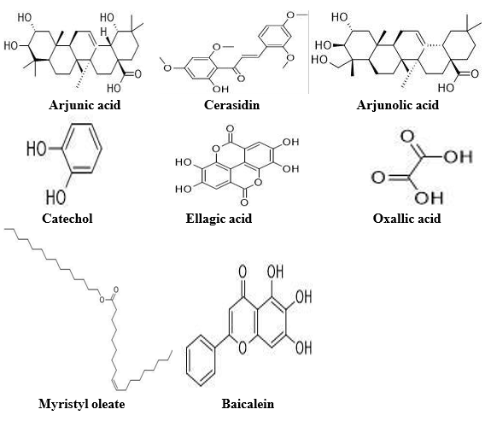
Figure 1: The 2D Structure of bioactive compounds Physiochemical Properties

Slide 7
RESULTS AND DISCUSSION
Analysis of physiochemical properties
Physiochemical characteristics play a major impact on drug likeness and oral bioavailability. Using the SwissADME webtool and SMILE, the physiochemical characteristics such as molecular weight, number of hydrogen bond donors and acceptors, log P, number of rotable bonds, TPSA (Topological Polar Surface Area), and % absorption are obtained. All phytochemical substances adhere to the RO5 rule (Lipinski Rule of Five) for excellent oral bioavailability and drug similarity. LogP is less than five, the number of hydrogen bond donors is fewer than five, and the number of hydrogen bond acceptors is less than ten, all of which are determined by RO5. All of the bioactive compounds follow the rule of five except Arjunin and Arjunetin which are summarized in table 1.
The TPSA value establishes a good intestinal absorption and good blood-brain barrier penetration are indicated by TPSA values less than 140 Å² and 60 Å², respectively. In this study we find that Arjunin, Arjunetin, Ellagic acid have high TPSA value and low percentage absorption and Catechol, Myristyl oleate, have low TPSA value and high percentage absorption. The log Kp value determined the compound is hydrophilic and lipophilic.All of the bioactive compounds are lipophilic except Oxalic acid. The number of rotable bond represents the flexibility of compounds. All of the bioactive compounds have rotable bond except Catechol, Ellagic acid.

Slide 8
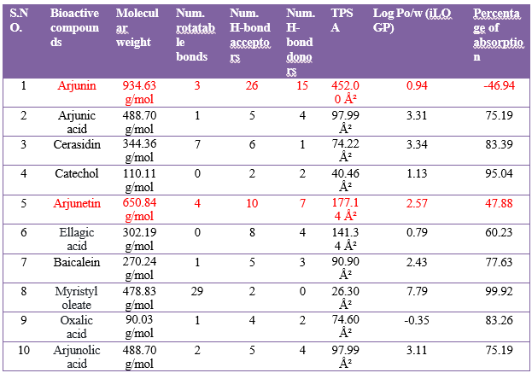
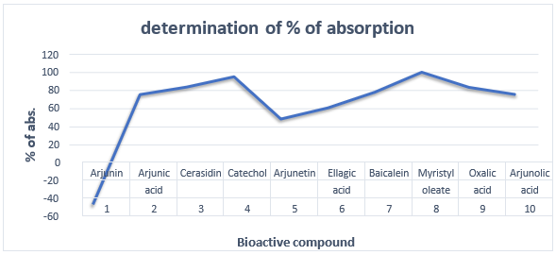
Table - 1 The analysis of physiochemical properties
Figure 2 Graphical representation of % absorption

Slide 9
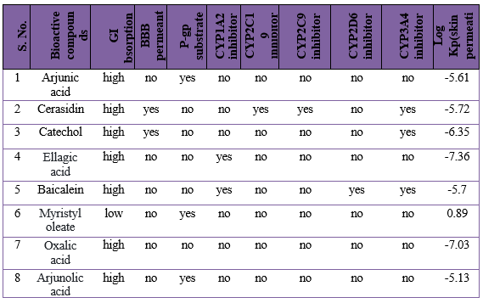
Analysis of Pharmacokinetics Properties
Using SMILE, the Swiss ADME webtool was used to assess the pharmacokinetic characteristics of phytochemical substances, including GI absorption, BBB penetration, P-gp substrate, CYP1A2 inhibitor, CYP2C19 inhibitor, CYP2C9 inhibitor, CYP2D6 inhibitor, CYP3A4 inhibitor, and LogKp (cm/s).All of the bioactive compounds shows high GI absorption except Arjunin, Arjunetin, Myristyl oleate.
Cerasidin, Catechol is permeating to BBB and rest of the bioactive compounds do not permeate the BBB. The result showed that all of the bioactive compounds showed Arjunin, Arjunic acid, Arjunetin, Myristyl oleate, and Arjunolic acid are P-gp transporter and rest of the bioactive compounds do not P-gp transporter. Ellagic acid, Baicalein were found inhibitors for CYP1A2 inhibitor and rest of the compounds were not inhibitors for CYP1A2.All of the bioactive compounds were not found inhibitors for CYP2C19 inhibitor and CYP2C9 inhibitor except Cerasidin. In this study we find that Baicalein were found inhibitors for CYP2D6 inhibitor and rest of the bioactive compounds were not found inhibitors for CYP2D6. Cerasidin, Catechol, Baicalein were found inhibitors for CYP3A4 inhibitor and rest of the compounds were not found inhibitors for CYP3A4. In this study we analyzed that Arjunin shows highest skin permeation and Myristyl oleate shows lowest skin permeation.
Table-2 The analysis of Phramcokinetics properties

Slide 10












Prediction of toxicity
The assessment of phytochemical substances' toxicity profiles with the aid of SMILE, ProTox 3.0 assessed the toxicity of phytochemicals. Hepatotoxicity, neurotoxicity, respiratory toxicity, cardiotoxicity, nephrotoxicity, carcinogenicity, mutagenicity, cytotoxicity, immunotoxicity, clinical toxicity, nutritional toxicity, toxicity class, and LD50 value are some of the several kinds of toxicity endpoints.
In this study we found that all of the bioactive compounds are inactive for Hepatotoxicity and Neurotoxicity. Cerasidin, Ellagic acid, Baicalein, Oxalic acid are active for nnnephrotoxicity.
Toxicity Class
6
5
4
3
2
1
0
Arjunic Cerasidin Catechol
acid
Ellagic
acid
Baicalein Myristyl Oxalic acid Arjunolic
oleate
acid
1
2
3
4
5
6
7
8
BIOACTIVE COMPOUND
Figure 3 Graphical representation of toxicity class

Slide 11
CONCLUSION
The primary duty of the drug design and development process is the evaluation of pharmacokinetic and physicochemical characteristics. Ten phytochemicals were assessed in this study using in silico screening techniques based on ADMET characteristics. According to evaluations of in silico computer studies, such as ADME, all phytochemicals have the highest GI absorption and follow the RO5 rule for oral medication bioavailability. Ellagic acid and Arjunic acid have a toxicity class of 4, which is innocuous, and they exhibit good intestinal absorption. According to our research, Ellagic acid and Arjunic acid may be potential agent for hypertension. We will molecularly dock these molecules in the future to see which ligand-protein interactions and binding energies work best.

Slide 12
REFERENCE
Egan, William J. "Predicting ADME properties in drug discovery." Drug design: structure-and ligand-based approaches (2010): 165-177.
Di, Li. "Strategic approaches to optimizing peptide ADME properties." The AAPS journal 17 (2015): 134-143.
Li, Albert P. "Screening for human ADME/Tox drug properties in drug discovery." Drug discovery today 6, no. 7 (2001): 357-366.
Sultana, Bushra, Farooq Anwar, and Roman Przybylski. "Antioxidant activity of phenolic components present in barks of Azadirachta indica, Terminalia arjuna, Acacia nilotica, and Eugenia jambolana Lam. trees." Food chemistry 104, no. 3 (2007): 1106-1114.
Chowdhury, Miraj Kobad, Nazmul Ahsan, and Anwarul Azim Akhand. "Leaf extracts of Azadirachta indica and Terminalia arjuna induce death of HeLa cells without DNA degradation." Dhaka University Journal of Pharmaceutical Sciences 8, no. 1 (2009): 75-79.
Asif, Mohammad. "Antimicrobial potential of Azadirachta indica against pathogenic bacteria and fungi." Journal of Pharmacognosy and phytochemistry 1, no. 4 (2012): 78-83.

Slide 13
THANK
YOU

