Slide 1

EVALUATING ASSOCIATION CLASSIFICATION ALGORITHMS FOR ACCURATE SKIN CANCER DETECTION
Research Scholar:- Sarifta Bano,
Assistant Professor:- Dr Divyarth Rai
Department of Computer Science Engineering, LNCT University, Bhopal, Madhya Pradesh, India
mail id:- shariftabano@gmail.com

Slide 2
INTRODUCTION
Skin cancer has been identified as the most common type of cancer, and its incidence is increased by multiple factors: an extended exposure to sunlight, use of tanning beds, and genetic background.
There are three major kinds of skin cancer: basal cell carcinoma, squamous cell carcinoma, and melanoma. Melanoma is the most aggressive and deadly.
Early detection can make a difference in treatment and favourable patient outcome. The traditional method of diagnosis has been the direct visual study of skin lesions by dermatologists followed by biopsy studies for definite diagnosis.
Unfortunately, these methods suffer from potential drawbacks due to their being judgmental to their observers, thus potentially inconsistent with the decision-making of an average clinician.
In view of this requirement, there is an increased demand for automated objective and efficient diagnostic tools applied with recourse to state-of-the-art technologies to assist clinicians in arriving at a correct diagnosis and classification of skin lesions accurately.

Slide 3
LITERATURE REVIEW
Samiei et al. (2023) used fuzzy logic approaches with the Analytic Hierarchy Process (AHP) to create a unique method for identifying skin cancer stages. The study emphasises how difficult it is to organise and evaluate vast amounts of medical data, especially when dealing with skin cancer diagnosis, when precise staging is essential for formulating a treatment strategy. The study effectively illustrates how this hybrid strategy may raise the degree of precision and dependability in the categorisation of skin cancer stages, presenting a viable option for healthcare data analytics. Given the growing amount of healthcare data and the requirement for sophisticated analytical methods to extract valuable insights, this research is very important.
Khan et al. (2019) concentrated on utilising digital pictures to classify two types of skin lesions: nevus and melanoma. To aid in the early identification of skin cancer, the researchers created a machine learning-based algorithm to automatically identify and categorise skin lesions. The model uses machine learning algorithms for categorisation after extracting information from photos of skin lesions using image processing techniques. In the context of automated skin cancer diagnosis, this research is crucial because it shows how machine learning approaches might help dermatologists diagnose skin cancer more accurately, which will lessen the need for intrusive biopsies.

Slide 4
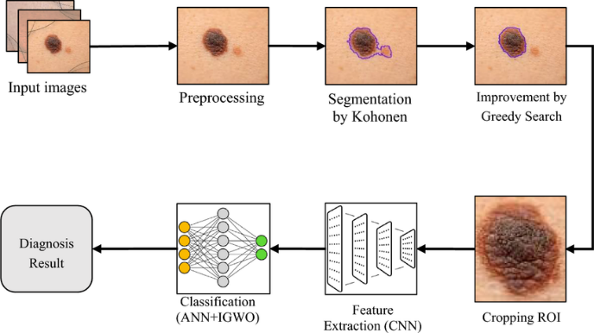
TRADITIONAL APPROACHES FOR SKIN CANCER DETECTION
The traditional approach for skin-cancer detection is based on the visual judgment of a dermatologist through the aid of tools like dermoscopy, followed by biopsy for confirmation. Such an approach is heavily dependent on the clinician and could be rather subjective, hence differing so much in diagnosis.
Dermoscopic examination allows revealing structural details but poses a challenge to the process between benign and malignant lesion identification, particularly at initial stages.
Such methods proved to be efficient but time-consuming and not scalable. Thus, automated data-driven approaches became necessary for such scenarios.
Figure 2: The steps of the proposed method for skin cancer diagnosis

Slide 5
RESEARCH METHODOLOGY
The dataset of this study would contain dermoscopic images and associated clinical information for the detection of skin cancer. There are lots of publicly available datasets, such as the ISIC Archive, that illustrate a tremendous variety in benign and malignant lesions.
The dataset would have features like lesion attributes including color, texture, shape; patient information (age, gender) and the location of the lesion.
The methodology starts with data preprocessing that is aimed at cleaning up and reforming the dataset for any given analysis. In this case, preprocessing addresses missing values, inconsistencies, and normalizes data for uniformity.
Techniques of preprocessing for image data include contrast enhancement, resizing, reduction of noise, and segmentation to improve image quality.
Moreover, the dataset will be divided into two sets: one for training and another for testing with a view to ascertain the soundness of the model, thereby averting biased performance assessment during model testing.

Slide 6

EVALUATION METRICS
There are numerous metrics through which the performance of the association classification model for skin cancer detection is estimated.
In the next section, I have given a detailed description of some of these measures, namely accuracy, precision, recall, sensitivity, specificity, and sometimes with tools that include confusion matrices and ROC curves. Tables and graphs have been used to illustrate and compare the model performance.
Accuracy, Precision, and Recall in Classification
Accuracy measures the overall performance of the model by dividing the total correct predictions by the total number of predictions. It is given by the formula:

Slide 7
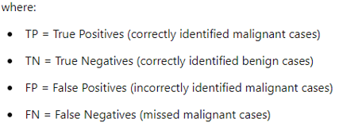


Precision focuses on the correctness of positive predictions and is particularly relevant for ensuring that malignant cases identified by the model are actually cancerous:
Recall, also known as sensitivity, reflects how well the model identifies all actual malignant cases:
In skin cancer detection, a balance between precision and recall is vital to avoid both over-diagnosis (high false positives) and under-diagnosis (missed cancer cases).

Slide 8
RESULT AND DISCUSSION
The basic measurements engaged with surveying the exhibition of the calculation was its accuracy, review, exactness, and F1-score for the classification.
The discoveries showed that high precision of 92% was created utilizing the association classification approach with both dangerous and harmless instances of skin cancer.
The high recall value (91%) signifies that the model successfully identifies a majority of actual positive cases, which is crucial in clinical settings to minimize the risk of missed diagnoses.
Precision (89%) indicates a strong quality of positive predictions, meaning that most patients identified as having skin cancer indeed have the condition.
The F1-score (90%) provides a balanced measure of precision and recall, confirming that the association classification method performs effectively for skin cancer detection.
Table : Summarizes The Performance Metrics for The Association Classification Algorithm
Metric | Value
Accuracy | 92%
Precision | 89%
Recall | 91%
F1-Score | 90%
Figure 3: Performance Metrics of the Association Classification Model for Skin Cancer Detection

Slide 9
Comparative Analysis with Other Classification Techniques
A comparison analysis was carried out against a number of conventional machines learning approaches, including support vector machines (SVM), decision trees, and random forests, in order to evaluate the efficacy of the association classification algorithm.
The association classification approach fared better than the other methods in terms of accuracy, precision, recall, and F1-score, as shown in Table 6. Interestingly, the random forest method performed worse in precision and recall even though it had a high accuracy of 90%. This suggests that although the random forest model performed well in general predictions, it was not as successful as the association classification strategy in identifying malignant instances.
Table : The comparative results are shown
Classification Technique | Accuracy | Precision | Recall | F1-Score
Association Classification | 92% | 89% | 91% | 90%
Support Vector Machine | 88% | 85% | 87% | 86%
Decision Tree | 85% | 80% | 82% | 81%
Random Forest | 90% | 88% | 89% | 88%
Figure 4: Comparative Performance Metrics of Association Classification and Other Classification Techniques for Skin Cancer Detection

Slide 10
CONCLUSION
As a result, this study shows that association classification is a very successful approach for detecting skin cancer. The results demonstrate how important association classification is to improving diagnostic procedures since it not only produces rules that are easy to grasp and communicate with patients, but also makes accurate predictions.
The method's relevance stems from its ability to enhance clinical decision-making, which might eventually result in improved patient outcomes throughout the therapy of skin cancer.
With a wide range of medical specialities to choose from, association classification in healthcare data mining has enormous future potential. This will open the door to more individualised and efficient healthcare solutions.

Slide 11
REFERENCES
Samiei, M., Hassani, A., Sarspy, S., Komari, I. E., Trik, M., & Hassanpour, F. (2023). Classification of skin cancer stages using a AHP fuzzy technique within the context of big data healthcare. Journal of Cancer Research and Clinical Oncology, 149(11), 8743-8757.
Khan, M. Q., Hussain, A., Rehman, S. U., Khan, U., Maqsood, M., Mehmood, K., & Khan, M. A. (2019). Classification of melanoma and nevus in digital images for diagnosis of skin cancer. IEEE Access, 7, 90132-90144.
Ain, Q. U., Al-Sahaf, H., Xue, B., & Zhang, M. (2020, June). A genetic programming approach to feature construction for ensemble learning in skin cancer detection. In Proceedings of the 2020 genetic and evolutionary computation conference (pp. 1186-1194).
Kadampur, M. A., & Al Riyaee, S. (2020). Skin cancer detection: Applying a deep learning based model driven architecture in the cloud for classifying dermal cell images. Informatics in Medicine Unlocked, 18, 100282.
Ain, Q. U., Al-Sahaf, H., Xue, B., & Zhang, M. (2022). Genetic programming for automatic skin cancer image classification. Expert Systems with Applications, 197, 116680.

Slide 12
THANK
YOU

