Slide 1
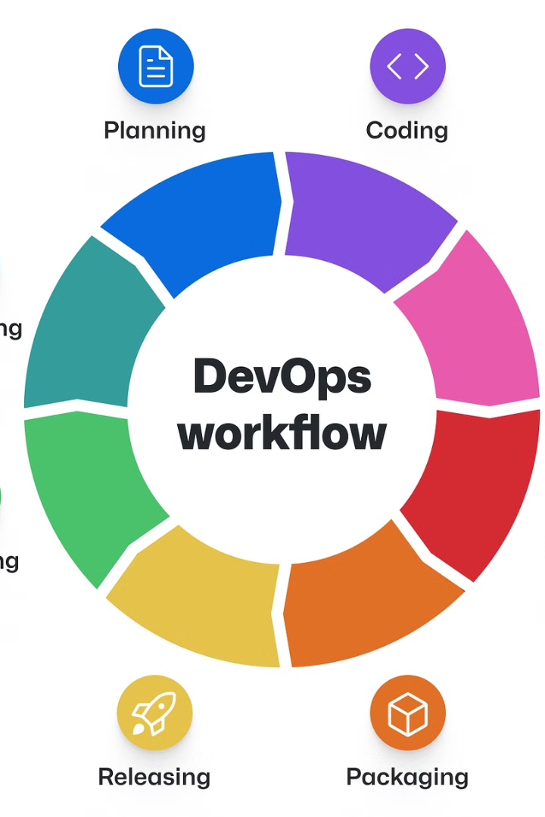

A Methodical Approach to Overcoming Important Obstacles in Software Development Adopting a DevOps Practices
PRASANNA THALARI
Computer Science

Slide 2

Introduction
To achieve better relationship and durability between efficient and effective professionals in software development endeavours, software assessment procedures are switched. The promotion of the newest electronic technologies both demonstrates grave problems and gives firms independence. Apart from delaying, computer scientists in the DevOps field provide useful programs and hardware to the customer promptly in the context of rapid software transportation. The main objectives of DevOps, which is a collection of applications and civilization values, are to integrate businesses, identify obstacles, foster collaboration, and communicate in an efficient manner that connects with assessment and operational coordination.
1
Strengths
Identifying your strengths is the first step in leadership development. It's important to understand what you're naturally good at and where your skills lie. This can help you focus on areas where you can excel and contribute the most.
2
Goal Setting
Setting achievable goals is a crucial part of leadership development. Goals give you a clear direction and a target to aim for. They help you measure progress and keep you motivated. Remember to make your goals SMART - Specific, Measurable, Achievable, Relevant, and Time-bound.
3
Tools & Resources
Gathering the right tools and resources is essential for effective leadership development. This could include books, courses, mentors, and real-world experiences. The right resources can provide valuable insights and help you develop the skills you need to be an effective leader.

Slide 3




Related Work-II
Today's competitive, fast-paced technological advancements and mechanization, along with sophisticated software development, sometimes require technology developers to be familiar with the electronic mechanism foundation that enables them to quickly release software to clients. The IT sectors are transitioning from outdated digital era frameworks to the most recent ones, which allows them to provide stakeholders with prompt and coherent solutions. Traditional programming methods are very time-consuming, and stakeholders must wait a long period for the most recent updates before providing their replies. Many programming development processes, such as incremental, agile, and waterfall mock-ups, are antiquated and take a while to reveal to customers.
Classic Paradigm
Agile Process
DevOps
The software life cycle uses a classic paradigm called the waterfall paradigm, which is easy to use and adheres to a sequential process. Within the waterfall paradigm, each development activity has its distinct stage, involving a length of time for the execution of the phase that comes before and the phase that comes after.
On the other hand, the agile process combines the incremental and iterative approaches, segmenting the process into distinct iteration phases. It takes two to three weeks to complete the specific iterations. The agile approach is typically used in stable domains—except complex software.
DevOps idea seems to promote implementations to customers with a high standard and prompt service. DevOps was created during the 2008 Agile process in Toronto when Patrick identified it as a cornerstone of advancement and effectiveness. Coordination and cooperation result in quick services that meet customer needs.

Slide 4
Research Methodology-III
To address the study concerns, a methodological approach is necessary. The current study uses a quantitative method to identify limited studies and extract the relevant data. The other authors similarly follow an LR to identify the problems.
10
8
Challenges
Challenges
Lack of Management
Lack of DevOps Approach
7
6
Challenges
Challenges
Criticism Practices
Complicated Infrastructure

Slide 5
Participant Selection
The purpose of the current study is to identify the challenges encountered in implementing DevOps culture, which is why the researcher chose to focus on software businesses that have successfully implemented DevOps culture. The questionnaire survey is being completed by the following applicants: developers, testers, analysts, designers, team managers, and project managers. The candidates were chosen using the snowball method. are additionally contacted in this manner via emails, Facebook, and LinkedIn, and some were contacted through the candidate's associates. The entire set of data was gathered between December 2, 2022, and February 20, 2023. Out of 220 candidates, 340 received the survey without error. Every comment was taken into consideration, and incomplete surveys were removed.
Research by Applying search string
Research by Primary string
Research by Final Decision
11813
414
83

Slide 6
Conclusion and Future Work-VI
Owing to its complexity, there is no concept of DevOps culture across multiple countries. The main goal was to identify the obstacles that significantly affect how the identified DevOps culture is implemented. The fact that DevOps culture is a relatively new concept and that there isn't much research on it limits the scope of our study. It is advisable to consider applying the DevOps culture for mitigation. Although the research strategy used in this study is quantitative, the authors plan to explore quantitative and qualitative methods in the future for mitigating concerns related to the execution of DevOps culture. Moreover, a case study approach might be used to identify the difficulties impairing the execution of the DevOps culture.
1

Slide 7
References
. R. W. Macarthy and J. M. Bass
"An empirical taxonomy of DevOps in practice", Proc. 46th Euromicro Conf. Softw. Eng. Adv. Appl. (SEAA), pp. 221-228, Aug. 2020.
2. A. Wiedemann and M. Wiesche
"Are you ready for DevOps? Required skill set for DevOps teams", 2018.
3. A. Qumer Gill, A. Loumish, I. Riyat, and S. Han
"DevOps for information management systems", VINE J. Inf. Knowl. Manage. Syst., vol. 48, no. 1, pp. 122-139, Feb. 2018.
4. W. P. Luz, G. Pinto and R. Bonifácio
"Adopting DevOps in the real world: A theory a model and a case study", J. Syst. Softw., vol. 157, Nov. 2019.
5. W. P. Luz, G. Pinto, and R. Bonifácio
"Building a collaborative culture: A grounded theory of well succeeded DevOps adoption in practice", Proc. 12th ACM/IEEE Int. Symp. Empirical Softw. Eng. Meas., pp. 1-10, Oct. 2018.
6. M. Senapathi, J. Buchan and H. Osman
"DevOps capabilities practices and challenges: Insights from a case study", Proc. 22nd Int. Conf. Eval. Assessment Softw. Eng., pp. 57-67, Jun. 2018.
7. Z. Yiran and L. Yilei
"The challenges and mitigation strategies of using DevOps during software development", Karlskrona, Sweden: Blekinge Inst. Technol, 2017.
8. T. SeppLassila and S. Hyrynsalmi
"An assessment of DevOps maturity in a software project", Comput. Sci., vol. 80, no. 10, pp. 1-87, Oct. 2017.
9. M. A. Akbar
"Identification and prioritization of DevOps success factors using fuzzy-AHP approach", Soft Computing, pp. 1-25, 2020.
10. J. Humble and and J. Molesky
"DevOps: A software revolution in the making", Cutter IT J., vol. 24, no. 8, pp. 6-12, 2011.

