Slide 1
MOTH BEAN: AN UNTAPPED POTENTIAL MEDICO-THERAPEUTIC PLANT IN NEED OF POLICY SUPPORT
¹Department of Biotechnology, Science and Humanities, SRM Institute of Science and Technology Delhi NCR Campus Modinagar Ghaziabad
^{1*}Department of Biology, Science and Humanities, Faculty of Engineering and Technology, SRM Institute of Science and Technology Delhi NCR Campus Modinagar Ghaziabad
E-mail: Kg8057@srmist.edu.in,^{1*} kamakshr@srmist.edu.in
Corresponding Author: kamakshr@srmist.edu.in

Slide 2
INTRODUCTION
There are many legumes native to arid and semi-arid regions of India and Pakistan, including moth beans (Vigna aconitifolia (Jacq.) Marechal).
Despite its resilience to harsh environmental conditions and nutritional and therapeutic potential, moth bean remains a neglected and underutilized legume crop (NUCL).
The recognition of its nutritional and medicinal properties highlights the need for renewed focus and policy support to enhance its cultivation and utilization.
In addition to being an excellent source of protein, essential amino acids, unsaturated fats, vitamins, and minerals, moth beans are also a good source of fiber. It is known for its high nutritional value and is utilized as Food and fodder.
Its potential medicinal properties, including antibacterial effects attributed to compounds like Vicilin, make it a promising candidate for pharmaceutical applications.
Moreover, the moth bean's genetic diversity and adaptability to adverse environmental conditions, such as salinity stress, underscore its importance as a resilient crop in climate change.

Slide 3
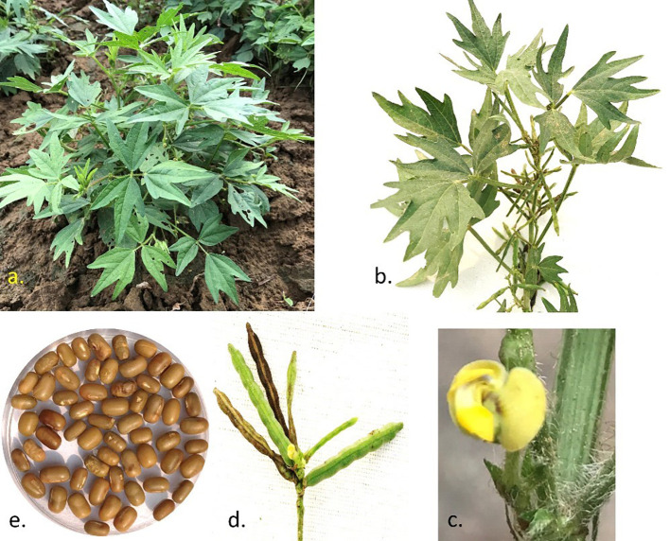
    Effect of Salinity Stress on Morphology
Morphological Changes: Abiotic stresses such as salinity severely affect plant growth and productivity. Moth bean, however, exhibits remarkable tolerance to salinity stress. In salinity stress conditions, plant height is reduced, leaf size is reduced, and root growth is stunted, as shown in Figure 1.
Adaptive Mechanisms: The adaptive mechanisms of moth beans to salinity stress include osmotic adjustment, ion homeostasis, and the activation of antioxidant defense systems. These mechanisms enable the moth bean to survive and produce under adverse conditions, making it a resilient crop suitable for cultivation in saline and arid regions.
Figure 1: Morphological Key Features of Moth Bean

Slide 4
LITERATURE REVIEW
A member of the Fabaceae family, the moth bean (Vigna aconitifolia L.) is also known as mat bean, matki bean, mout bean, dew gram, or Turkish gram. In India, it is grown for its pods and seeds, both of which are immature. Moth beans are an important food source, especially in developing nations, because of their nutritional and high protein content (Adsule, 1996; Bravo et al., 1998; Kadam et al., 1985).
There are several species of moth bean in the Fabaceae family and the genus Vigna, such as mung beans, black grams, cowpeas, and moth beans. Despite its nutritional benefits, the edible species Vigna aconitifolia is underutilized (Takahashi et al., 2016).
Due to its favourable climate, it thrives in tropical climates and can be cultivated in infertile soil, making it a staple in Southeast Asia, particularly in Rajasthan, India. Predominantly a Kharif crop, moth bean is grown during the monsoon season from June to November. The plant is known as dew beans, haricot mats, mat beans, moth grams, matkis, and Turkish grams. Food, fodder, feed, and green manure are all offered by moth bean, which is also an economical protein source (Sedani et al., 2021).

Slide 5
METHODOLOGY
Sample Collection: This study used Agro-climatic regions in India to collect different moth bean genotypes. These genotypes were cultivated under controlled conditions to ensure uniformity in growth parameters.
Nutritional Analysis: Nutritional analysis of moth bean seeds was conducted using standard procedures. The Kjeldahl method was used to measure protein content, and HPLC was used to measure amino acid composition.
Phytochemical Screening: Phytochemical screening was done to identify bioactive compounds in moth bean seeds. Methanolic extracts of the seeds were prepared and subjected to qualitative analysis for alkaloids, flavonoids, tannins, saponins, and phenolic compounds. Quantitative analysis was performed using HPLC and GC-MS.
Salinity Stress Experiment: The effect of salinity stress on moth bean morphology was examined by growing plants under controlled conditions under various salinity levels (0, 50, 100, 150 mM NaCl).
Statistical Analysis: Data collected from nutritional and phytochemical analyses and salinity stress experiments were subjected to statistical analysis using SPSS software. Statistical analysis, an analysis of variance, and post hoc tests were performed to determine whether differences between treatments were significant.

Slide 6
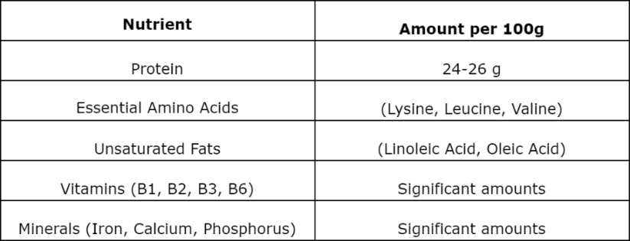
RESULTS AND DISCUSSION
Nutritional Analysis: In analyzing the nutritional content of moth bean seeds, essential amino acids, unsaturated fats, vitamins, and minerals were found to be high. Table 1 shows the summary of the nutritional composition. According to the nutritional analysis, moth bean seeds contain a significant amount of protein (24-26%), essential amino acids (lysine, leucine, and valine), as well as unsaturated fats (linoleic and oleic acids).
Table 1: Nutritional Composition of Moth Bean Seeds

Slide 7
Phytochemical Screening: Phytochemical screening identified several bioactive compounds in moth bean seeds. Phytochemical screening identified several bioactive compounds with medicinal properties. Vicilin exhibited antibacterial activity, and other compounds demonstrated antioxidant properties. Vicilin, a major storage protein, strongly inhibits Gram-positive and Gram-negative bacteria. Other identified compounds, such as flavonoids and phenolic acids, demonstrated antioxidant properties, supporting the potential use of moth bean in managing oxidative stress-related conditions, as shown in table 2.
Table 2: Phytochemical Composition of Moth Bean Seeds
Compound | Detected Presence | Activity
Vicilin | Present | Antibacterial
Flavonoids | Present | Antioxidant
Phenolic Acids | Present | Antioxidant
Saponins | Present | Antimicrobial, Anti-inflammatory
Tannins | Present | Antioxidant, Antimicrobial

Slide 8
Genetic Diversity and Resilience: The genetic diversity among the collected moth bean genotypes was evident from the morphological and physiological variations observed, as shown in Table 3. Genotypes with superior thermo-drought tolerance and salinity resistance were identified, highlighting the potential for breeding programs to enhance these traits. The results highlighted significant variability and resilience among genotypes, particularly in thermo-drought tolerance and salinity resistance.
Table 3: Genetic Diversity and Stress Tolerance
Genotype | Thermo-Drought Tolerance | Salinity Resistance | Key Traits
Genotype 1 | High | High | Deep root system, efficient water use
Genotype 2 | Moderate | High | Heat-shock protein expression
Genotype 3 | High | Moderate | Osmotic adjustment
Genotype 4 | Low | Moderate | Antioxidant defense activation

Slide 9
CONCLUSION
The moth bean, or Vigna aconitifolia, is a legume that remains underutilized despite its high nutritional and medicinal potential.
Its high protein content, rich nutritional profile, and resilience to environmental stresses make it a valuable crop for future agricultural and pharmaceutical applications.
There is a pressing need for policy support, community awareness, and focused research efforts to unlock its full potential.
In addition to enhancing food security and supporting sustainable agriculture, we can discover new therapeutic agents by cultivating and utilizing moth beans.
Legislative and research initiatives will be critical for the moth bean to become a cornerstone of modern medicine and agro-beneficial practices.

Slide 10
REFERENCES
Adsule, R. N. (1996). Moth bean (Vigna aconitifolia (Jacq.) marechal). In Food and feed from legumes and oilseeds (pp. 203–205). Springer.
Bhadkaria, A., Srivastava, N., & Bhagyawant, S. S. (2021). A prospective of underutilized legume moth bean (Vigna aconitifolia (Jacq.) Marechàl): Phytochemical profiling, bioactive compounds and in vitro pharmacological studies. Food Bioscience, 42, 101088. https://doi.org/10.1016/j.fbio.2021.101088
Bravo, L., Siddhuraju, P., & Saura-Calixto, F. (1998). Effect of various processing methods on the in vitro starch digestibility and resistant starch content of Indian pulses. Journal of Agricultural and Food Chemistry, 46(11), 4667–4674.
Gayacharan, Chandora, R., & Rana, J. C. (2023). Moth bean (Vigna aconitifolia): A minor legume with major potential to address global agricultural challenges. Frontiers in Plant Science, 14, 1179547.
Kadam, S. S., Salunkhe, D. K., & Maga, J. A. (1985). Nutritional composition, processing, and utilization of horse gram and moth bean. Critical Reviews in Food Science & Nutrition, 22(1), 1–26.

Slide 11
Thank You

