Slide 1


Building a Competency Framework for Organizations Using Generative AI – AIDA
Harsha Mary
Organisational Psychology

Slide 2
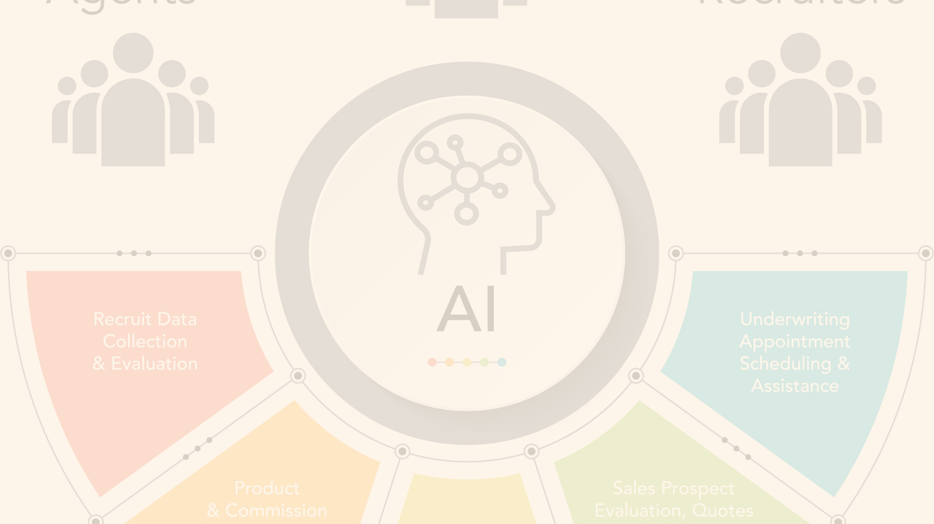
The Era of AI and Competency Frameworks
1
AI's Impact
2
Competency Framework Necessity
3
Generative AI
The era of AI brings significant changes to the way organizations operate and the skills their employees need to succeed.
Generative AI holds promise to identify, predict, and manage the skills and competencies an organization needs to thrive.
This development necessitates a competency framework that considers AI tools and their integration in organizational settings.

Slide 3

The Rise of AI
1
AI's Historical Context
The concept of AI was first introduced by John McCarthy at a conference at Dartmouth College in 1956.
2
AI's Recent Growth
AI started gaining significant traction in the last two decades due to increased computational power, advancements in machine learning algorithms, and the availability of large data sets.
3
AI Technologies
AI encompasses a range of technologies, including NLP, ML, DL, and robotics.

Slide 4
AI in Industries
Healthcare
Finance
Retail
AI assists in disease diagnosis, drug discovery, patient care, and health record management.
AI supports automated trading, risk management, fraud detection, and customer service.
AI powers personalized marketing, demand forecasting, inventory management, and customer service.

Slide 5

AI and the Future of Work
1
Nature of Jobs
2
Skills Required
AI is more likely to change the nature of jobs rather than eliminate them.
There is a growing demand for AI literacy across job roles.
3
Organizational Structures
AI could lead to more flattened, flexible, and dynamic organizational structures.

Slide 6

What Problem does this Research Aim to Tackle?
1
Competency Framework Definition
2
Research Aim
The primary aim of this research is to conceptualize, develop, and test an effective and dynamic competency framework for organizations using Generative AI.
A competency framework is a structured system that defines and categorizes the knowledge, skills, and attributes needed for individuals to perform effectively within an organization.
3
Research Objectives
The research is structured around key objectives, including analyzing existing competency frameworks, exploring generative AI capabilities, understanding and addressing implementation challenges, and contributing to theory and practice.

Slide 7
Theoretical Background
Competency Theory
AI and HRD
Generative AI
Competency theory has been central to the field of HRD for several decades.
The integration of AI into HRD is an emerging field of both practice and study.
Generative AI, a subset of AI, encompasses algorithms capable of generating new data from existing data.

Slide 8

AIDA’s Capabilities
1
Description
2
Proposed Architecture
3
Dynamic and Personalized Nature
AIDA represents a novel approach to competency management, integrating Generative AI with traditional competency mapping.
The proposed architecture includes creating a well-informed data infrastructure, integrating Generative AI models, architecting a dynamic competency mapping framework, conducting skill gap analysis, developing personalized training and development plans, and implementing feedback and establishing a refinement mechanism.
AIDA's dynamic nature allows it to continuously learn and update its predictions, aiding in proactive and strategic workforce planning.

Slide 9
Proposed Research Methodology
Research Design
Data Collection
Developing and Testing AIDA
Ethical Considerations
Quantitative data will be collected from various sources, while qualitative data will be gathered through interviews and focus groups.
This research will employ explanatory sequential design, involving both quantitative and qualitative research.
A prototype version of AIDA will be developed and implemented within a selected organization for evaluation.
The research will be conducted with full adherence to ethical guidelines. Informed consent will be obtained from all participants in the research, and their anonymity and confidentiality will be maintained.

Slide 10
Conclusion
The proposed research aims to develop an innovative competency framework for organizations, AIDA, leveraging the predictive capabilities of Generative AI. This aligns with the evolving context of the Fourth Industrial Revolution, where AI and other advanced technologies are rapidly transforming industries and occupations.
The research will integrate AI with traditional HR practices, specifically in the realm of competency management. While AI is widely used in many areas of HR, its use in competency mapping is limited. This research will fill that gap, making a novel contribution to both HRD theory and practice.
The proposed methodology involves a multi-stage process, starting with an extensive literature review, followed by data collection, model development, and empirical testing. The literature review will cover existing theories and models in HRD and AI. Primary data will be collected from various sources, including HR professionals, employees, and AI experts. This will inform the development of Generative AI models that can predict future competency needs. These predictions will then be empirically tested in a real-world context.

