Slide 1
PHYTOCHEMICAL PROFILE OF LEAVES OF IPOMOEA OBSCURA
Neethu Varghese^{*1}, Mythreyi R¹, Arun Rasheed²
¹Chettinad School of Pharmaceutical Sciences, Chettinad Hospital and Research Institute, Chettinad Academy of Research and Education, Kelambakkam, Tamilnadu 603103.
² Department of pharmaceutical chemistry, Al Shifa College of Pharmacy, Perinthalmanna, Malappuram
^{*1}Presenting author: neethu.va@gmail.com

Slide 2
INTRODUCTION
Ipomoea is a diverse genus within the family Convolvulaceae, consisting of approximately 600 to 800 species that are primarily distributed across tropical and subtropical regions worldwide.
This genus includes a variety of growth forms such as herbs, shrubs, lianas, and small trees, with many species characterized by their twining or climbing habits.
Commonly known as morning glories, Ipomoea species are admired for their striking funnel-shaped flowers, which display a variety of colors, including violet, blue, pink, and red.
Notable members include economically important crops such as sweet potato (Ipomoea batatas) and water spinach (Ipomoea aquatica), both of which have significant culinary uses worldwide. Furthermore, numerous Ipomoea species are grown as ornamental plants for their appealing blooms.
However, some species have become invasive in various regions, posing ecological threats. The genus also holds potential for medicinal applications, with various species traditionally used in herbal remedies for ailments ranging from diabetes to inflammation.

Slide 3
MATERIALS AND METHODS
2.1. Reagents and solution preparations: All chemicals used were of analytical grade reagents. Ethanol, , Gallic acid, 7% Sodium carbonate, Folin-Ciocalteu reagent (FCR), Quercetin, ferric chloride (FeCl₃), Potassium Chloride, Ammonium molybdate.
2.2. Collection of plant samples: The leaves of Ipomoea obscura were harvested from sites, in Malappuram, Kerala. The collected plants were authenticated by the Centre for Medicinal Plants Research, Arya Vaidya Sala, Kottakkal, Kerala. After collection, the leaves were carefully cleaned thoroughly with tap water and allowed to naturally dry under ambient room temperature.
2.3. Instrumentation: UV–Vis spectrophotometer (Schimadzu, Japan) have a wavelength range from 190 nm to 1100 nm, allowing for the detection of both the phenolic and flavonoid compounds, which typically absorb in the UV-visible range (200-600 nm).
2.4 Extraction: Soxhlet extraction using 200 g of Ipomoea obscura leaf powder was done with 95% ethanol as the solvent for 24 hours. The solvent was subsequently removed and evaporated to dryness at 42°C under reduced pressure using a rotary evaporator. The extraction process yielded an extract with a 22% (w/w) yield.

Slide 4
2.5. Procedure for phytochemicals screening
The initial phytochemical screening of the extracted plant samples was carried out using various chromophoric reagents. The crude extract was treated with the chemical reagents in test tubes, to identify the chemical constituents present.⁵ The detailed procedure for the qualitative analysis of phytochemicals in the plant samples is presented in Table 1.
Table 1: Method for preliminary phytochemical screening using different chemical reagents
S. No. | Name of phytochemical | Method of detection | Observation
1. | Alkaloid | Dragendorf's Test Mayer's Test | orange-red colour creamy-white precipitation
2. | Flavonoids | Shinoda Test Ethyl Acetate Test | yellow coloured precipitate yellow colour
3. | Phenols | Ferric Chloride Test | greenish-black color
4. | Terpenoids | Liebermann-Burchard's Test | violet coloured ring at the junction
5. | Steroids | Salkowski Test | green fluorescence
6. | Glycosides | Baljet Test | yellow to orange colour
7. | Saponins | Foam Test | persistent frothing
8. | Carbohydrates | Molisch's Test | Violet ring at the junction of two liquids

Slide 5
2.6. Estimation of total phenolic contents
The Folin-Ciocalteu (F.C.) method is used to quantify total phenols, also known as the GAE method. This method involves reacting the sample with a reagent that produces a blue colour, the intensity of which is proportional to the phenolic content.
2.7. Estimation of total flavonoid contents
The total flavonoid content was determined according to the aluminum chloride-colorimetric method. The AlCl₃ colorimetric assay functions on the principle that aluminum chloride forms stable complexes with flavonoids. This reaction occurs through the interaction between the aluminum chloride and the carbonyl group at the fourth carbon position, as well as the hydroxyl groups at either the third or fifth carbon positions of flavones and flavonols.
2.8. LC MS analysis
LC-MS is a sophisticated technique commonly used for screening bioactive secondary metabolites. It is a simple, fast, and widely accepted method for identifying bioactive molecules from crude plant extracts, requiring only a small amount of the sample. In this investigation, LC-MS was employed to detect and identify the bioactive compounds in the leave extracts of Ipomoea obscura. This technique allows for efficient and precise analysis, contributing significantly to the understanding and exploration of plant-based bioactive compounds.

Slide 6
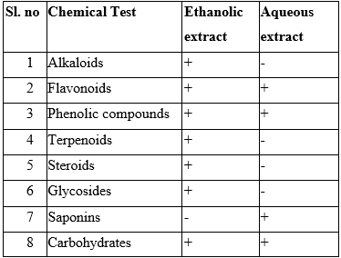
RESULTS AND DISCUSSION
3.1.Screening of phytochemicals using reagents
Preliminary phytochemical examination of the alcohol and aqueous extracts of Ipomoea obscura leaves revealed the presence of alkaloids, flavonoids, phenolic acids, terpenoids, tannins, saponins, carbohydrates, proteins and quinones. The results are summarized in Table 2.
Table 2: Preliminary phytochemical screening of all extracts (+ indicates presence and - indicates absence of phytoconstituents)

Slide 7
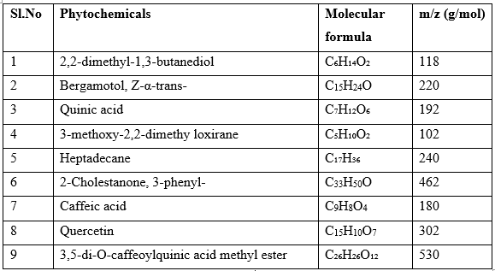
3.2. LC MS
The preliminary identification of compounds in the ethanolic and aqueous extracts was conducted through LC-MS analysis. Compounds were detected and identified based on their fragmentation patterns and by analysing their peak areas and retention times. Nine compounds were identified in the ethanolic extract of Ipomoea obscura leaves.
Table 3: Compounds identified from the ethanolic extract of Ipomoea obscura leaves by LC-MS

Slide 8
CONCLUSIONS
In summary, Ipomoea obscura leaf extract contains many phytochemicals, makes it a promising candidate for use as a phytotherapy with their further study.
This extract is rich in phenolic compounds and flavonoids, known to have important antioxidant properties, suggests potential therapeutic benefits, particularly in the management of oxidative stress-related diseases.
However, more research is needed to fully explore the medicinal properties of Ipomoea obscura and to establish its efficacy and safety for clinical use.

Slide 9
REFERENCES
Shrestha, S., Shrestha, N., & Rajbhandary, S. (2020). "Micromorphological Studies of the Genus Ipomoea (Convolvulaceae) in Nepal." Himalayan Ecology and Development, 19(1), 1-12.
Mungole AJ, Awati R, Chaturvedi A, Zanwar P. Preliminary Phytochemical screening of Ipomoea obscura (L)-A hepatoprotective medicinal plant. International Journal of PharmTech Research. 2010 Oct;2(4):2307-12.
De Silva GO, Abeysundara AT, Aponso MM. Extraction methods, qualitative and quantitative techniques for screening of phytochemicals from plants. American Journal of Essential Oils and Natural Products. 2017;5(2):29-32.
Patle TK, Shrivas K, Kurrey R, Upadhyay S, Jangde R, Chauhan R. Phytochemical screening and determination of phenolics and flavonoids in Dillenia pentagyna using UV–vis and FTIR spectroscopy. Spectrochimica Acta Part A: Molecular and Biomolecular Spectroscopy. 2020 Dec 5; 242:118717.
Lin JY, Tang CY. Determination of total phenolic and flavonoid contents in selected fruits and vegetables, as well as their stimulatory effects on mouse splenocyte proliferation. Food chemistry. 2007 Jan 1;101(1):140-7.

Slide 10
Thank You

